Slide 1
Exploration of Auricular Chondrocytes as a Cell Source of Tissue Engineering of Temporomandibular Joint Disc Cartilage
By: Nicole Gonzales Class of 2025, and Iris Rivas Junior Specialist
Mentored by: Dr. Vapniarsky-Arzi
Notes:
GOOD!

Slide 2
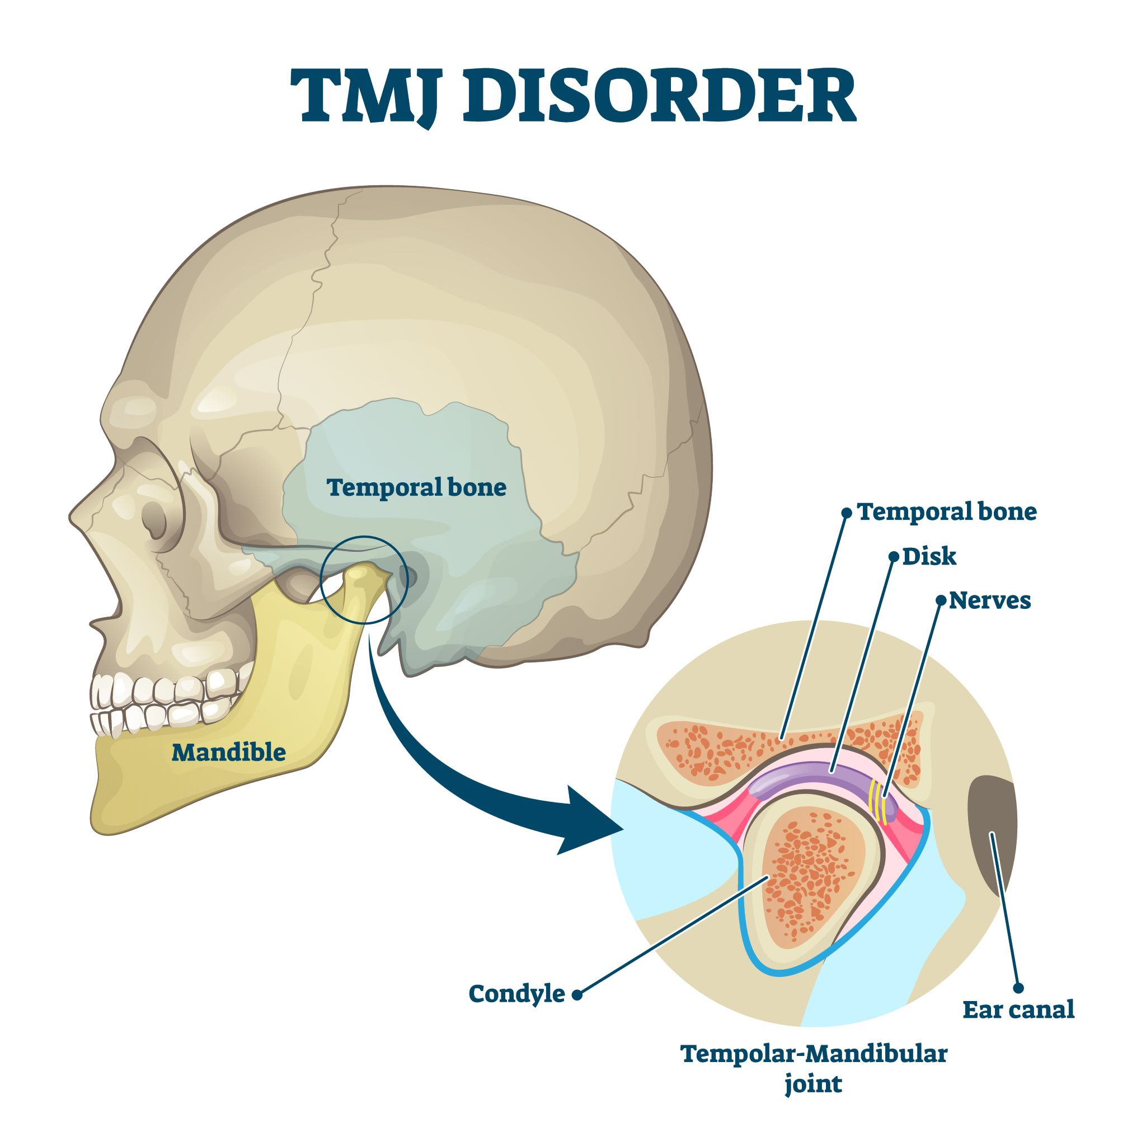
What is the TMJ?
Temporomandibular Joint (TMJ)
Synovial and condylar joint capable of translation between the temporal bone and the mandible
TMJ Disc
Elastin distribution varies by region
Superior layer contains more elastic fibers than the inferior layer ¹
Elastin concentration increases from the center towards the margins of the disc ¹
Notes:
The disc has no nerves so it is not able to feel pain
TMJ DISC ATTACHMENTS DO CONTAIN NERVES, THEREFORE WHEN DISC IS DISPLACED IT IS PAINFUL
ALSO HINGE JOINT TYPE IS IN DOGS ONLY, IN HUMANS, IT IS CAPABLE OF TRANSLATION (I.E. ROSTRO-CAUDAL GLIDING AND SIDE TO SIDE MOVEMENT, HENCE NOT A HINGE JOINT
** Costal cartilage with years becomes ossified– which is another reason why Since TMJ is not a problem of young people, we face a problem of ossified trissue source even though they are cartilage**

Slide 3
Normal TMJ Disc Function:
Normal Jaw Tone
Hyper-extend Jaw
Video Source: https://www.youtube.com/watch?v=mB468Jh9aAY

Slide 4
TMJ Disc Displacement:
TMJ Disc displacement is one of the most common causes of TMJ disorders^{2,3}
Disc slides forward, causing the retro discal tissue to be pinched between the two bones
Painful
May result in painful clicks of jaw locking in more severe cases
With time→ disc perforation can occur
“Click”
“Pain”
Video Source: https://www.youtube.com/watch?v=mB468Jh9aAY
Notes:
As the disc moves forward, the retrodiscal tissue is pulled between the two bones-– this is painful because its vascular and innervated unlike the disc
THE “CLICK” EXPLANATION IS NOT CLEAR: NG: this is a video, you have to play it to see what im describing
Condyl has to jump over the back of the disc to reach the center

Slide 5
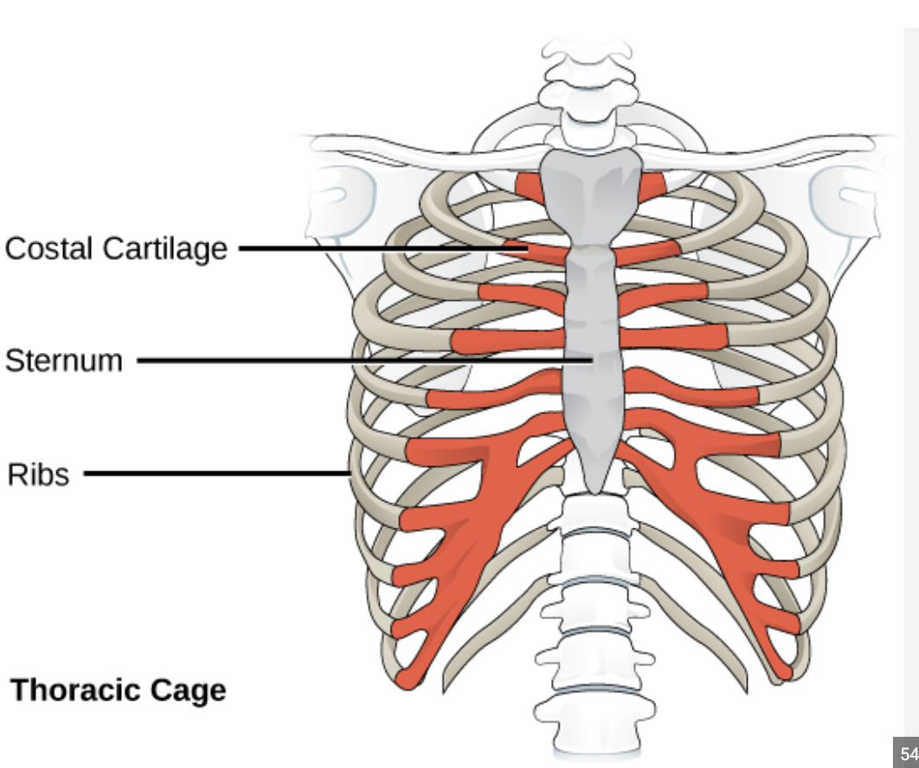
Gonzales STAR Significance:
TMJ dysfunction causes pain and disability in 20-25% of adults worldwide⁴
Currently– no regenerative solutions available
Tissue engineering offers a possible solution:
Manufacture TMJ Disc implants from costal chondrocytes
Lack elasticity
Invasive/painful procedure
Image by: Anatomy Medicine

Slide 6
Gonzales STAR 2023:
The main objective of this study is to determine if auricular chondrocytes can be used to tissue engineer a cartilage construct with chondrogenic properties akin to the native TMJ disc.
Notes:
I REMOVED POIGS BECAUSE IT SOUNDS LIKE YOU ARE TRYING TO MAKE IMPALNTS FOR HUMANS FORM PORCINE CELLS. THIS OPENS A WHOLE NEW CAN OF WORMS CALLED IMMUNIGENICITY
INSTEAD JUST SAY THAT : IN THIS EFFORT WE ARE USING PIGS (MINIPIGS) – A WELL ESTABLISHED TRANSLATIONAL ANIMAL MODEL

Slide 7
Gonzales STAR 2023:
Hypothesis:
We hypothesize that implants with biomechanical properties akin to the native TMJ disc can be engineered from auricular chondrocytes
Notes:
WOULD BE NICE TO HAVE A SIZE REFERENCE FOR THE IMAGES- DONE – EXCELENT – THANK YOU.
I CHANGED THE HYPOTYSIS TO BE SHORTER. ALSO YOU CAN SAY THAT THIS IS A VERY HIGH-SET BAR, BECAUSE THE TE IMPALNTS FROM COSTAL CHONDROCYTES ARE GOOD BUT STILL NOT EXACTLY SAME IN THEIR BIOMECHNAICL PROPERTIES AS NATIVE TISSUE. SO IF WE CAN MAKE TE CONSTRUCT FROM AURICULAR CHONDROCYTES THAT WILL BE AS GOOD AS COSTAL-SOURCED, IT IS ALREADY A GREAT ACHIEVEMENT
ALSO IT IS IMPARTENT TO STATE THAT OUR GOAL AND ONE OF THE CHALANGES IS TO GENERATE A LARGE IMPLANT FROM VERY SMALL AMOUNT OF CELLS. REMEMEBR DR. KOL’S QUESTION?

Slide 8
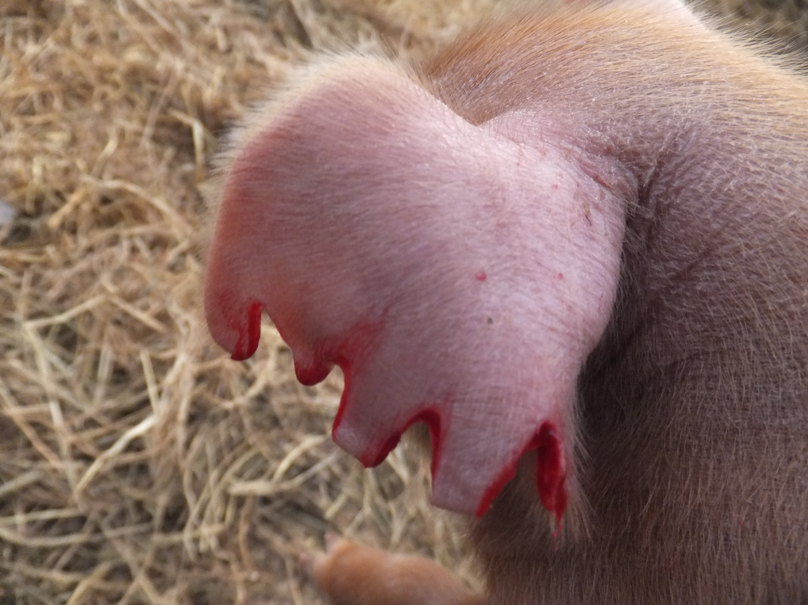
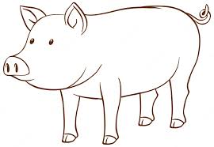
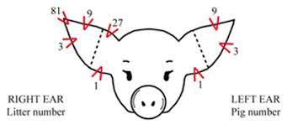
Methods: How to get to constructs
Gross notch size: 0.3 inches
Number of Cells: <0.5 x 10⁶
Notes:
I WOULD ADD HERE THE PIG EAR NOTCH COLLECTION – STRESSING OUT HOW SMALL THEY ARE AND THEM STRESS OUT THAT WE CAN COMPENSATE FOR THE SMALL AMOUNT OF INTITIAL CELLS BY A REOBUST EXPANSION WE OPTIMIZED

Slide 9
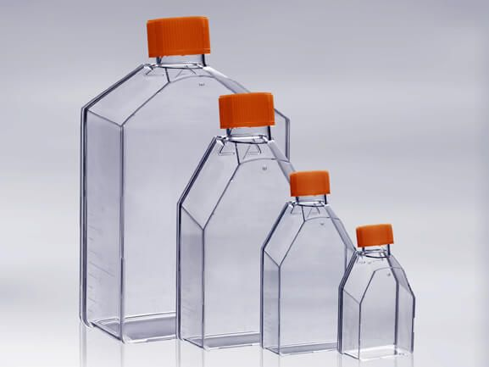
Methods: How to get to constructs
Expand cells in monolayer
Want at least ~ 60 x 10⁶
Seed cells in Aggregate Phase
Want ~20 x 10⁶ per plate
Seed in cell-dense construct phase
Want ~8 x 10⁶ per construct
Notes:
I WOULD ADD HERE THE PIG EAR NOTCH COLLECTION – STRESSING OUT HOW SMALL THEY ARE AND THEM STRESS OUT THAT WE CAN COMPENSATE FOR THE SMALL AMOUNT OF INTITIAL CELLS BY A REOBUST EXPANSION WE OPTIMIZED
WE ALSO LEARNED HOW TO OVERCOME THE LIMITATION OF CHONDROCYTE DE-DIFFRENTIATION TOWARDS FIBROBLASTIC PHENOTYPE DURING THE EXPANSION STAGE BY APPLYING AN AGGREAGTE (OR 3D SUSPETION SPHERICAL CULTURE STAGE) WHICH RESULTS IN RE-DIFFERENTION OF CELLS BACK TO CHONDROCYTIC PHENOTYPE

Slide 10
Preliminary Results: Histology
Hematoxylin and Eosin
Pico Serous Red
Safran O
Histology Results
H&E and Safran O: demonstrate high glycosaminoglycan content
Pico Serous Red: collagen lies superficial and horizontal to the surface like native disc⁵
Van Gieson: Stain for elastin pending…
Notes:
PLEASE COMPARE THE HISTOLOGY TO THAT OF NATIVE TISSUE IN MANUSCRIPT: PMID: 28548559 and PMID: 29925634
The first one has all the values you need for native porcine TMJ disc and the second compares the TE construct to native tissue and discusses on what happens to it after the implantation. YOU MUST READ THESE TWO MANUSCIPRTS TO BETTER UNDERSTAND HOW TO INTERPRET YOUR RESULTS
Collagen fibrils are in the same orientation as shear stress forces causing an increased resistance to these forces.
I STILL DON’T SEE COMPARISON TO THE REFERENCES I GAVE YOU TO WORK WITH.
PLEASE SEE HOW OUR AURICULAR CHONDROCYTES-SOURCES IMPLANTS COMPARE TO NATIVE TISSUE AND TO COSTAL CHONDROCYTES-SOURCES TE IMPLANTS
ALSO YOU NEED TO BE ABLE TO COMMENT WHY WE ARE HAPPY WITH THIS.
TO ANSWER THE LATTER YOU HAVE TO READ THE DISCUTTION ON MY SINCE TRANSLATIONAL PAPER.
Notes from paper:
At time of implantation, the implants young modulus and relaxation modulus were similar to native TMJ which allowed for immedaiate load baring and joint movement upon implantation
After implantation, tissue engineered constructs underwent adaptive remodeling and biochemical properties that approached native tissues
Gag decreased
Collagen increased
Cellularity decreased
As good as costal

Slide 11
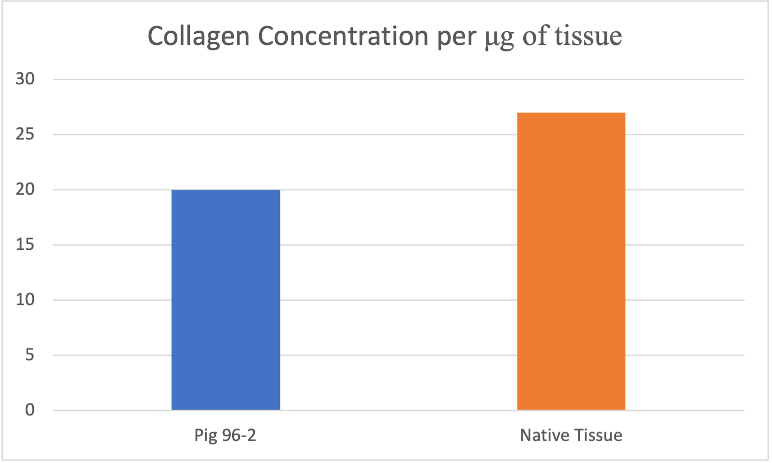
Preliminary Results: Biochemistry
← OH-Proline Assay
OH-Proline Assay – Quantification of total collagen
Results of this assay:
Tissue engineered constructs have a lower amount of collagen per microgram of tissue compared to native tissue⁵
Gag Blyscan Assay – Quantification of glycosaminoglycans
Pending…
Notes:
Collagen is the main component that gives tensile strength, therefore our biochem results affirm our tensile data as our constructs were overall less strong in tensile and has less collagen
But this differs based on what cartilage you use (costal has 60% collagen so they have higher tensile strength)
*small difference– we can tweak the media composition to improve it further**
State: we are happy with this because it will change in vivo

Slide 12
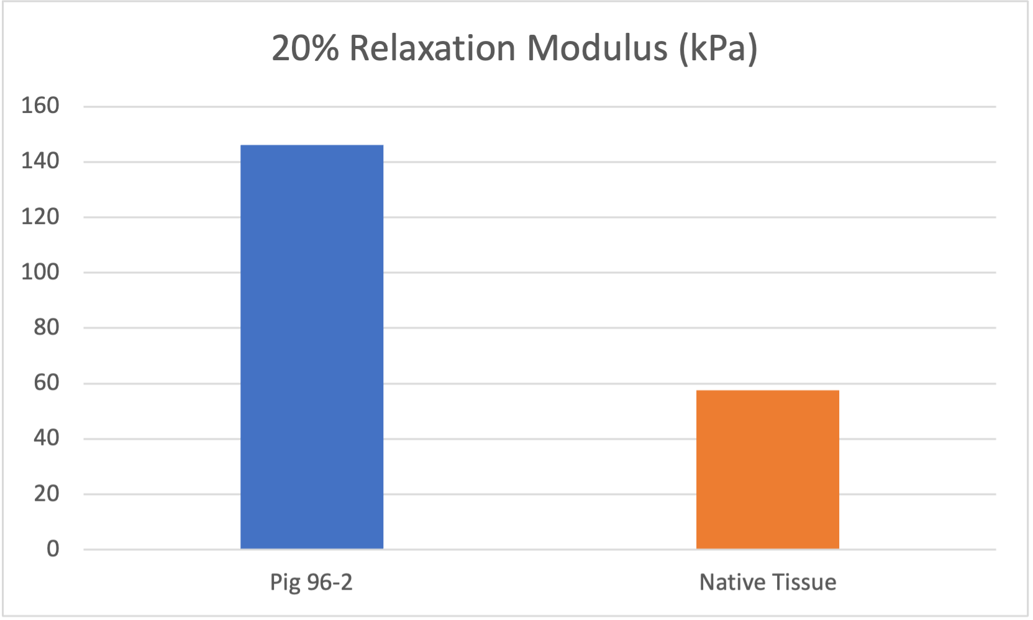
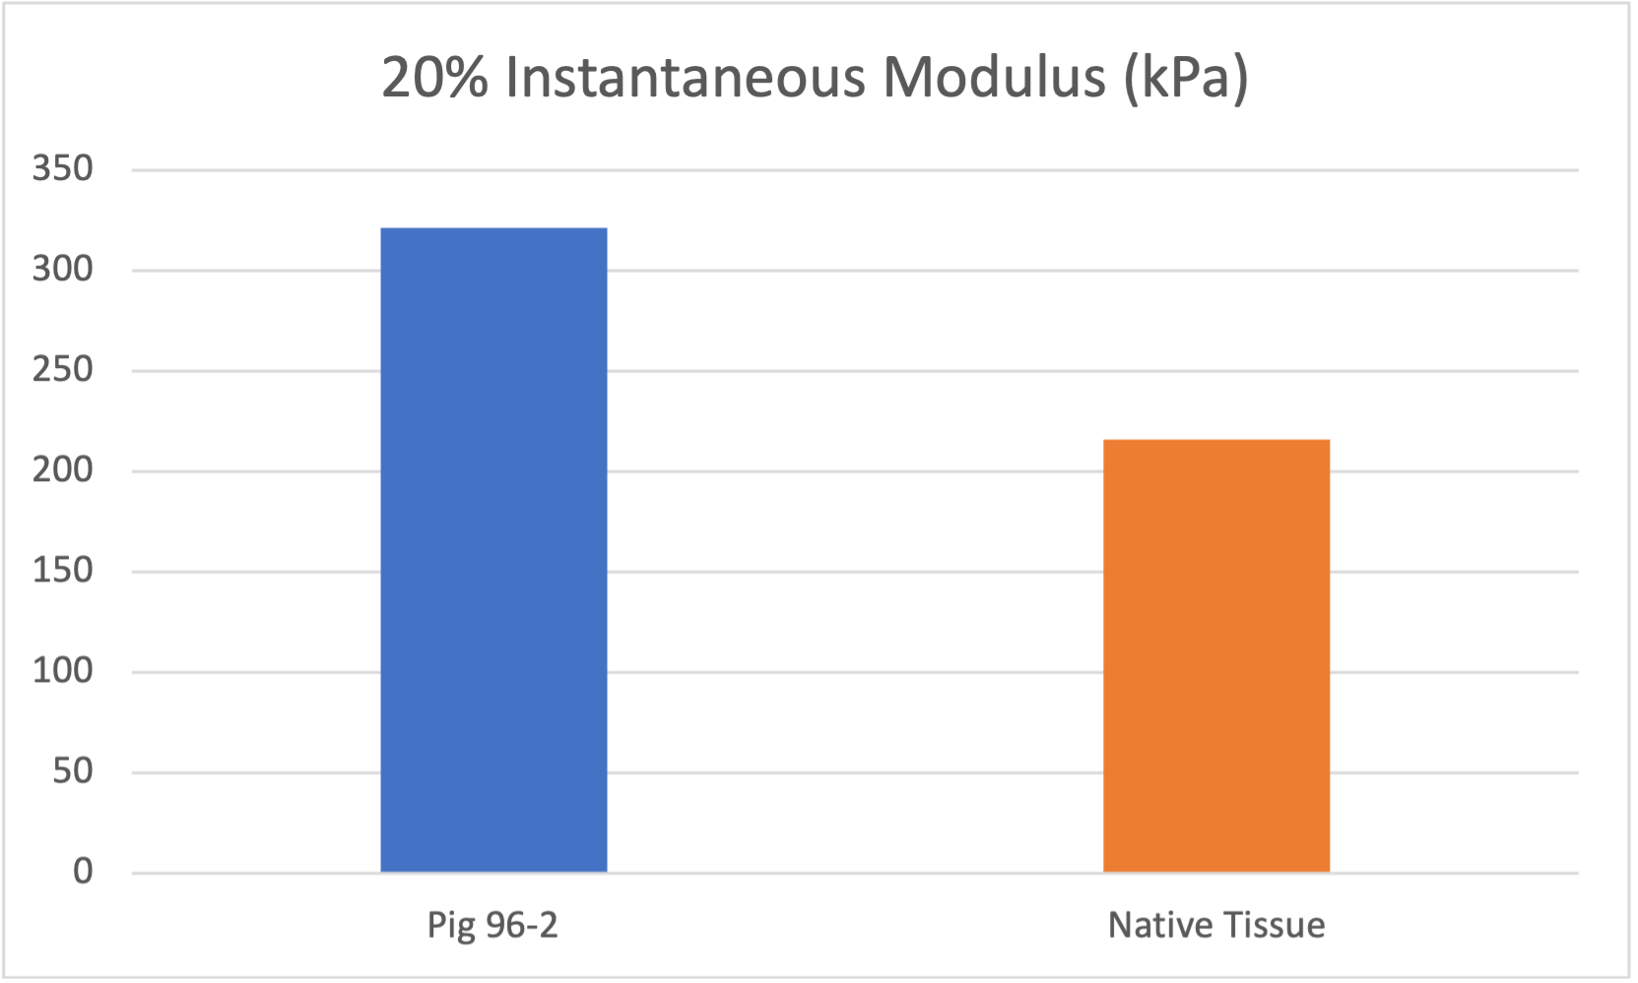
Preliminary Results: Mechanical
Instron 5565, Norwood, MA
Uniaxial, unconfined stress-relaxation testing
Instantaneous and Relaxation Moduli
Compressive Properties:
Tissue engineered constructs have ~3x the relaxation stiffness compared to native tissue⁵
Constructs have ~1.5x the compressive stiffness relative to native tissue⁵
Notes:
DO YOU KNOW WHAT DOES 20% IN YOUR CHART TITLE MEAN?

Slide 13
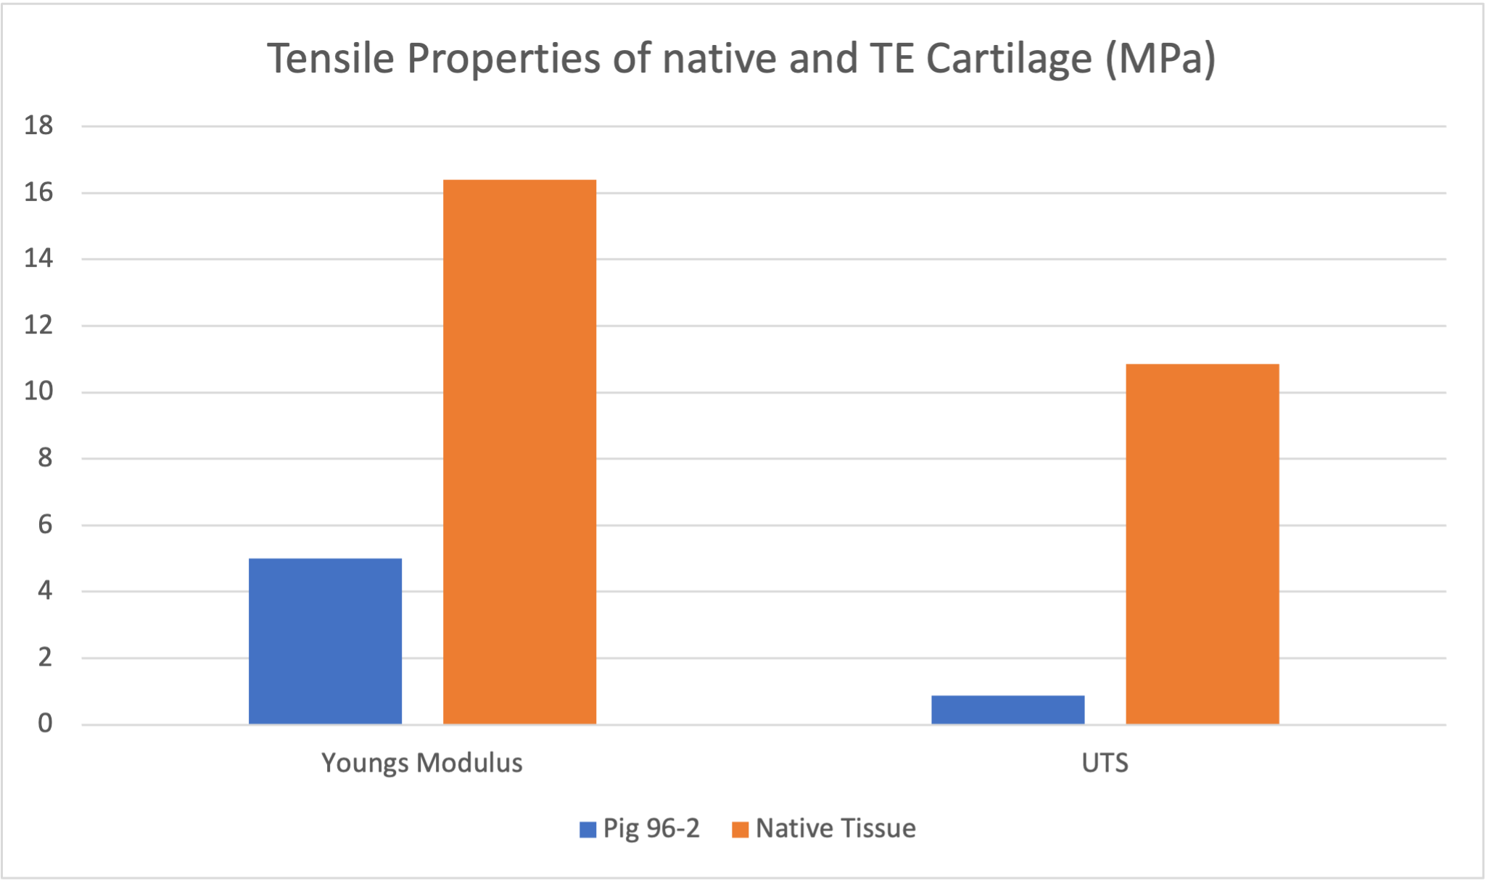
Preliminary Results: Mechanical
Tensile Properties:
Youngs modulus: the comparison between stress and strain which defines the material stiffness
Stress: amount of force per unit area on the tissue
Strain: distance of displacement of the tissue
Data Interpretation:
Tissue engineered construct has 10x less tensile strength in comparison to native tissue⁵
Notes:
Youngs modulus: tensile sTIFFNESS as it stretches
- stress and strain on the tissue:
- Stress: how much force your putting on the construct
- Strain: how much the tissue is stretching (CHANGE IN LENGTH) as a result of your force
Ultimate tensile: point in which it rips – THIS IS THE STRENGTH
Collagen takes a long time to mature- even if collagen is there ther is cross-;linking which only happens with maturity which adds to the strength of the tissue– we also have tricks to improve cross-linking (LOX)

Slide 14
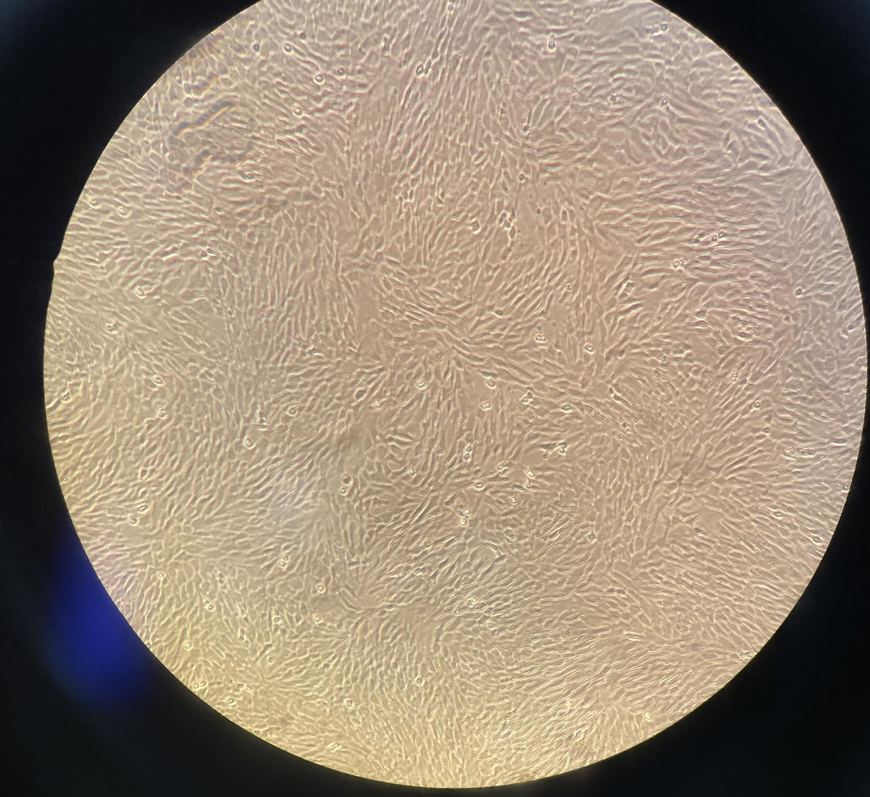
Next Steps:
Continue Biochemical and Mechanical testing on constructs currently growing….
Eventually going in vivo!

Slide 15
QUESTIONS?

Slide 16
Work Cited:
Runci A., Michele et al. Articular Disc of a Human Temporomandibular Joint: Evaluation through Light Microscopy, Immunofluorescence and Scanning Electron Microscopy. J of Func. Morph. and Kines. vol. 6,1 22. 25 Feb. 2021, doi:10.3390/jfmk6010022
Farrar W.B., McCarty W.L. Jr.1979.The TMJ dilemma. J Ala Dent Assoc. 63(1):19-26. PubMed PMID:297713
Wilkes C.H. 1989. Internal derangements of the temporomandibular joint. Pathological variations. Arch Otolaryngol Head Neck Surg. 115(4):469-477. PubMed PMID:2923691
Vapniarsky N., et al. 2018. Tissue engineering toward temporomandibular joint disc regeneration. Sci Transl Med. 10(446). PubMed PMID:29925634
Vapniarsky N., Aryaei A., Arzi B., Hatcher D.C., Hu J.C., Athanasiou K.A. 2017. The Yucatan minipig temporomandibular joint disc structure- function relationships support its suitability fort human comparative studies. Tissue Engineering. Part C, Methods 23(11):700-709, PubMED PMID:28548559

