Slide 1
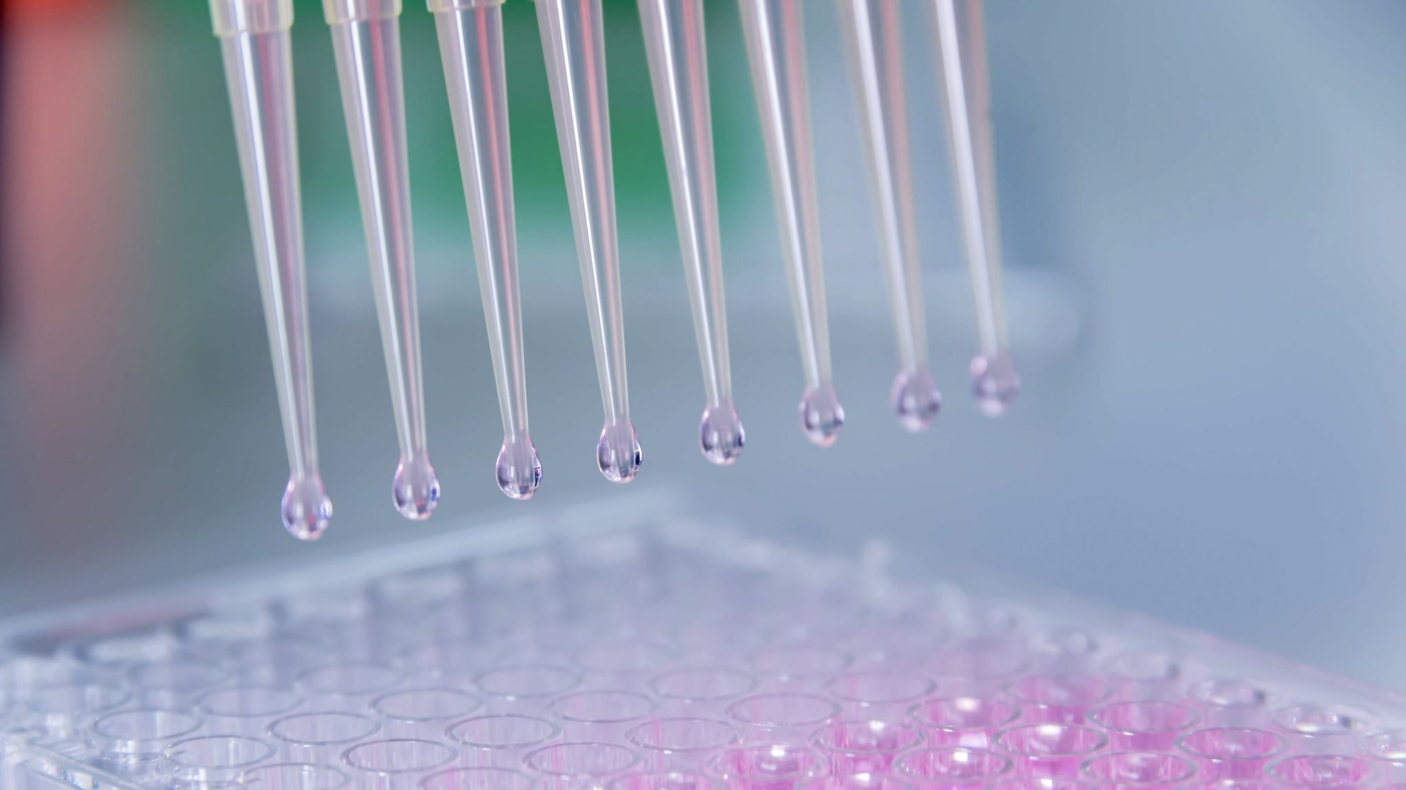
Understanding the Tenogenic and Cytoprotective Roles of Vitamin C
By: Mienaltowski Lab: Nicole Gonzales

Slide 2
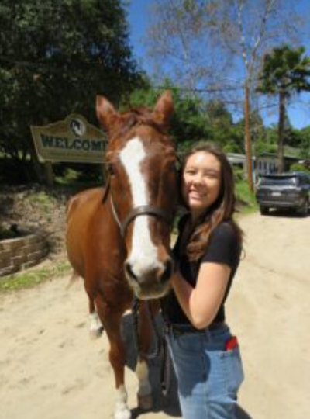


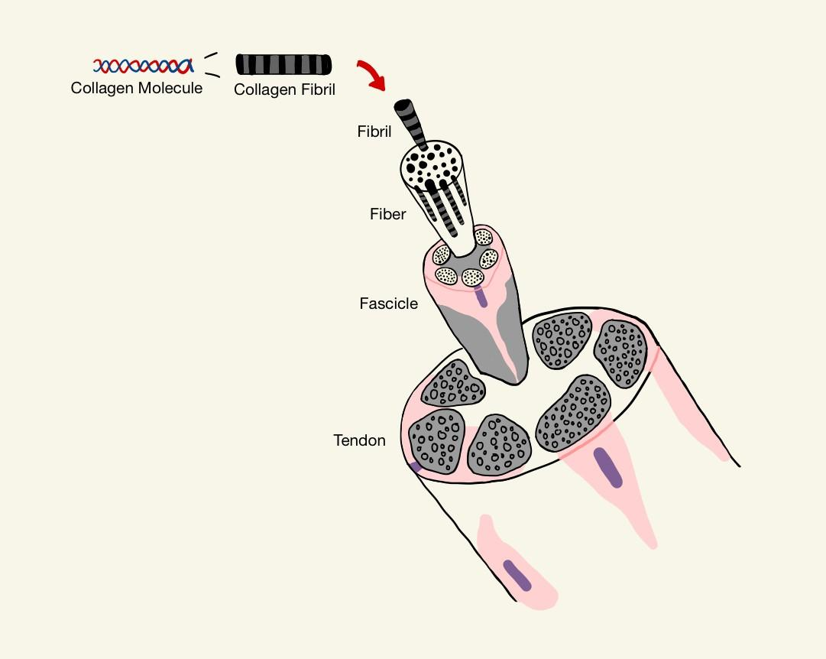
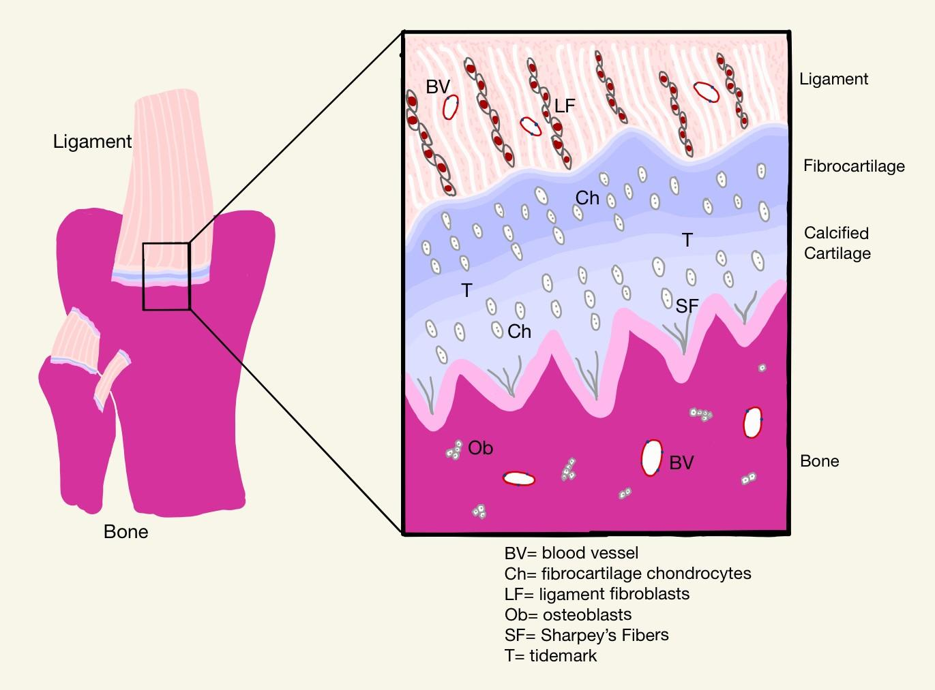
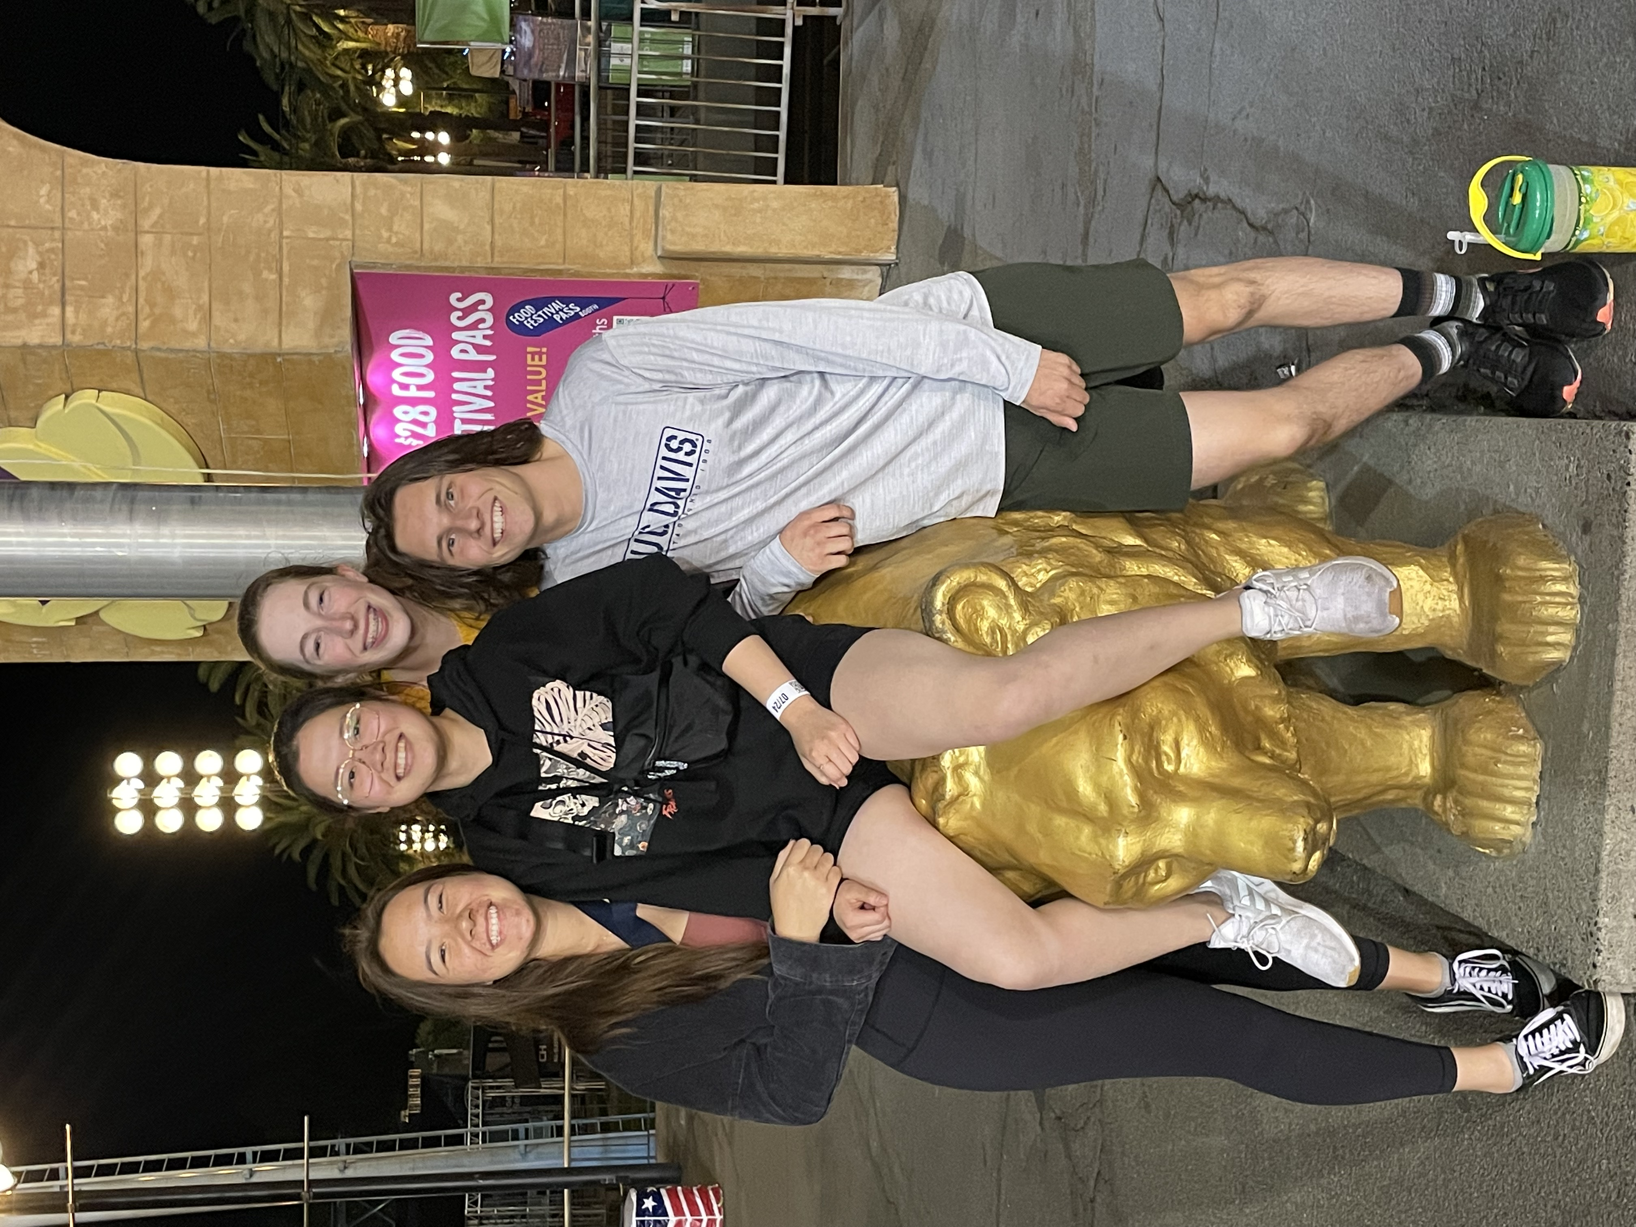
Determining if corrections in niche components and organization of musculoskeletal cell physiology can lead to more optimal repair pathways or tissue engineering pathways to prevent and treat musculoskeletal injuries

Slide 4
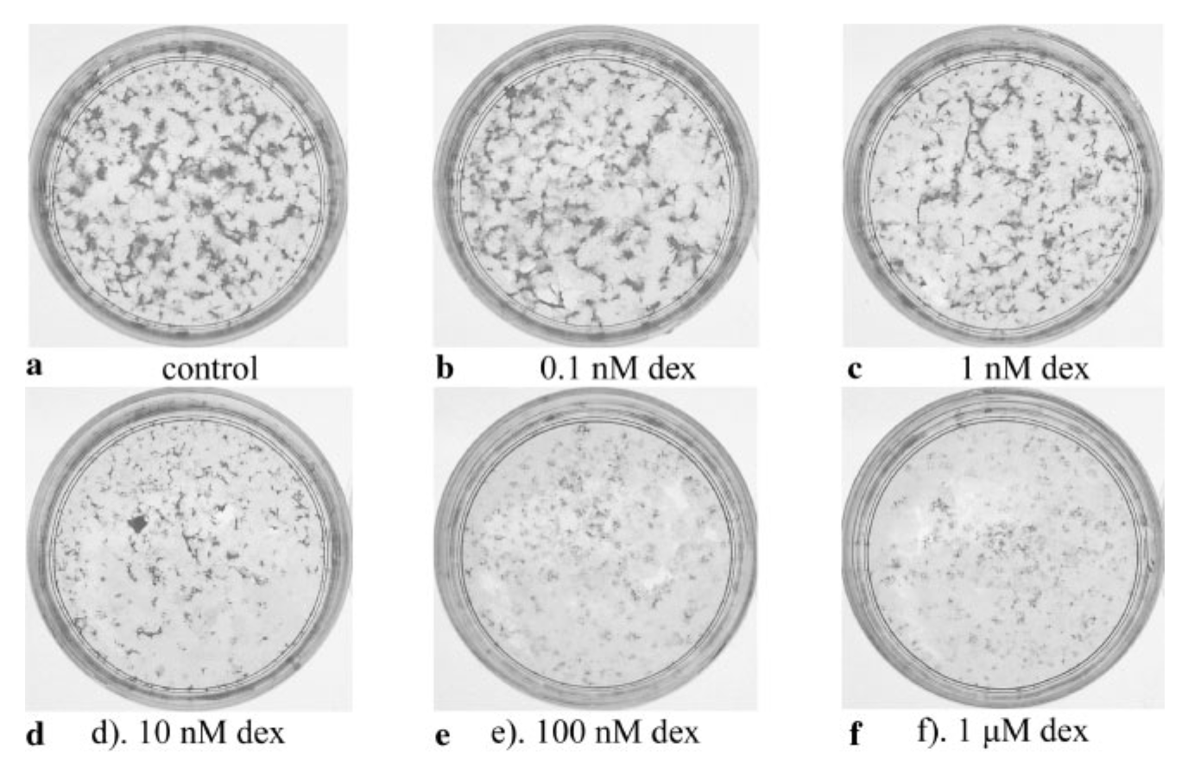
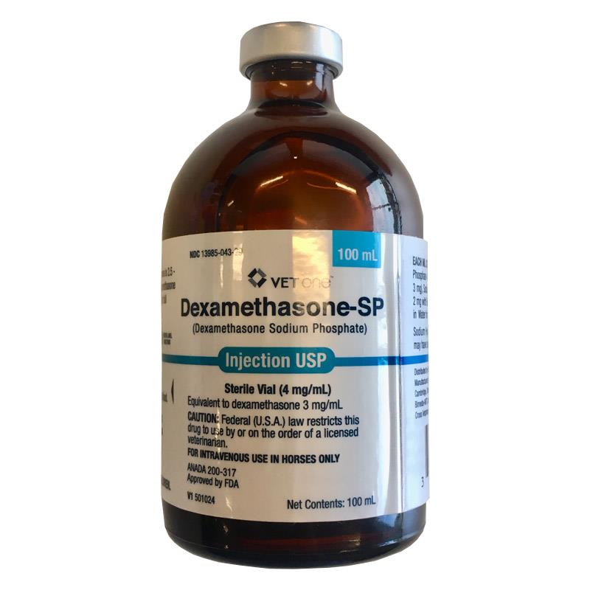

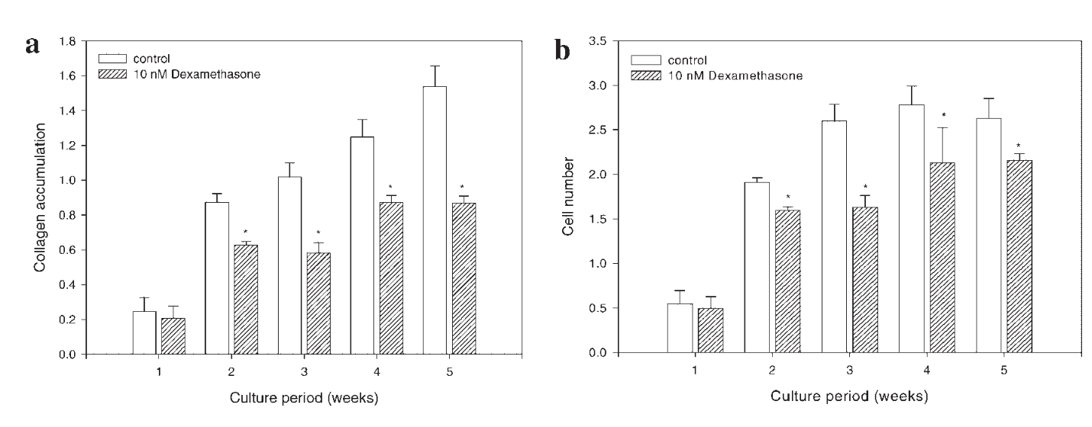
Dexamethasone
Most widely prescribed class of drugs used for anti-inflammatory and analgesic effects especially within equine musculoskeletal injuries
Dexamethasone was shown to reduce both overall cell number and collagen production in tenocytes
Scutt N., Rolf C.G., Scutt A. 2006. Glucocorticoids inhibit tenocyte proliferation and tendon progenitor cell recruitment. J Orthop Res. 24(2):173-182

Slide 5

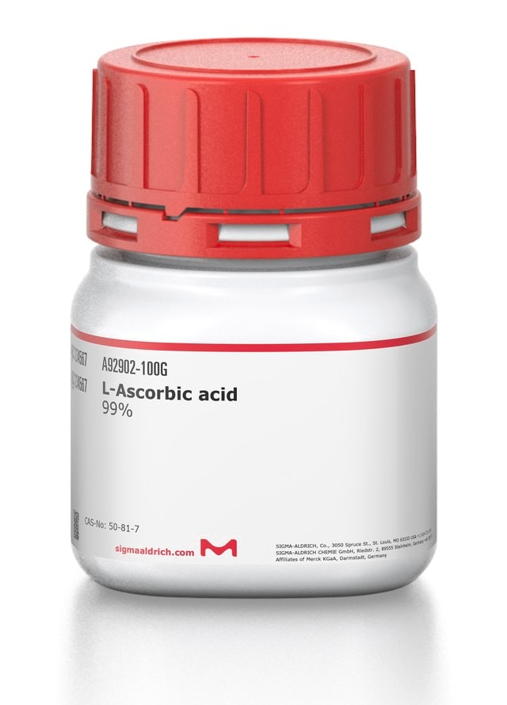
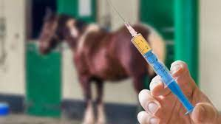
Mienaltowski Lab STAR 2022
AIM 1: Determine if vitamin C supplementation promotes tenogenic properties in TP and PERI stem/progenitor cells utilizing qPCR makers indicating tenogenesis, chondrification, vascular marker identity, and cell proliferation. Collagen content specifically will be assessed with a hydroxyproline assay
AIM 2: Determine if increasing levels of vitamin C cause a cytoprotective effect against anti-inflammatory glucocorticoid induced cellular apoptosis through detection of genetic expression of apoptotic genes with qPCR well as an apoptosis assay

Slide 6
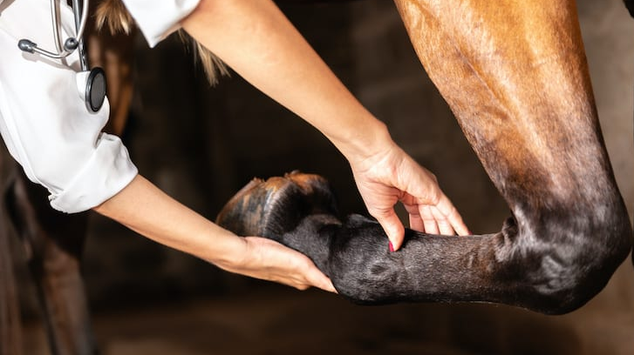
Mienaltowski Lab STAR 2022 Hypothesis
We hypothesize, based on previously conducted studies, that supplemental vitamin C administered to tendon proper (TP) and peritenon (PERI) stem/progenitor cells of the equine superficial digital flexor tendon (SDFT) promotes tendon regeneration by bolstering collagen synthesis and can serve as a protective agent against negative anti-inflammatory glucocorticoid consequences.

Slide 7

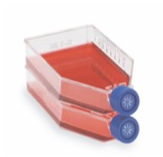
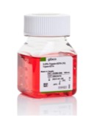
Aim 1: Tenogenic Effect of Vitamin C Methods
3. Cells were trypsinized with 25% trypsin-EDTA and seeded in 6 well plates
1. Cells were harvested from equine superficial digital flexor tendon and cryopreserved
2. Cells were expanded to 95% confluence in cell culture media
FOUR TREATMENTS:
0 μM (control)
100 μM
200 μM
400 μM
800 μM

Slide 8
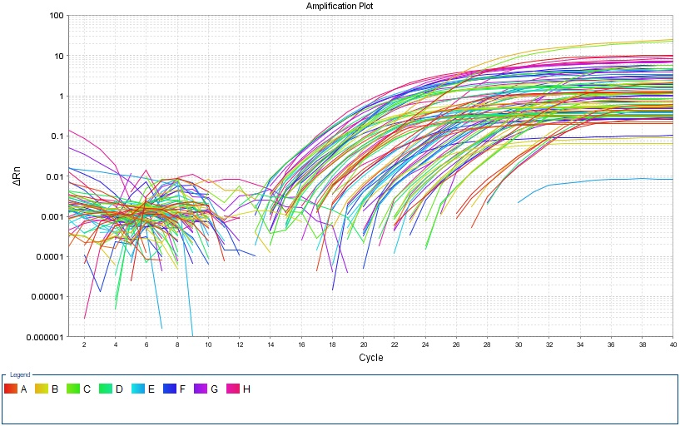
Aim 1: Tenogenic Effect of Vitamin C Methods
TaqMan RT-qPCR Genes:
Reverse Transcription with High-Capacity Reverse Transcription Kit
Transcript abundance relative to POLR2A (housekeeping gene)
Marker | Gene
Tenogenesis | SCX, MKX
Matrix assembly | BGN, DCN, COL1A1, PLOD1, LARP6
Vasculature Formation | CSPG4
Chondrification | ACAN
Cellular Proliferation | MKI67

Slide 9
Results

Slide 10
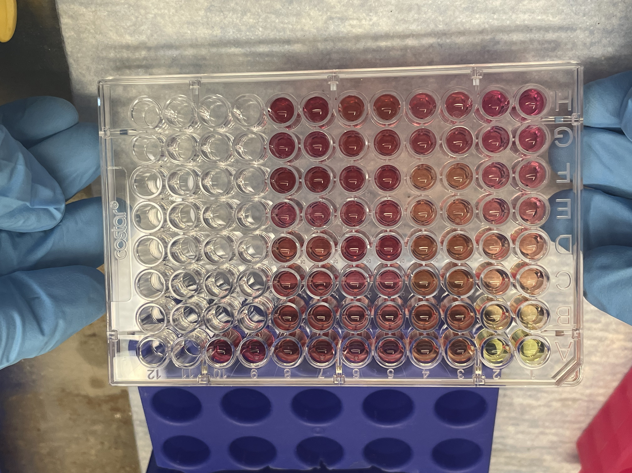
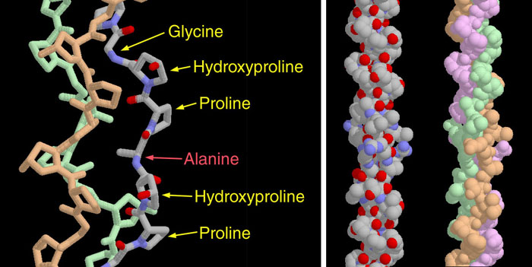
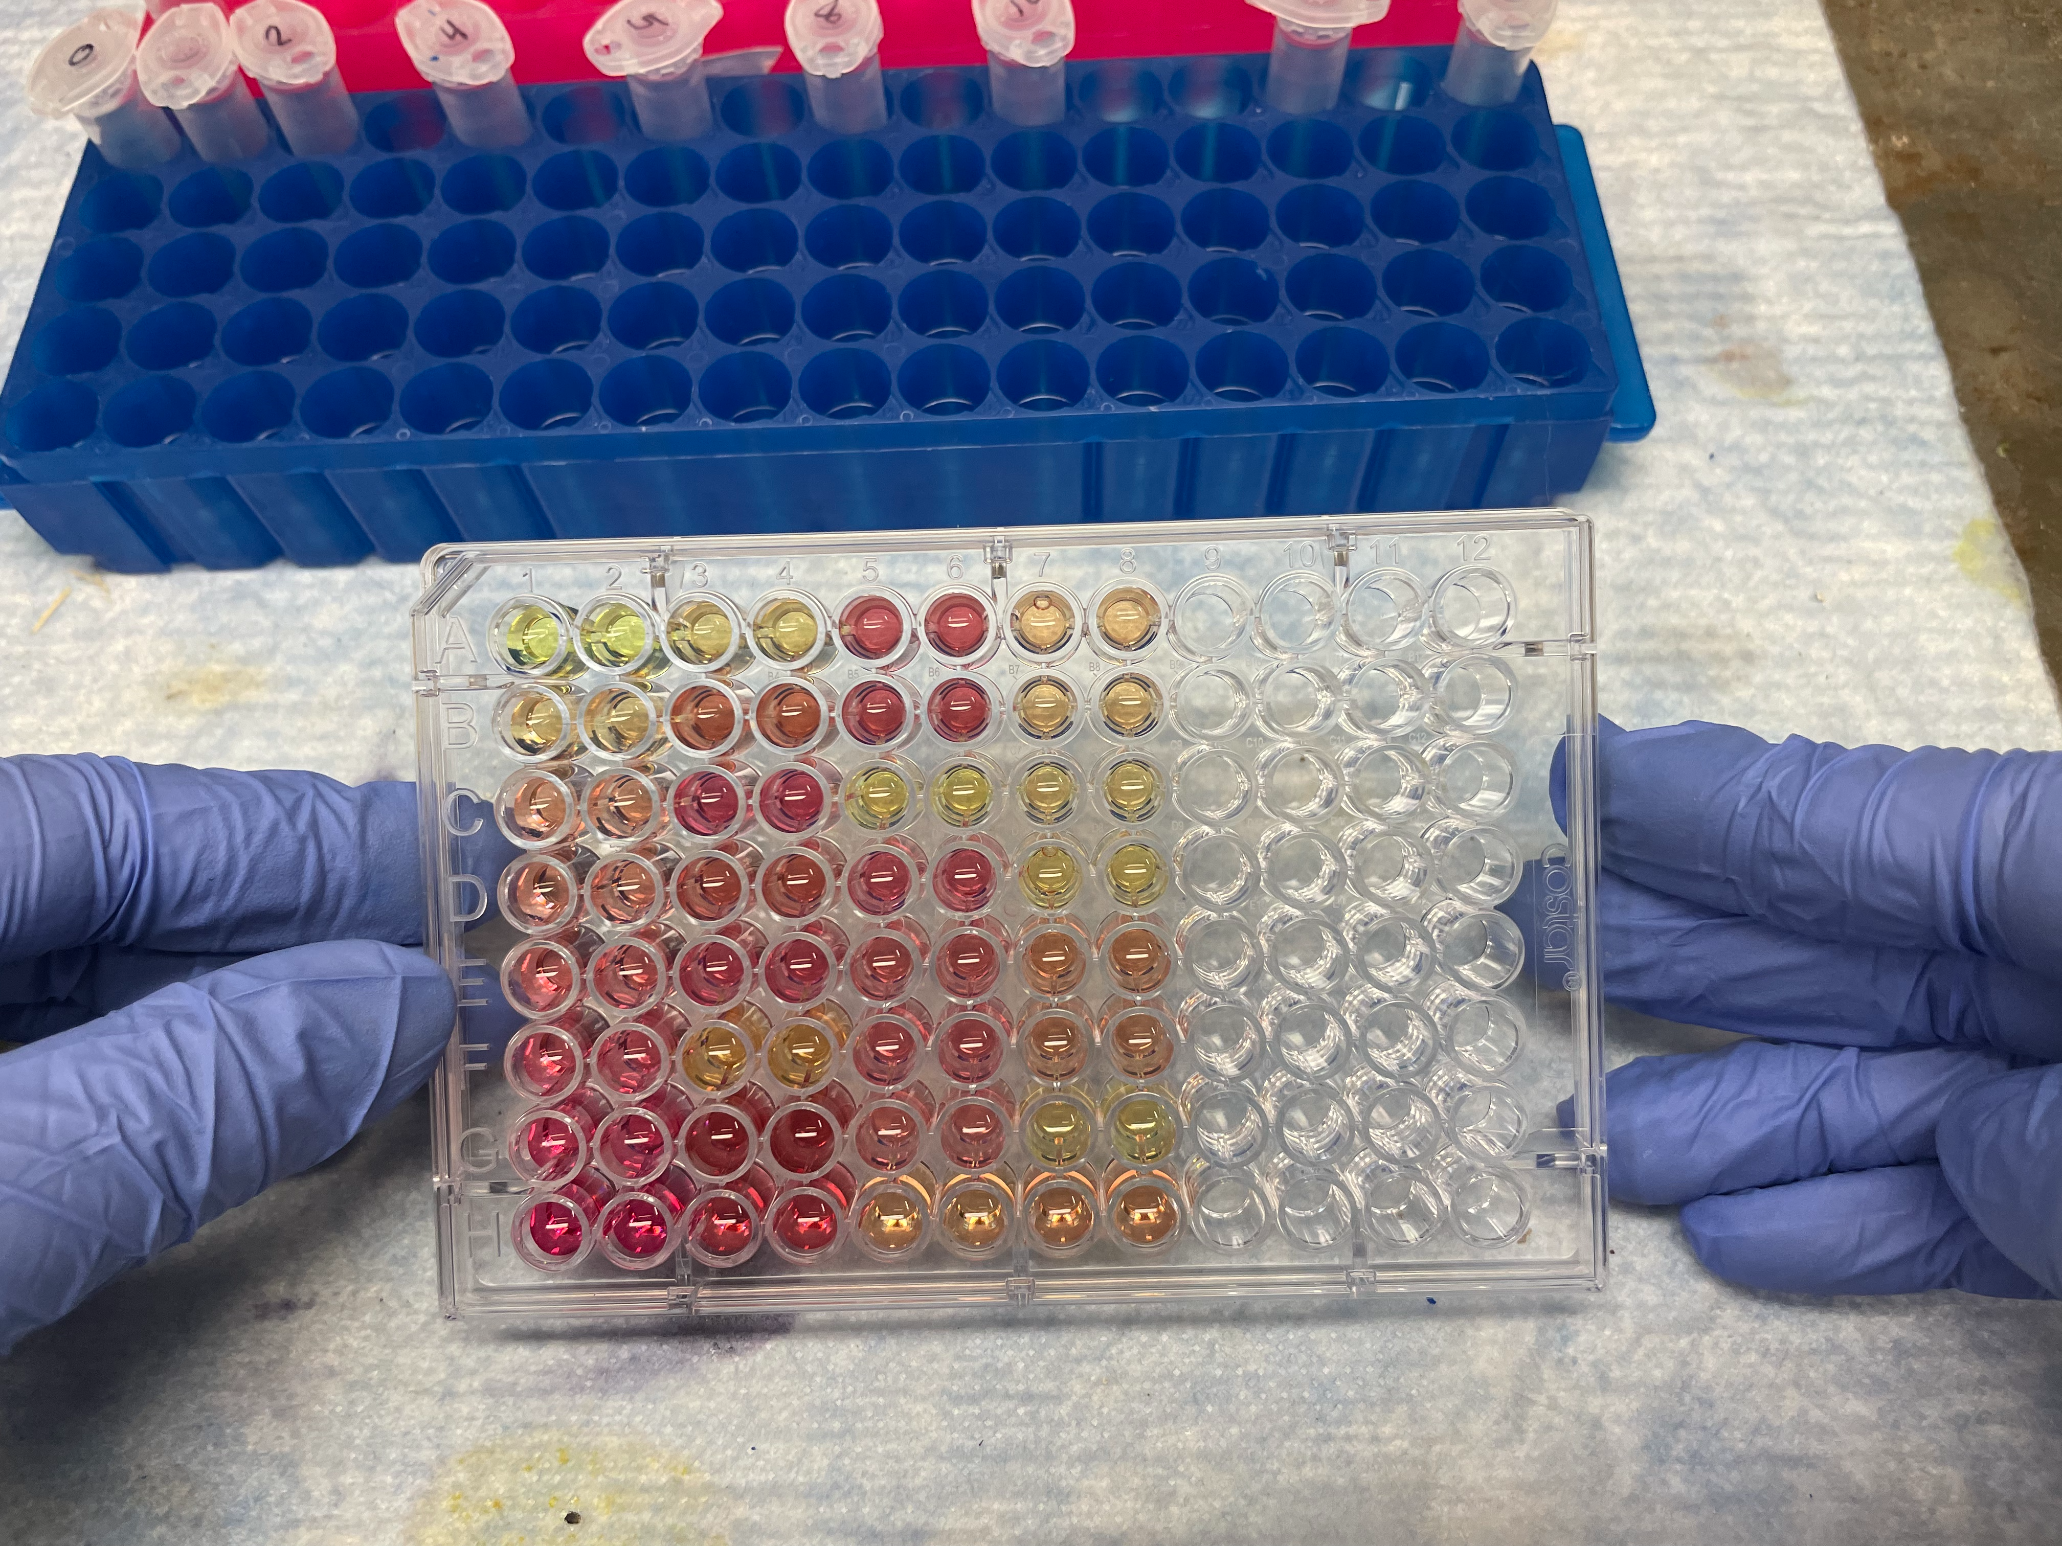
Aim 1: Tenogenic Effect of Vitamin C Methods: Hydroxyproline Assay
Determines how much collagen is in each sample
Notes:
Hydroxyproline is a component of collagen
Contributes to the stabilization of collagen
13.7% of collagen is hydroxyproline

Slide 11
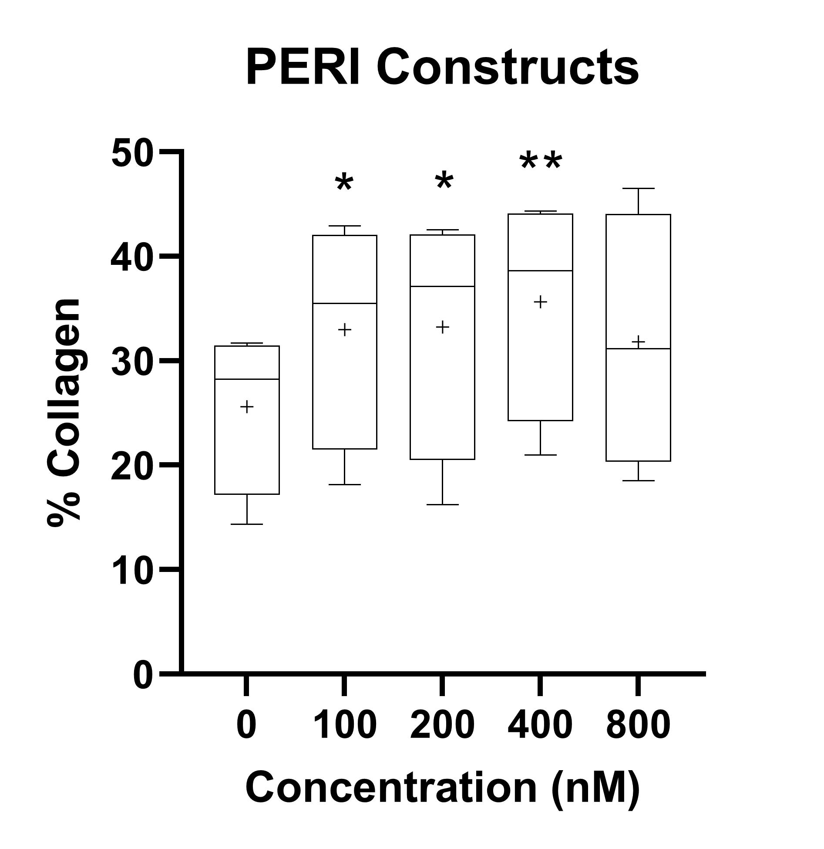
Aim 1: Hydroxyproline Assay Preliminary Results
*: Less than .05
**: Less than .01

Slide 12

Aim 2: Cytoprotective Properties of Vitamin C Methods
TaqMan RT-qPCR Genes:
Reverse Transcription with High-Capacity Reverse Transcription Kit
Transcript abundance relative to POLR2A (housekeeping gene)
Marker | Gene
Apoptosis | FOX01, FOX03A
FOXO gene is a subfamily involved in a wide range of cellular processes such as stress resistance, metabolism, cell cycle arrest, and apoptosis
FOXO1 and FOXO3A are related specifically to the regulation of apoptosis

Slide 13
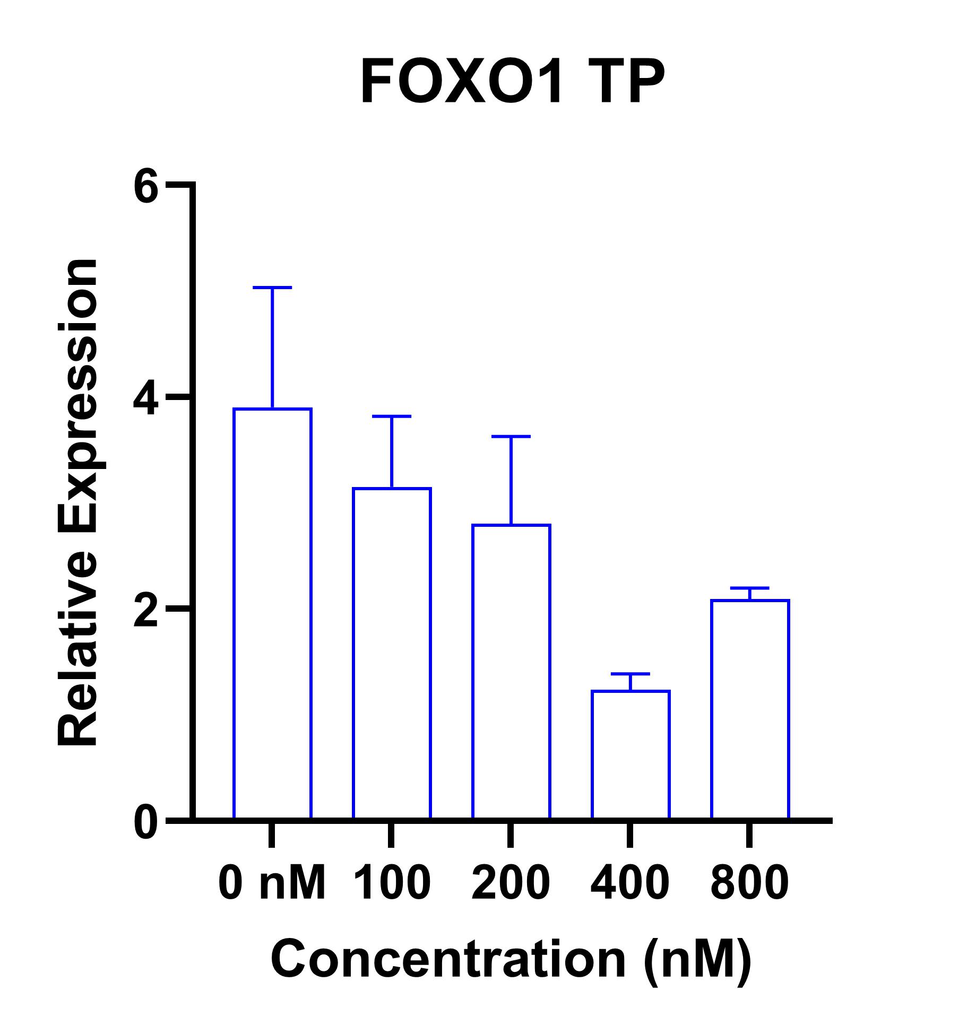
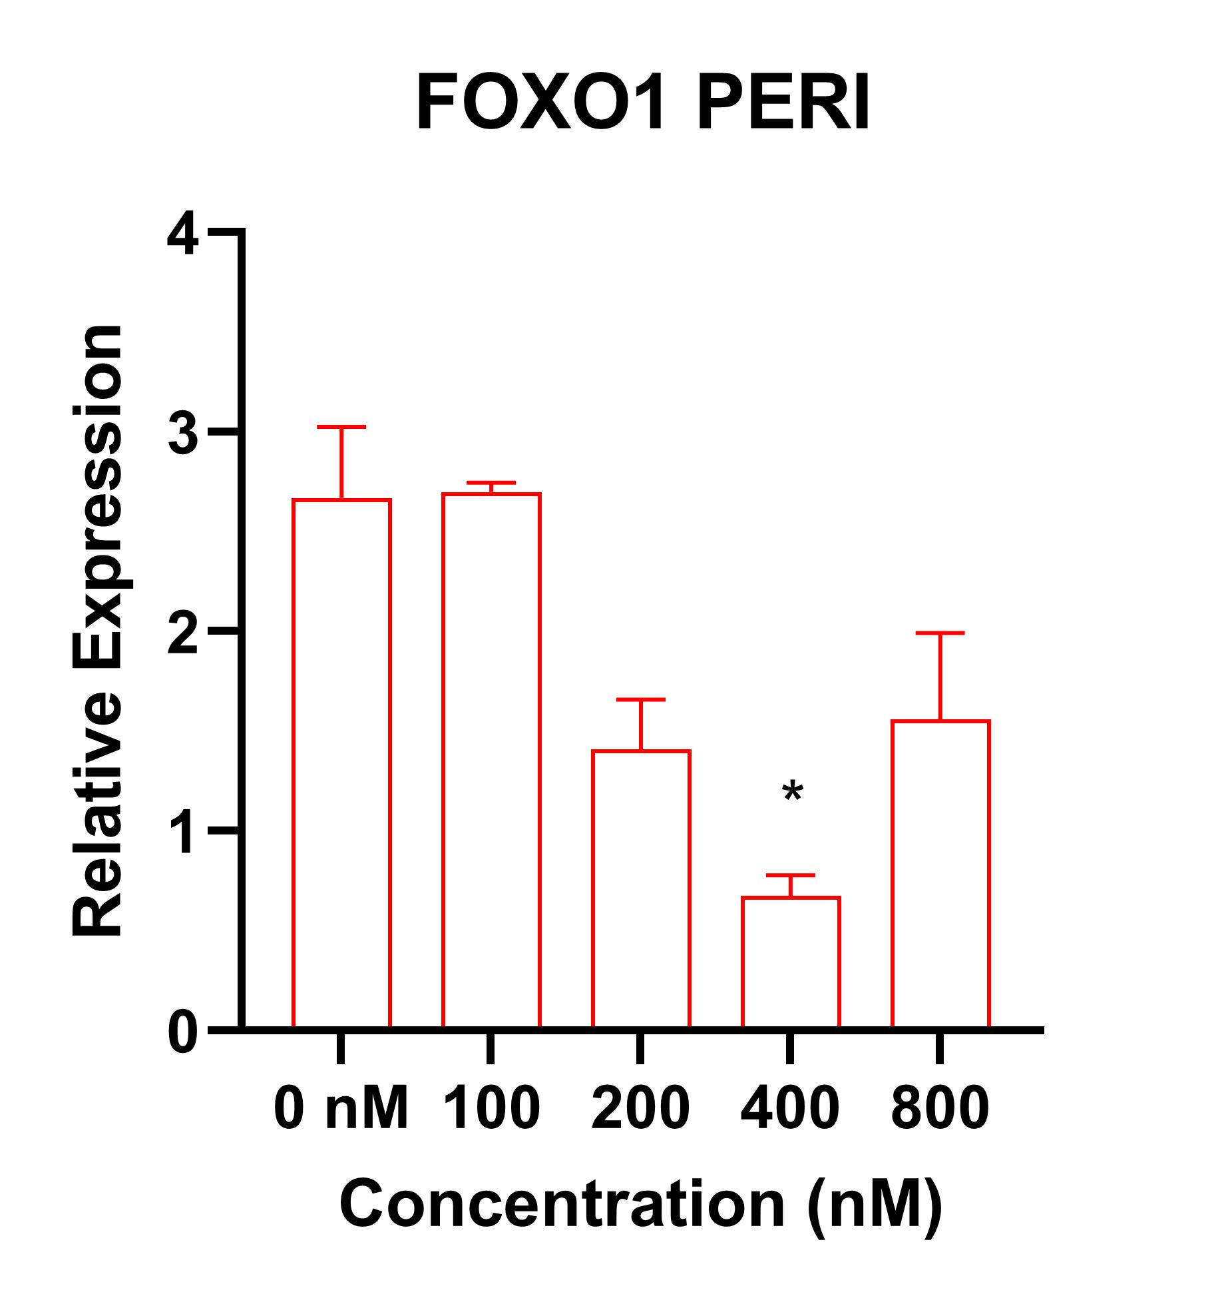
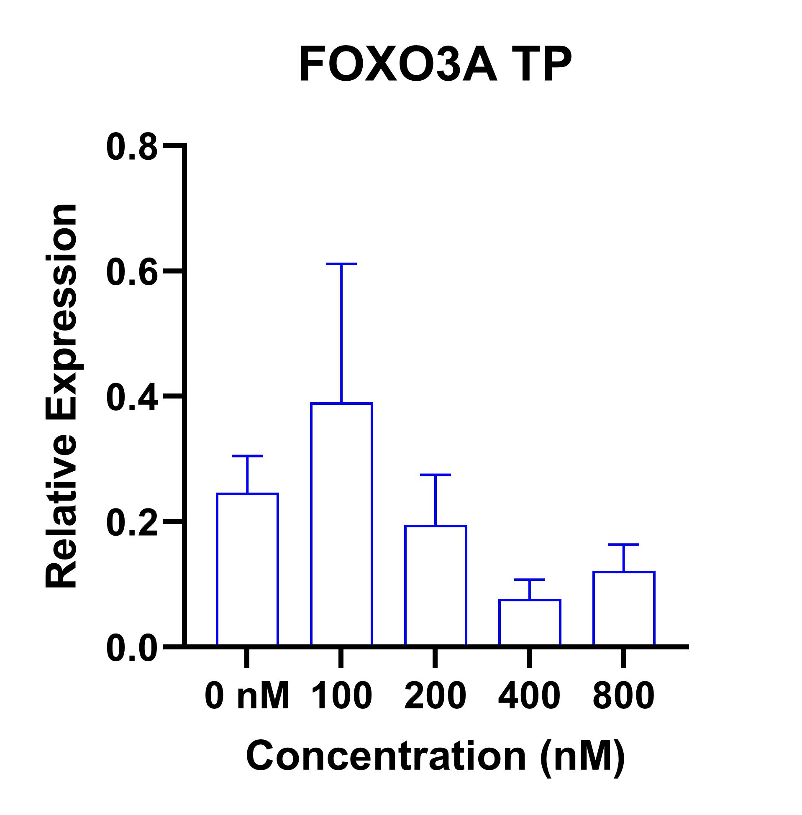
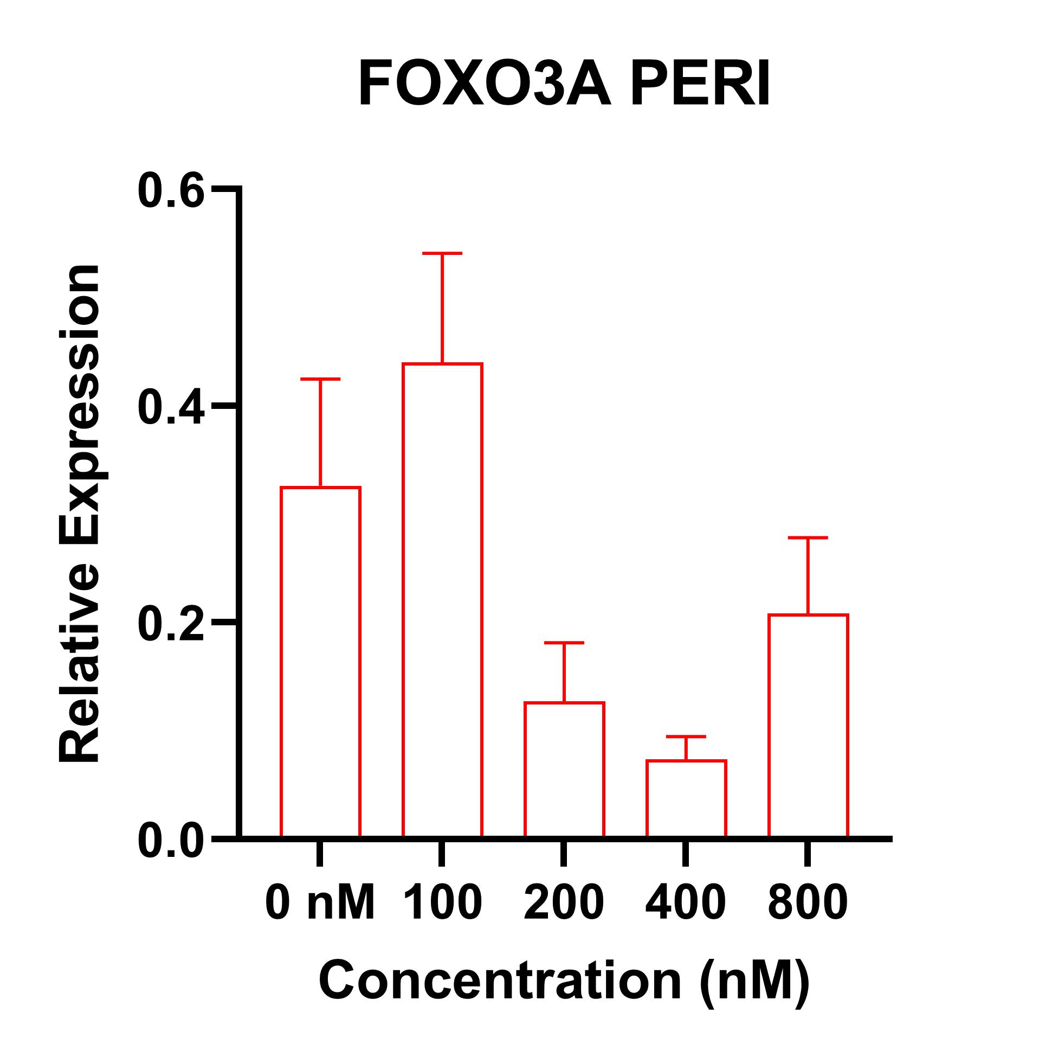
Aim 2: Cytoprotective Properties of Vitamin C Results

Slide 14

Conclusions
Finishing tests:
Apoptosis Assay
qPCR on all samples for apoptotic genetic markers
Future Directions of the Project:
In vivo trials with oral supplementation of Vitamin C
Identify and analyze markers for collagen 1 degradations in the blood
Ultrasound tendons in order to determine structure inside a live animal
Notes:
Understand which processes are changing in order to determine how to detect those changes in a live animal

Slide 15
ACKNOWLEDGEMENTS
We, the Mienaltowski Laboratory, gratefully acknowledge the financial support of the Students Training in Advanced Research program as well as the Center of Equine Health at UC Davis.
I personally acknowledge my lab family for their continued support throughout my STAR project, as well as my life mentor Dr. Mienaltowski for his continued support over the past 3 years and for many more to come.

