Slide 1
Characterization of genes involved in the host specificity of Salmonella enterica serovars
Sophie Gretler, Aurore Demars, PhD, Renee Tsolis, PhD
Notes:
Remove Typhi?

Slide 2
Host specificity of Salmonella serovars
S. Typhimurium
Notes:
Generalist vs specialist host strategies – ex Stm and Sty

Slide 3
Host specificity of Salmonella serovars
S. Typhimurium
Notes:
Generalist vs specialist host strategies – ex Stm and Sty

Slide 4
Host specificity of Salmonella serovars
S. Typhimurium
S. Typhi
Notes:
Generalist vs specialist host strategies – ex Stm and Sty

Slide 5
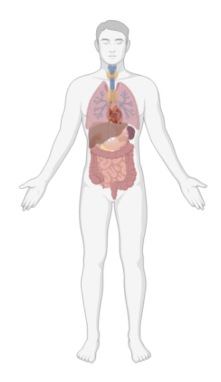
Host specificity of Salmonella serovars
S. Typhimurium
S. Typhi
Notes:
Generalist vs specialist host strategies – ex Stm and Sty

Slide 6
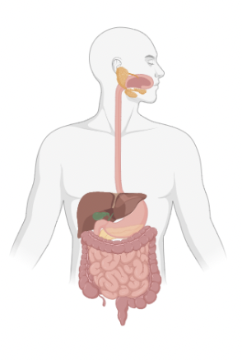
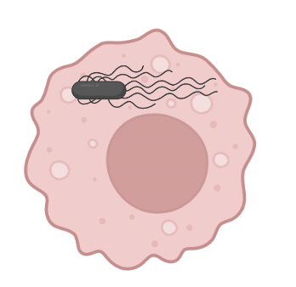
Host specificity of Salmonella serovars
S. Typhimurium
S. Typhi
MP
Notes:
Stm – primarily gastroenteritis; Sty – systemic infection also known as typhoid fever
Both are transmitted through fecal-oral route where they either remain local in the gut or invade into the systemic circulation
Both Stm and Sty can infect and persist within host macrophages in the gut as well as systemically

Slide 7
Host adaptation of Salmonella serovars
S. Typhimurium
MP
+++ Itaconate [8 mM]
Notes:
One of the hypotheses as to why Stm can infect mice but Sty cannot is due to differences in host MPs
Ms MPs have much higher concentrations of an antimicrobial compound called itaconate compared to human cells

Slide 8
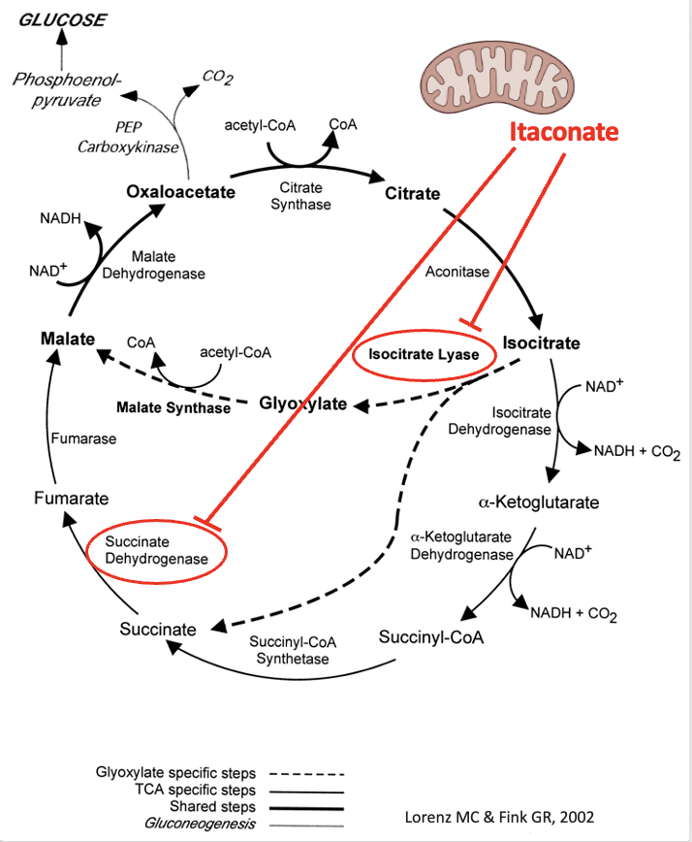
Host adaptation of Salmonella serovars
S. Typhimurium
Glyoxylate Shunt
TCA Cycle
MP
+++ Itaconate [8 mM]
Notes:
One of the hypotheses as to why Stm can infect mice but Sty cannot is due to differences in host MPs
Ms MPs have much higher concentrations of an antimicrobial compound called itaconate compared to human cells

Slide 9
Host adaptation of Salmonella serovars
S. Typhimurium
S. Typhi
Glyoxylate Shunt
TCA Cycle
MP
MP
+++ Itaconate [8 mM]
+ Itaconate [60 μM]
Notes:
One of the hypotheses as to why Stm can infect mice but Sty cannot is due to differences in host MPs
Ms MPs have much higher concentrations of an antimicrobial compound called itaconate compared to human cells

Slide 10
Host adaptation of Salmonella serovars
S. Typhimurium
Notes:
Stm has a set of genes called the itaconate response operon that encodes a set of genes involved in the degradation of itaconate
These genes are also found in other bacteria such as Yersina pestis and P. aeriginosa and are thought to promote the survival of the bacteria within host macrophages

Slide 11
Host adaptation of Salmonella serovars
S. Typhimurium
MP
MP
ripABC_lgl
+++ Itaconate
Itaconate
Notes:
Stm has a set of genes called the itaconate response operon that encodes a set of genes involved in the degradation of itaconate
These genes are also found in other bacteria such as Yersina pestis and P. aeriginosa and are thought to promote the survival of the bacteria within host macrophages

Slide 12
Host adaptation of Salmonella serovars
S. Typhi
MP
+ Itaconate [60 μM]
Notes:
Unlike Stm, Sty lacks these RipABC genes, possibly due to the lack of selection pressure to maintain these genes as there is much less itaconate in human macrophages

Slide 13
Salmonella ripABC genes necessary for mouse infection
Hypothesis:
“The deletion of ripABC_lgl genes from S. Typhimurium will decrease their ability to infect and replicate within the mouse”
S. Typhimurium

Slide 14
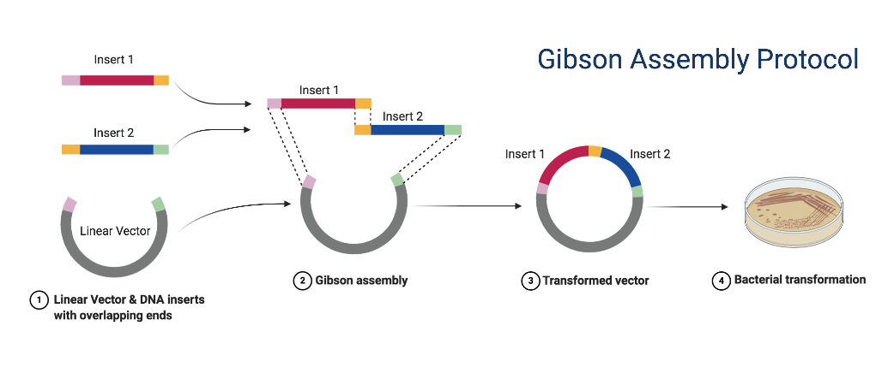
Construction of S. Typhimurium deletion mutants
Sequencing check
PCR check
Sequencing check
Notes:
Add selection

Slide 15
S. Typhimurium (S. Tm) deletion mutant
S. Typhimurium △ripABC_lgl

Slide 16
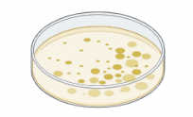
S. Typhimurium = S. Tm
In vivo – Competitive index infection
Infect 1:1 S. Tm WT (Cm^{R}): S. Tm △ripABC_lgl (Kan^{R})
Streptomycin
OG
D-1
D0
D4
Spleen
Liver
Cecum contents
Feces
S. Tm WT - Cm^{R}
S. Tm △ripABC_lgl - Kan^{R}
Count CFUs

Slide 17
In vivo – Competitive index infection model
S. Typhimurium - virulent
inflammation
MP
MP
MP
+++ Itaconate
Notes:
As a negative control for our mouse experiments, we also constructed our mutant S. Tm in an avirulent strain that lacks the important virulence factors of S. Tm that allows the bacteria to invade and cause inflammation
So when we infect with our virulent WT and mutant bacteria, they have the necessary genes to invade local epithelium and cause inflammation in the GIT which will then bring in macrophages, exposing the bacteria to high concentrations of itaconate when they are phagocytized
In contrast, for our negative control, infection with the avirulent strains of S. Tm will not cause significant inflammation and therefore very few macrophages will be recruited, leaving the bacteria in an environment of low itaconate. We expect that without exposure to itaconate, our mutant and “WT” strains will show similar levels of fitness

Slide 18
In vivo – Competitive index infection model
S. Typhimurium - virulent
S. Typhimurium - avirulent
inflammation
inflammation
MP
MP
MP
MP
+++ Itaconate
+ Itaconate
Notes:
As a negative control for our mouse experiments, we also constructed our mutant S. Tm in an avirulent strain that lacks the important virulence factors of S. Tm that allows the bacteria to invade and cause inflammation
So when we infect with our virulent WT and mutant bacteria, they have the necessary genes to invade local epithelium and cause inflammation in the GIT which will then bring in macrophages, exposing the bacteria to high concentrations of itaconate when they are phagocytized
In contrast, for our negative control, infection with the avirulent strains of S. Tm will not cause significant inflammation and therefore very few macrophages will be recruited, leaving the bacteria in an environment of low itaconate. We expect that without exposure to itaconate, our mutant and “WT” strains will show similar levels of fitness

Slide 19
Deletion of the ripABC_lgl genes results in decreased local replication compared to S. Typhimurium WT
S. Typhimurium = S. Tm
Notes:
Add font colors

Slide 20
Deletion of the ripABC_lgl genes results in decreased local replication compared to S. Typhimurium WT
S. Typhimurium = S. Tm
Notes:
Add font colors

Slide 21
Deletion of the ripABC_lgl genes results in decreased local replication compared to S. Typhimurium WT
S. Typhimurium = S. Tm
Notes:
Add font colors

Slide 22
Deletion of the ripABC_lgl genes results in decreased local replication compared to S. Typhimurium WT
S. Typhimurium = S. Tm
Notes:
Add font colors

Slide 23
Deletion of the ripABC_lgl genes results in decreased systemic replication compared to S. Tm WT
S. Typhimurium = S. Tm
Virulent background

Slide 24
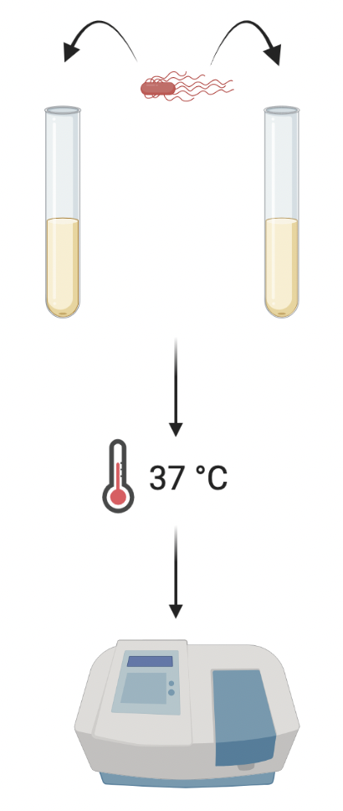
Is the decreased growth in the mutant due to impaired itaconate resistance?
- Itaconate
+8mM Itaconate
Measure OD

Slide 25
Is the decreased growth in the mutant due to impaired itaconate resistance?
S. Typhimurium = S. Tm
- Itaconate
+8mM Itaconate
Measure OD

Slide 26
Conclusions
S. Typhimurium
Notes:
In conclusion, we showed that in vivo, the mutant RipABClgl had decreased replication in both local and systemic organs compared to the WT strain and in vitro we saw that the growth of the mutant was almost completely inhibited by itaconate whereas the WT strain was unaffected
This supports our hypothesis that the RipABClgl genes aid in the bacterial replication within the mouse and that one of the reasons for that may be the increased growth and survival in conditions with itaconate as experienced in macrophages

Slide 27
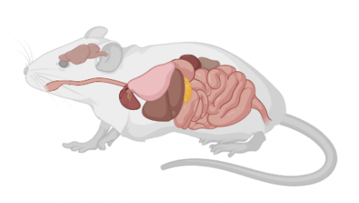
Conclusions
S. Typhimurium
Replication
Notes:
In conclusion, we showed that in vivo, the mutant RipABClgl had decreased replication in both local and systemic organs compared to the WT strain and in vitro we saw that the growth of the mutant was almost completely inhibited by itaconate whereas the WT strain was unaffected
This supports our hypothesis that the RipABClgl genes aid in the bacterial replication within the mouse and that one of the reasons for that may be the increased growth and survival in conditions with itaconate as experienced in macrophages

Slide 28
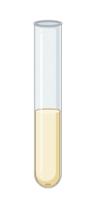
Conclusions
S. Typhimurium
+Itaconate
Replication
Growth
Notes:
In conclusion, we showed that in vivo, the mutant RipABClgl had decreased replication in both local and systemic organs compared to the WT strain and in vitro we saw that the growth of the mutant was almost completely inhibited by itaconate whereas the WT strain was unaffected
This supports our hypothesis that the RipABClgl genes aid in the bacterial replication within the mouse and that one of the reasons for that may be the increased growth and survival in conditions with itaconate as experienced in macrophages

Slide 29
Future Directions
S. Typhimurium
Notes:
So we were able to support our hypothesis that the deletion of RipABClgl from S.Tm decreased the ability of the bacteria to infect and replicate within the mouse. Our next steps will be to test whether the addition of the RipABClgl genes into S. Typhi will then increase the ability of Typhi to infect and replicate within the mouse compared to WT Typhi
As preliminary data, we have constructed the S. Typhi mutant containing RipABClgl and have shown that in vitro in the presence of itaconate while S. typhi WT is inhibited, the mutant is resistant to the effects of itaconate, similar to S. Tm

Slide 30
Future Directions
S. Typhimurium
S. Typhi ripABC_lgl
S. Typhi
Notes:
So we were able to support our hypothesis that the deletion of RipABClgl from S.Tm decreased the ability of the bacteria to infect and replicate within the mouse. Our next steps will be to test whether the addition of the RipABClgl genes into S. Typhi will then increase the ability of Typhi to infect and replicate within the mouse compared to WT Typhi
As preliminary data, we have constructed the S. Typhi mutant containing RipABClgl and have shown that in vitro in the presence of itaconate while S. typhi WT is inhibited, the mutant is resistant to the effects of itaconate, similar to S. Tm

Slide 31
Future Directions
S. Typhimurium
Preliminary Data
S. Typhi ripABC_lgl
S. Typhi
Notes:
So we were able to support our hypothesis that the deletion of RipABClgl from S.Tm decreased the ability of the bacteria to infect and replicate within the mouse. Our next steps will be to test whether the addition of the RipABClgl genes into S. Typhi will then increase the ability of Typhi to infect and replicate within the mouse compared to WT Typhi
As preliminary data, we have constructed the S. Typhi mutant containing RipABClgl and have shown that in vitro in the presence of itaconate while S. typhi WT is inhibited, the mutant is resistant to the effects of itaconate, similar to S. Tm

Slide 32
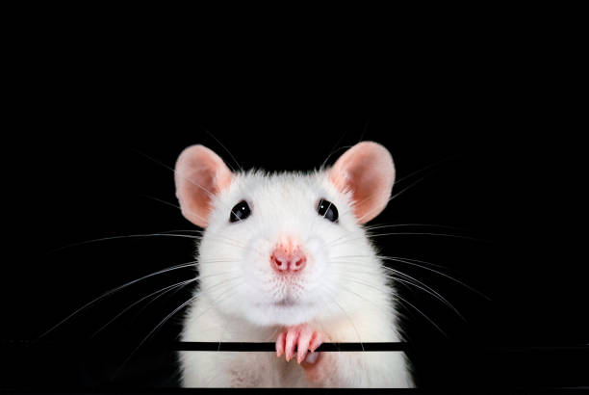
Acknowledgements
A big thanks to:
Renee Tsolis, PhD
Aurore Demars, PhD
Tsolis Lab
Baumler Lab
Financial support was provided by the Students Training in Advanced Research (STAR) Program (SG) and NIH grant R01AI112949 (RT, AD)

Slide 33
Notes:
Other mutants – in vivo

Slide 34
Notes:
Other mutants - itaconate

Slide 35
Solid = 0 mM Itaconate
Striped = 8 mM Itaconate

