Slide 1
Pharmacokinetics of grapiprant and effects on TNF-alpha concentrations following oral administration to horses
Silke L. Hoffmann, Russell W. Baden, Dan S. McKemie, Philip H. Kass, Heather K. Knych
K.L. Maddy Equine Analytical Pharmacology Lab, School of Veterinary Medicine, University of California Davis

Slide 2
introduction
Non-steroidal anti-inflammatory (NSAID) therapy is centric to equine-medicine due to prevalence of equine musculoskeletal-related diseases and pathologies
Grapiprant usage is currently approved only in canines
Well tolerated and effective
Previous reports describe the pharmacokinetics of grapiprant following low dose administration to horses¹
Pharmacodynamic effects not characterized
¹ Knych et al (2018) Drug Test Anal, 10, 1237-1233

Slide 3
Arachidonic Acid pathway
Arachidonic Acid
EP₁
PGE₂ inhibits TNF-⍺ secretion
EP₂
PGE₂
COX 1
EP₃
-constitutive
-normal functions
5-lipoxygenase (LOX)
Cyclooxygenase (COX)
PGH₂
EP₄
COX 2
Grapiprant
-inducible
Inflammation, pain, fever

Slide 4
Study Objectives
Hypothesis: Oral administration of grapiprant will result in a significant increase in TNF-alpha concentrations, compared to baseline, following oral administration to horses
Describe the pharmacokinetics of grapiprant following administration of a single dose of 15 mg/kg to horses
Describe the magnitude and duration of the pharmacodynamic effect of grapiprant using an ex vivo inflammatory model and assessment of TNF-alpha concentrations

Slide 5
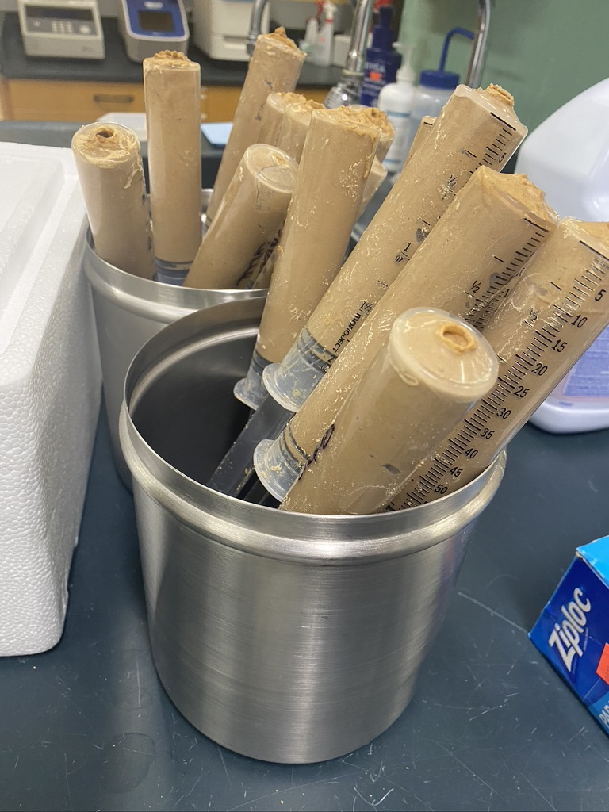
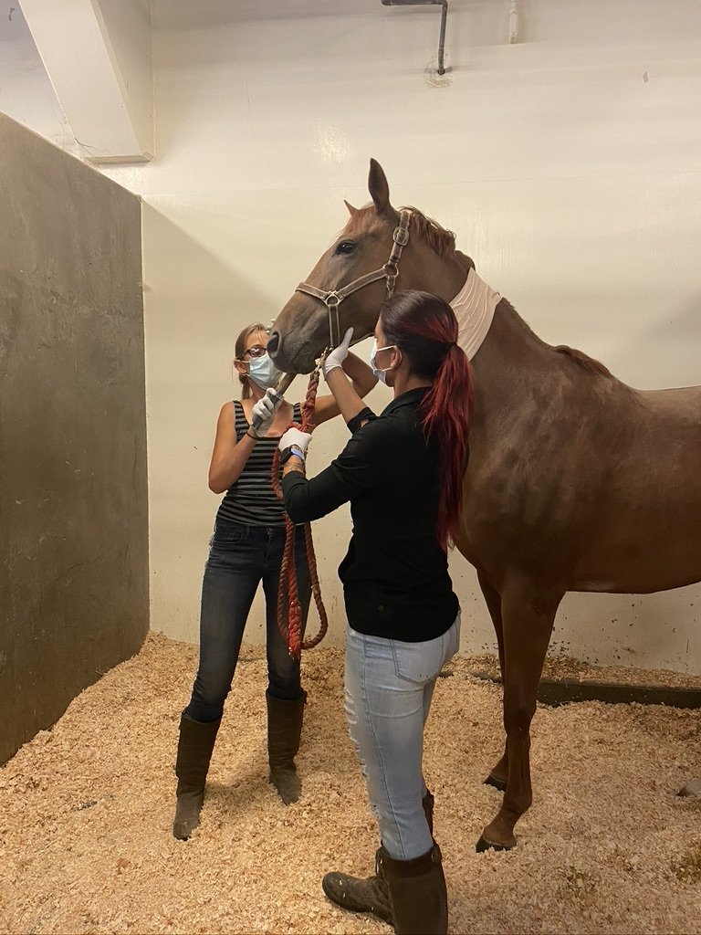
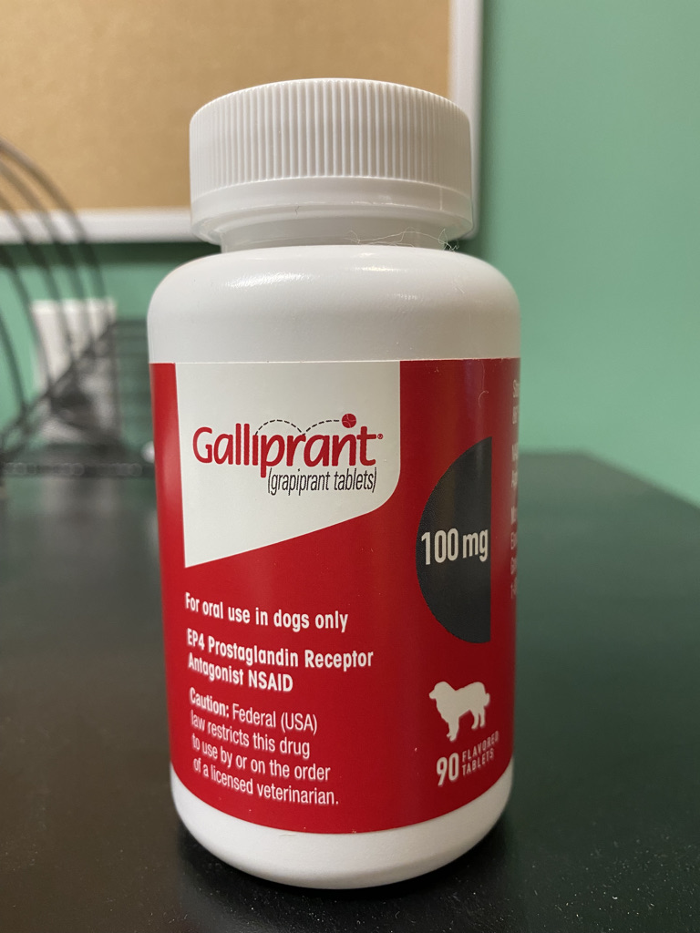
Experimental Design
8 healthy, exercised thoroughbreds
4 mares, 4 geldings
4 - 8 years old
Single oral administration of 15mg/kg grapiprant (Galliprant®)
Blood samples for concentration determination:
Prior to until 96 hours post administration

Slide 6
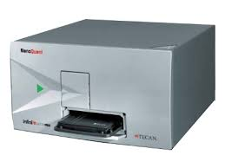
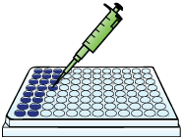
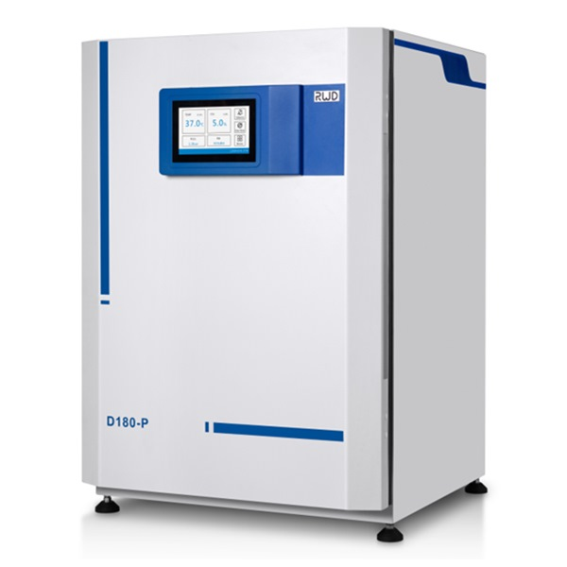
Experimental Design
Sample collected into heparin tube
Spiked with PGE₂ and lipopolysaccharide (LPS) to simulate an inflammatory response
Plasma collected and TNF-⍺ concentrations determined via ELISA
Statistical Analysis
ANOVA to compare post drug administration to baseline
PGE2 + LPS

Slide 7
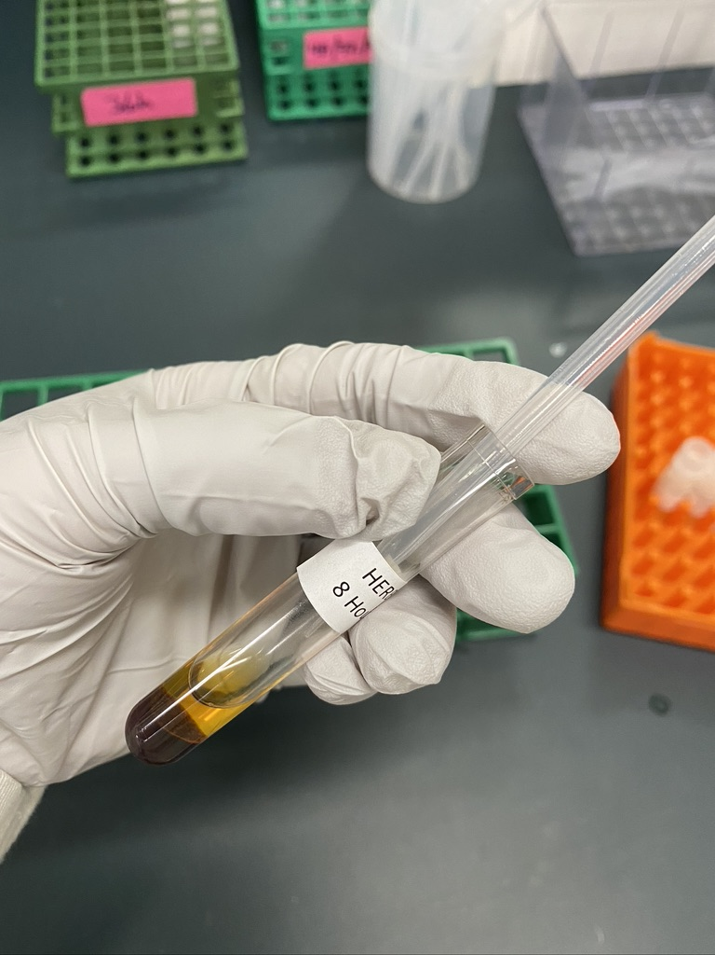
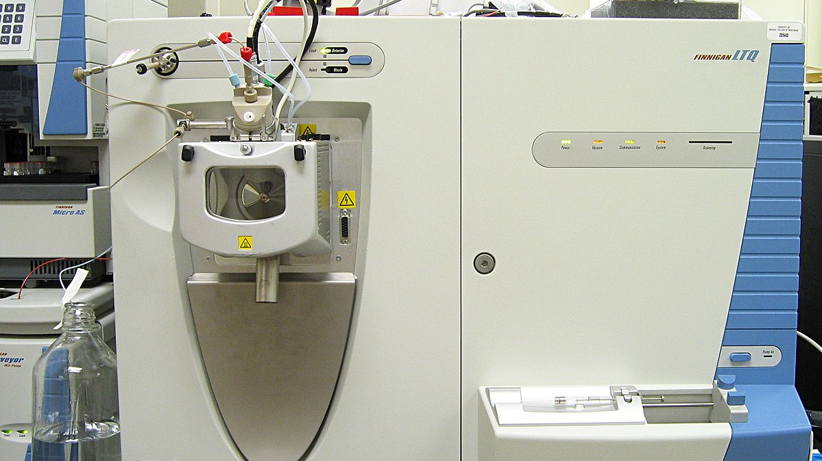
Experimental Design
Plasma Grapiprant concentration analyzed with liquid chromatography-tandem mass spectrometry
Pharmacokinetic analysis:
Phoenix Winnonnlin tool

Slide 8
Results – Grapiprant Concentrations

Slide 9
RESULTS – Pharmacokinetic Parameters
Maximum grapiprant concentration (Cmax) : 327.5 ng/mL
Range: 188.4-663.0 ng/mL
Time to maximum concentration (Tmax): 1 hour
Range: 0.75-2.0 hours
Area under the curve: 831.8 h*ng/mL
Range: 512.6-1421.6 h*ng/mL
Terminal half life: 11 hours
Range: 8.27-21.2 hours

Slide 10
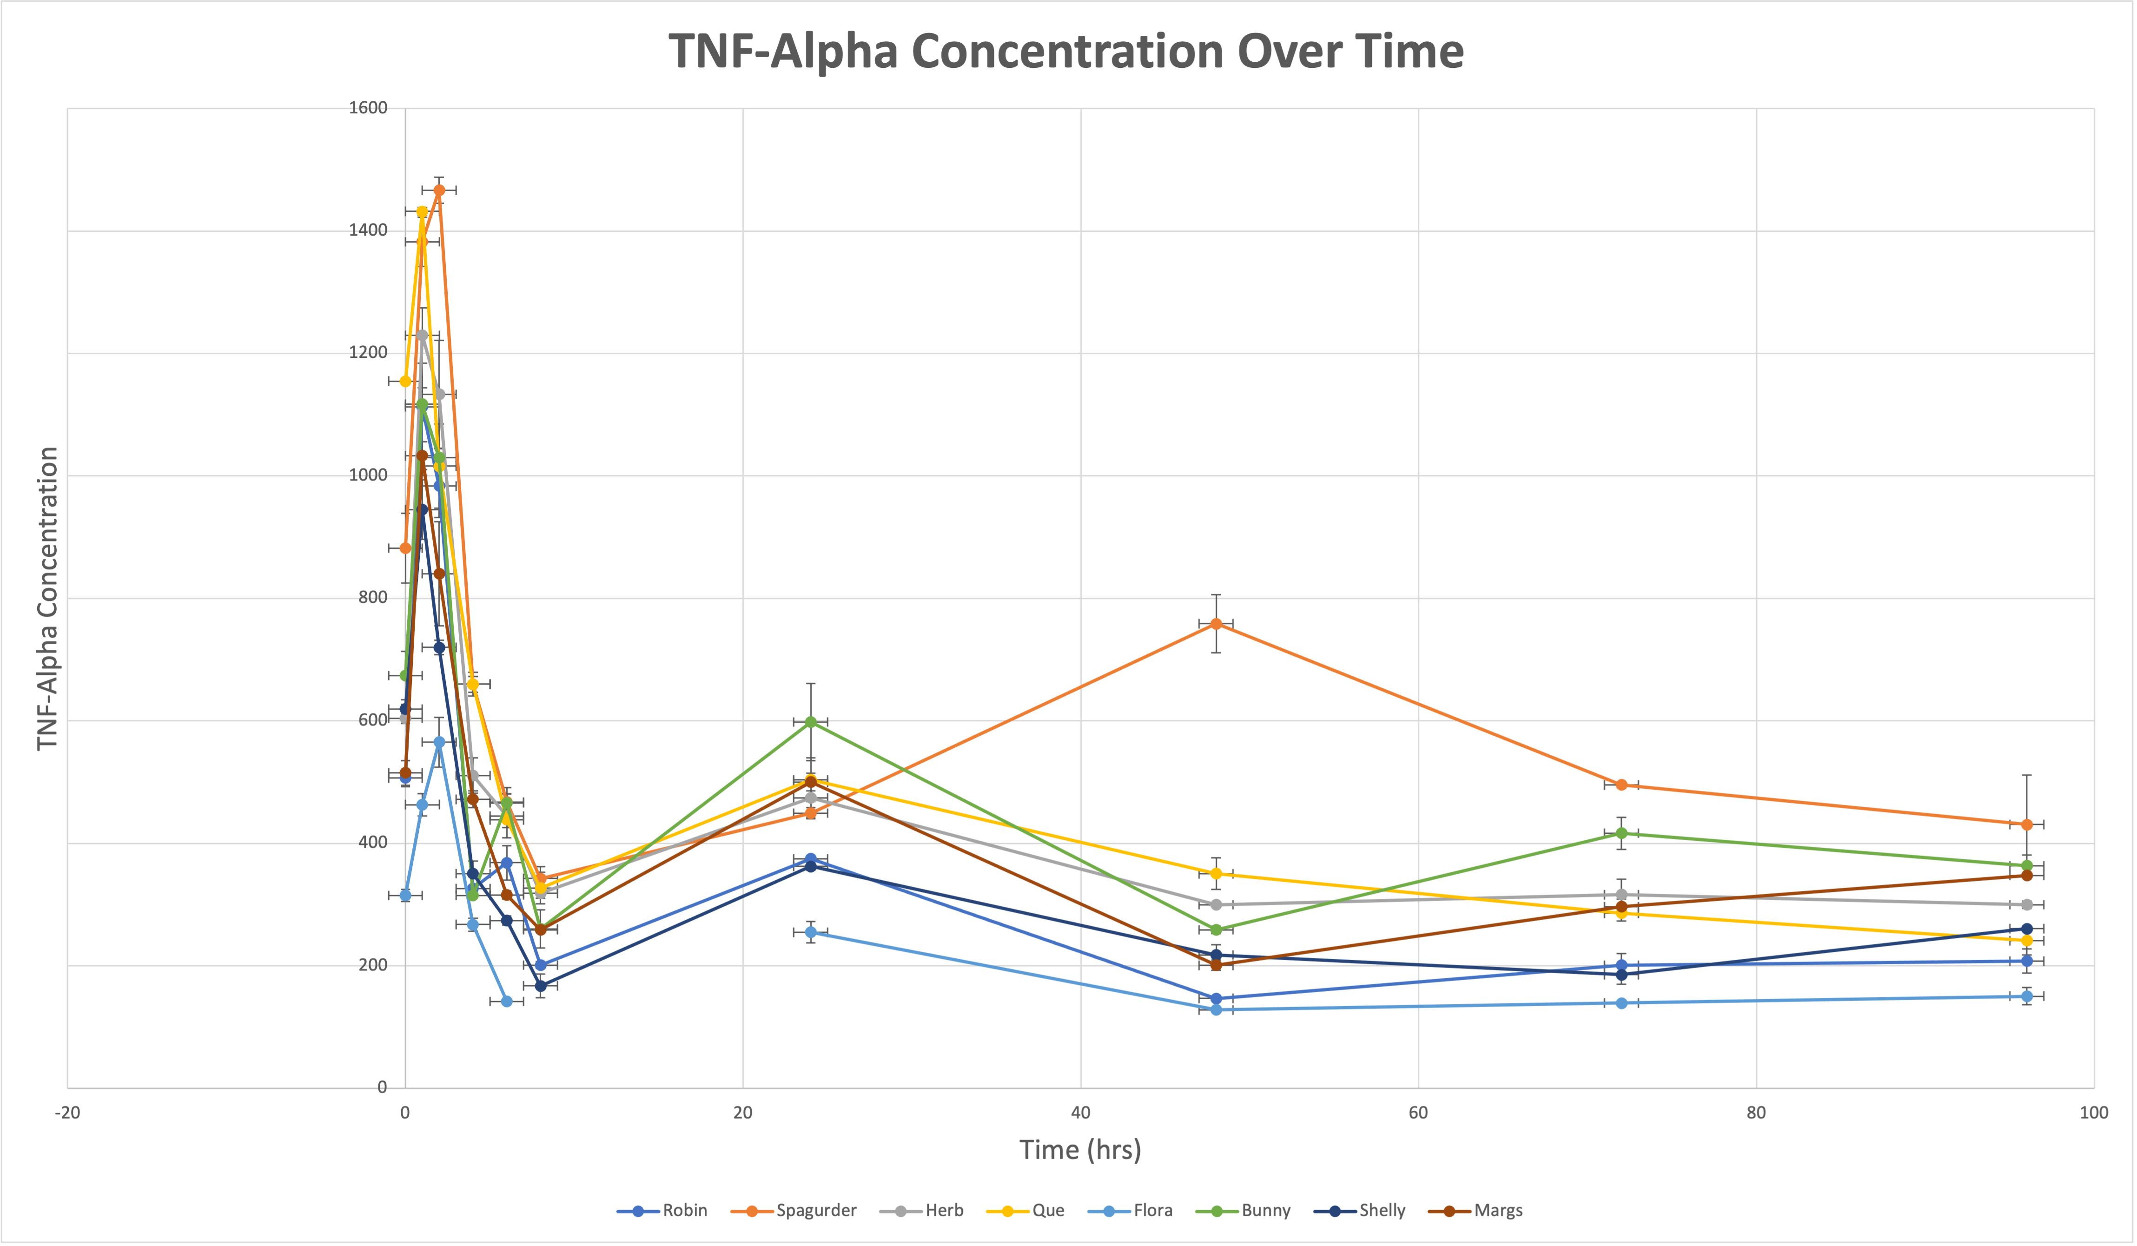

Slide 11
Results – TNF alpha Concentrations

Slide 12
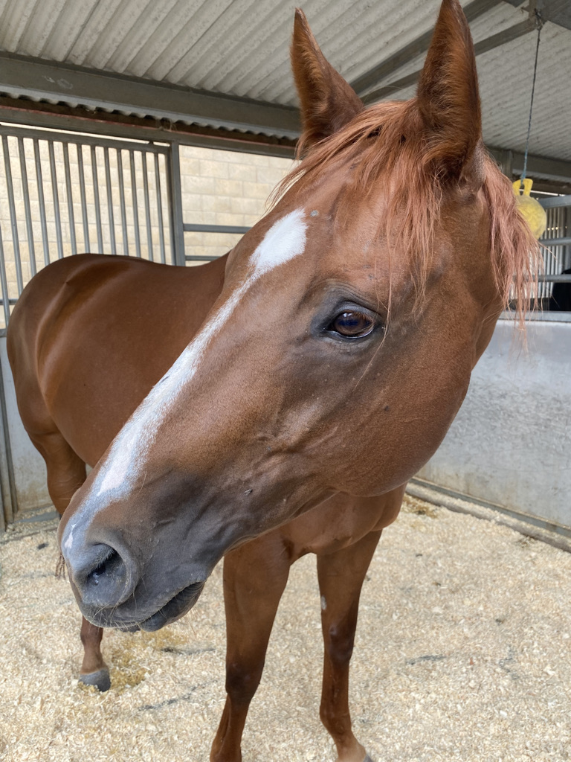
Conclusion/future direction
Significant inhibition of the PGE₂ EP₄ receptor for 2 hours post-drug administration
Anti-inflammatory effect for 2-4 hours
Future direction
Test higher or multiple doses to try to maintain an effective concentration for a longer time period

Slide 13
Acknowledgments
Special thanks to Dr. Knych, Dr. Kass, the National Institute of Health (NIH), Dr. Pessah, and the UC Davis STAR program
Technical Staff
Russell Baden
Dan McKemie
Stacy Steinmetz
Kelsey Sminoff
Kirsten Kanarr
Sandy Yin-Yim

Slide 14
Questions???
Notes:
A couple of suggestions for questions slides-don’t feel like you have to use these at all☺

