Slide 1
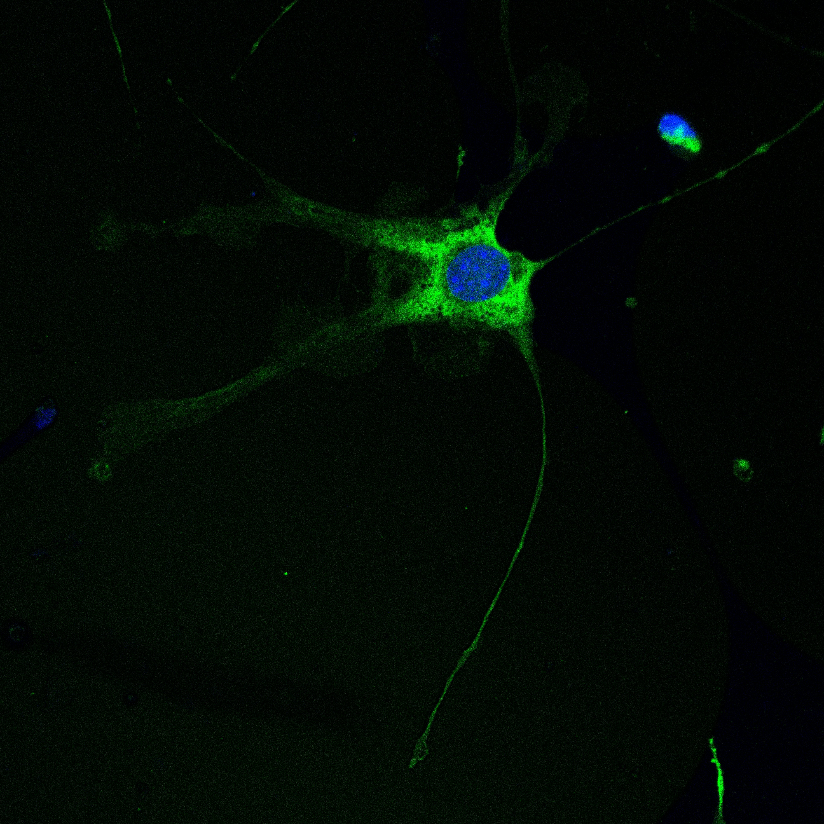
The effect of microglia-derived olfactomedin-like 3 on primary mouse brain endothelial cell angiogenesis
Laila Joseph

Slide 2
The Toedebusch Lab
Studying the role of microglia within glioma
  Most common primary brain tumor in humans
  Second most common primary brain tumor in dogs
  Key feature is new blood vessel formation (angiogenesis)

Slide 3
Background
Microglia are recruited into the tumor microenvironment
Under the influence of TGF-β1 microglia increase tumor growth
9-fold increase in olfactomedin-like 3 (OLFML3) within glioma (The Cancer Genome Atlas)
OLFML3 is a novel secreted glycoprotein
Preliminary data
  Olfml3 direct target gene of TGF-β1 within microglia
  Only microglia increase Olfml3 expression in response to TGF-β1
  Recombinant OLFML3 (rOLFML3) increases immortalized mouse brain endothelial cell (EC) tube formation

Slide 4
Hypothesis
TGF-β1 induced microglia derived olfactomedin-like 3 increases primary mouse brain endothelial cell angiogenesis

Slide 5
Importance
Anti-VEGF therapy within glioma still results in new blood vessel formation
VEGF independent mechanisms of angiogenesis exist
OLFML3 could be a therapeutic target in conjunction with VEGF to reduce tumor vascularization

Slide 6
Aim 1: Determine whether recombinant OLFML3 (rOLFML3) is sufficient for angiogenesis in primary mouse brain endothelial cells (ECs)
Mock treated endothelial cells
1ng/ml rOLFML3
(low dose)
10ng/ml rOLFML3
(high dose)
Evaluate phases of angiogenesis
  Proliferation, migration and tube formation assays

Slide 7
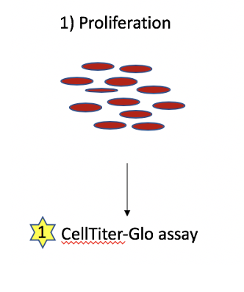
rOLFML3 had a dose-dependent effect on EC proliferation
1
Statistical analysis performed using a One-way ANOVA and a Tukey multiple comparisons post hoc test where* p < 0.05, **** p < 0.0001

Slide 8
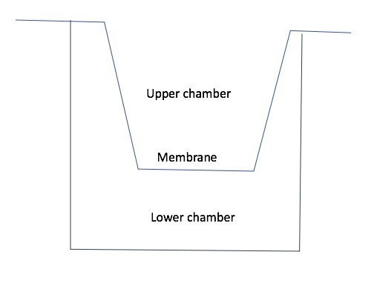
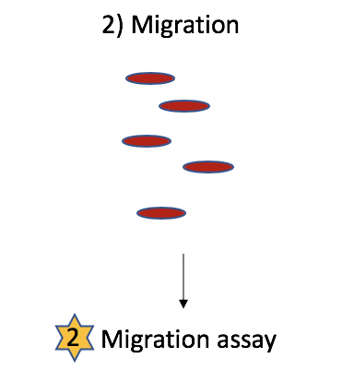
rOLFML3 increased migration in primary ECs
2
Representative image of migration
50 μc
Statistical analysis performed using a One-way ANOVA and a Tukey multiple comparisons post hoc test where* p < 0.05

Slide 9
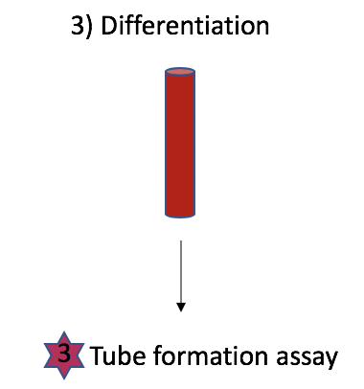
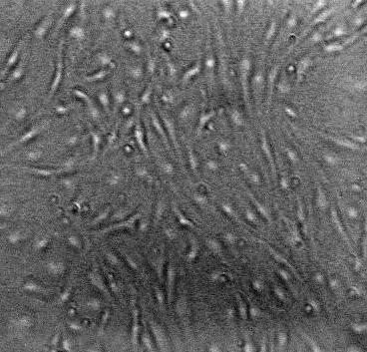
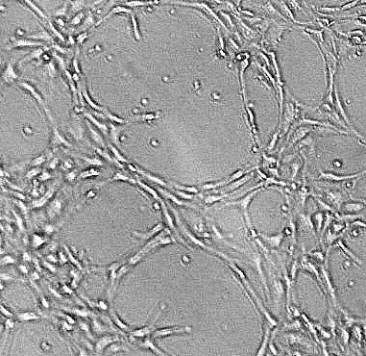
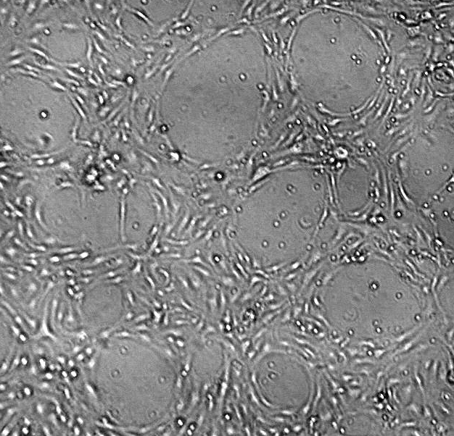
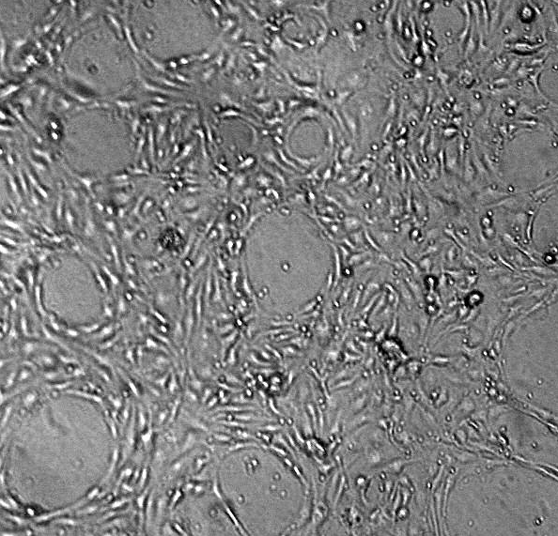
rOLFML3 affected tube formation morphology
3
Monolayer of ECs
Untreated
Low dose rOLFML3
High dose rOLFML3
50 μM
50 μM
50 μM
50 μM
Tubes are 1-4 cell layers thick
Long tubes and branches
Geometric shaped loops
Tubes are 4+ cell layers thick
Shorter tubes
Frequent branching
Loops are smaller and circular
Notes:
Tubes are 4-6 cell layers thick
Shorter tubes
Frequent branching
Loops are smaller and circular

Slide 10
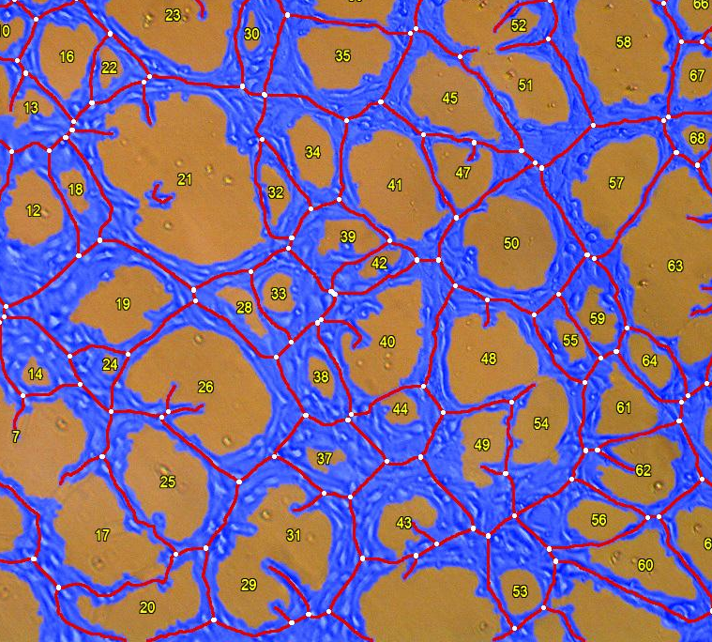
High dose rOLFML3 increased tubes and branching points but decreased mean tube length
3
  Number of tubes
    Sum of purple lines
  Number of branching points
    White dots
  Average tube length
    Average length of purple line between two white dots
Statistical analysis performed using a One-way ANOVA and a Tukey multiple comparisons post hoc test where* p < 0.05, ** p < 0.01

Slide 11
Aim 2: Determine whether conditioned media (CM) from isogenic control (ctl) and Olfml3^{-/-} (KO) microglia differentially increases primary mouse brain EC angiogenesis

Slide 12
Untreated
Treated
Olfml3 knockout microglia
(KO)
TGF-β1
TGF-β1
Olfml3 knockout microglia
(KO β1)
Control microglia
(Ctl)
Control microglia
(Ctl β1)
Untreated conditioned media
(contains OLFML3)
Untreated conditioned media
(no OLFML3)
Treated conditioned media
(contains ↑ OLFML3)
Treated conditioned media
(no OLFML3)
Endothelial cells
Endothelial cells
Endothelial cells
Endothelial cells

Slide 13
Assumptions
Ctl CM contains OLFML3
KO CM does not contain OLFML3
TGF- β1 treated ctl CM should contain more OLFML3 than untreated ctl CM
(experiments in progress to support assumptions)

Slide 14
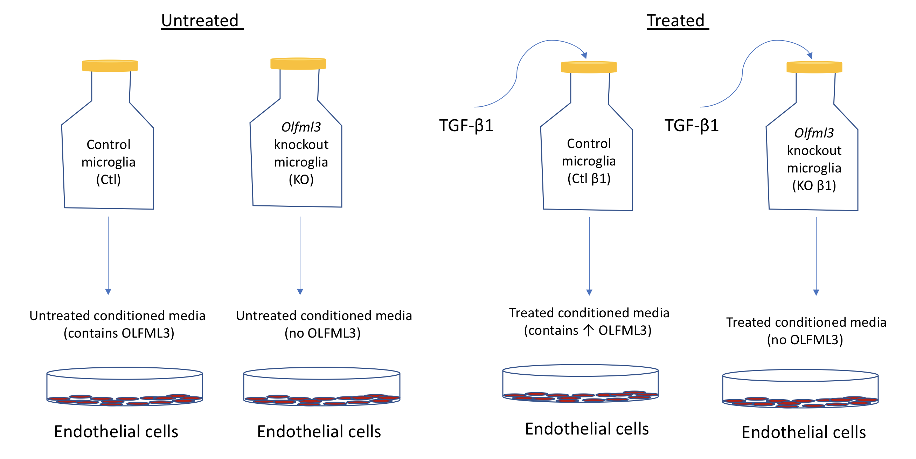
Untreated KO and treated ctl decreased proliferation and migration
1
2
Statistical analysis performed using a One-way ANOVA and a Tukey multiple comparisons post hoc test where * p < 0.05, ** p < 0.01, *** p < 0.001

Slide 15
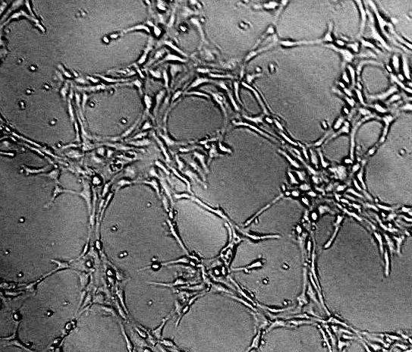
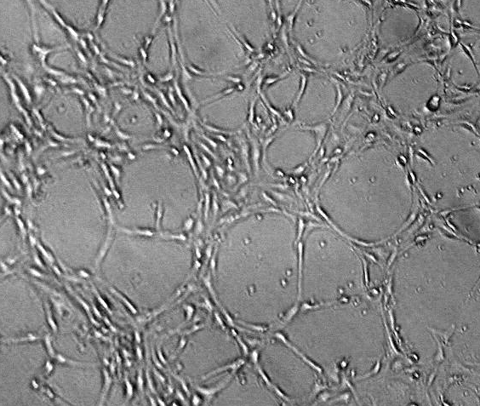
Untreated KO did not affect tube formation relative to untreated ctl
3
ECs treated with control microglia CM
ECs treated with Olfml3^{-/-} microglia CM
50 μM
50 μM

Slide 16
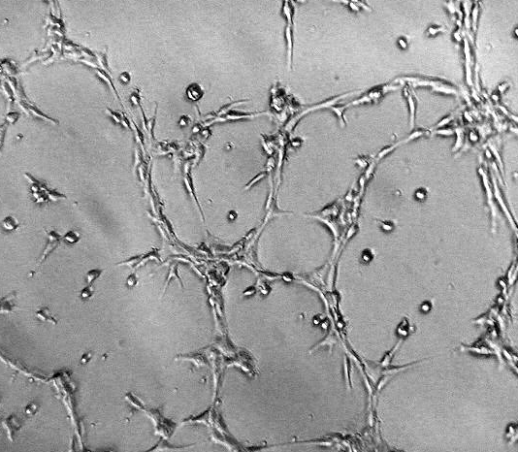
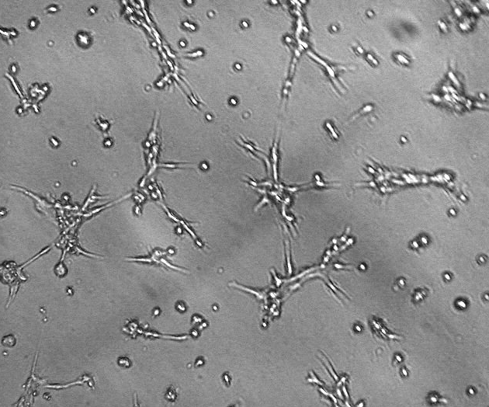
Treated ctl and treated KO reduced EC tube formation relative to untreated ctl
3
ECs cultured in TGF-β1 treated control microglia CM
ECs cultured in TGF-β1 treated Olfml3^{-/-} microglia CM
50 μM
50 μM

Slide 17
TGF-B1 pre-treatment decreases EC differentiation
3
Statistical analysis performed using a One-way ANOVA and a Tukey multiple comparisons post hoc test where ** p < 0.01, *** p < 0.001, **** p < 0.0001

Slide 18
Interpretation
The effect of OLFML3 on all phases of angiogenesis is complex and variable
The effect of OLFML3 on angiogenic parameters may be dose-dependent
  Too much or not enough → decrease in angiogenic parameters
  Just enough → increase in angiogenic parameters
  Possible homeostatic function

Slide 19
Future directions
Confirm that OLML3 secretion is increased following TGF-β1
Quantify how much OLFML3 is in the media
Assess secretome of KO microglia following TGF-β1 treatment
  May be compensatory pathways upregulated in response to TGF-β1 that results in no change in proliferation or migration of ECs

Slide 20
Thank you

Slide 21
Acknowledgements
Financial support was provided by the Students Training in Advanced Research (STAR) Program
Student support provided by NIH-T35 training grant

Slide 22
Questions?

