Slide 1
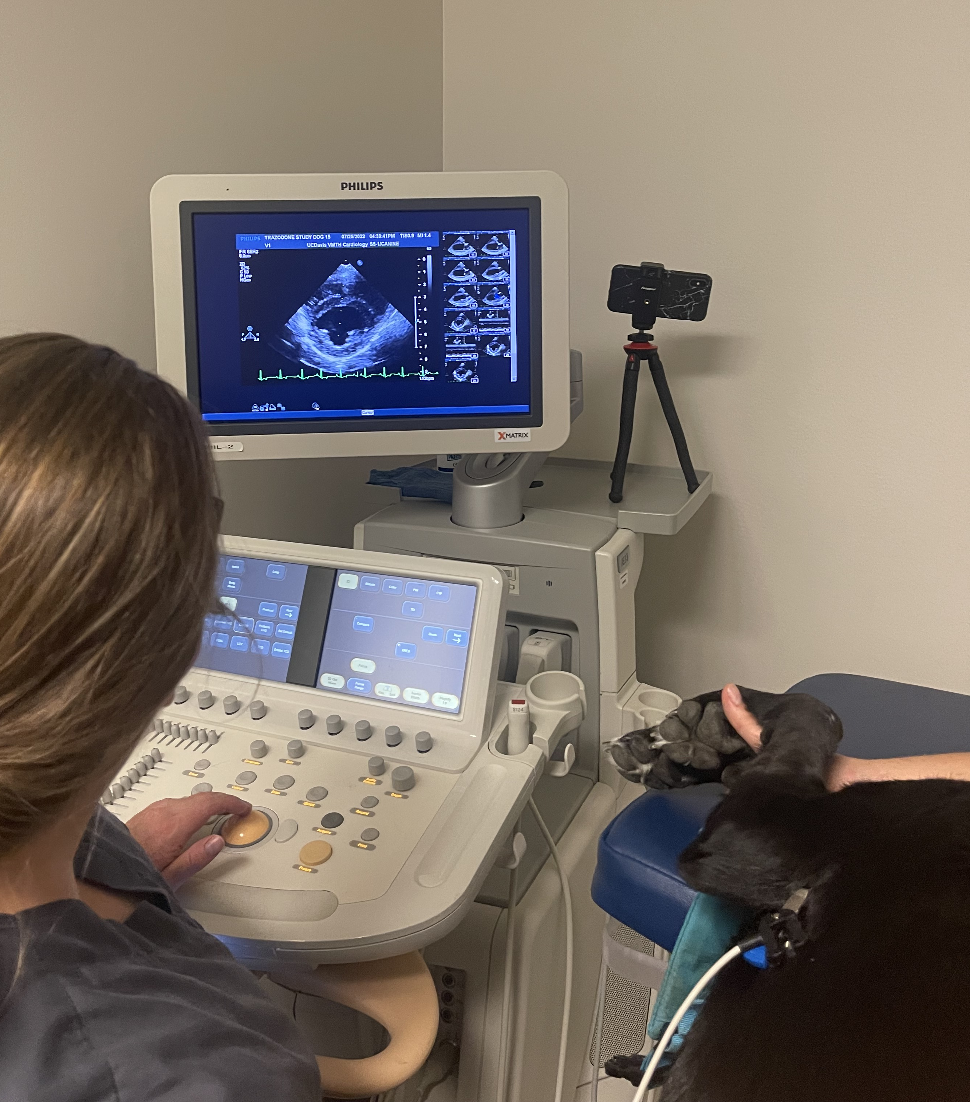
Echocardiographic Effects of Oral Trazodone on Left Ventricular Function in Healthy Dogs.
Lauren Quigley

Slide 2
What is “FAS”? How do we reduce it?
FAS =
Fear, anxiety, stress
Vet visits =
Increased FAS
Low noise environments
Low stress handling techniques
Use of food
Anti-anxiety medications
Trazodone is commonly used extra-label as a short-acting, oral medication in dogs for anxiety, post-surgical confinement, and mild sedation for veterinary visits
Notes:
Mention fear free
FAS causes incomplete diagnostics, behavioral/cardiovascular/endocrine changes, risk to patients and staff, lowered chance of owners bringing their dog back to the vet (bain)
Pre print trazodone paper - Randomized placebo-controlled clinical trial on the effects of trazodone on behavioral and physiologic signs of stress in dogs during veterinary visits (Kim, 2022)
A review of pre appointment medications to reduce fear and anxiety in dogs and cats at vet visits (Erickson, 2021)

Slide 3
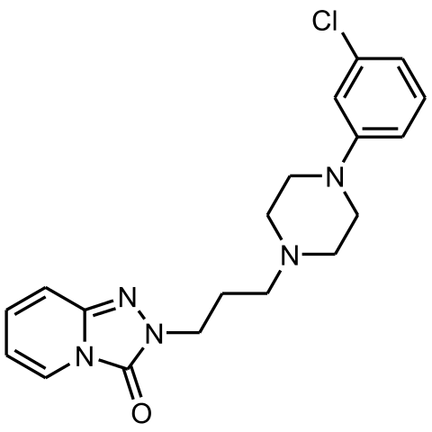
Trazodone Basics
Great potential for echocardiograms on anxious dogs
Antagonizes
5-HT2A R and
a1 adrenergic R
Prevent serotonin reuptake
Mild sedation, stress reduction
Trazodone
hydrochloride
Well tolerated in dogs
Common side effects are mild
Cost effective
Proven anxiolysis for veterinary visits
Notes:
SARI – serotonin antagonist and reuptake inhibitor
9-12 mg/kg oral dose shown to reduce stress in anxious dogs at the clinic
Pre print trazodone paper - Randomized placebo-controlled clinical trial on the effects of trazodone on behavioral and physiologic signs of stress in dogs during veterinary visits (Kim, 2022)
Effects of trazodone on behavioral signs of stress in hospitalized dogs (Gilbert-Gregory 2016)

Slide 4
What DO we know about trazodone’s cardiac effects?
Species | ROA of trazodone | Echocardiogram? | Major Findings
Dog | IV | No | ↑ QT interval, ↓ BP, ↓ myocardial contractile force, ↓ HR
Dog | Oral | No | No adverse cardiovascular events
Cat | Oral | Yes | ↓BP, No major echocardiographic changes
Human | Oral/IV | No | ↑ QT interval, ventricular tachycardia, arrhythmia
Notes:
Hemodynamic and cardiac actions of trazodone and imipramine in the anesthetized dog (Gomoll, 1979)
Differential Effects of Trazodone and Imipramine on intracardiac conduction in the anesthetized dog (Byrne, 1982) Pharmacokinetics, bioavailability and hemodynamic effects of trazodone after IV and oral admin to dogs (Jay, 2013): Trazodone well tolerated at oral doses 8 mg/kg, no adverse cardiovascular events. IV adverse effects seen show that its more useful orally.
Trazodone and imipramine: comparative effects on canine cardiac conduction (Gomoll, Byrne, 1979)
Trazodone should evidence little to no propensity to promote conduction disturbances (heart block, rhythm irregularities) other than slowing of HR.
Lee S, Lee HA, Kim SJ, Kim KS. Cellular mechanisms for trazodone-induced cardiotoxicity. Hum Exp Toxicol. 2016 May;35(5):501-10. doi: 10.1177/0960327115595683. Epub 2015 Jul 17. PMID: 26187900.
Trazodone dose-dependently decreased the maximum upstroke velocity (Vmax) and prolonged the AP duration, inducing early after depolarizations at 3 and 10 μM that triggered ventricular arrhythmias in hiPSC-CMs. Trazodone also inhibited all of the major ion channels (IKr, IKs, INa, and ICa), with an especially high inhibitory potency on hERG. These data indicate that the prolonged AP duration and decreased Vmax due to trazodone are mainly the result of hERG and sodium ion inhibition, and its inhibitory effects on cardiac ion channels can be exhibited in hiPSC-CMs.
"Ventricular arrhythmias possibly aggravated by trazodone." American Journal of Psychiatry, 140(6), pp. 796–797

Slide 5
Current Research Gap
Research Gap!
Does oral trazodone cause changes in echocardiographic parameters in dogs?
Notes:
Maybe put right side of the slide into speaker notes?
We need to answer this question because trazodone is already commonly used in cardiology diagnostics. If it is changing our results, this could affect accurate diagnoses. Left ventricular function is routinely used to diagnose and stage common heart diseases in dogs such as DCM and MMVD.

Slide 6
Specific Aims and Hypotheses
#1
Determine if trazodone has a significant effect on echocardiographic measurements of left ventricular function.
Hypothesis: No effect
#2
Assess whether trazodone changes patient behavioral parameters.
Hypothesis: Increased compliance/sedation, decreased stress/aggression
#3
Obtain physical exam findings, blood pressure measurements, and ECG data to evaluate for adverse effects of trazodone.
Hypothesis: Changes in QT interval, BP, HR
Notes:
Determine if single oral dose administration of trazodone has a significant effect on echocardiographic measurements of left ventricular function in healthy dogs as compared to placebo.

Slide 7
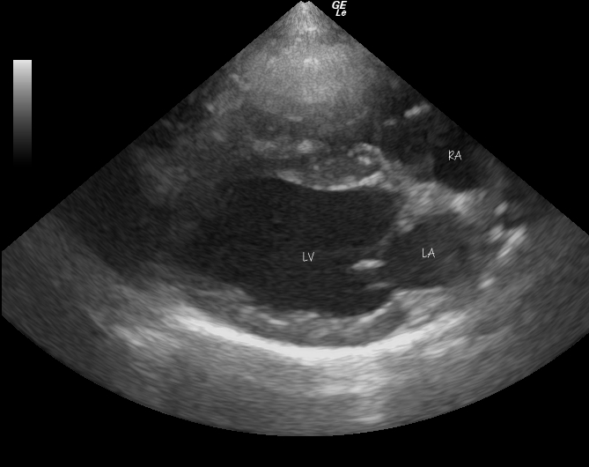
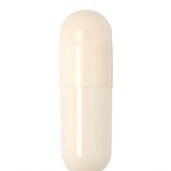
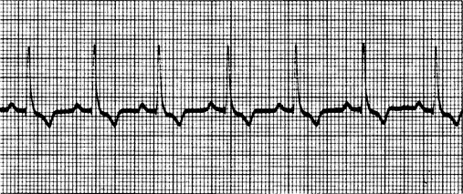
Study Design
Prospective, double-blinded, placebo-controlled, crossover study
15 healthy dogs selected
2 visits: Trazodone or placebo
Data collection and analysis
Notes:
Exclusion criteria: other meds, systemic health problems, 1-9 yo, murmurs ausculted
A prospective, double-blinded, placebo-controlled, crossover study was conducted with 15 client-owned, healthy dogs with mild vet-related anxiety.
Trazodone or placebo capsules were given 90 minutes before departure to the veterinary clinic.
one-way ANOVA (analysis of variance), consulting with CTSC biostatistics team to make final data analysis plans soon

Slide 8
Let’s follow Graham Cracker through a typical study visit!
Given 9-12 mg/kg trazodone or placebo
90 minutes before departure to VMTH

Slide 9
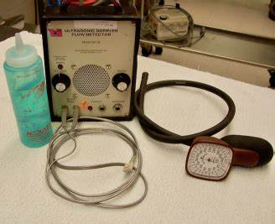
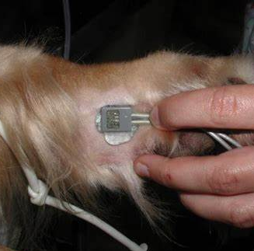
Doppler blood pressure
Right lateral recumbency
5 minutes after entry to exam room
Systolic BP measured in mmHg
5-7 consecutive measurements averaged
Notes:
Pics of each procedure with caption

Slide 10
Echocardiogram
2D Right parasternal long axis 4 chamber view
Measure LVVs and LVVd
Ejection fraction = [(LVVd - LVVs) / LVVd] x 100
RV
RA
LV
LA
Notes:
Talk about ejection fraction – put in equation

Slide 11
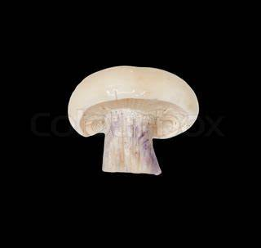
Echocardiogram
Measure LVIDd and LVIDs
Fractional shortening: [(LVIDd-LVIDs)/LVIDd] x 100
2D Right parasternal short axis LV view
M-mode
LV
LVIDs
LVIDd

Slide 12
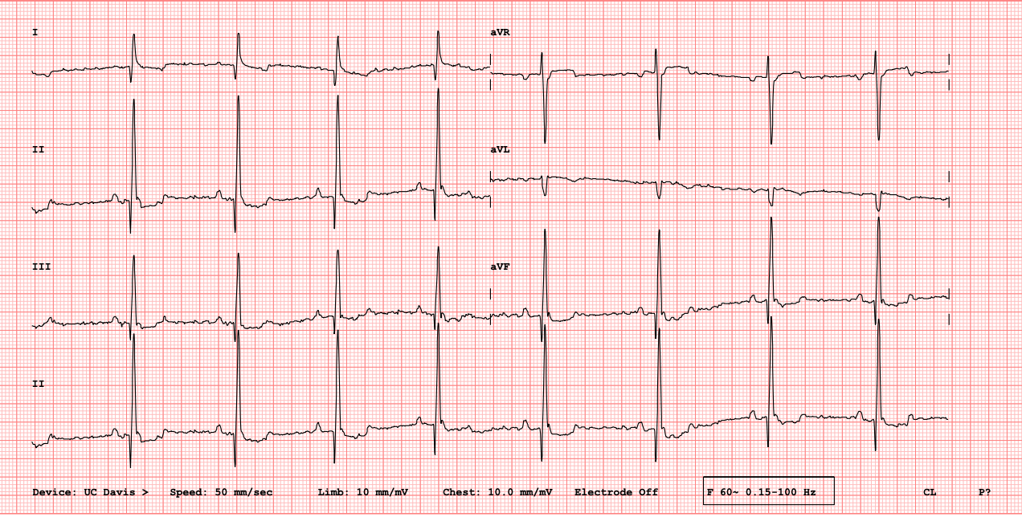
5 minute ECG
5-minute electrocardiogram
PQ interval
QT interval
Notes:
A prolonged PQ interval is a sign of a degradation of the conduction system or increased vagal tone
QT prolongation may increase the risk of developing abnormal heart rhythms and may lead to sudden cardiac arrest.

Slide 13
24-hour Holter monitor
Chest patches shaved
5 electrodes placed
Wrap electrodes with tape
Place vest
24-hour ECG measured
in dog’s home environment
Parameters of interest:
Heart rate variability, ectopy, pauses, arrhythmia, QT interval

Slide 14
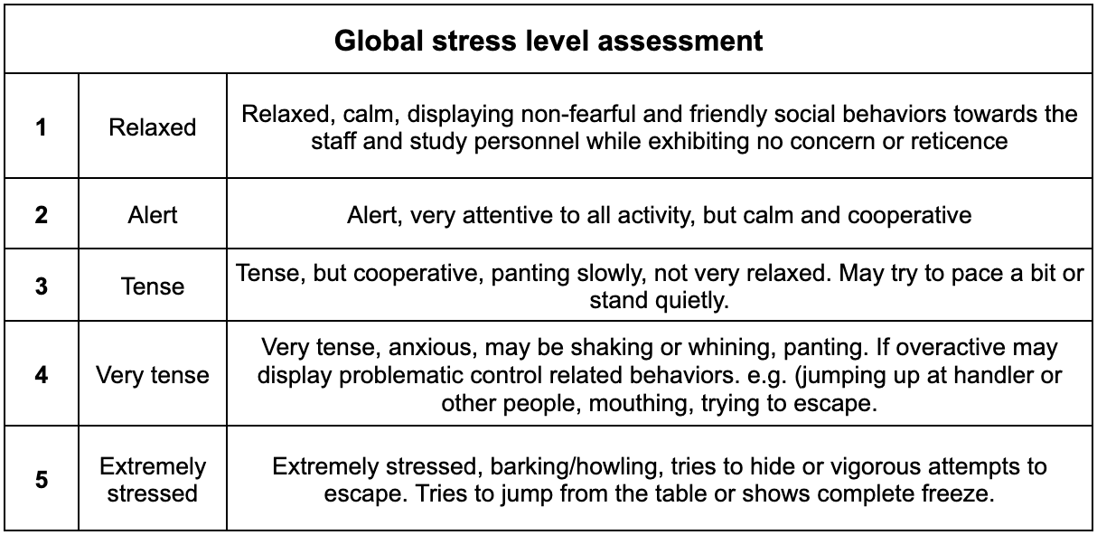
Behavior Analysis
Owner and handler questionnaires +
Video analysis

Slide 15
We’re still blinded…
BUT we have seen differences in:
-Blood pressure
-Heart rate
-Behavioral scores
-QT Interval

Slide 16
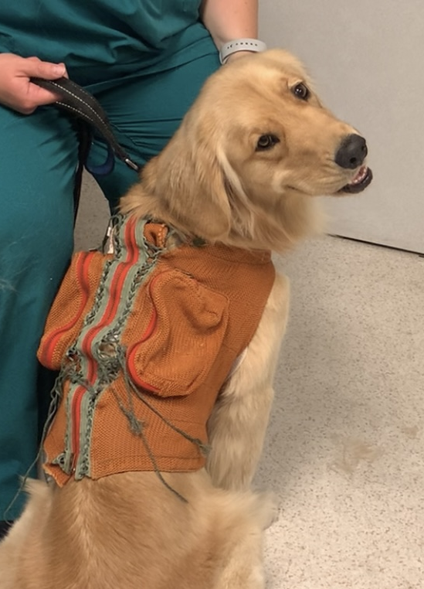
Future Research / Applications
Same study design in dogs with heart disease
Same study design using gabapentin (coming soon)
Notes:
Same study with dogs that have heart disease (humans with mitral prolapse had arrythmia increases with trazodone)

Slide 17
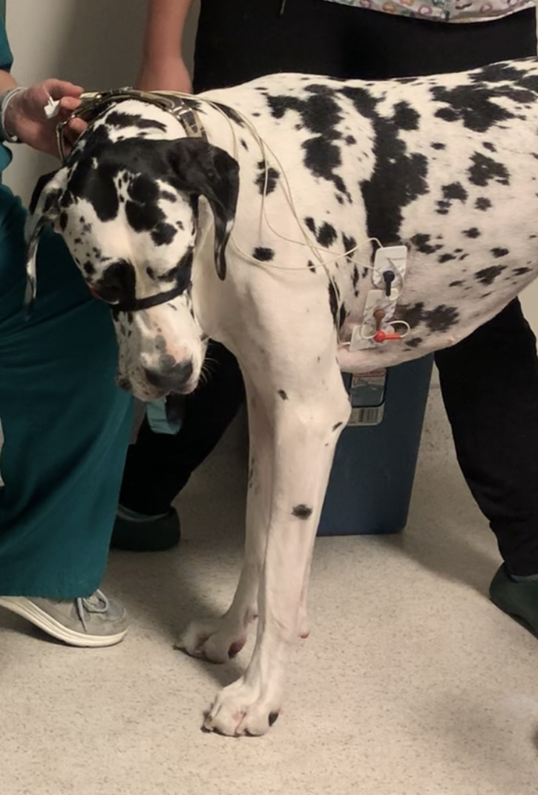
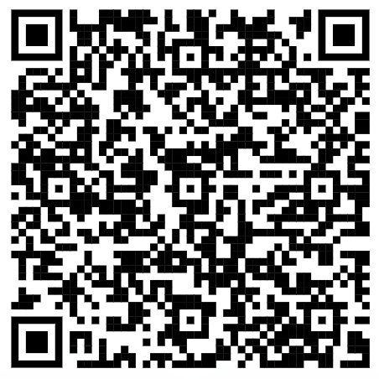
Acknowledgements
STAR program
Fear free
Dr. Gagnon
Dr. Bain
VMTH Cardiology
References:

