Slide 1
Effects of Vitamin E Status on RORα and LXR Expression in Dorsal Root Ganglion Neurons of Young Mice
Megan Rivera and Dr. Carrie Finno

Slide 2
Introduction
Vitamin E: fat-soluble vitamin that is an important antioxidant
Ataxia with vitamin E deficiency (AVED)
Mutations in TTPA
Symptoms localize to the dorsal root ganglia (DRG)
Nuclear receptors: ligand-regulated transcription factors that are activated by lipid-soluble signals, regulating lipid metabolism
RORα and LXR

Slide 3
Rationale
Approximately 90% of Americans do not meet the recommended intake requirements for vitamin E
Possible subclinical effects
Previous studies focus on cerebrum and cerebellum and include individuals that already show clinical signs
Molecular dysregulation begins in spinal cord
1- and 6-month-old mice
Sex effects have not been evaluated

Slide 4
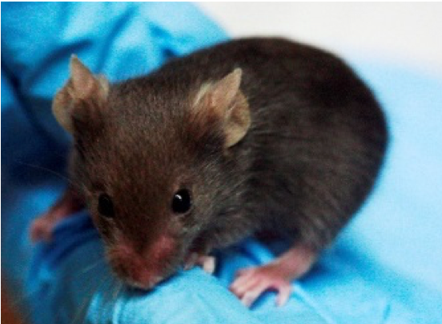
Hypothesis
Decreased vitamin E intake early in life results in altered nuclear receptor signaling of RORα and LXR within murine DRG

Slide 5
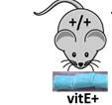
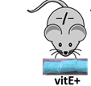
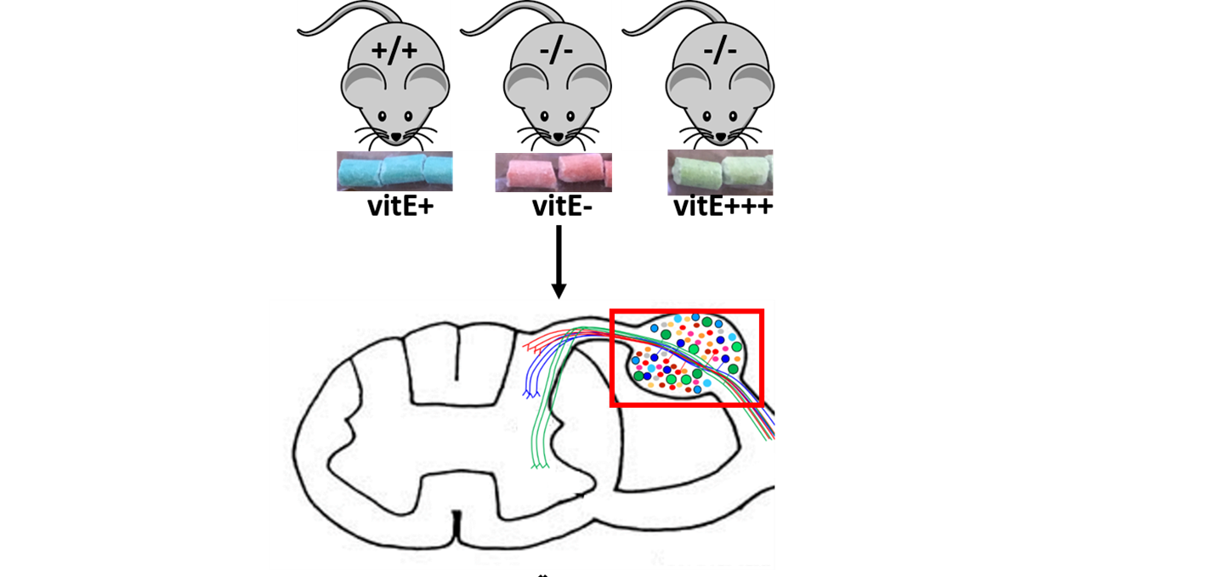
Methods
Ttpa-null mouse model
Isolated RNA from mice DRG, synthesized cDNA
Executed qRT-PCR for Rora, Nr1h3, and Nr1h2
FC analyses performed for the groups
Parametric and nonparametric statistical analyses
1-month
6-month

Slide 6
Results
Rora (encodes RORα) or Nr1h3 (LXRα)- no significant differences

Slide 7
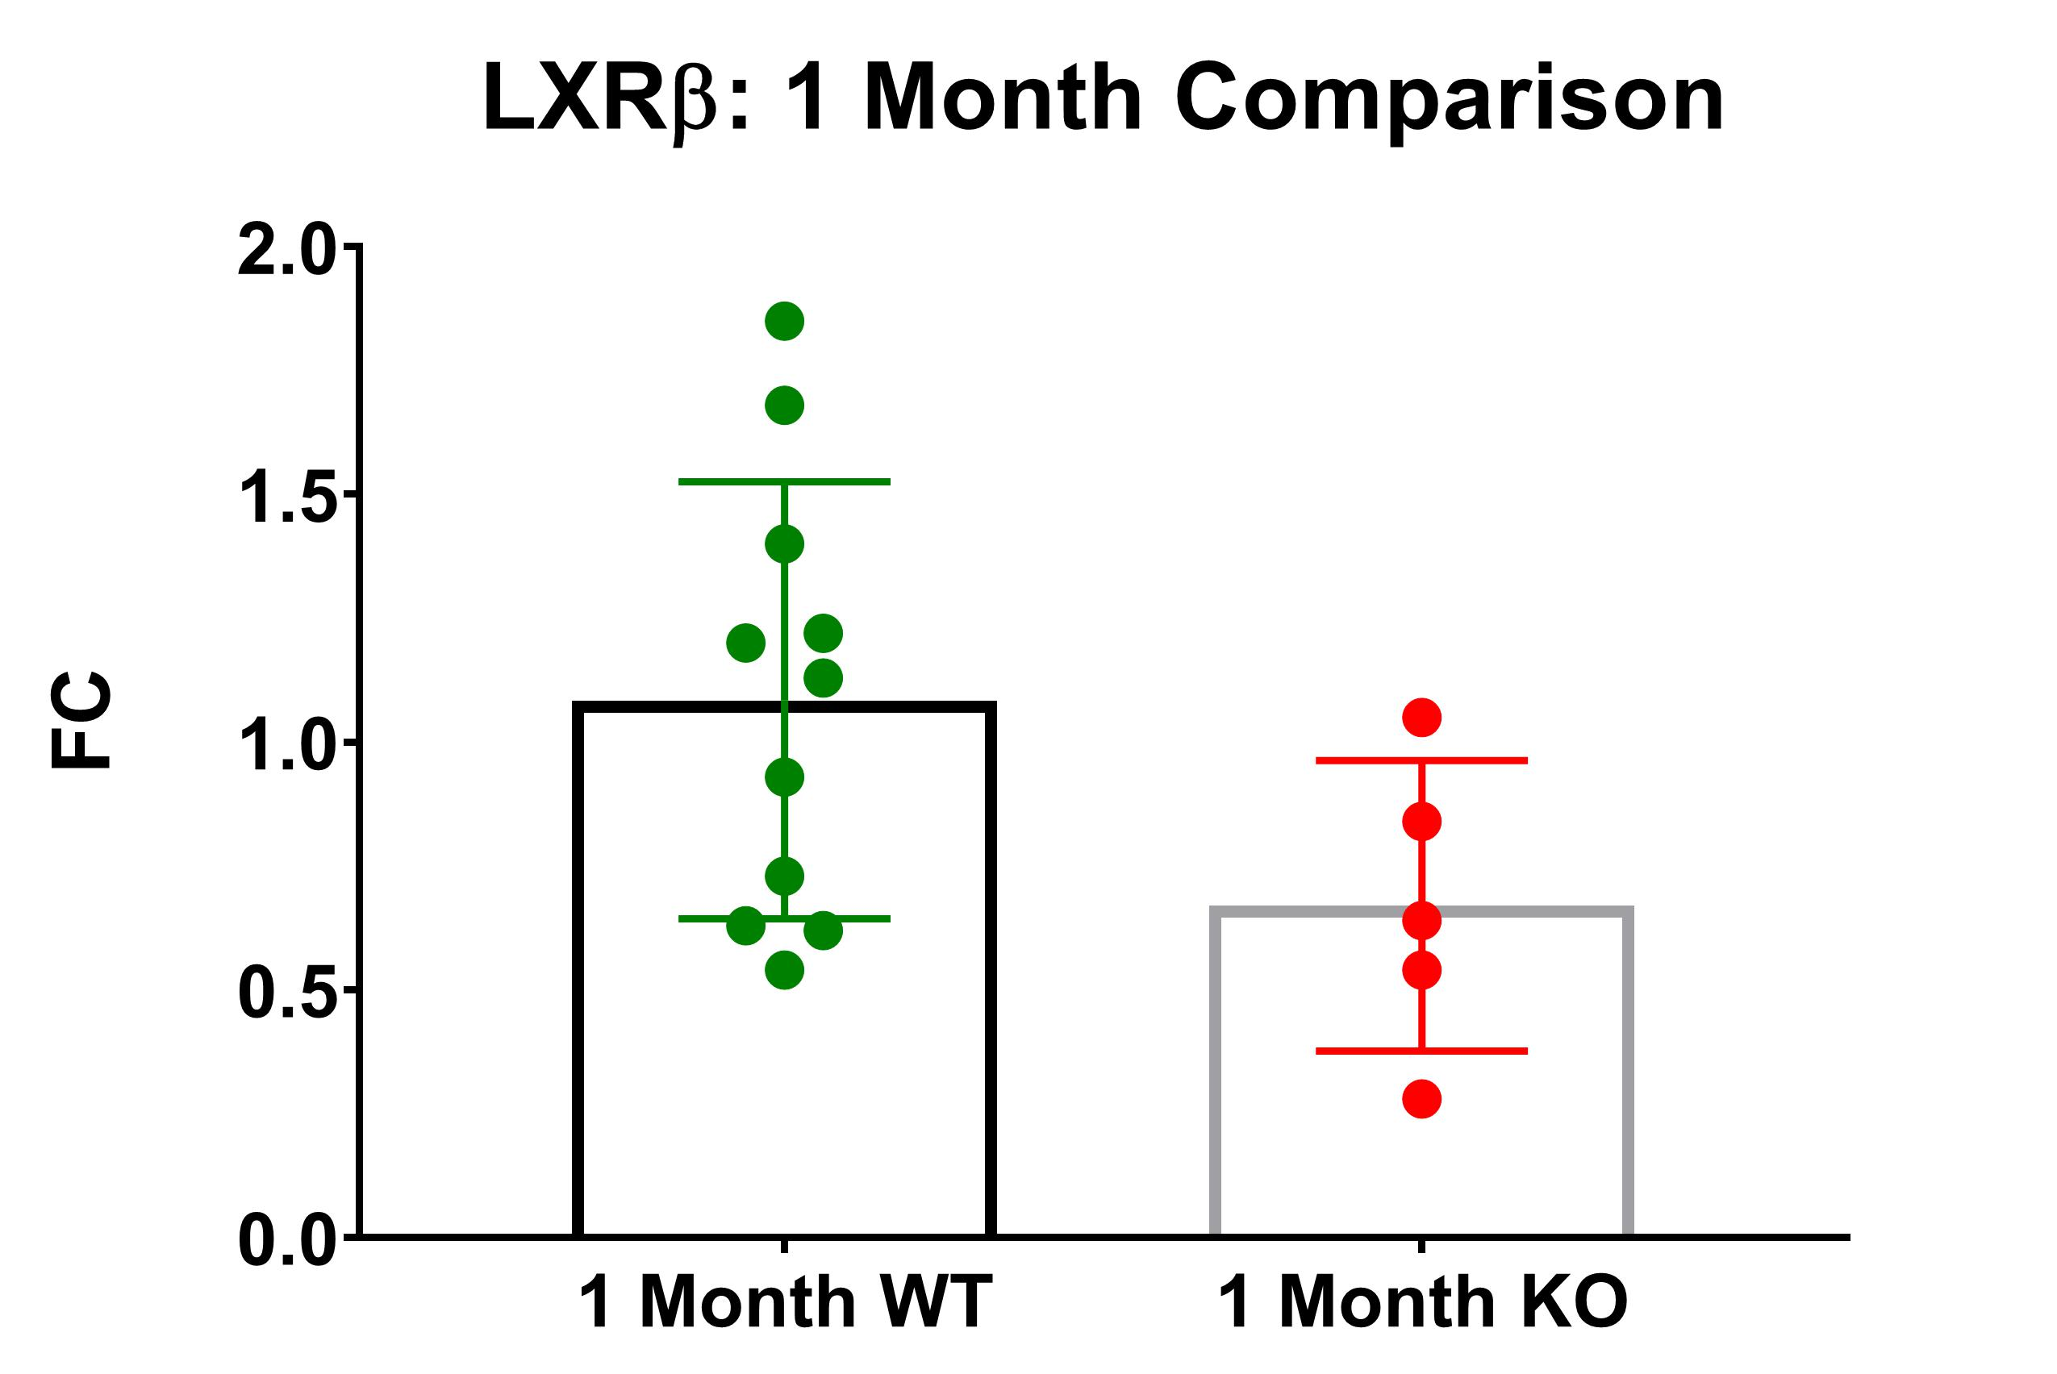
Results
No significant difference between 1-month-old mice in expression levels of Nr1h2 (LXRβ)

Slide 8
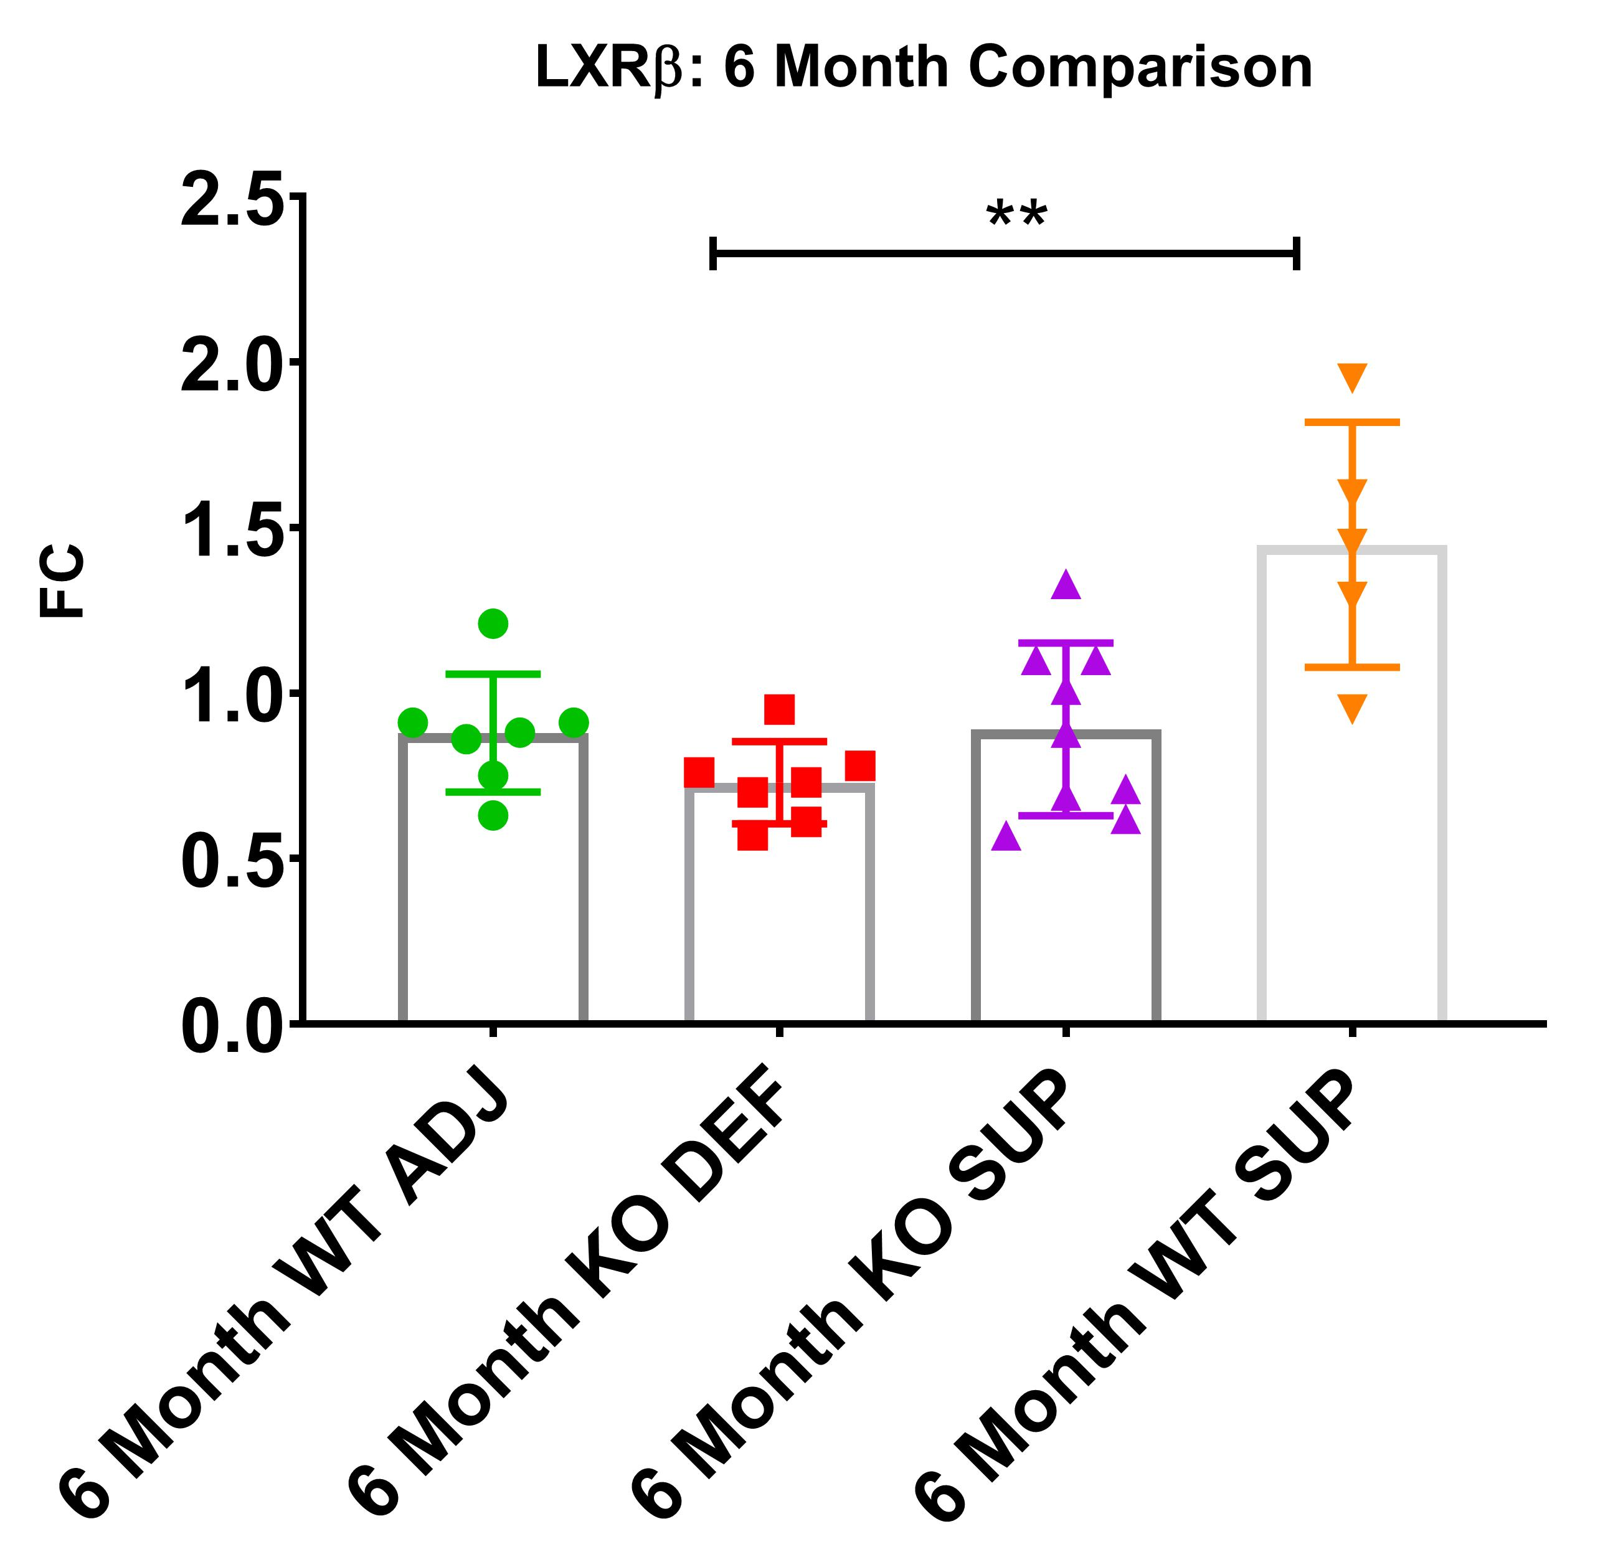
Results
Significant difference between 6-month-old mice (p=0.006) in expression levels of Nr1h2 (LXRβ)
Ttpa^{+/+} supplemented and Ttpa^{-/-} deficient
**: p-value is less than or equal to .01

Slide 9
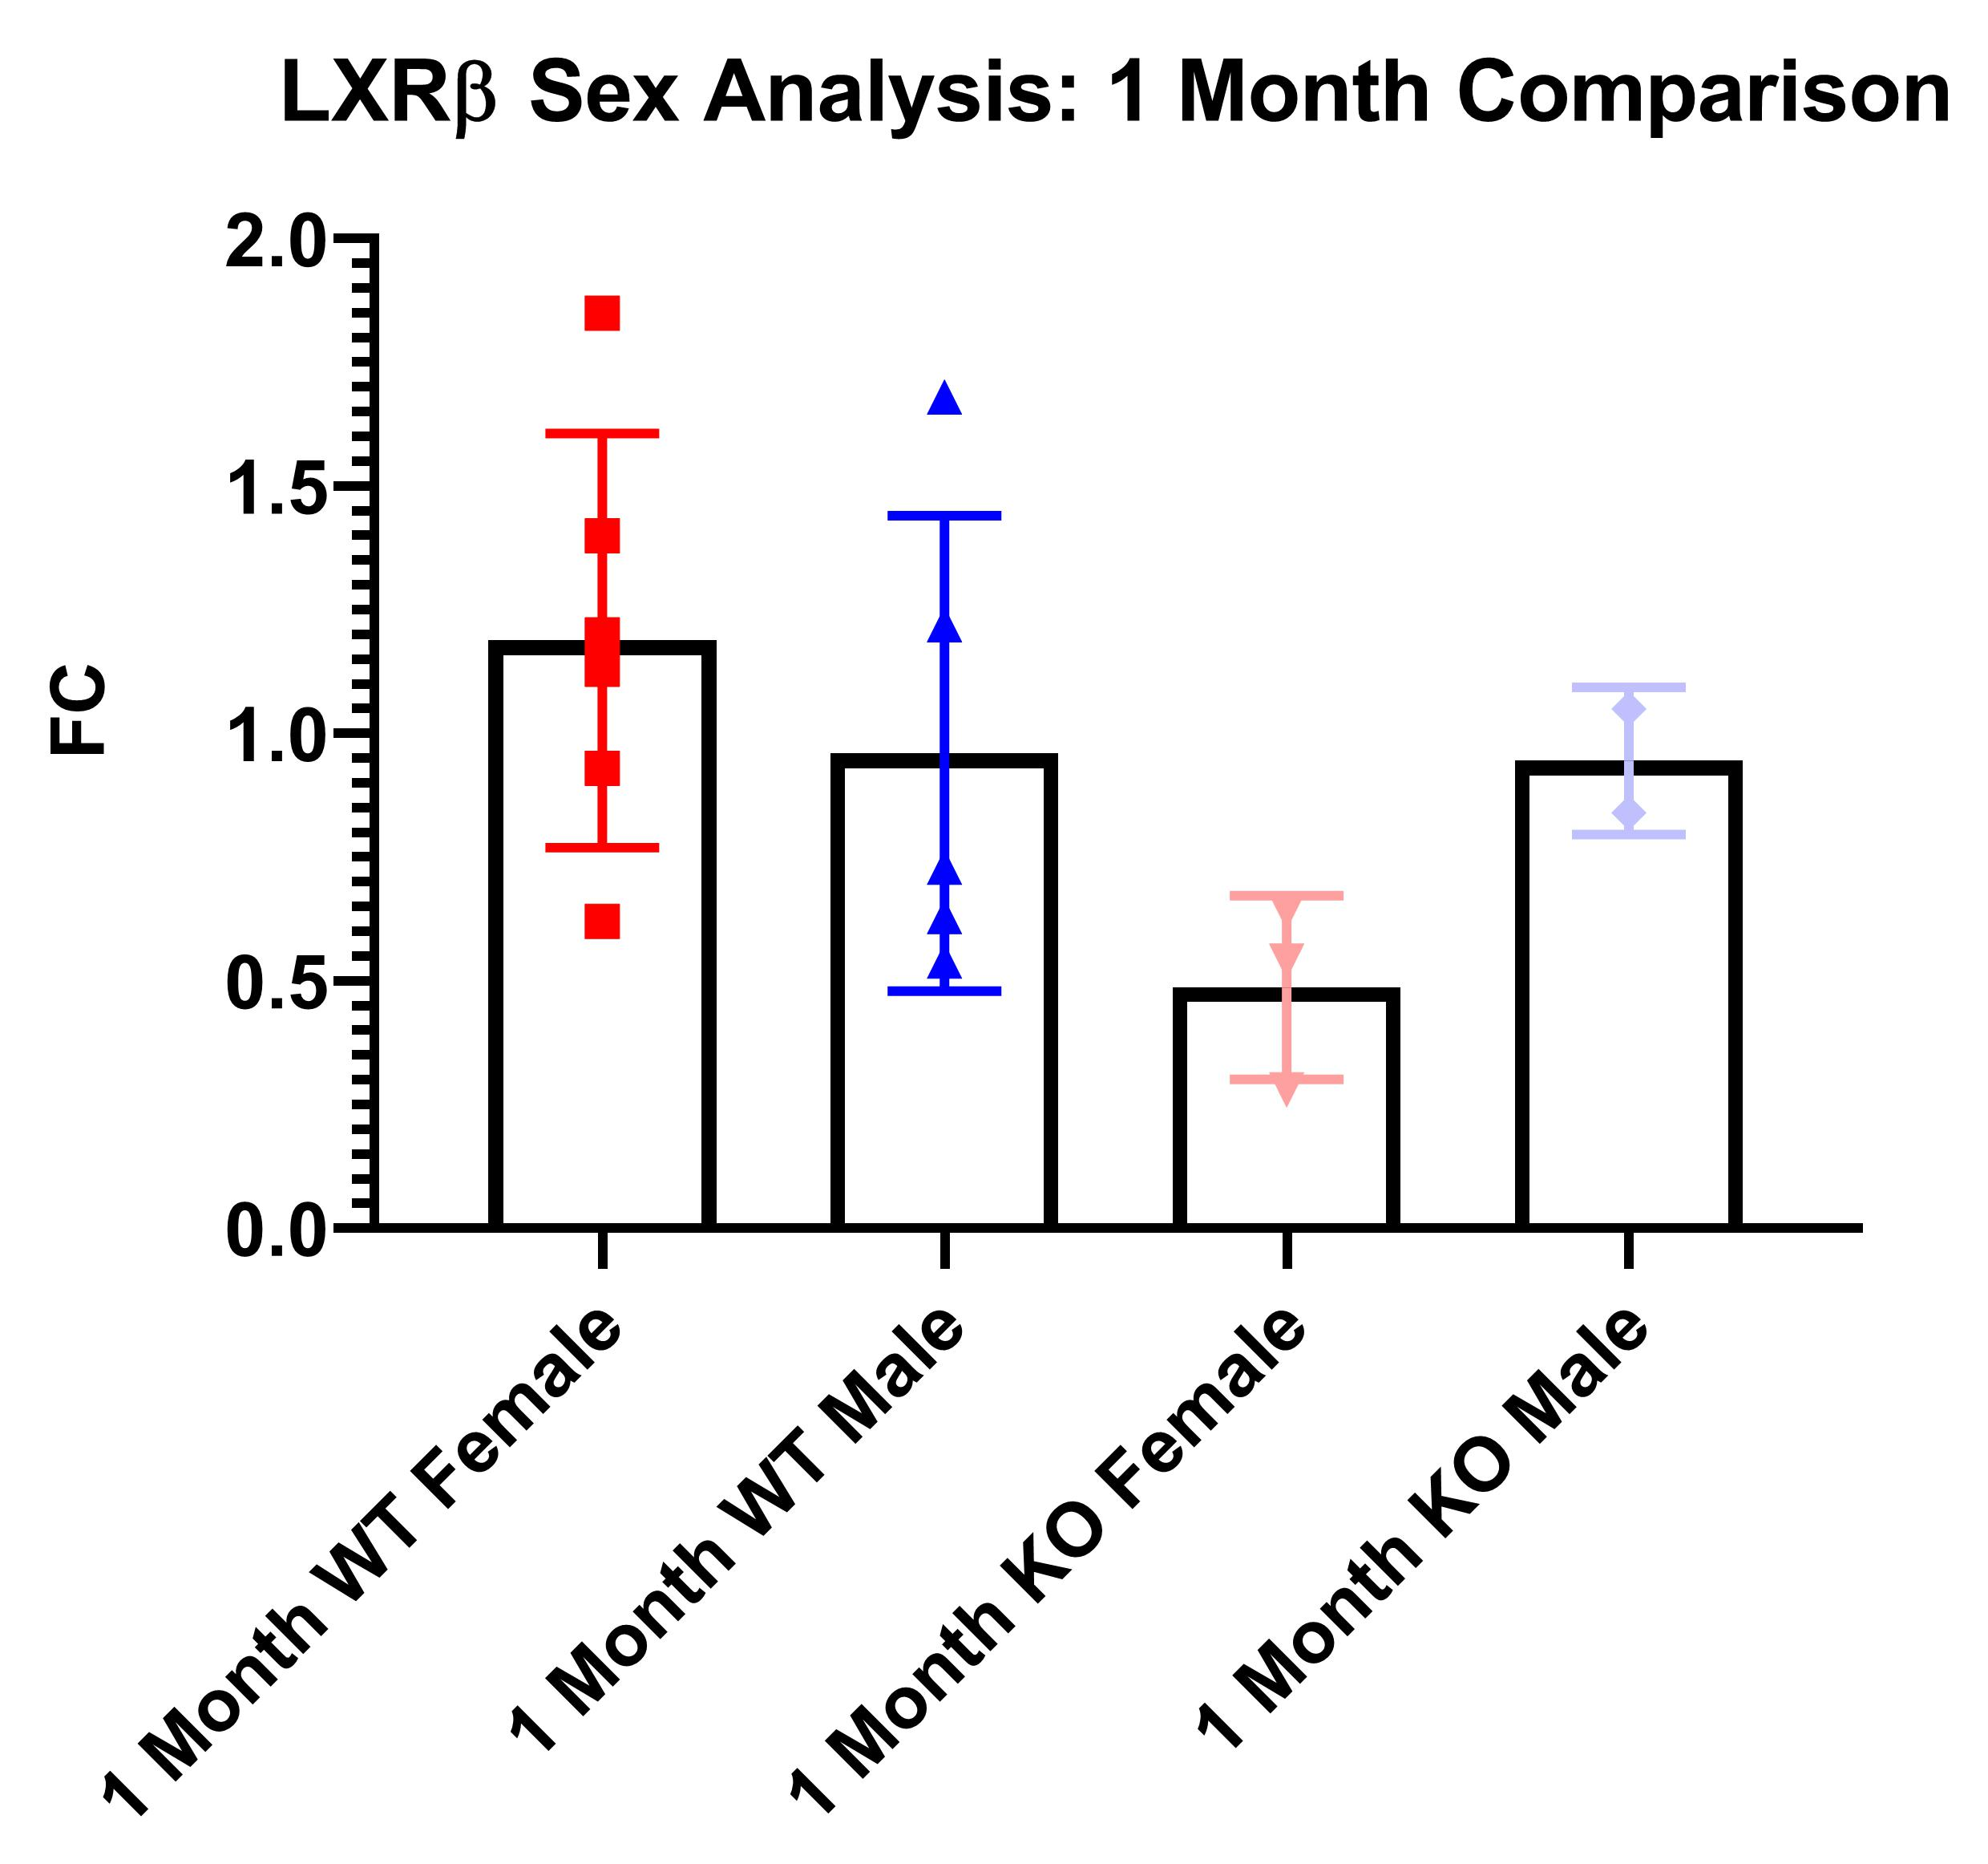
Results
No significant difference between 1-month groups in expression levels of Nr1h2 (LXRβ)

Slide 10
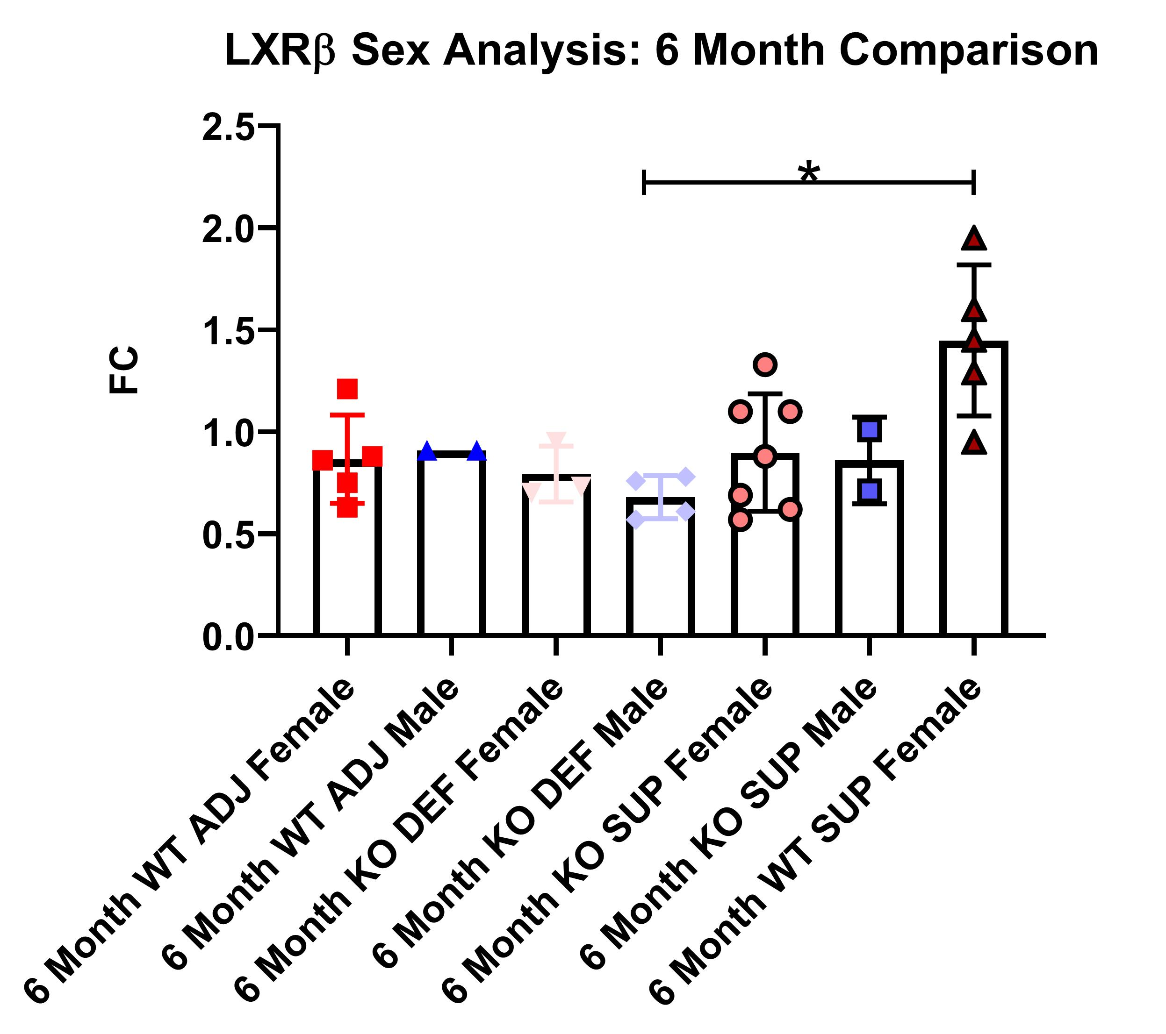
Results
Significant difference between 6-month-old mice (p=0.0258) in sex-specific expression levels of Nr1h2 (LXRβ)
Ttpa^{-/-} deficient male and Ttpa^{+/+} supplemented female
*: p-value is less than or equal to .05
Red=female and Blue=Male

Slide 11
Significance Summary
Vitamin E status affects LXRβ expression in DRG and may be a therapeutic target for AVED
Possible sex-specific effects in expression levels of Nr1h2 (LXRβ)
Female mice seem to be more sensitive to changes in vitamin E than males

Slide 12
Future Studies
Utilize immunohistochemistry to visualize expression within DRG
Explore sex-specific effects of vitamin E
Small n impacted power of analysis
Females may be more sensitive to changes in vitamin E than males

Slide 13
Acknowledgments
Students Training for Advanced Research (STAR) Program
Dr. Finno’s Veterinary Genetics Laboratory at the UC DAVIS SCHOOL OF VETERINARY MEDICINE Department of POPULATION HEALTH AND REPRODUCTION
Annee Nguyen

