Slide 1
The immune response of Nile Tilapia vaccinated with novel diatom-based oral vaccines against piscine francisellosis
Collin Meyer, Roshan Shrestha, Ruth Milston-Clements, Sarah Gibson, Taylor Heckman, Zeinab Yazdi, Esteban Soto

Slide 2
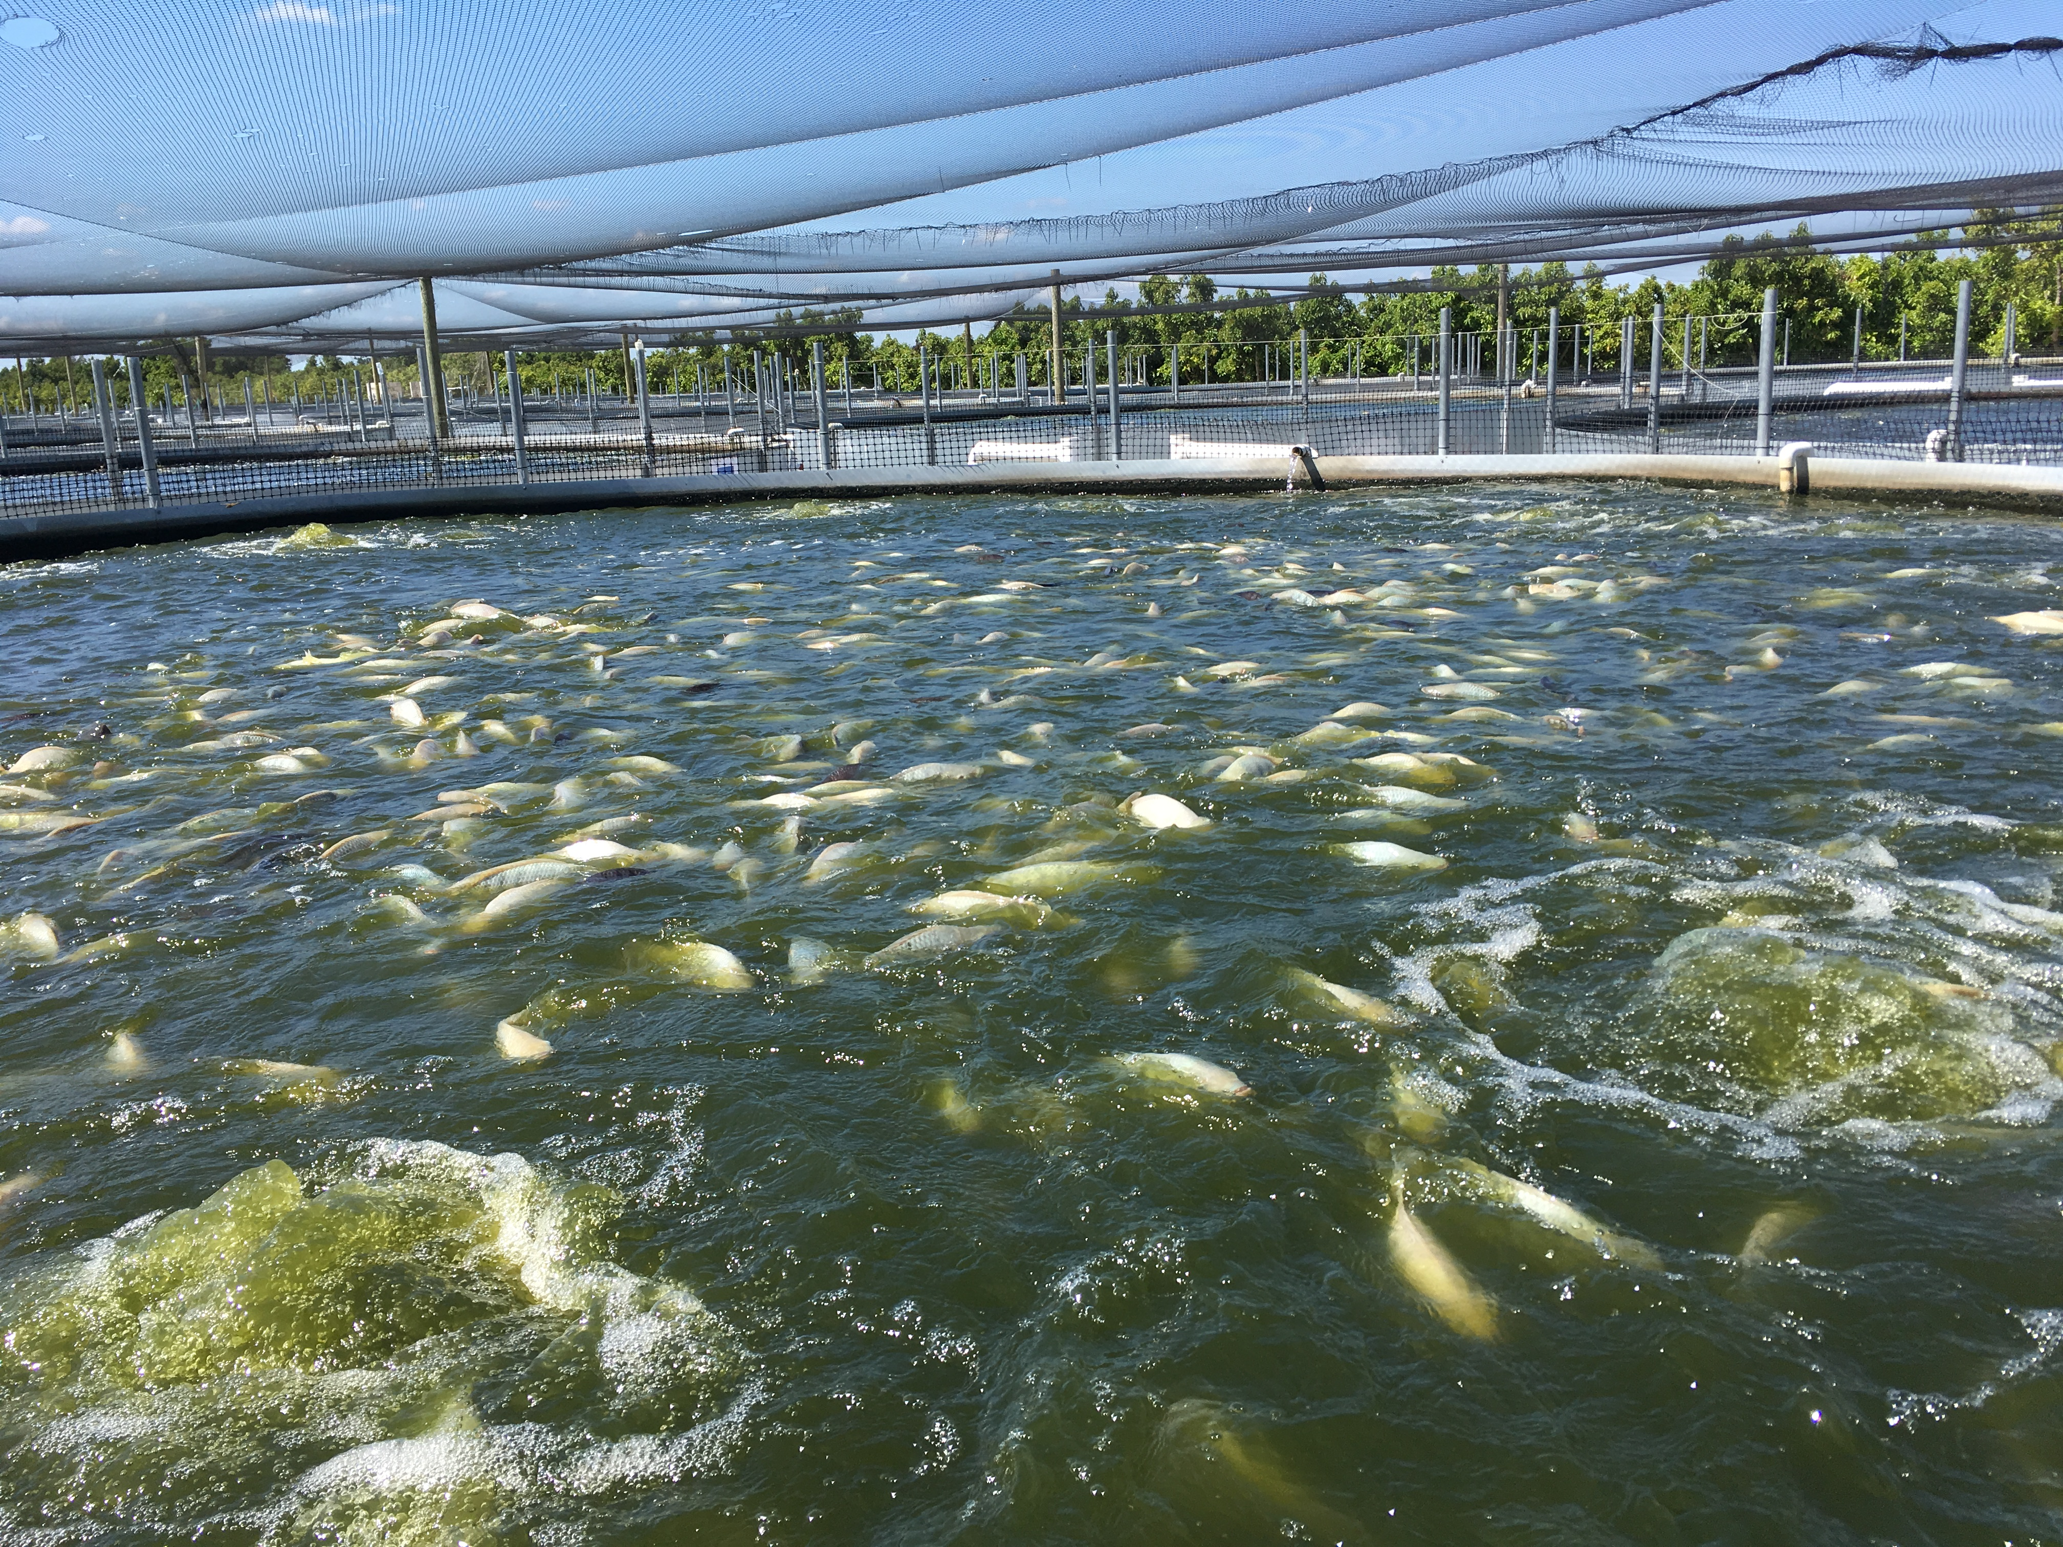
Nile Tilapia (Oreochromis niloticus)
Farmed fish with an estimated market value of $9.8 billion
Infectious diseases can result in mortalities and delayed growth, decreasing the profitability

Slide 3
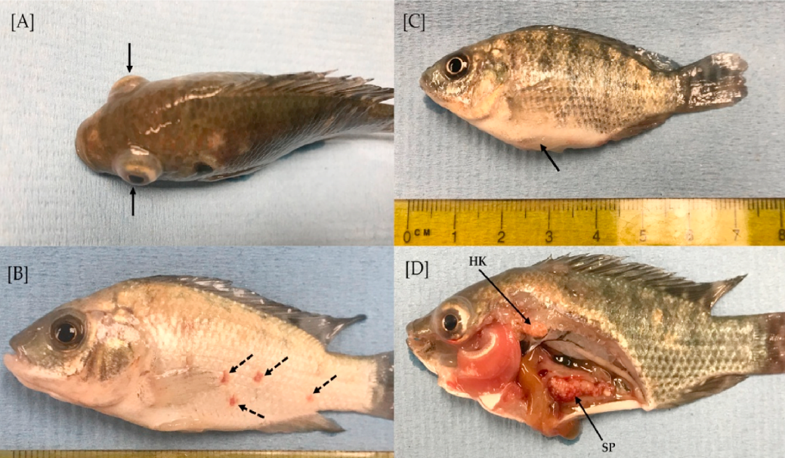
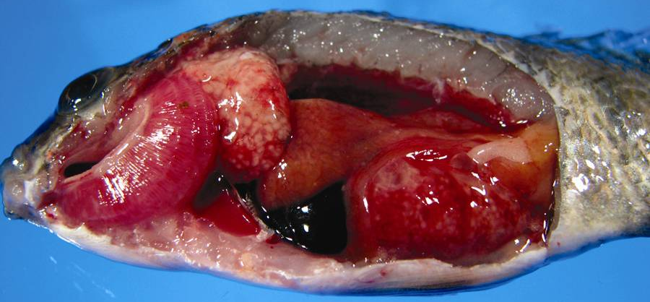
Piscine francisellosis (Francisella orientalis)
Gram-negative facultative intracellular bacteria
Highly infectious and environmentally persistent with a mortality rate up to 95% in tilapia
Granulomatous disease, primarily affecting internal organs
Shahin et al. Development of IglC and GroEL recombinant vaccines for francisellosis in Nile tilapia, Oreochromis niloticus. 2020

Slide 4
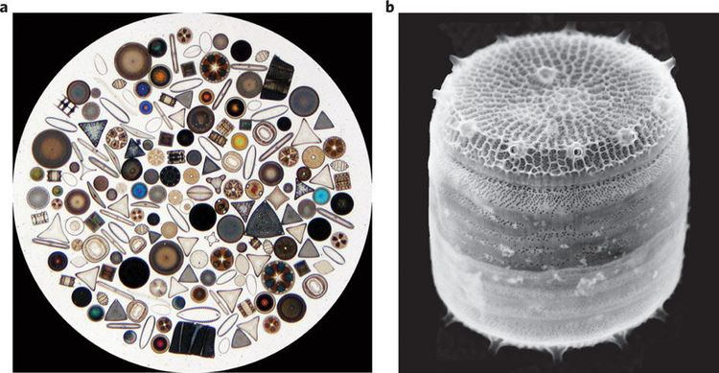
Diatoms (Thalassiosira pseudonana)
Algae used as a nutritional supplement for fish
Can be modified to express foreign proteins, meaning it can be used to create vaccine-candidates
https://alchetron.com/Thalassiosira-pseudonana

Slide 5
Rationale and Objectives
Transgenic diatoms have been shown to confer a protective immunostimulant against F. orientalis when injected, but no oral vaccine trials have been performed in Tilapia before
Oral vaccines are quick and eliminate the need to handle the thousands of individuals in a farm for injection, making it a preferred administration route for aquaculturalists
No alternative commercial vaccines available or approved antimicrobials for treatment available at this time
Objective: Assess how orally administered recombinant eGFP-flagellin-IglC fusion proteins expressed in Thalassiosira pseudonana diatoms alter gene expression and survivability against Francisella orientalis infection in Nile Tilapia fingerlings.

Slide 6
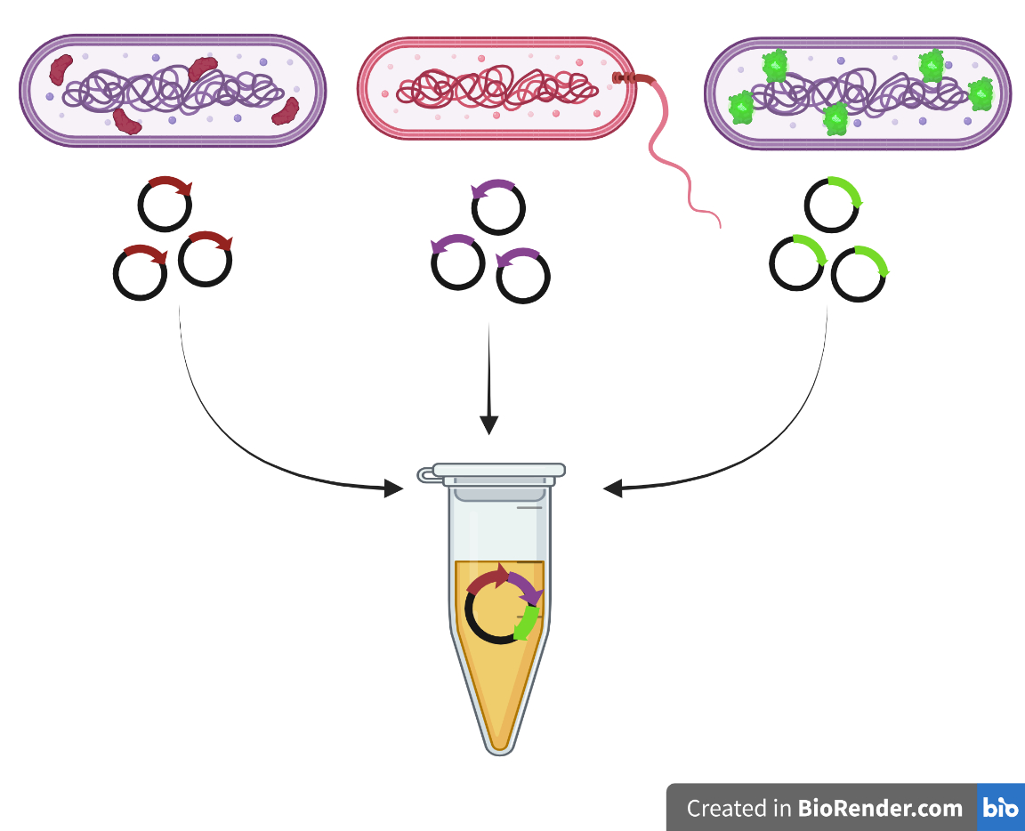
Methods: Vaccine Preparation

Slide 7
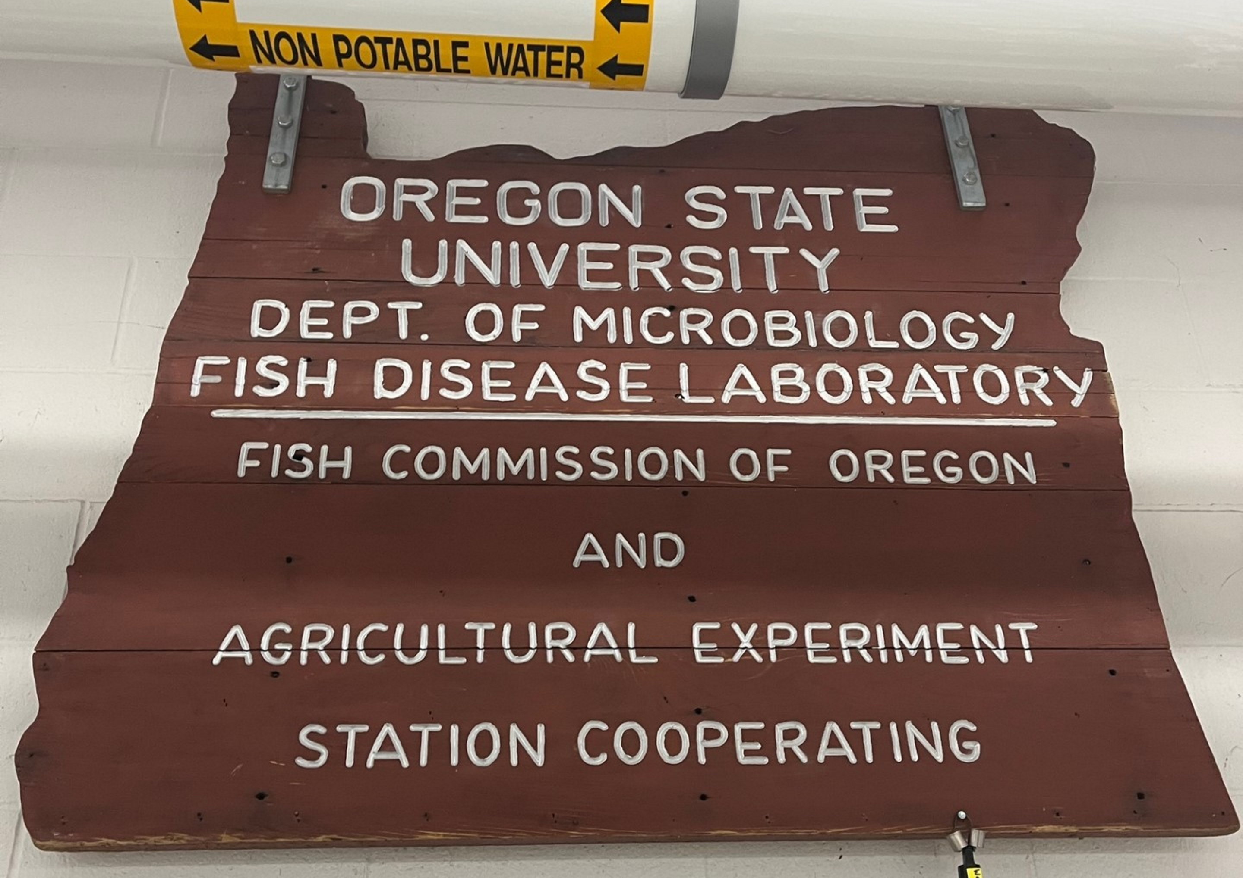
Roadblocks

Slide 8
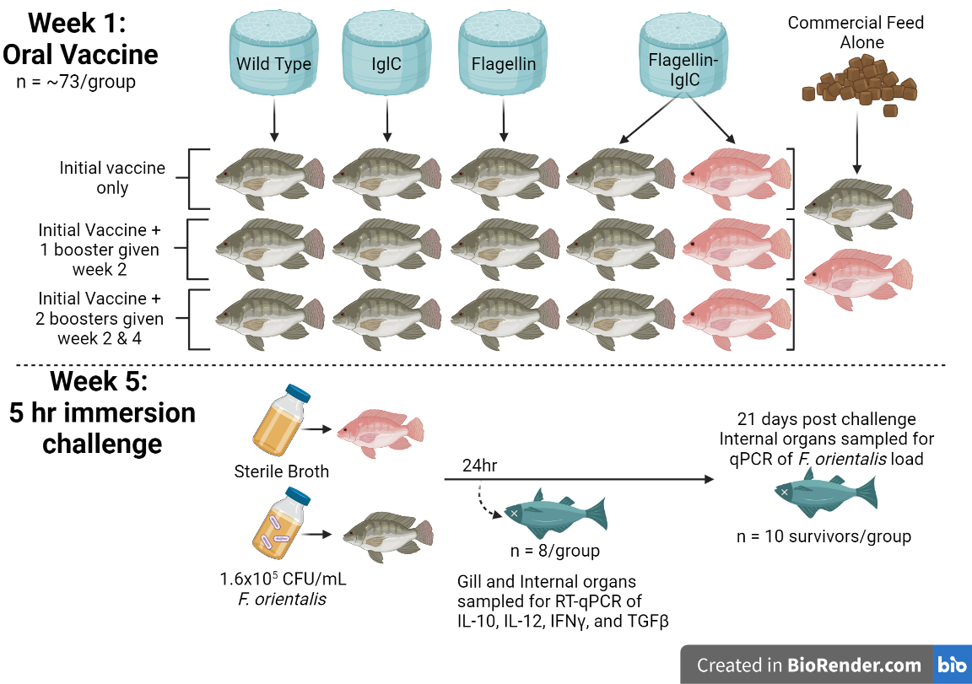
Methods: Grouping and Vaccination

Slide 9
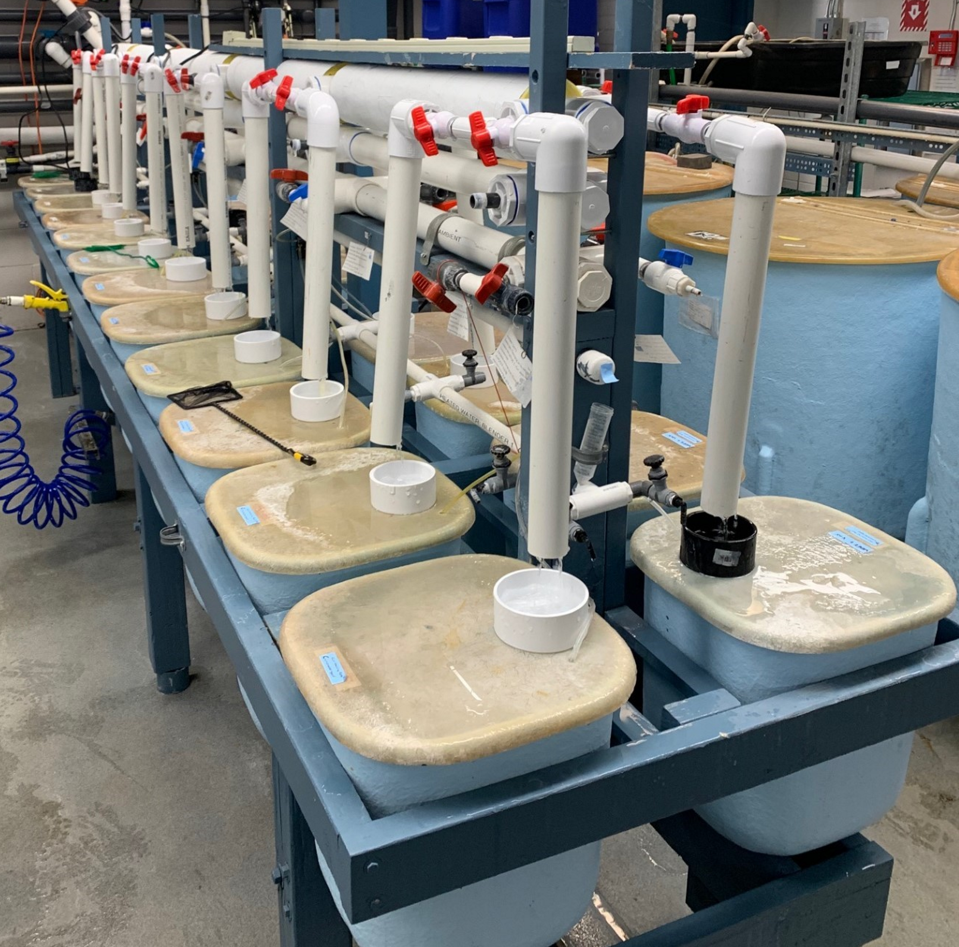
Methods: Challenge

Slide 10
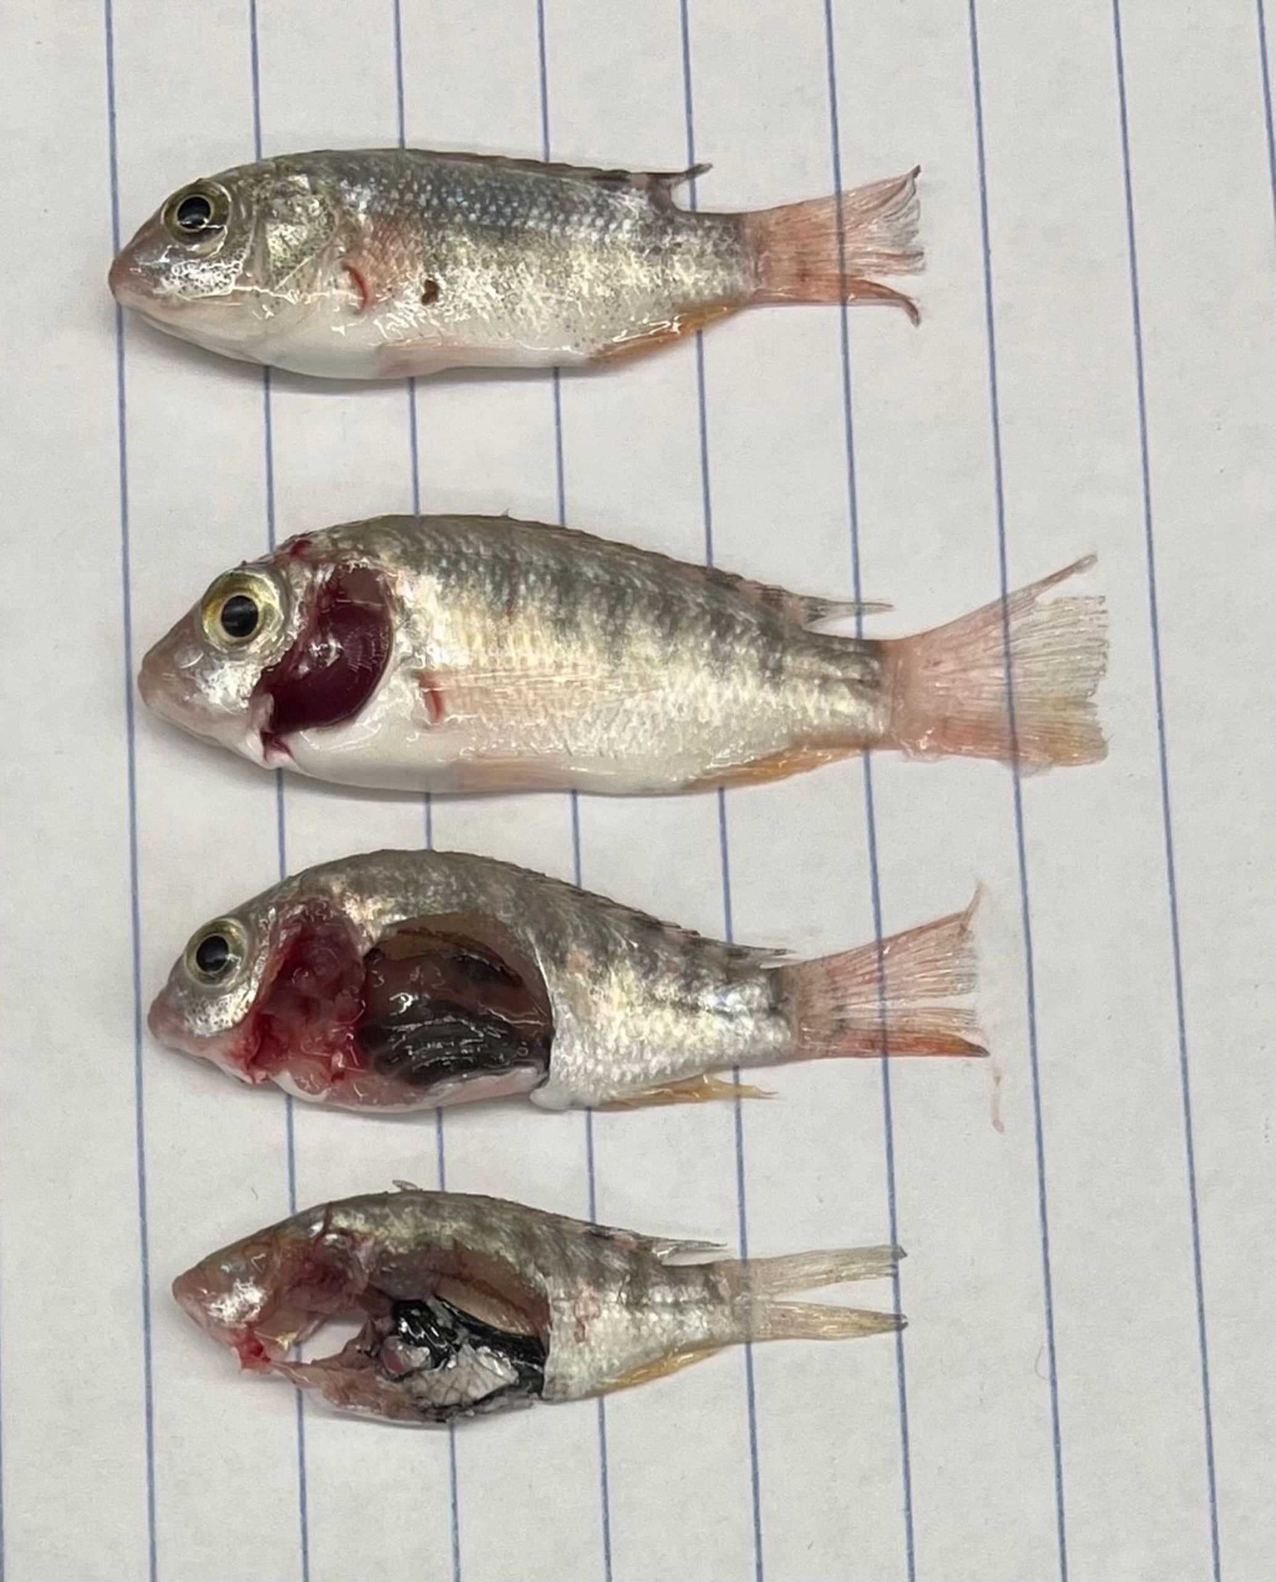
Methods: Gene Assay and F. orientalis Quantification
tank water

Slide 11
Results: Cumulative Mortalities
Fig 1: Cumulative mortality rate of tilapia fingerlings 21 days post challenge with 1.6x10⁵ CFU/mL tank water/5hr of Francisella orientalis. Each curve represents the average of 4 parallel tanks holding n=16 fish. Columns with asterisk (*) were unchallenged controls. Groups that do not share letters are significantly different (p < 0.05) as determined by one-way ANOVA with post hoc Tukey Test.

Slide 12
Results: Survival Curves
Fig 2: Kaplan-Meier survival curves of tilapia fingerlings through 21 days post challenge with 1.6x10⁵ CFU/mL tank water/5hr of Francisella orientalis. Each curve represents the average of 4 parallel tanks holding n=16 fish. Groups that do not share letters are significantly different (p < 0.05) as determined by Log-rank (Mantel Cox) test. (A) Wild-type diatom oral vaccines, (B) Flagellin expressing diatom oral vaccine, (C) IglC expressing diatom oral vaccine, (D) Flagellin-IglC expressing diatom oral vaccines, including both challenged and unchallenged groups.

Slide 13
Results: Survival Curves
Fig 2: Kaplan-Meier survival curves of tilapia fingerlings through 21 days post challenge with 1.6x10⁵ CFU/mL tank water/5hr of Francisella orientalis. Each curve represents the average of 4 parallel tanks holding n=16 fish. Groups that do not share letters are significantly different (p < 0.05) as determined by Log-rank (Mantel Cox) test. (A) Wild-type diatom oral vaccines, (B) Flagellin expressing diatom oral vaccine, (C) IglC expressing diatom oral vaccine, (D) Flagellin-IglC expressing diatom oral vaccines, including both challenged and unchallenged groups.

Slide 14
Results: Gene Assay
Fig 3: Relative gene expression of interleukin 12, interferon gamma, interleukin 10, and transforming growth factor beta in (A) gills and (B) internal organs of n=8/group tilapia fingerlings 24 hrs post challenge with F. orientalis. Gene expression was normalized against the expression of the average of β-actin and UBCE reference genes. Different letters within each gene are significantly different (p < 0.05) as determined by one-way ANOVA with post hoc Tukey Test.

Slide 15
Results: F. orientalis Quantification
Fig 4: F. orientalis genome equivalent quantification in internal organs of tilapia fingerlings by qPCR. Treatments (n=10/group) sampled from survivors at 21 dpc, mortalities (n=20) sampled at time of death across same treatments. Different letters are significantly different (p < 0.05) as determined by one-way ANOVA with post hoc Tukey Test.

Slide 16
Conclusions
Recombinant eGFP-flagellin-IglC fusion proteins expressed in diatoms are safe to consume by Nile Tilapia fingerlings
None of the tested transgenic diatoms were effective in reducing mortality or bacterial load against F. orientalis
Transgenic diatoms expressing eGFP-flagellin-IglC fusion proteins were associated with a significant decrease of TGFβ in both gills and internal organs, and increase of IFNγ in the gills
Although the novel delivery method shows promise, further research is needed to provide a safe and effective vaccine against this disease.

Slide 17
Acknowledgements and Funding
Financial support was provided by the Students Training in Advanced Research (STAR) Program through a UC Davis School of Veterinary Medicine Endowment Fund
United States Department of Agriculture- Small Business Innovation Research grant
Special thanks to Phycovaxx LLC for manufacturing the transgenic diatoms used in this study, the team at the Aquatic Animal Health Laboratory for their help teaching me to be a scientist, and to the John L. Fryer Aquatic Animal Health Laboratory at Oregon State University for the use of their facilities and their care for our fish!

