Slide 1
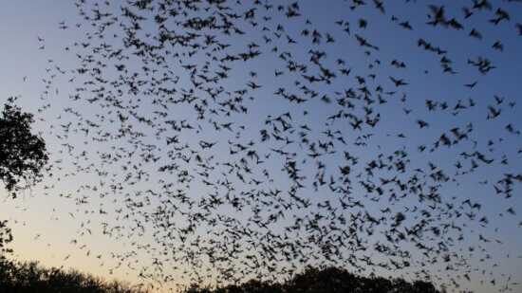
Surveillance for Novel Paramyxoviruses in West African Bats
Danielle Myers
Mentor: Dr. Simon Anthony

Slide 2
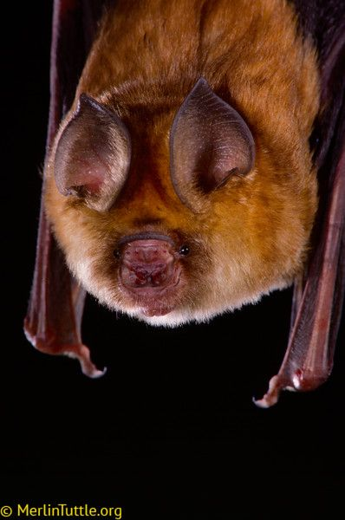
Paramyxoviruses - Paramyxoviridae
Negative-sense single-stranded RNA viruses⁴
Affects many different hosts – humans, birds, livestock, etc.^{3,4}
Bats are known reservoirs³
~3% Prevalence³
Potentially zoonotic¹⁰
ex. Nipah and Hendra viruses¹⁰
Human encroachment can lead to spillover events and disease emergence^{1,2}

Slide 3
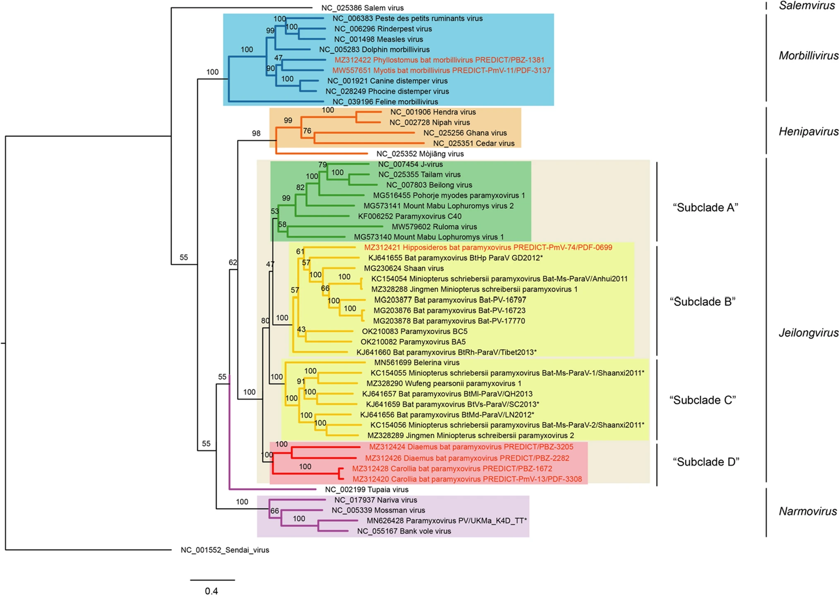
Wells et al. 2022

Slide 4
The Study
Detecting novel paramyxoviruses
Hypothesis: We hypothesize that bats in Liberia will host diverse paramyxoviruses.
Factors associated with detection
Sample type
Collection Site
Species
Hypothesis: Of the sample types, the urine samples will have a greater paramyxovirus detection rate than other sample types.

Slide 5
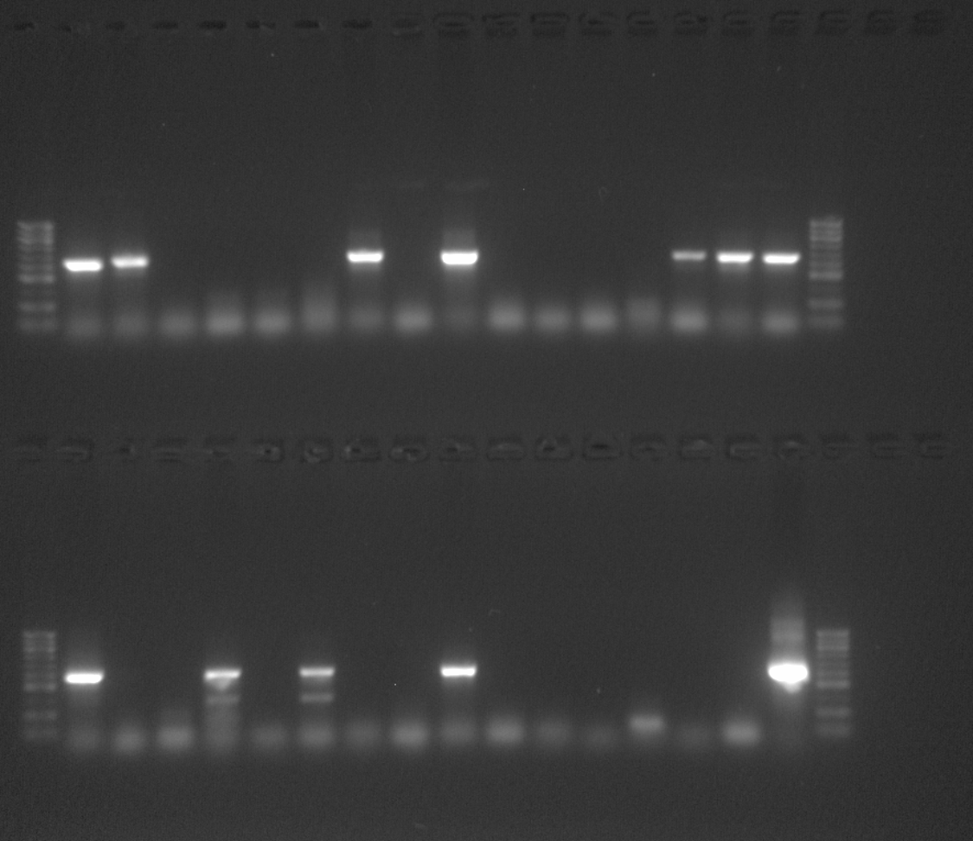
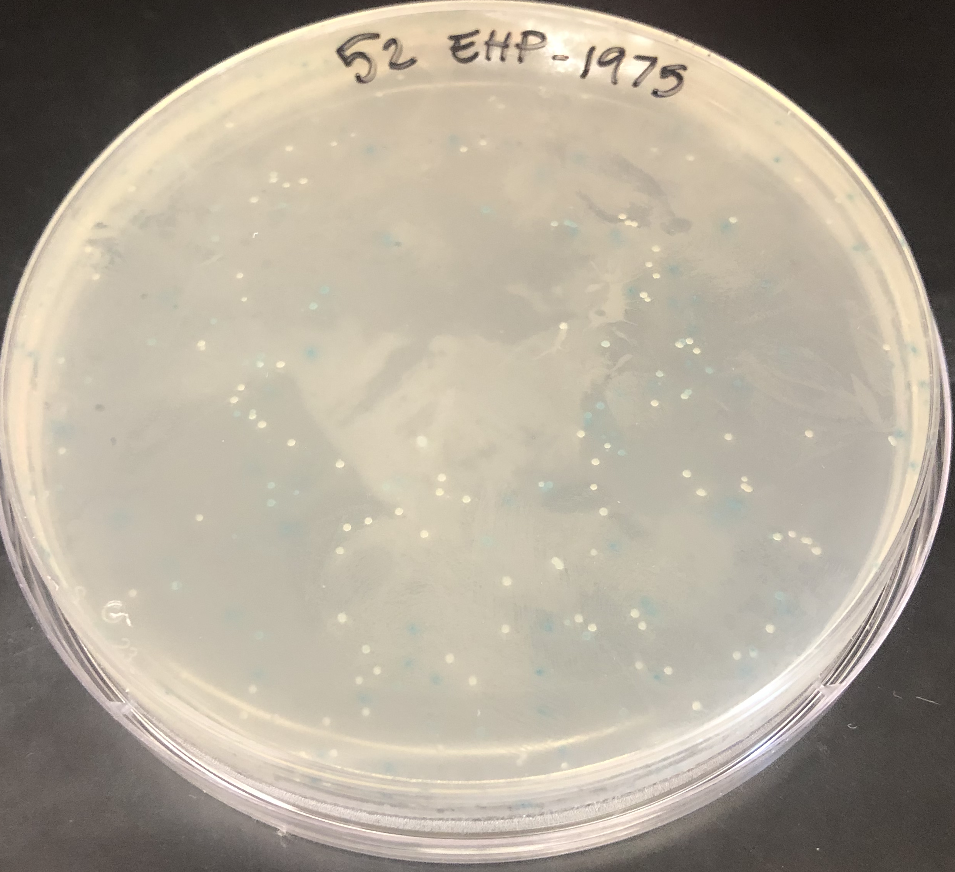
Methods
Sanger Sequencing
Hemi-nested PCR
Target: RNA-dependent RNA polymerase
Tong, S et al. (2008)
Gel Electrophoresis
Cut bands ~560 bp
Clone Purified PCR Products

Slide 6
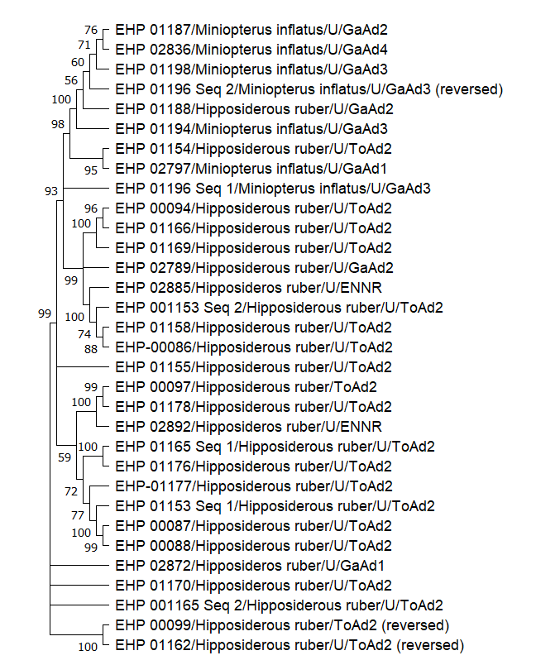
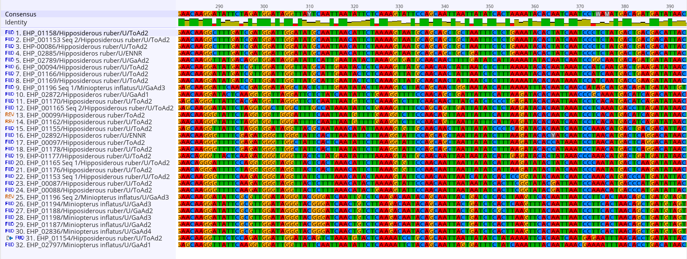
Sequence Analysis
BLAST sequences to confirm paramyxoviruses
Align and trim sequences
Mega X
Phylogenetic Analysis

Slide 7
Preliminary Results
Sample Type | Total | PmV Seq
Oral swab | 359 | 0
Rectal swab | 86 | 0
Urine/Urogenital swab | 206 | 35
Blood | 418 | 0
Feces | 301 | 0
1370 Samples
35 Paramyxovirus sequences
4 Co-infections
Novel viruses: 17 Sequences <85% Identity Match
Prevalence: 2.6%
Species | Total | PmV Seq
Hipposiderous ruber | 907 | 28
Miniopterus inflatus | 438 | 7
Lissonycteris angolensis | 25 | 0
Collection Site | Total | PmV Seq
Tokadeh Adit | 509 | 20
Gangra Adit | 773 | 10
East Nimba Nature Reserve | 86 | 5
Yuelliton Adit-2 | 2 | 0

Slide 8
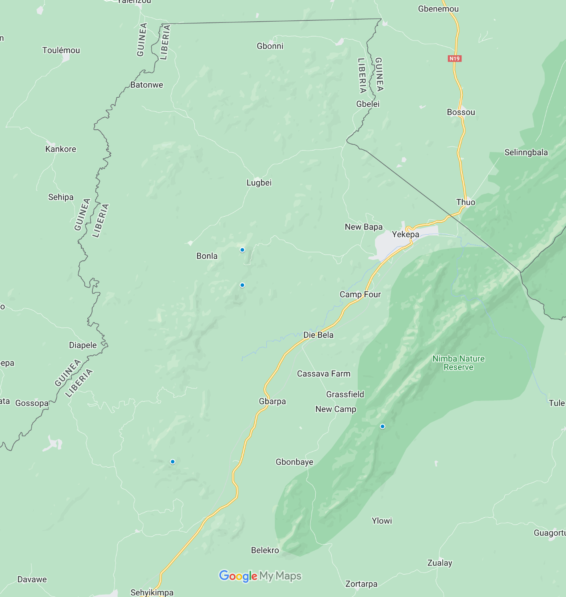
 | % of Samples | % of Paramyxovirus
Urine/Urogenital Swab | 15% | 100%
Hipposideros ruber | 66% | 80%
Miniopterus nimbae | 32% | 20%
Tokadeh Adit | 37% | 57%
Gangra Adit | 56% | 29%
East Nimba Nature Reserve | 6% | 14%
Gangra Adit
10 Sequences
Tokadeh Adit
20 Sequences
East Nimba Nature Reserve
2 Sequences

Slide 9
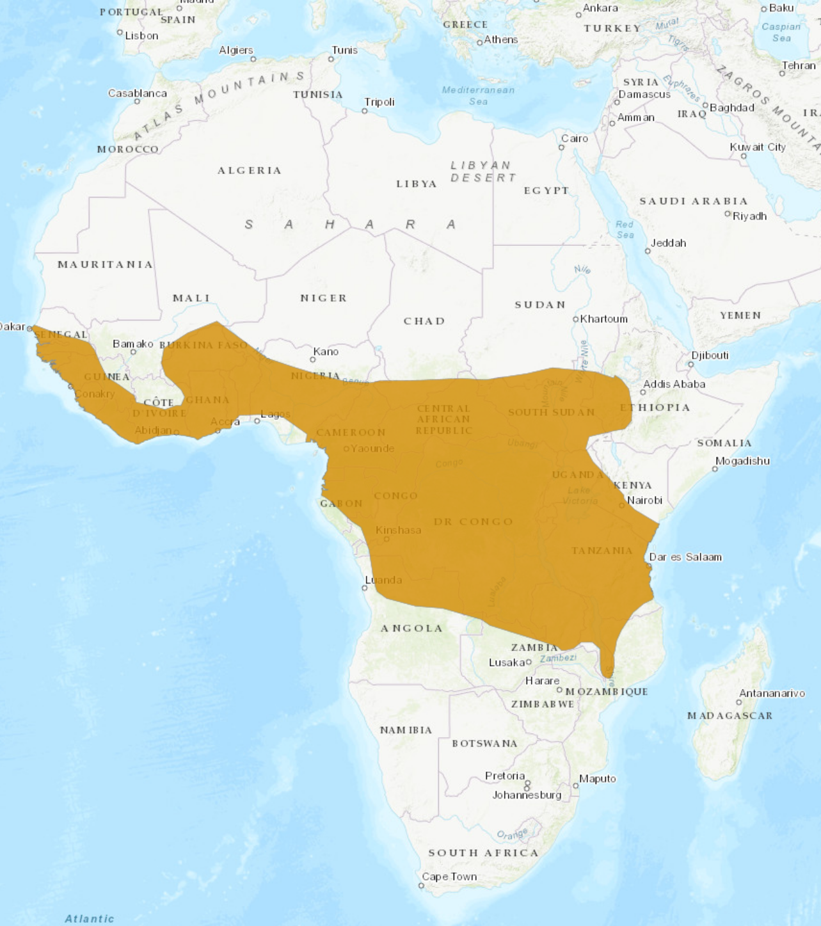
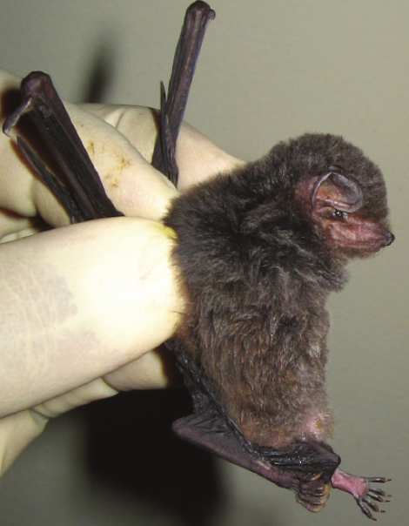
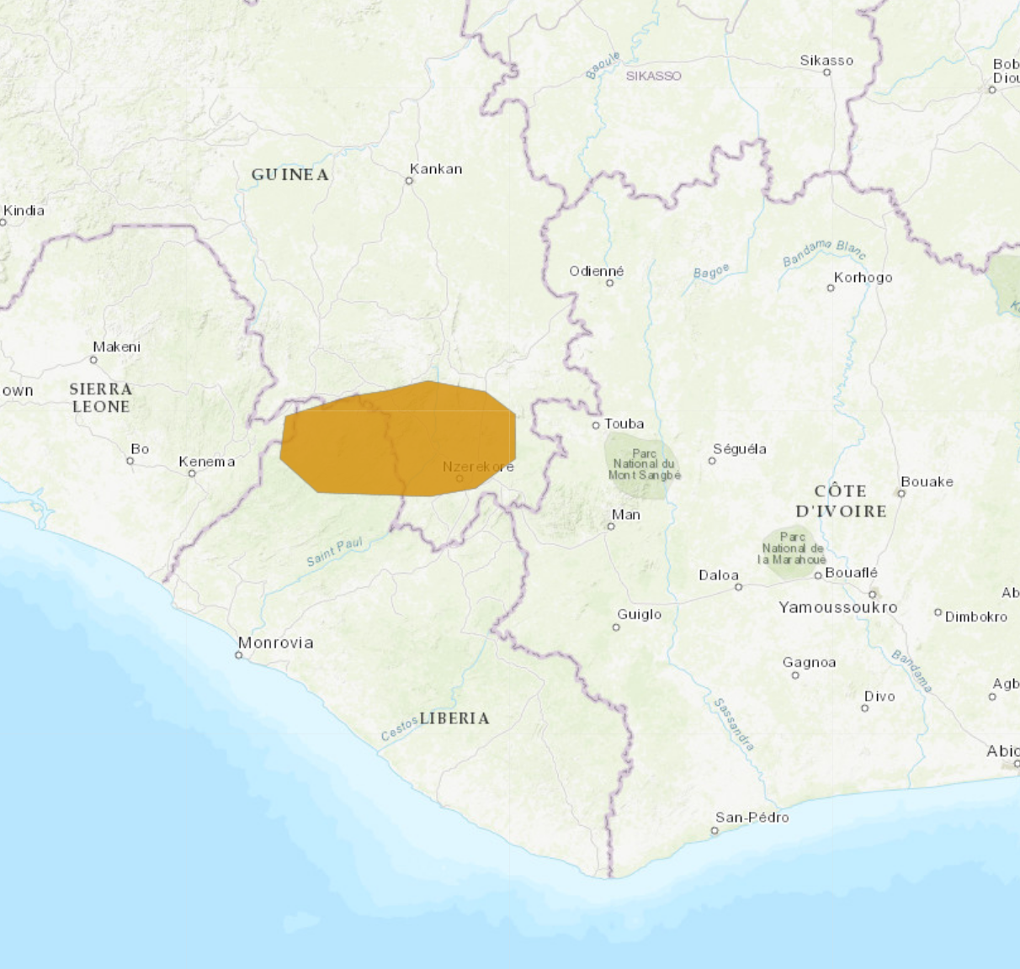
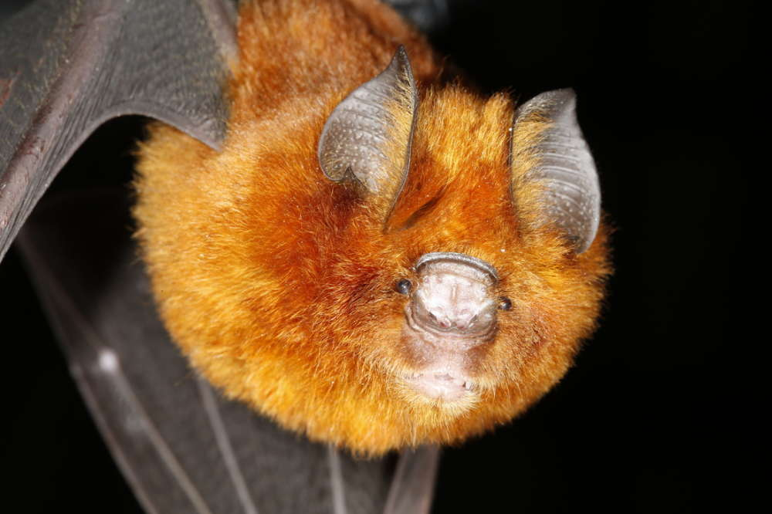
About the Bats
Hipposideros ruber
Common Name: Noack’s roundleaf bat
Order: Chiroptera⁵
Family: Hipposideridae⁵
Small bats with a large distripution⁷
Insectivorous⁷
Miniopterus nimbae
Common Name: Nimba long-fingered bat
Order: Chiroptera⁸
Family: Miniopteridae⁶
Inscetivorous⁶
Monadjem et al. 2020

Slide 10
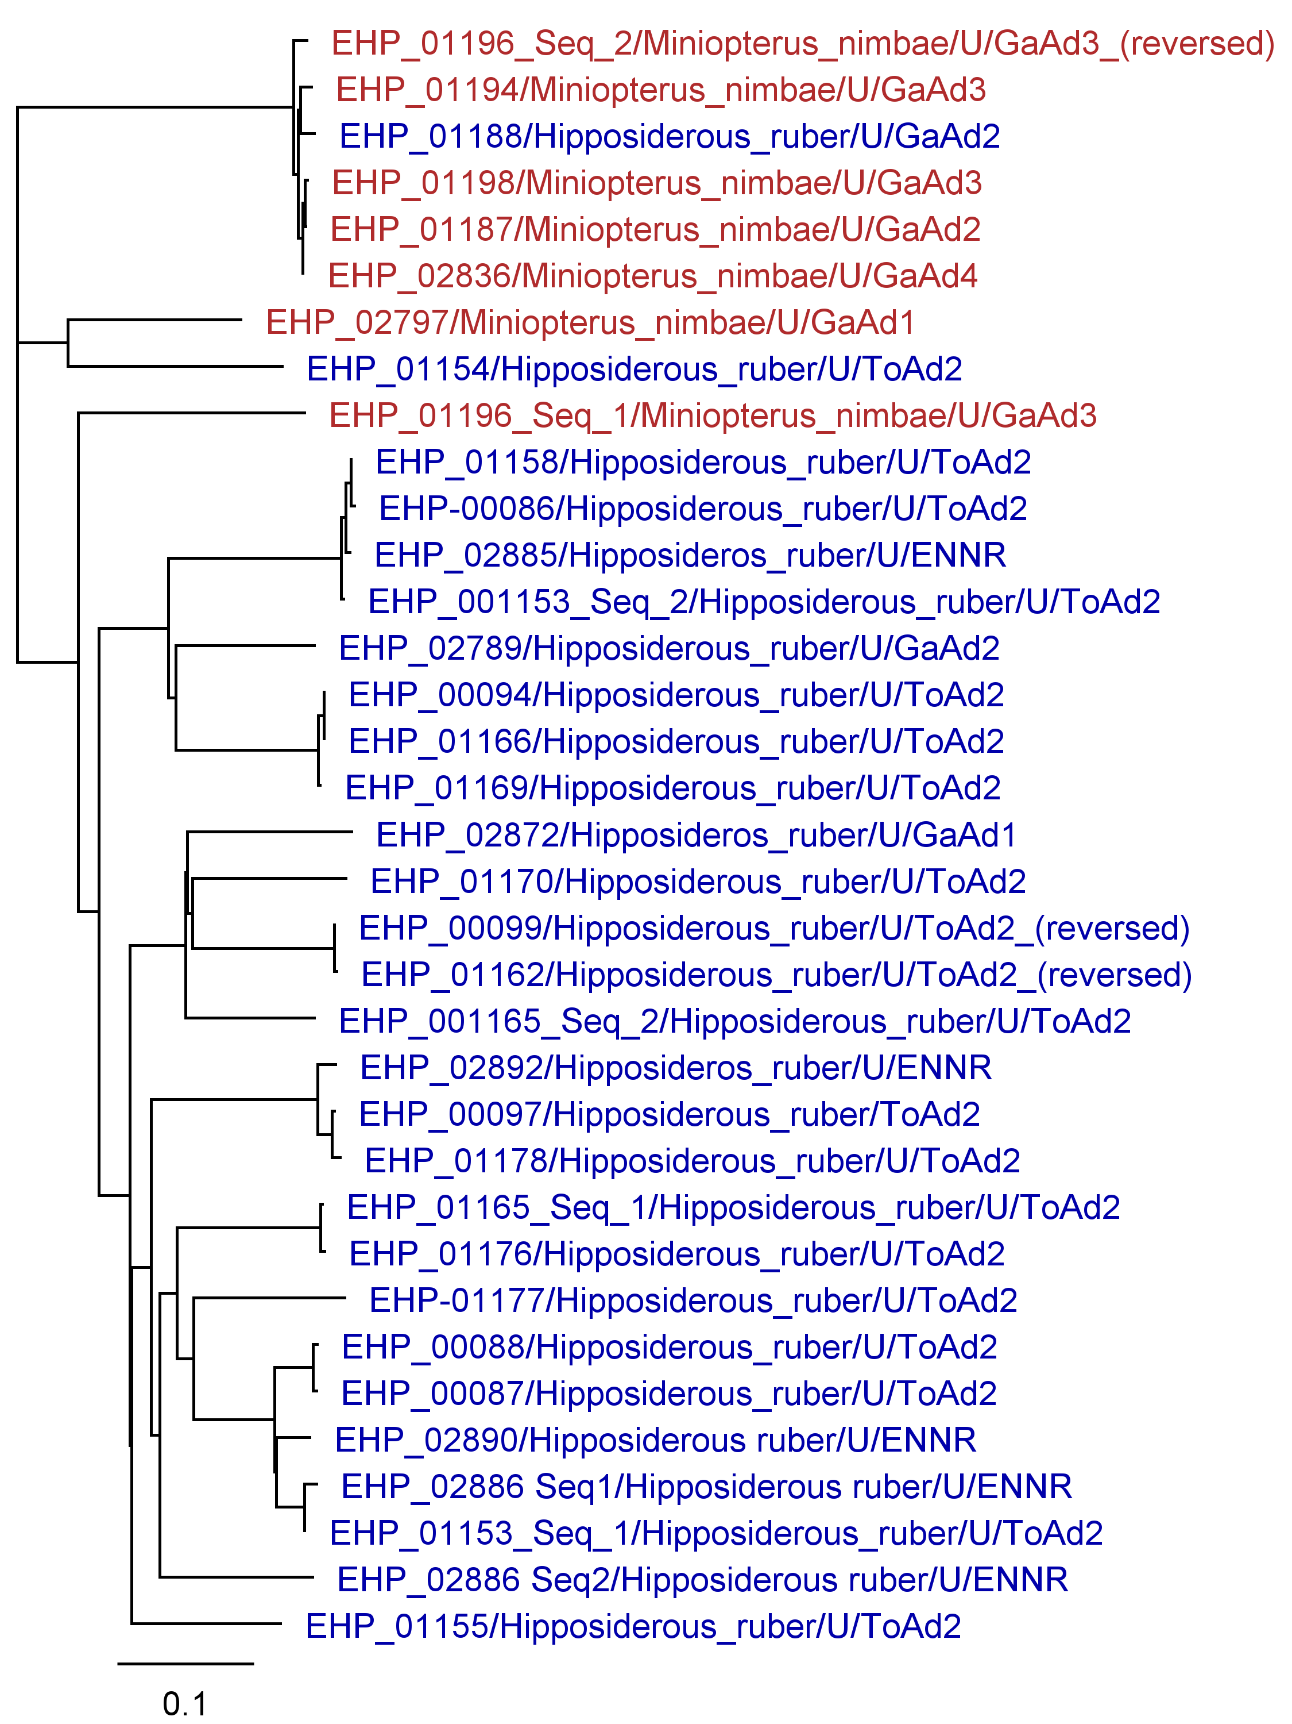
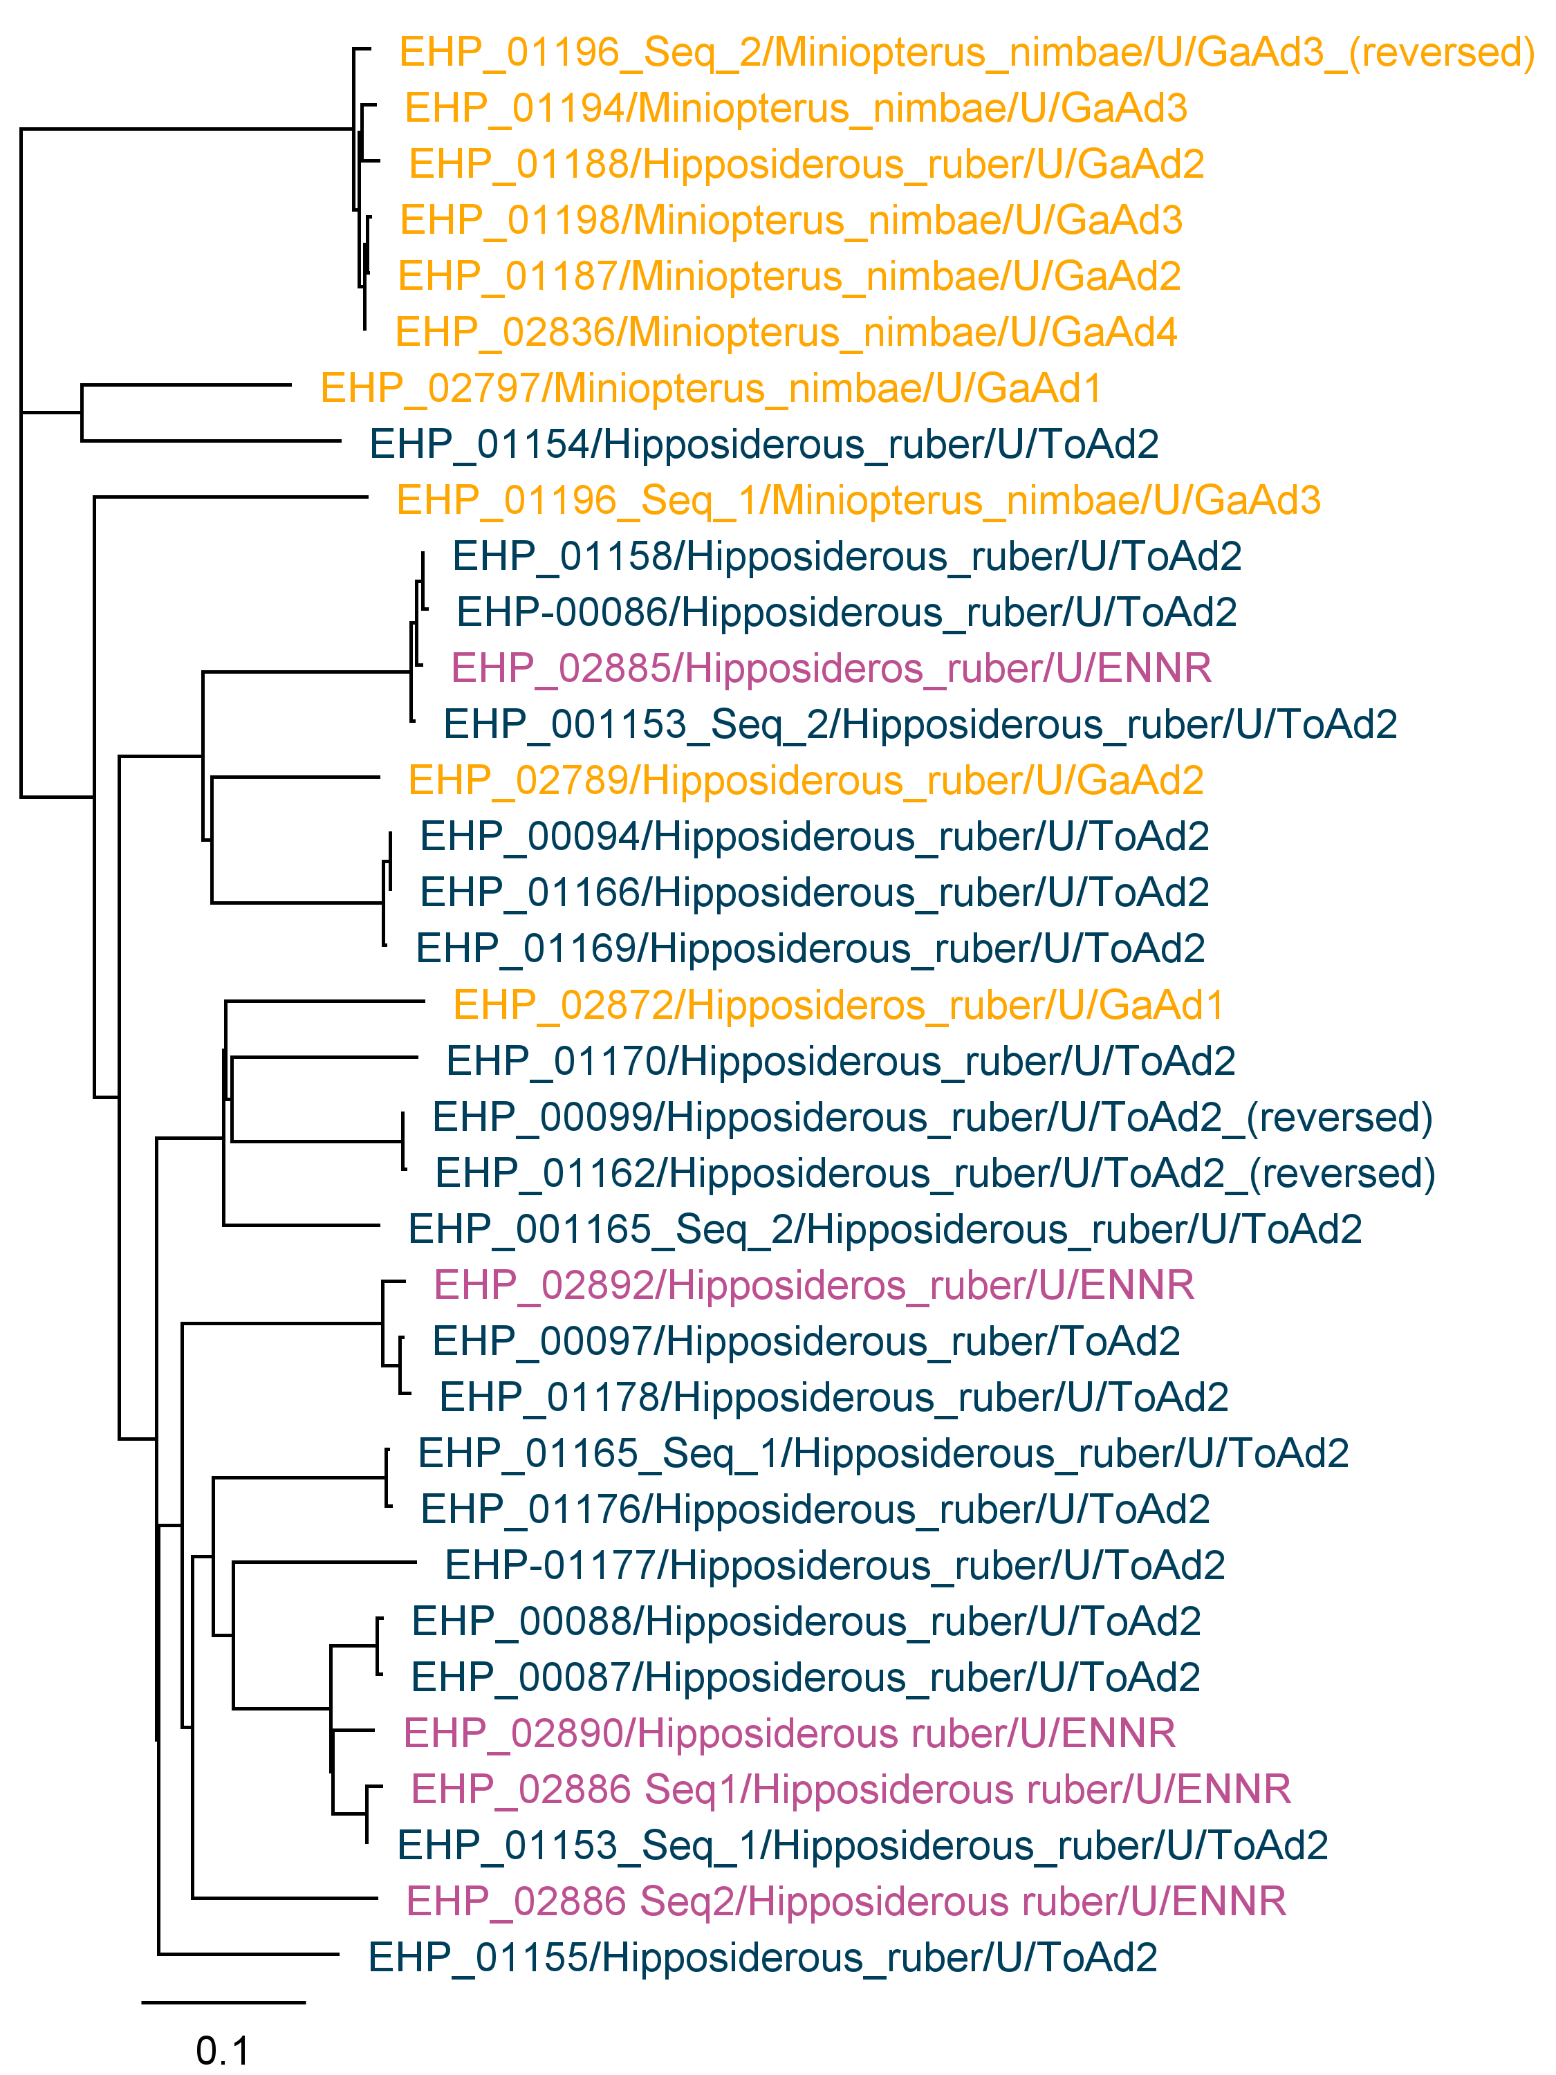
Species
Site

Slide 11
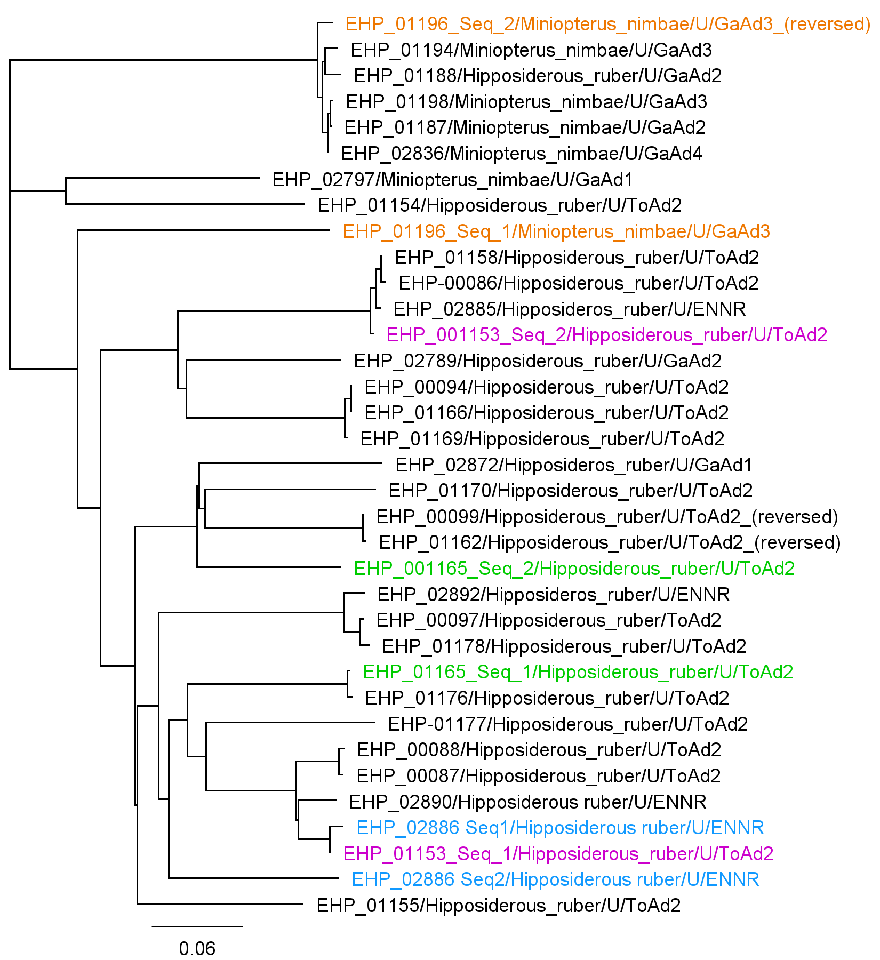
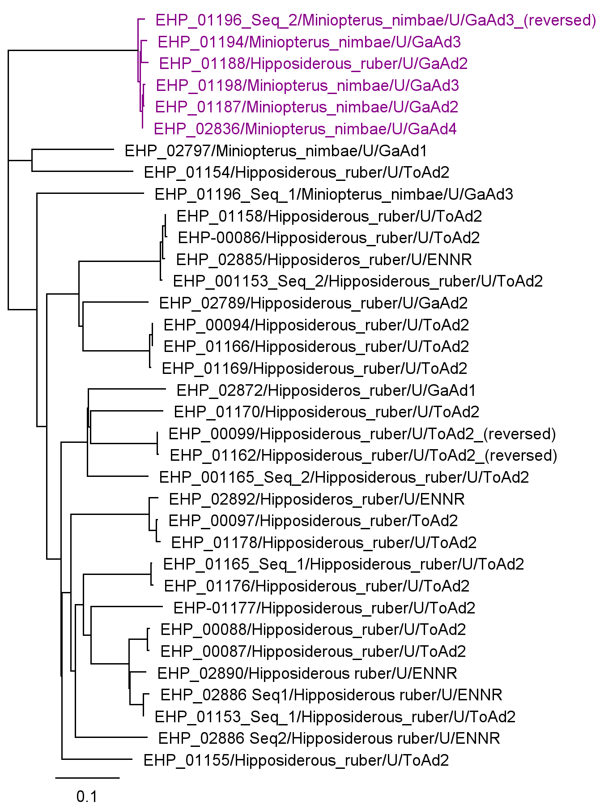
Co-infections
Multi-Species Cluster

Slide 12
Where to go from here?
~8,000 samples to go
Whole Genome Sequencing on novel paramyxoviruses

Slide 13
Acknowledgements
Thank you to the entire Anthony Lab!
Dr. Simon Anthony
Dr. Isamara Navarrete-Macias
Dr. Cassandra Bonavita
And everyone else!
Financial support was provided by the Students Training in Advanced Research (STAR) Program through the NIH T35 OD010956-22 grant

Slide 14
References
Bourgarel, M., Pfukenyi, D. M., Boué, V., Talignani, L., Chiweshe, N., Diop, F., ... & Liégeois, F. (2018). Circulation of Alphacoronavirus, Betacoronavirus and Paramyxovirus in Hipposideros bat species in Zimbabwe. Infection, Genetics and Evolution, 58, 253-257. https://doi.org/10.1016/j.meegid.2018.01.007
Brook, C. E., & Dobson, A. P. (2015). Bats as ‘special’ reservoirs for emerging zoonotic pathogens. Trends in microbiology, 23(3), 172-180. https://doi.org/10.1016/j.tim.2014.12.004
Drexler, J. F., Corman, V. M., Müller, M. A., Maganga, G. D., Vallo, P., & Binger, T. Bats host major mammalian paramyxoviruses. Nat Commun. 2012; 3: 796. https://doi.org/10.1038/ncomms1796
Markotter, W., Coertse, J., De Vries, L., Geldenhuys, M., & Mortlock, M. (2020). Bat‐borne viruses in Africa: a critical review. Journal of Zoology, 311(2), 77-98. https://doi.org/10.1111/jzo.12769
Monadjem, A. & Schlitter, D. 2017. Miniopterus inflatus. The IUCN Red List of Threatened Species 2017: e.T13565A22104819. https://dx.doi.org/10.2305/IUCN.UK.2017-2.RLTS.T13565A22104819.en. Accessed on 28 July 2022.
Monadjem, A., Fahr, J., Hutson, A.M., Mickleburgh, S. & Bergmans, W. 2017. Hipposideros ruber. The IUCN Red List of Threatened Species 2017: e.T10157A22102440. https://dx.doi.org/10.2305/IUCN.UK.2017-2.RLTS.T10157A22102440.en. Accessed on 28 July 202
Monadjem, Ara & Shapiro, Julie & Richards, Leigh & Karabulut, Hatice & Crawley, Wing-Yunn & Nielsen, Ida & Hansen, Anders & Bohmann, Kristine & Mourier, Tobias. (2020). Systematics of West African Miniopterus with the Description of a New Species. Acta Chiropterologica. 21. 237. 10.3161/15081109ACC2019.21.2.001.
Nkrumah, E. E., Vallo, P., Klose, S. M., Ripperger, S. P., Badu, E. K., Gloza-Rausch, F., ... & Oppong, S. K. (2016). Foraging behavior and habitat selection of Noack’s round-leaf bat (Hipposideros aff. ruber) and conservation implications. Tropical Conservation Science, 9(4), 1940082916680428.
Schoch CL, et al. NCBI Taxonomy: a comprehensive update on curation, resources and tools. Database (Oxford). 2020: baaa062. PubMed: 32761142 PMC: PMC7408187.
Thibault, P. A., Watkinson, R. E., Moreira-Soto, A., Drexler, J. F., & Lee, B. (2017). Zoonotic potential of emerging paramyxoviruses: knowns and unknowns. Advances in virus research, 98, 1-55. https://doi.org/10.1016/bs.aivir.2016.12.001
Tong, S., Chern, S. W. W., Li, Y., Pallansch, M. A., & Anderson, L. J. (2008). Sensitive and broadly reactive reverse transcription-PCR assays to detect novel paramyxoviruses. Journal of clinical microbiology, 46(8), 2652-2658. https://doi.org/10.1128/JCM.00192-08

