Slide 1
MHC I Knockout Through B2M Disruption to Enhance Allogeneic Feline Mesenchymal Stem Cells Immunomodulation
By: Nicole Cox - DVM Candidate Class of 2026)
Mentored by:
Dr. Vapniarsky - DVM PhD DACVP
Dr. Arzi - DVM DAVDC DEVDC FF-AVDC-OMFS

Slide 2
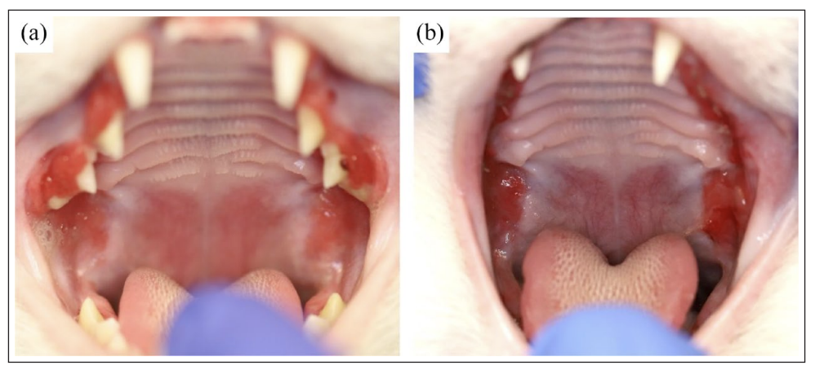
Feline Chronic Gingivostomatitis (FCGS)
What is it – Immune mediated inflammatory oral mucosal disease
Significance – Feline Mesenchymal Stem Cells (MSCs) Treatment
Curative in 60-70% of patients (1, 2)
Long term follow up demonstrated positive outcome in 58.6-65.6% of patients (3)
Soltero-Rivera et al. 2023

Slide 3
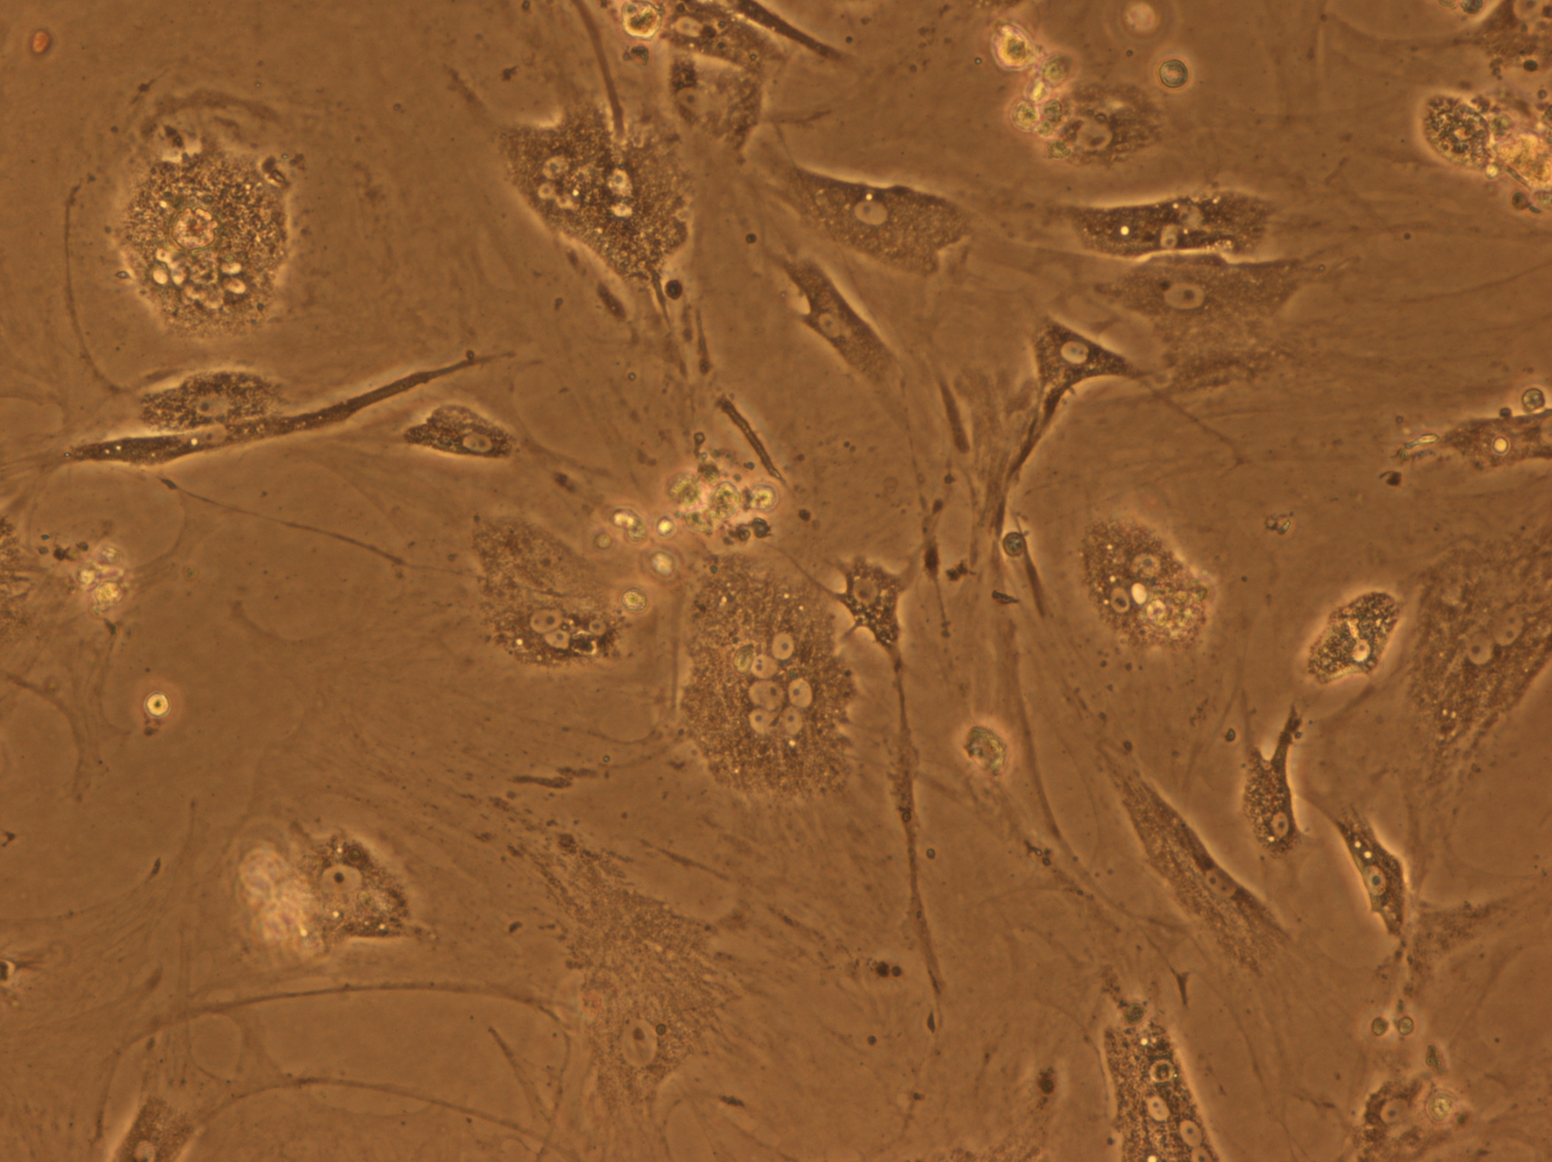
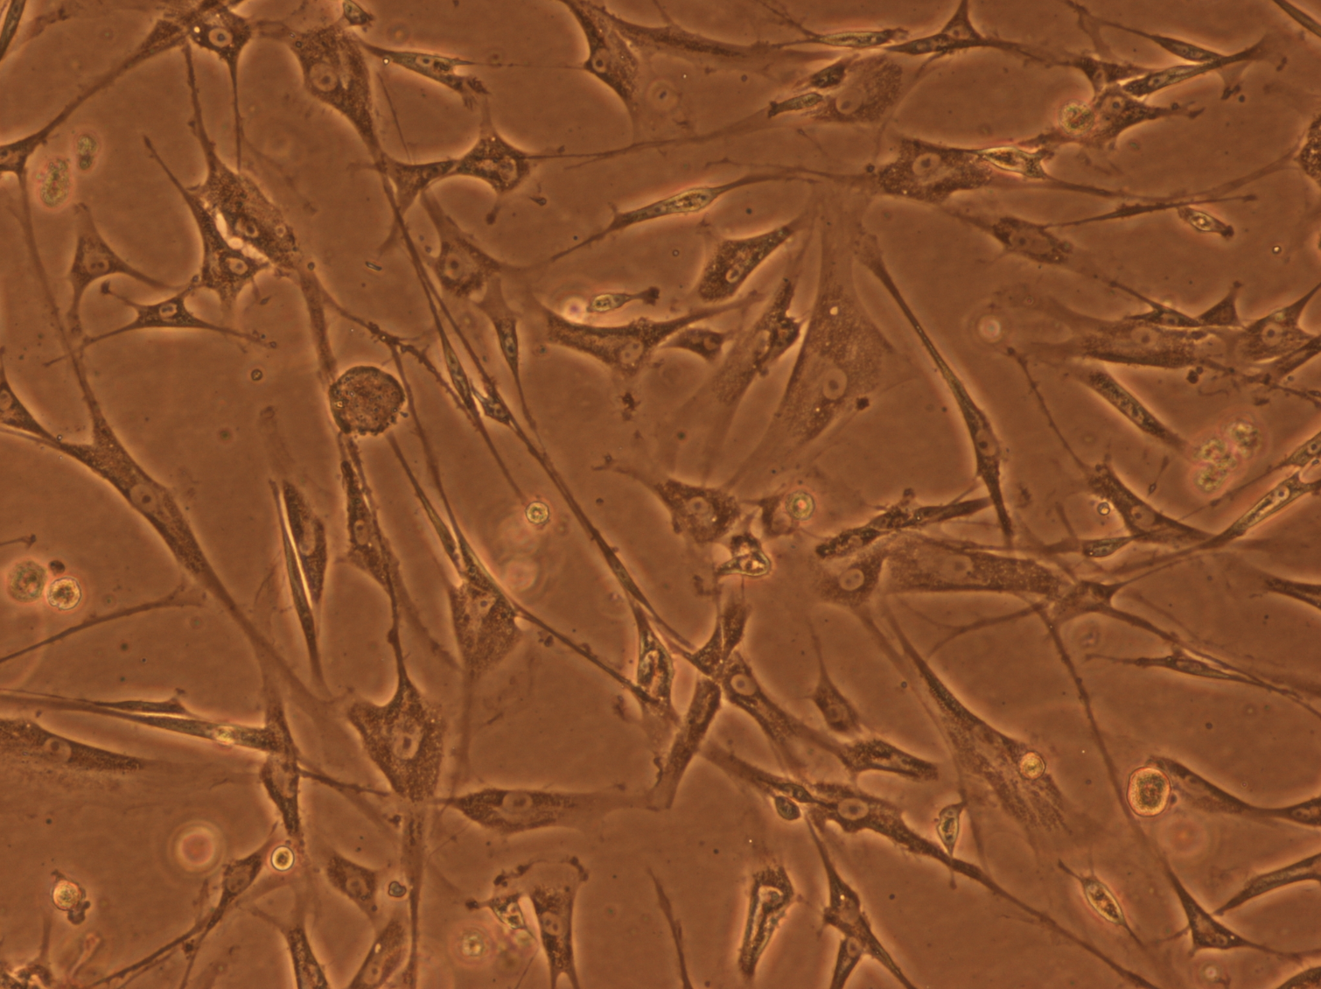
Allogeneic Mesenchymal Stem Cells
Allogeneic — Coming from a donor
Advantages
“Off the Shelf” treatments
Screened/Quality Assured (ex: feline foamy virus)
Disadvantages
Lower Efficacy
Longer to induce affects
Abnormal growth pattern
Normal growth pattern

Slide 4
Major Histocompatibility Complex I (MHC I)
What it does – Used by the immune system to detect self vs. non-self
Significance – Possible mechanism to explain lower efficacy when using allogeneic vs autologous MSCs
1. Allogeneic MSCs injected into recipient
4. Lower efficacy of treatment
2. Recipients immune system detects cells as “non-self” through MHC I
3. Recipients immune system destroys MSCs

Slide 5
Project Specific Aims
Construct a CRISPR/Cas 9 plasmid vector to knockout MHC I
Transfect MSCs with the plasmid and select MHC I-null MSC lines
Determine if MHC I-null MSCs decrease lymphocyte proliferation

Slide 6
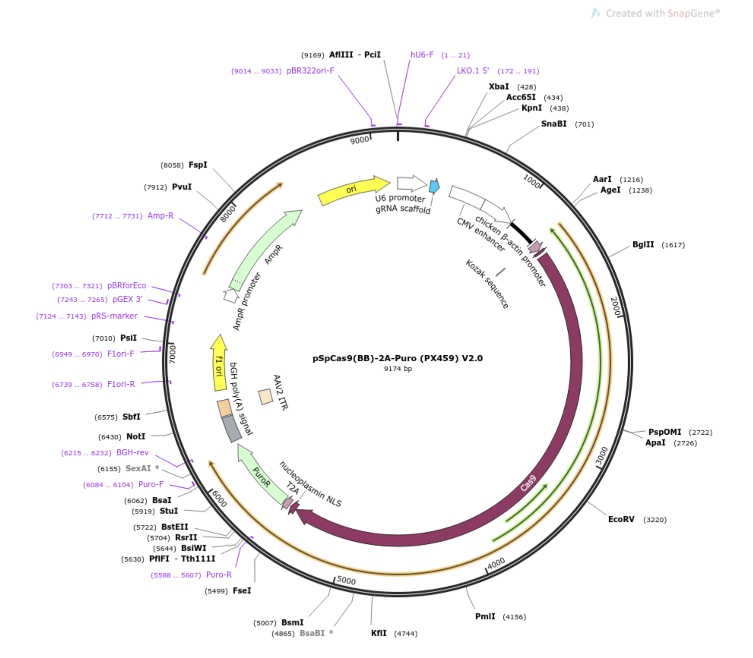
Aim 1 —The Plasmid Vector
What is a CRISPR/Cas9 plasmid?
A circular DNA molecule containing the necessary materials to cut DNA at a specific target sequence
How do we amplify the plasmid vector?
Propagation of the plasmid in bacteria
Selection of the bacteria that have incorporated the plasmid

Slide 7
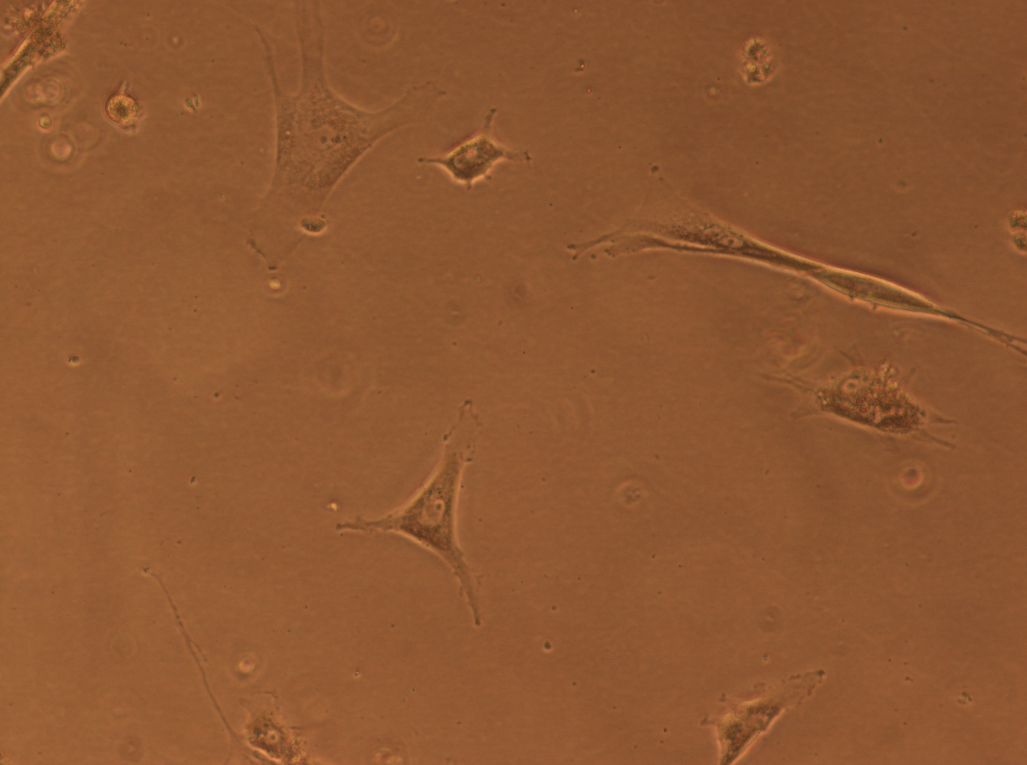
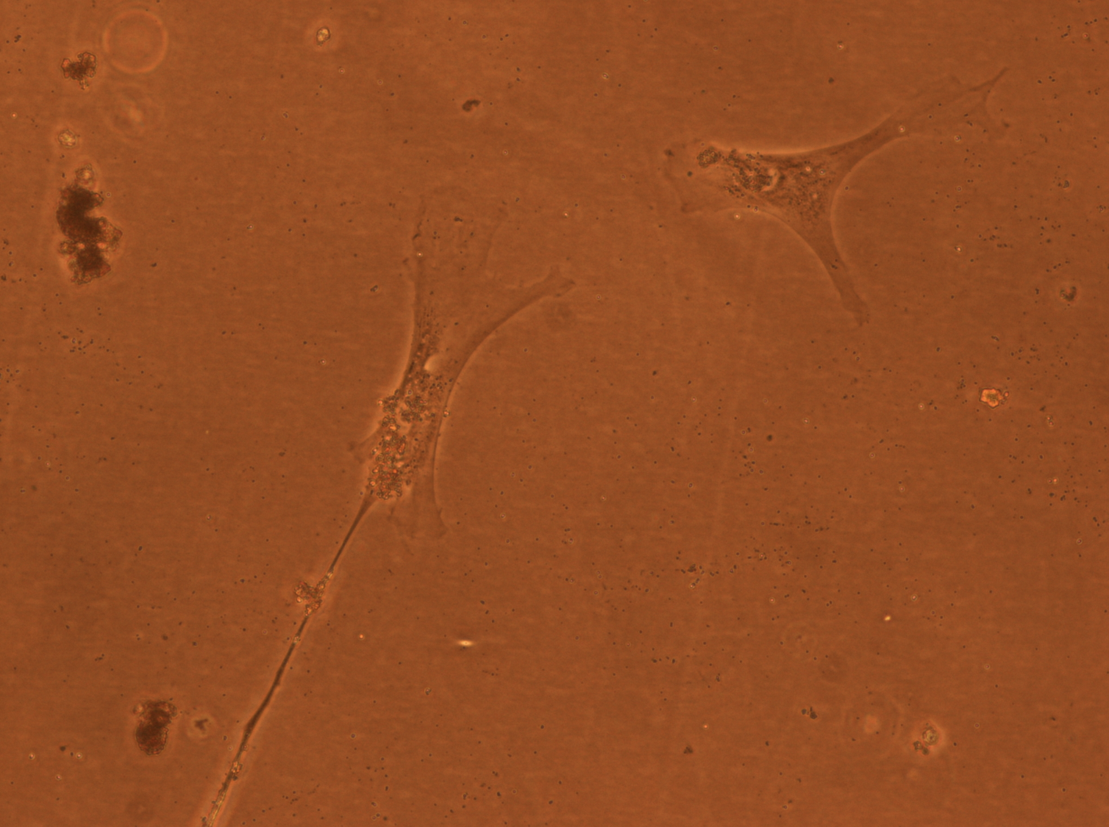
Aim 2 —Transfection of MSCs
Transfection – Exposure of MSCs to the vector plasmid allowing the specific DNA cuts to be made
Current Stage – 2/3 Donors growing and were selected using puromycin
Next Step – Testing the cells for gene disruption and decreased expression of MHC I

Slide 8
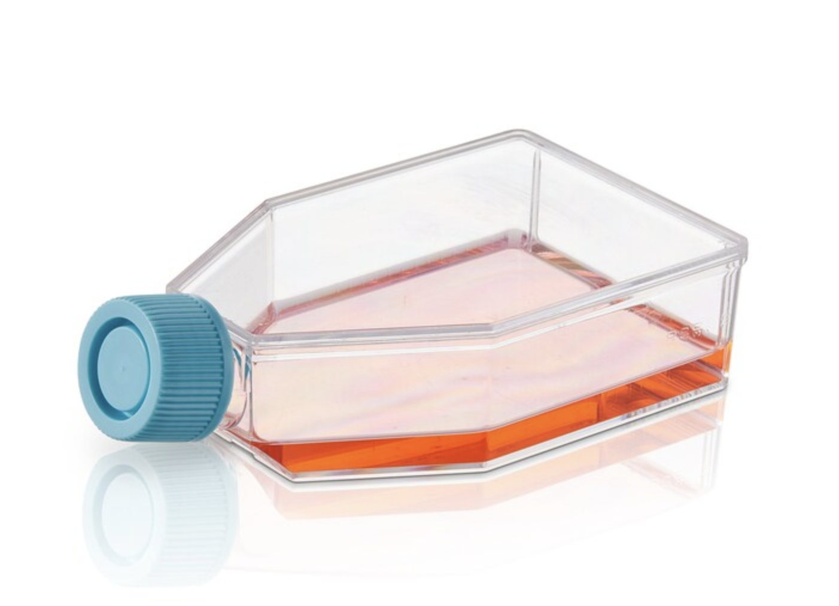
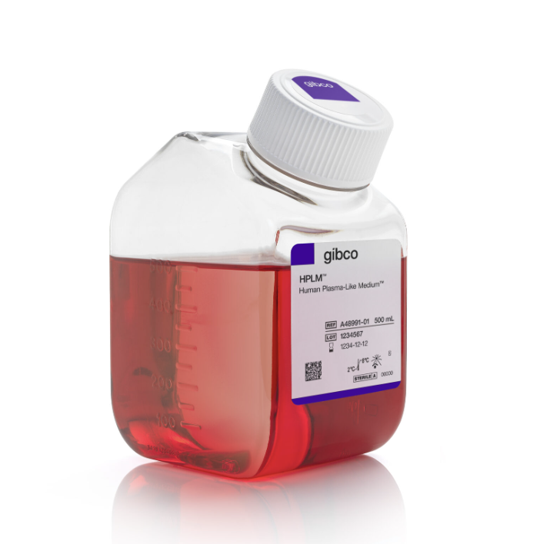
Aim 2 —Transfection of MSCs
How do we grow the millions of cells needed for testing?
MSC
MSC
MSC
+
+
MSC
MSC
MSC
MSC
MSC
MSC
MSC
MSC
MSC
MSC
MSC
MSC
MSC
MSC
MSC
MSC
MSC
MSC
MSC
MSC
MSC
MSC
MSC
MSC
MSC
MSC
MSC
MSC

Slide 9
Aim 3 – Lymphocyte proliferation
Comparing lymphocyte proliferation when cultured with MHC I-null vs. wildtype MSCs
What we expect to see:
Wildtype MSC → higher lymphocyte proliferation
MHC I-null MSC → lower lymphocyte proliferation
Wildtype MSC
MHC I-null MSC
Lymphocyte

Slide 10
Next Steps
The plan for what’s to come
1. Grow transfected MSCs
2. Confirm gene disruption and decreased expression of MHC I on the cell surface of MSCs
3. Test if decreased MHC I leads to lower lymphocyte proliferation when compared to wildtype

Slide 11
Acknowledgements
Carissa Garrity – PhD Candidate
Justine Irvine – Lab assistant
Iris Rivas – Junior Specialist
Funded by the National Institutes of Health

Slide 12
Thank You

Slide 13
References
Arzi, Boaz, et al. "Therapeutic efficacy of fresh, allogeneic mesenchymal stem cells for severe refractory feline chronic gingivostomatitis." Stem cells translational medicine 6.8 (2017): 1710-1722.
Arzi, Boaz, et al. "Therapeutic efficacy of fresh, autologous mesenchymal stem cells for severe refractory gingivostomatitis in cats." Stem cells translational medicine 5.1 (2016): 75-86.
Soltero-Rivera, Maria, et al. "Mesenchymal stromal cell therapy for feline chronic gingivostomatitis: Long term experience." Frontiers in Veterinary Science 10 (2023): 1171922.

