Slide 1
Associations between the humoral response to FIPV and treatment outcome in cats on antiviral therapeutics
Nicole Neely

Slide 2
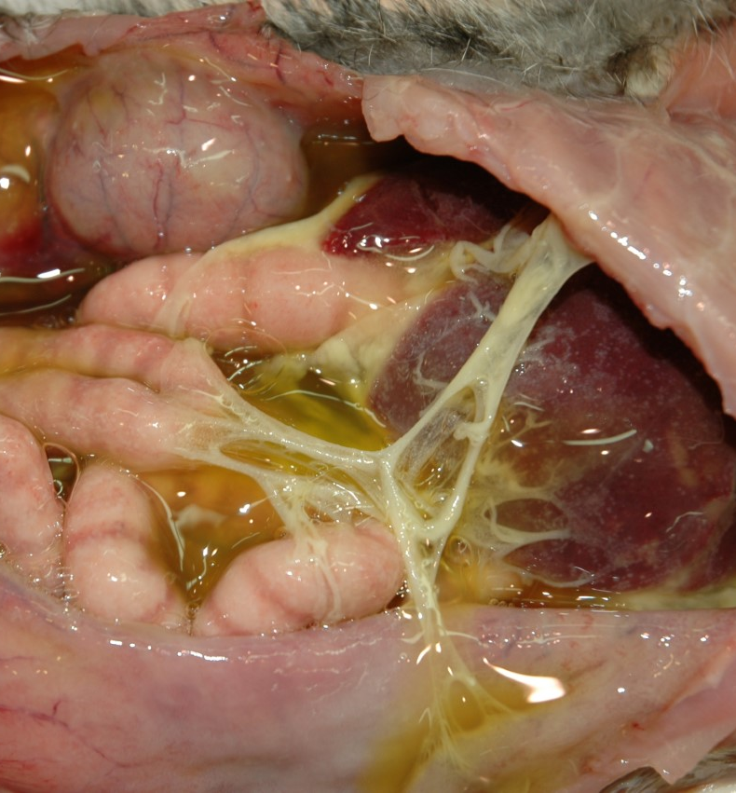
Background
FIPV: a peculiar feline coronavirus causing the disease “feline infectious peritonitis (FIP)”
Arises from the feline enteric coronavirus (FECV) after it undergoes certain mutations
Mutations allow for the infection of macrophages
Long considered a fatal, untreatable disease
Exhibits the property of “antibody-dependent enhancement (ADE)”
Recent research has revealed several modern antivirals with potential to actual efficacy against FIPV
GS-441524, GC376, nirmatrelvir, remdesivir, EIDD2801 (molnupiravir)
None are FDA-approved for use against FIPV (yet)
Notes:
Remdesivir is a nucleotide analogue (currently used in Australia as a successful FIP treatment). GS-441524 is its metabolite. GC376 is a protease inhibitor. EIDD2801 is a ribonucleoside analogue.
ADE is the ability of antibodies against a virus to facilitate cellular invasion, making viral spread easier and worsening disease

Slide 3
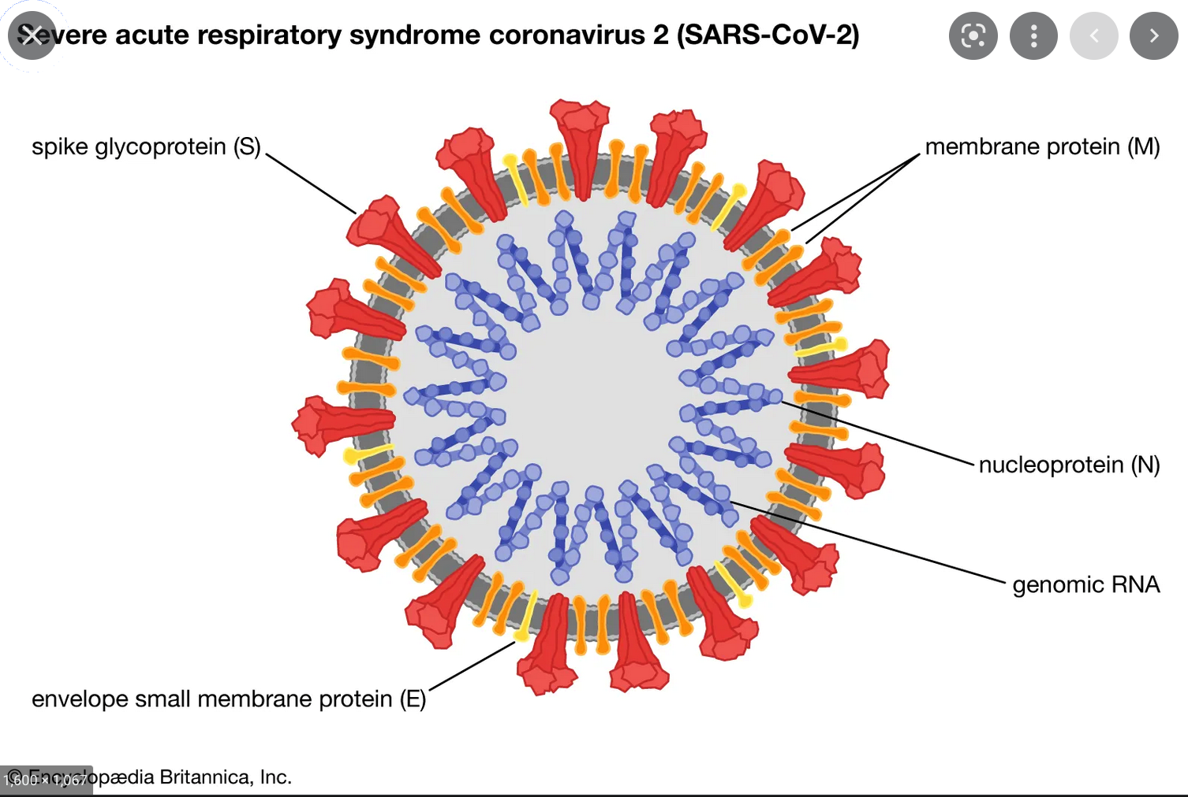
←Spike (>170 kDa)
N-protein (~55 kDa)
]M-protein (~24-32 kDa)
]E-protein (~12-18 kDa)
(>170 kDa)
(~24-34 kDa)
(>170 kDa)
(~24-34 kDa)
(~55 kDa)
(~55 kDa)
(~12-18 kDa)
(~12-18 kDa)
From Encyclopedia Britannica, Inc. and https://www.nature.com/articles/s41433-020-0790-7
Notes:
Model of a coronavirus showing the locations, names, and functions of the four structural proteins (plus the RNA genome, which is not actually circular). When infected with FIPV, a cat can produce a humoral response against these proteins.
Spike is responsible for serotype, of which there are two.

Slide 4
Cats
Three FIPV+ cats are currently enrolled in a clinical trial at the VMTH [Combined stem cell and antiviral treatment in cats with feline infectious peritonitis (FIP)]:
Mr. Miyagi
Leo
Sage
Other cats investigated:
Mr. Biscuit (multiple years post-experimental infection w/ serotype 1 and treatment with GS-441524)
SPF cat (negative control)
FECV-infected cats (serum supplied from Colorado State University)
Monoclonal antibodies against FIPV nucleocapsid protein:
FIPV3-70
CCV2-2
Notes:
All three trial cats are receiving GS-441524 +/- mesenchymal stem cell therapy as part of the clinical trial.
Cats receive weekly to bi-weekly appointments, including abdominocentesis and blood collection.
There is another post-infection cat (Fisher) on the way.

Slide 5
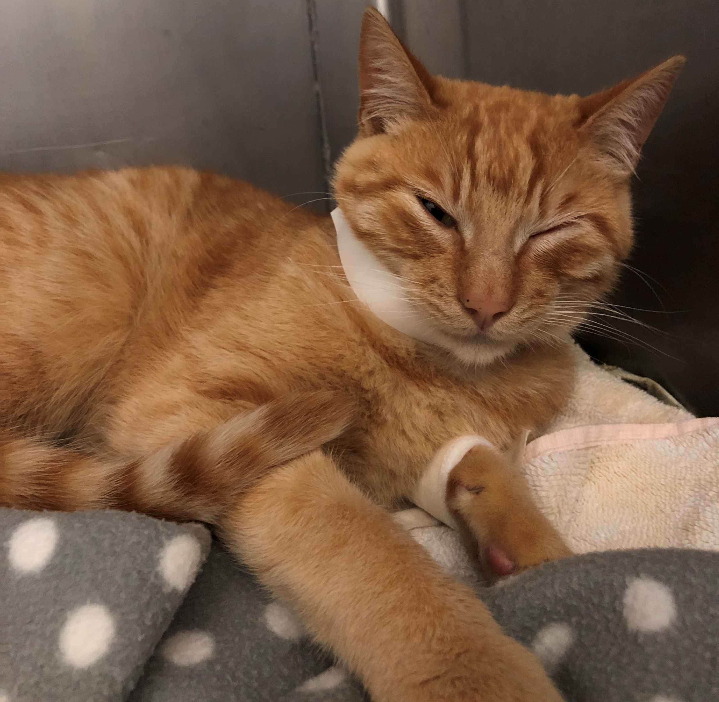
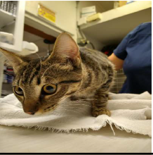
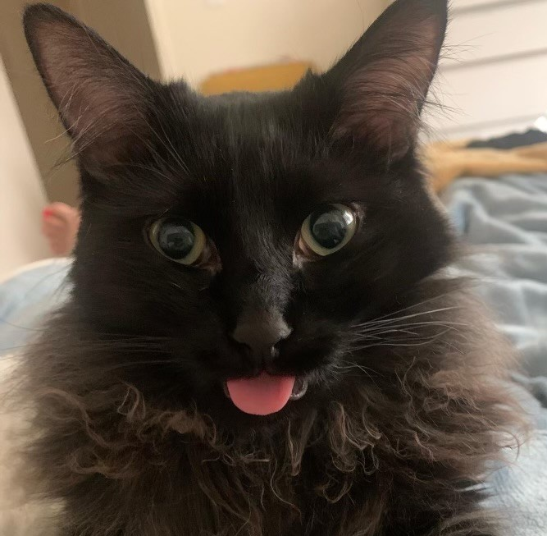
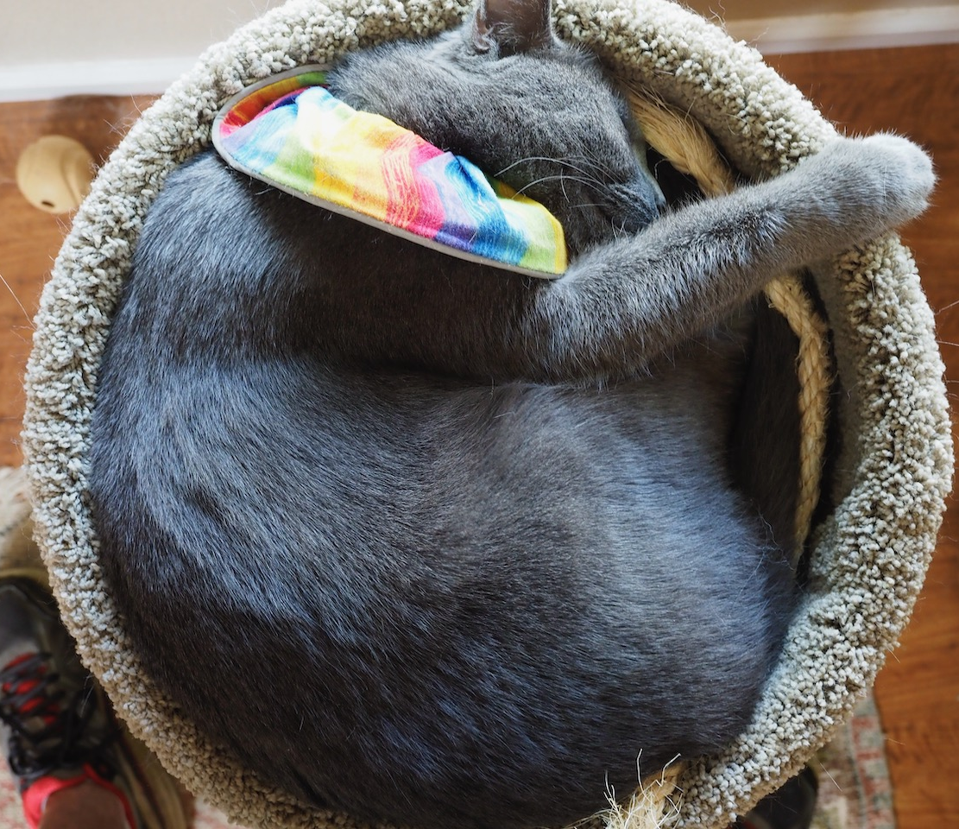
Cats
Mr. Miyagi
Leo
Sage
Mr. Biscuit →
Notes:
These are the three clinical trial cats. Plus Mr. B.

Slide 6
Hypothesis & Specific Aims
Hypothesis: The humoral response to feline infectious peritonitis (FIP) virus is associated with treatment outcome in cats naturally-infected with feline coronavirus and treated with antiviral therapeutics.
Specific Aim 1: Characterize the humoral response to FIPV in naturally-infected cats on antiviral treatments.
Specific Aim 2: Use traditional statistical methods to associate humoral response with response to antiviral therapy, mortality, and overall treatment outcome.
Notes:
Why do I hypothesize this? Because FIP exhibits ADE.

Slide 7
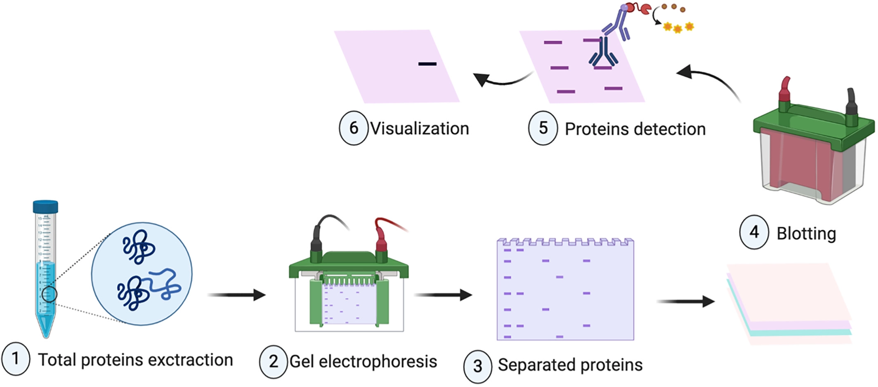
Technique #1: Western Blot
Feline serum can be used as the primary antibody, allowing the serum to be assayed for a humoral response to FIPV.
Western Blotting (WB) is a technique used to identify target proteins and/or antibodies from impure sources, such as serum or ascites fluid.
The degree of chemiluminescence (signal) corresponds to the amount of target protein/antibody present.
(Such as protein from cell culture of FIPV)
Image from https://doi.org/10.1002/bmb.21516
Notes:
Protein is run on an SDS-PAGE gel to separate it by molecular weight. That protein is then transferred to a blot (PDVF membrane). The blot is exposed to a primary antibody, which may bind to the separated proteins trapped in the membrane. A secondary antibody, which binds a conserved region on the primary antibody and is conjugated to a horseradish peroxidase (HRP) enzyme, is added. Visualization is done by exposing the membrane to a luminol/peroxide mixture. HRP oxidizes luminol, causing it to emit light, which can be captured using an imager or film exposure.

Slide 8
Western Blot 6/29/22 – FECV vs. FIPV Serum
Spike (>170 kDa)
??? (~72 kDa)
Nucleocapsid (~55 kDa)
]M-protein (~26-34 kDa)
← E-protein (~18 kDa)
1 2 3 4 5 6 7 8 9 10
FECV+ serum
FIPV+ serum
mAb
SPF cat serum
Mr. Biscuit serum
Notes:
This blot represents the typical way I set up my WBs. The primary antibody is a serum or ascites sample from a cat. The secondary antibody is an anti-cat HRP-conjugated antibody.
E-protein was likely not separated from M-protein due to the runtime of the gel.
I repeated this experiment with ascites fluid from the trial cats and got a very similar result.

Slide 9
Western Blot 7/14/22 – FIPV with Isotyping Reagents
Spike (>170 kDa)
Nucleocapsid (~55 kDa)
]M-protein (~26-34 kDa)
← E-protein (~18 kDa)
Anti-cat
IgG
IgA
IgM
Anti-cat
IgG
IgA
IgM
Anti-cat
IgG
IgA
IgM
Mr. Miyagi Leo Sage
Notes:
I also ran a WB using special isotyping reagents. Instead of two antibodies, this experiment used three. These reagents allow for the IgM, IgA, and IgG in a polyclonal sample to be differentiated from each other.
Only FIP II was run in the gel. Primary antibody was feline serum at 1:1000, secondary anti-isotype antibodies at 10ug/ml, and tertiary anti-mouse HRP at 1:3000.
IgG predominates.

Slide 10
WB Conclusions
A strong humoral response is elicited against N-protein and M-protein, including the various forms of glycosylation exhibited by M-protein
The antibody profile against FIPV in ascites fluids seems to imitate that of serum
The antibody profile in acute infection with FIPV or FECV appears equivalent
IgG is the predominant antibody produced against FIPV
The antibody profile may change over time post-infection
FIPV I does not appear well on Western Blot
Notes:
Mr. Biscuit may also show that there’s a difference between humoral response when experimentally vs. naturally infected.

Slide 11
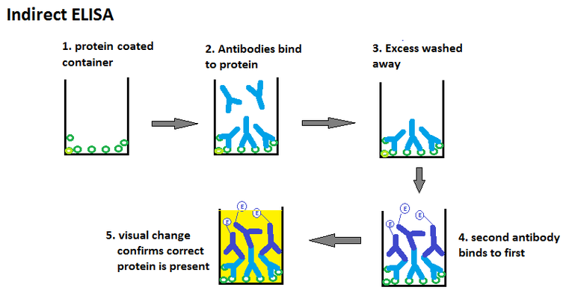
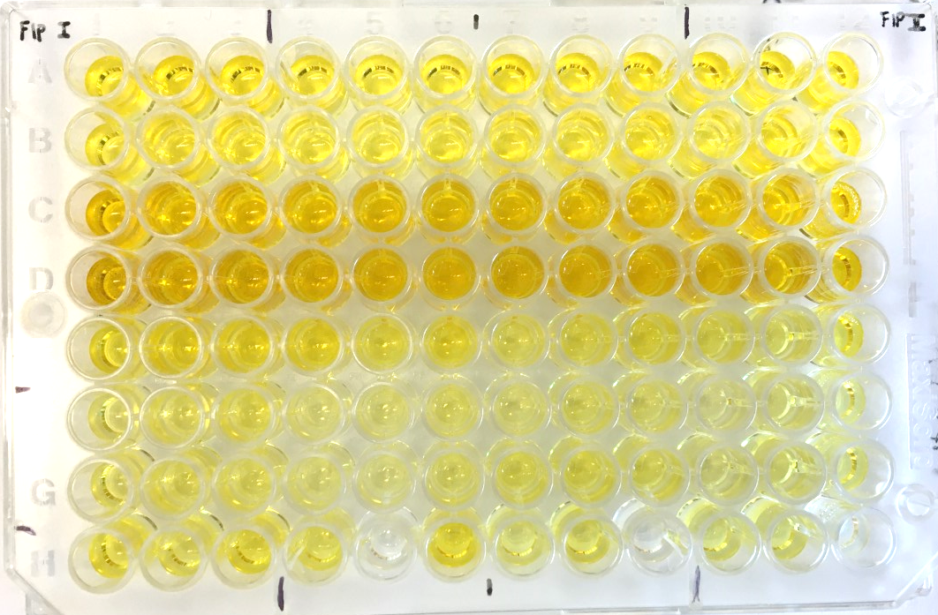
Technique #2: Indirect ELISA
Enzyme-linked immunosorbent assay (ELISA) is another technique used to identify proteins and/or antibodies.
The intensity of color (signal) corresponds to the amount of target protein/antibody present.
(Such as protein from cell culture of FIPV)
Image from https://pediaa.com/what-is-the-difference-between-direct-and-indirect-elisa/
Notes:
A 96-well ELISA plate is coated with a protein sample of choice. The plate is exposed to a serum or ascites sample, which contains many antibodies (polyclonal). If antibodies against the protein exist, they will bind to the plate. A secondary antibody, which binds a conserved region on feline antibodies and is conjugated to a horseradish peroxidase (HRP) enzyme, is added. Visualization is done by exposing the wells to a TMB reagent. HRP oxidizes TMB, causing it to produce a blue color. When the reaction is stopped with sulfuric acid, the color changes to yellow.
ELISA results are quantitative and easier to statistically analyze, while Western Blot results are not. However, ELISA cannot separate proteins by molecular weight; the signal seen on ELISA is the ‘sum’ of all the proteins WB can tell apart. While similar, the two techniques are not redundant.

Slide 12
ELISA 6/23/22 – FIPV Serum
Leo serum
Leo serum
Neg control
Sage serum
Neg control
Sage serum
SPF cat serum
Mr. Biscuit serum
SPF cat serum
Mr. Biscuit serum
Mr. Miyagi serum
Mr. Miyagi serum
No significant difference was found between FIPV I and FIPV II signal for any sample.
Notes:
An example of how the data from an ELISA is displayed. ELISAs are run in triplicate so color intensity is quantified by the plate reader, and then converted to an average with standard deviation.
ELISA plate coated w/ 250ng FIPV I or FIPV II, probed with cat serum at 1:400, and secondary antibody at 1:3000.
I repeated this ELISA with ascites fluid from the trial cats and serum from FeCoV+ cats:
A strong signal from FIPV+ ascites fluid (comparable to serum, maybe slightly less signal)
A significantly-stronger signal in FIPV+ vs. FeCoV+ cat samples
FeCoV signal is comparable to an uninfected cat.

Slide 13
ELISA 7/8/22 – Isotyping Reagents
FECV 1 FECV 3
Notes:
A special ELISA using reagents designed to differentiate the isotypes of feline antibodies.
ELISA plate coated w/ 250ng FIPV II, probed with cat samples at 1:400, secondary antibody at 10ug/ml, and tertiary antibody at 1:3000.
Secondary Ab are special murine Ab with targeted activity against different isotypes of feline Ab. Tertiary Ab is anti-mouse IgG HRP.

Slide 14
ELISA Conclusions
The humoral response to FIPV is not identical between cats, but present in all cats
Antibodies produced in response to infection bind FIPV proteins regardless of serotype
A significantly-stronger response is produced in FIPV+ vs. FECV+ infection
Response to FIPV (but not FECV) is IgG-heavy, with small amounts of IgM and IgA
The antibody profile in ascites fluids seems to imitate that of serum
Humoral immunity may be maintained for many years post-infection
The inequality between FIPV I and FIPV II seen on Western Blot is not indicative of a real difference in feline humoral response
Notes:
ELISA does not support the variation in FIPI and FIPII signal seen in the WBs. Something in the reduction step (DTT reducer and heating at 70C) or the exposure to PAGE in the gel may be altering the Ab-binding properties of FIPI proteins.

Slide 15
How are they doing?
“very active with a great energy and appetite at home”
“doing well at home with no current signs of illness”
“feeling good with a good appetite”
Notes:
With all three cats doing so well…there might not be an association between humoral response and treatment outcome. I also don’t have enough statistical power to mean anything (at this moment).
The clinical trial has room to enroll 7 more cats! There is also another clinical trial of 20 cats that has just started recruiting, and two more upcoming (60 cats total, different antivirals tested). With a greater sample size, any future statistical analyses will be more conclusive.

Slide 16
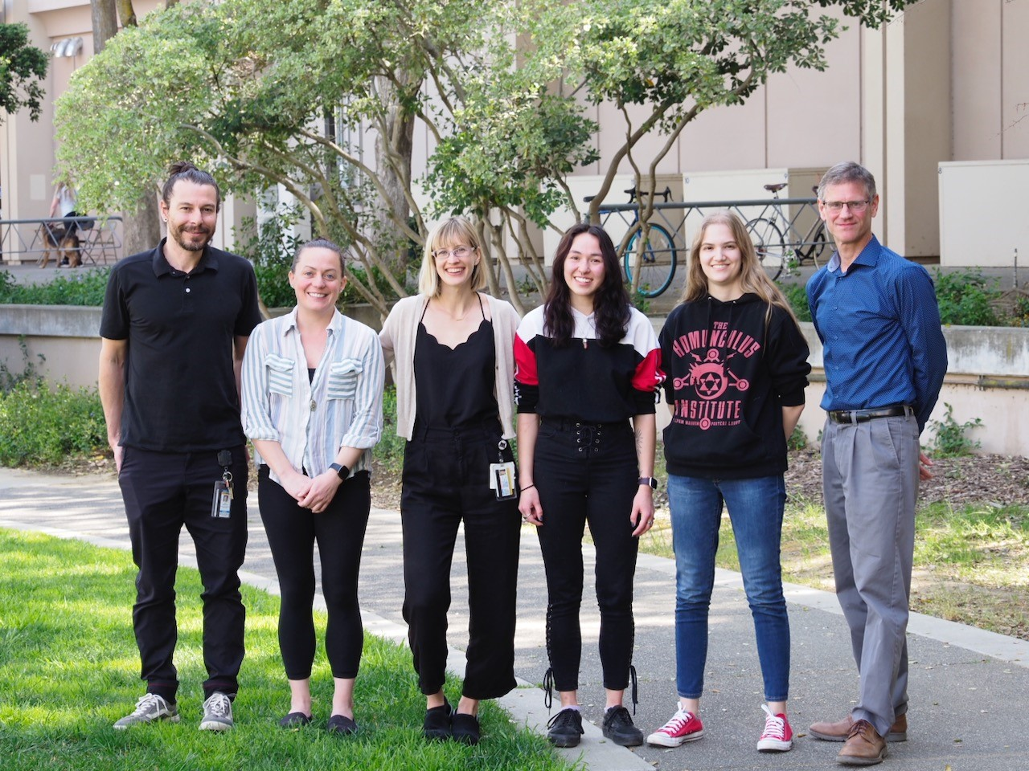
Acknowledgements
Everyone in the Murphy Lab
Brian, Diego, Sarah, and Sonyia
Dr. Gregg Dean (supplier of FECV+ serum)
Dr. Chris Grant (supplier of isotyping reagents and monoclonal antibodies)
Dr. Amir Kol (PI for the clinical trial)
Dr. Krystal Reagan (statistics expertise)
Dr. Philip Kass (statistics expertise)
The NIH for funding the clinical trial (grant #1 R21 HD106027-01)
The Center for Companion Animal Health Endowment Fund for funding my project

Slide 17
Citations
Cook, S. E., Vogel, H., Castillo, D., Olsen, M., Pedersen, N.C., and Murphy, B. G. (2021). Investigation of monotherapy and combined anti-coronaviral therapies against feline coronavirus serotype II in vitro. Journal of Feline Medicine and Surgery. https://doi.org/10.1177/1098612X211048647
Jaimes, J. A., Millet, J. K., Stout, A. E., Andre, N. M., and Whittaker, G. R. (2020). A tale of two viruses: the distinct spike glycoproteins of feline coronavirus. Viruses, 12(1). https://doi.org/10.3390/v12010083
Mahmood T, Yang PC. (2012). Western blot: technique, theory, and trouble shooting. North American Journal of Medical Sciences 4(9). doi: 10.4103/1947-2714.100998.
Murphy, B. G., Perron, M., Murakami, E., Bauer, K., Park, Y., Eckstrand, C., Liepnieks, M., and Pedersen, N. C. (2018). The nucleoside analog GS-441524 strongly inhibits feline infectious peritonitis (FIP) virus in tissue culture and experimental cat infection studies. Veterinary Microbiology, 219, pp. 226-233. https://doi.org/10.1016/j.vetmic.2018.04.026
Olsen, C. W., Corapi, W. V., Ngichabe, C. K., Baines, J. D., Scott, F. W. (1992). Monoclonal antibodies to the spike protein of feline infectious peritonitis virus mediate antibody-dependent enhancement of infection of feline macrophages. Journal of Virology 66(2). https://doi.org/10.1128/jvi.66.2.956-965.1992

Slide 18
Citations cont.
Pedersen, N. C. (2014). An update on feline infectious peritonitis: Virology and immunopathogenesis. The Veterinary Journal, 201(22), pp. 123-132. https://doi.org/10.1016/j.tvjl.2014.04.017
Rottier, P. J., Nakamura, K., Schellen, P., Volders, H., Haijema, B. J. (2005). Acquisition of macrophage tropism during the pathogenesis of feline infectious peritonitis is determined by mutations in the feline coronavirus spike protein. Journal of Virology, 79(22), pp. 14122-30. doi: 10.1128/JVI.79.22.14122-14130.2005.
Takano T, Kawakami C, Yamada S, Satoh R, Hohdatsu T. (2008). Antibody-dependent enhancement occurs upon re-infection with the identical serotype virus in feline infectious peritonitis virus infection. Journal of Veterinary Medical Science 70(12). doi: 10.1292/jvms.70.1315

