Slide 1
Variation on endothelial tight junctions in the TgF344-AD rat in Alzheimer’s disease
Marielle Rikkelman
Lein lab
STAR Project 2023

Slide 2
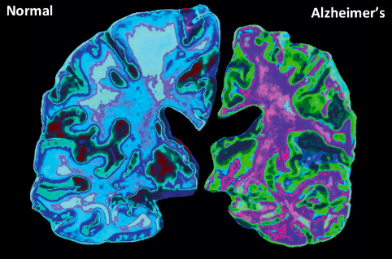
Canine brain
(Alzheimer's Association, 2023)
Notes:
Intro - I wanted an infographic as a “why research on the topic is important” for the audience to engage with while I highlight the main points (>50% of adults over 80 will have dementia and 50% of dementias are AD) and but I wasn’t sure if this was an appropriate one – I think its from a rather reputable source so definitely wanted feedback on that
Start with overarching reason theres relevance for research and that age is a primary risk factor esp bc age->inflammation->neurodegeneration and one hypothesis is because…

Slide 3
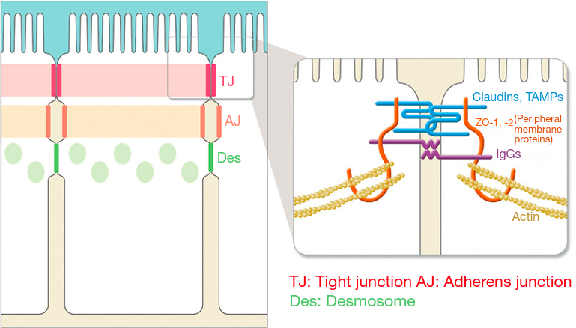
Occludin
(Tsukita, 2013)
Claudin-5
Notes:
Blood brain barrier (BBB in slides) becomes leaky due to tight junction loss. Then go over basic structure of tight junctions, how they are important for keeping important components like serum proteins and fibrinogen out (unlike other endothelial locations), but have been related to other neurodegenerative diseases like MS. Which is why loss of TJ over time with the presentation of AD phenotypes is worth the investigation

Slide 4
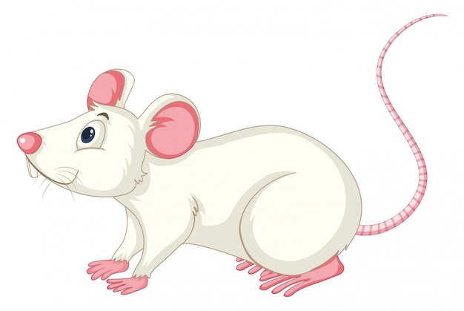
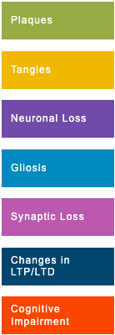
The TgF344-AD Rat
2.6x more human mutant amyloid precursor protein (Saido, 2013)
6.2x more human presinilin 1 (PS1△E9) (Saido, 2013)
Inflammatory responses and progression of clinical features of AD
age-dependent cerebral amyloidosis before gliosis and neuronal loss in cortex and HC)
TG mice commonly used for amyloid-β peptides, mutant presenilin and/or mutant tau do not

Slide 5
10 month collection (N=10)
N_{Wt}=4
N_{Tg}=6
15 month collection (N=9)
N_{Wt}=4
N_{Tg}=5
IHC Staining for:
BBB Integrity (TJs Occludin & Claudin 5)
Neuroinflammation (GFAP) + AQP4
AD-neuropathy (amyloid-β plaques)
Regions of Interest
Hippocampus
Prefrontal cortex
Entorhinal cortex
(Paxinos & Watson, 2018)
Notes:
Wasn’t sure whether to include AQP4? Also I figured the layout was neat like this so I could point to the regions while having it in writing but I don’t know if there is too much going on

Slide 6
Analysis: using ImageXpress® Micro
by Molecular Devices
BBB Integrity (TJs Occludin & Claudin-5)
Regional area
Neuroinflammation (GFAP) & AQP4
Morphology & area
AD-neuropathy (amyloid-β plaques)
Area & intensity
→ compare b/w age groups
→ compare b/w experimental groups
Notes:
Please leave notes on whether I got the analyses right!! I haven’t looked at them on the imager in a while so they may not be 100% correct. Also I took this image myself do I need to give myself credit or anything

Slide 7
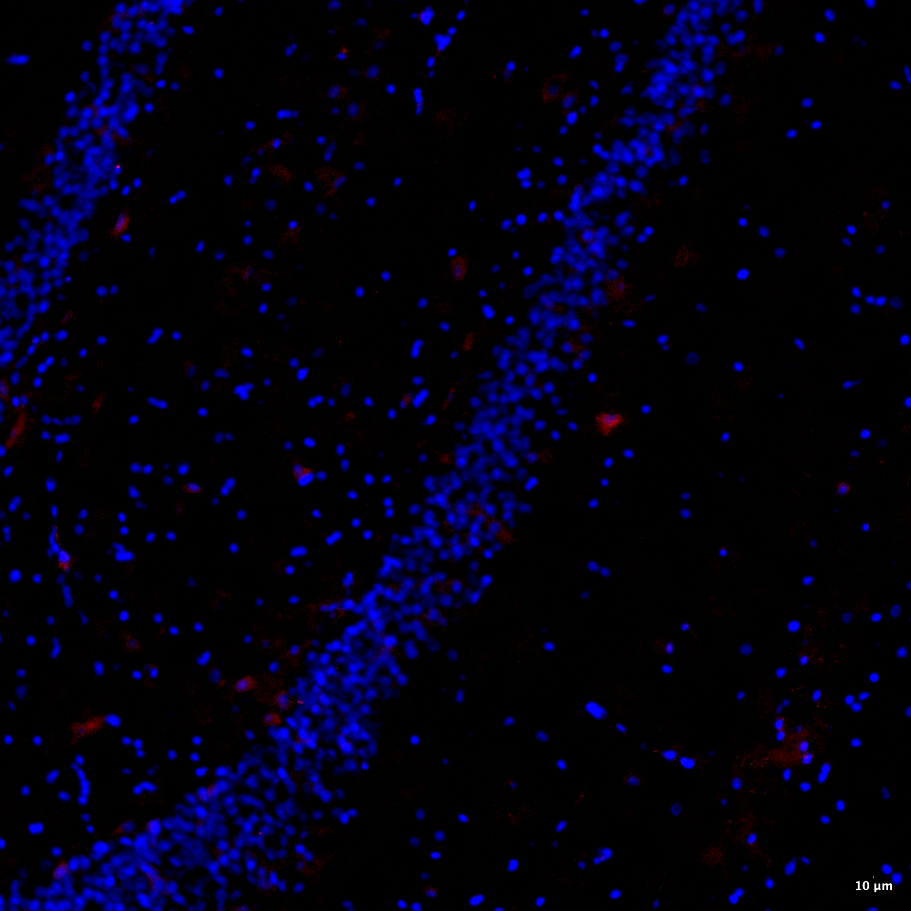
Amyloid-β Plaques
20x
DAPI
OC
Placeholder for WT image
transgenic, 15 months
wildtype, 15 months
Notes:
Add 20 x

Slide 8
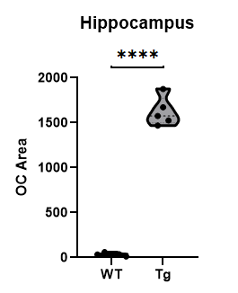
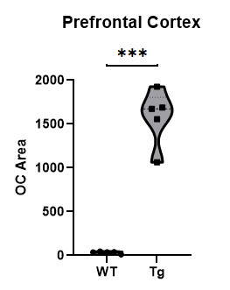
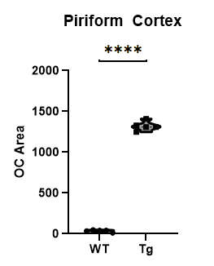
Amyloid-β Plaque Area – Regional Heterogeneity 15 months
*
*
*
* = p < 0.05
Notes:
I assume the asterisks were the p-values – im gonna write a key at the bottom of the slide and need the values (in case anyone asks or is curious).. Also I have once more forgotten pam’s favorite term but I want to separate the average vs regionally-parsed data with that as a header

Slide 9
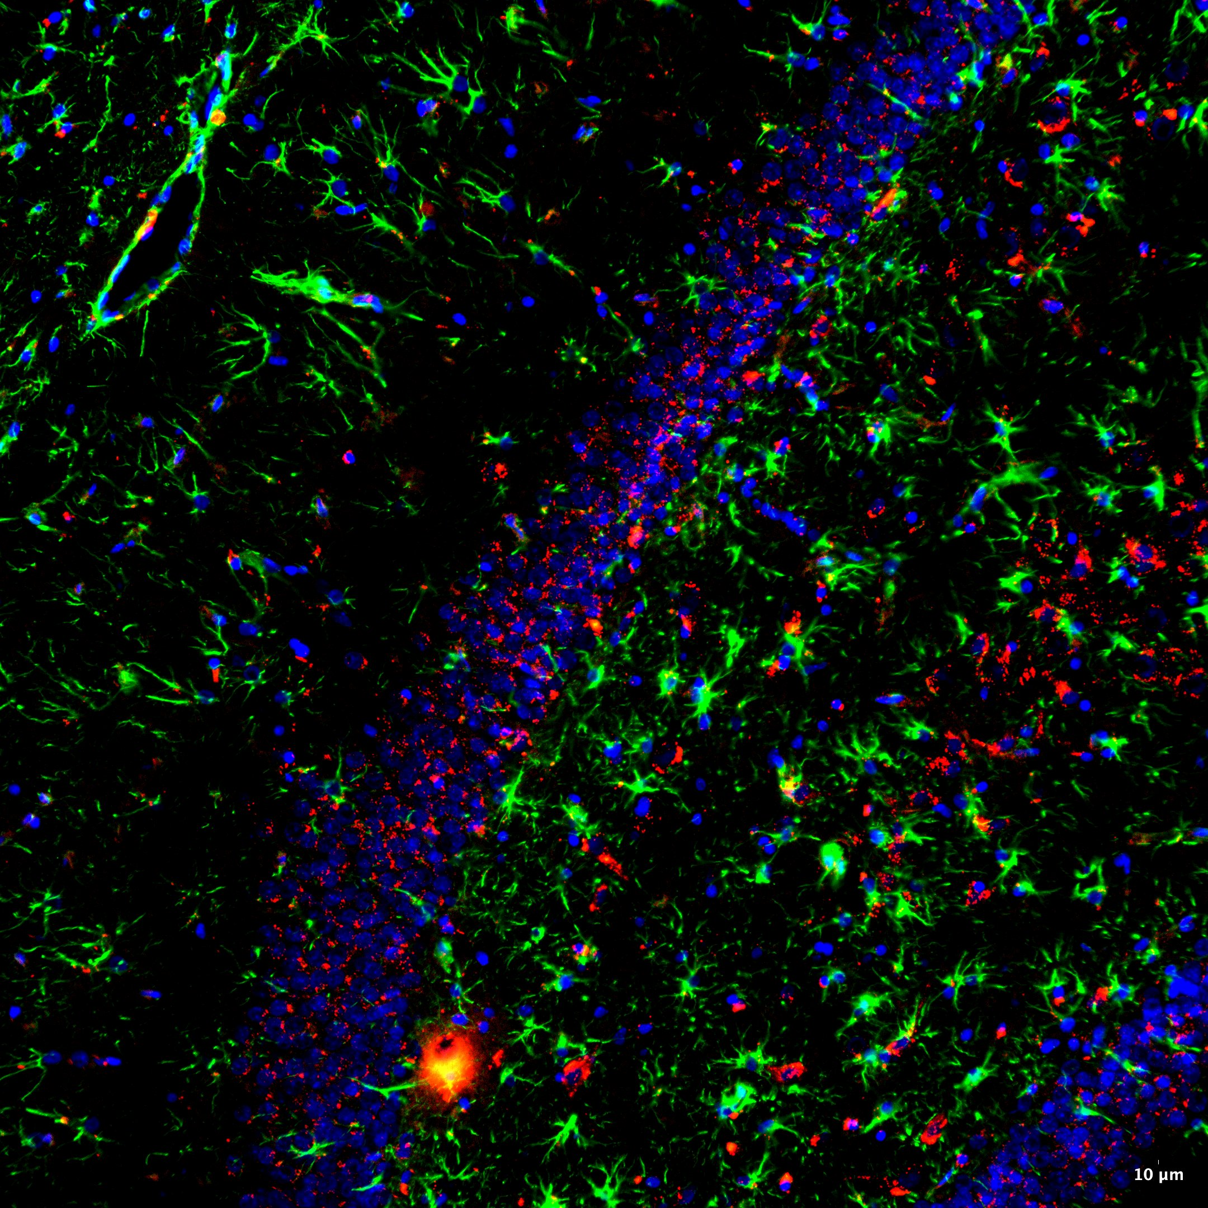
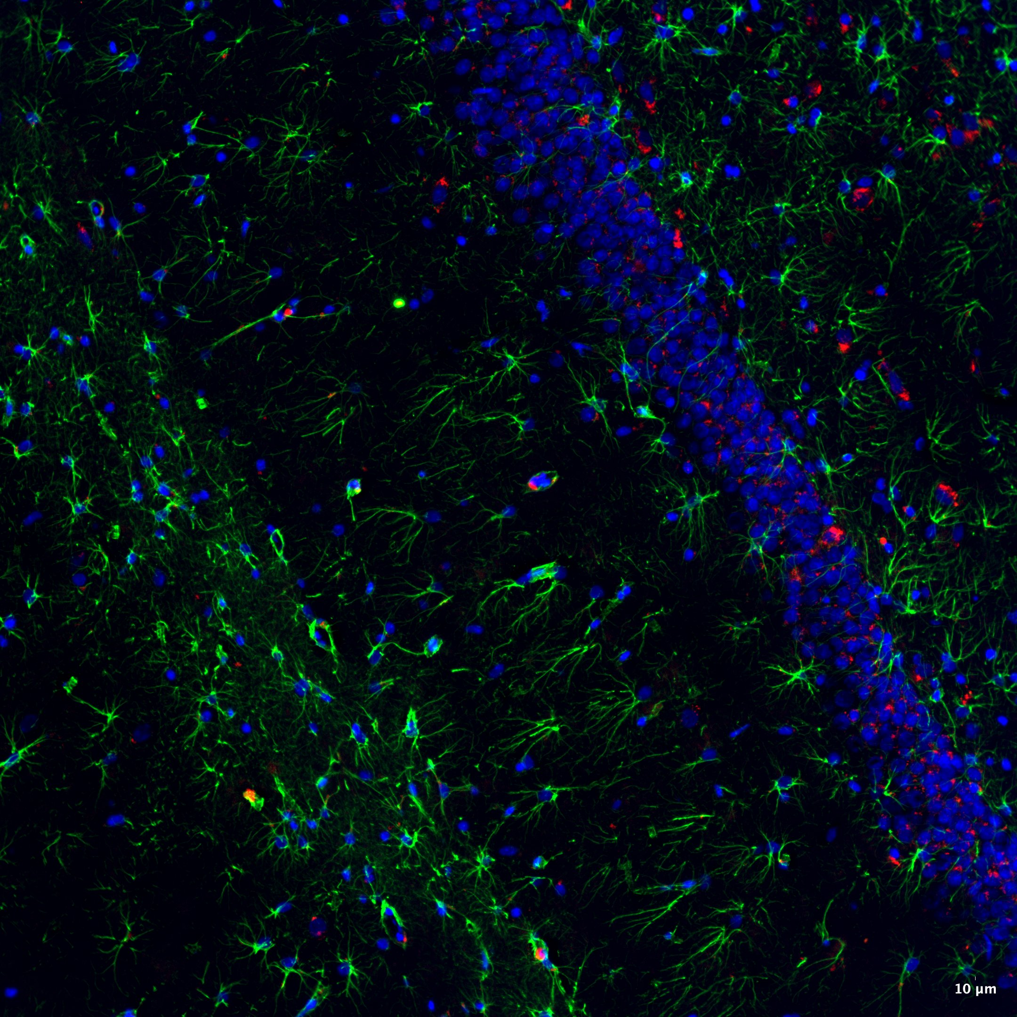
GFAP & AQP4 Aggregates
20x
DAPI
GFAP
AQP4
20x
DAPI
GFAP
AQP4
transgenic, 15 months
wildtype, 15 months
Notes:
Morphology – more fibrillary tangles (GFAP is present in non-reactive and reactive glia, but more blob-like with end feet)

Slide 10
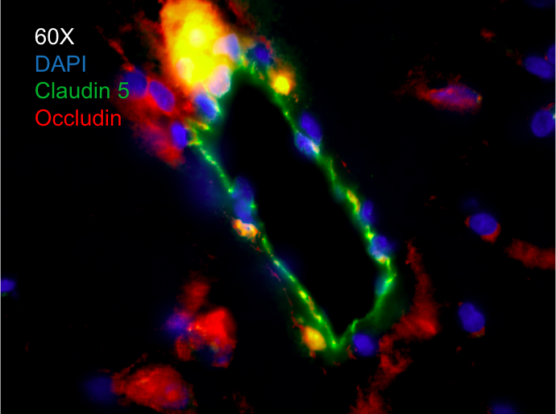
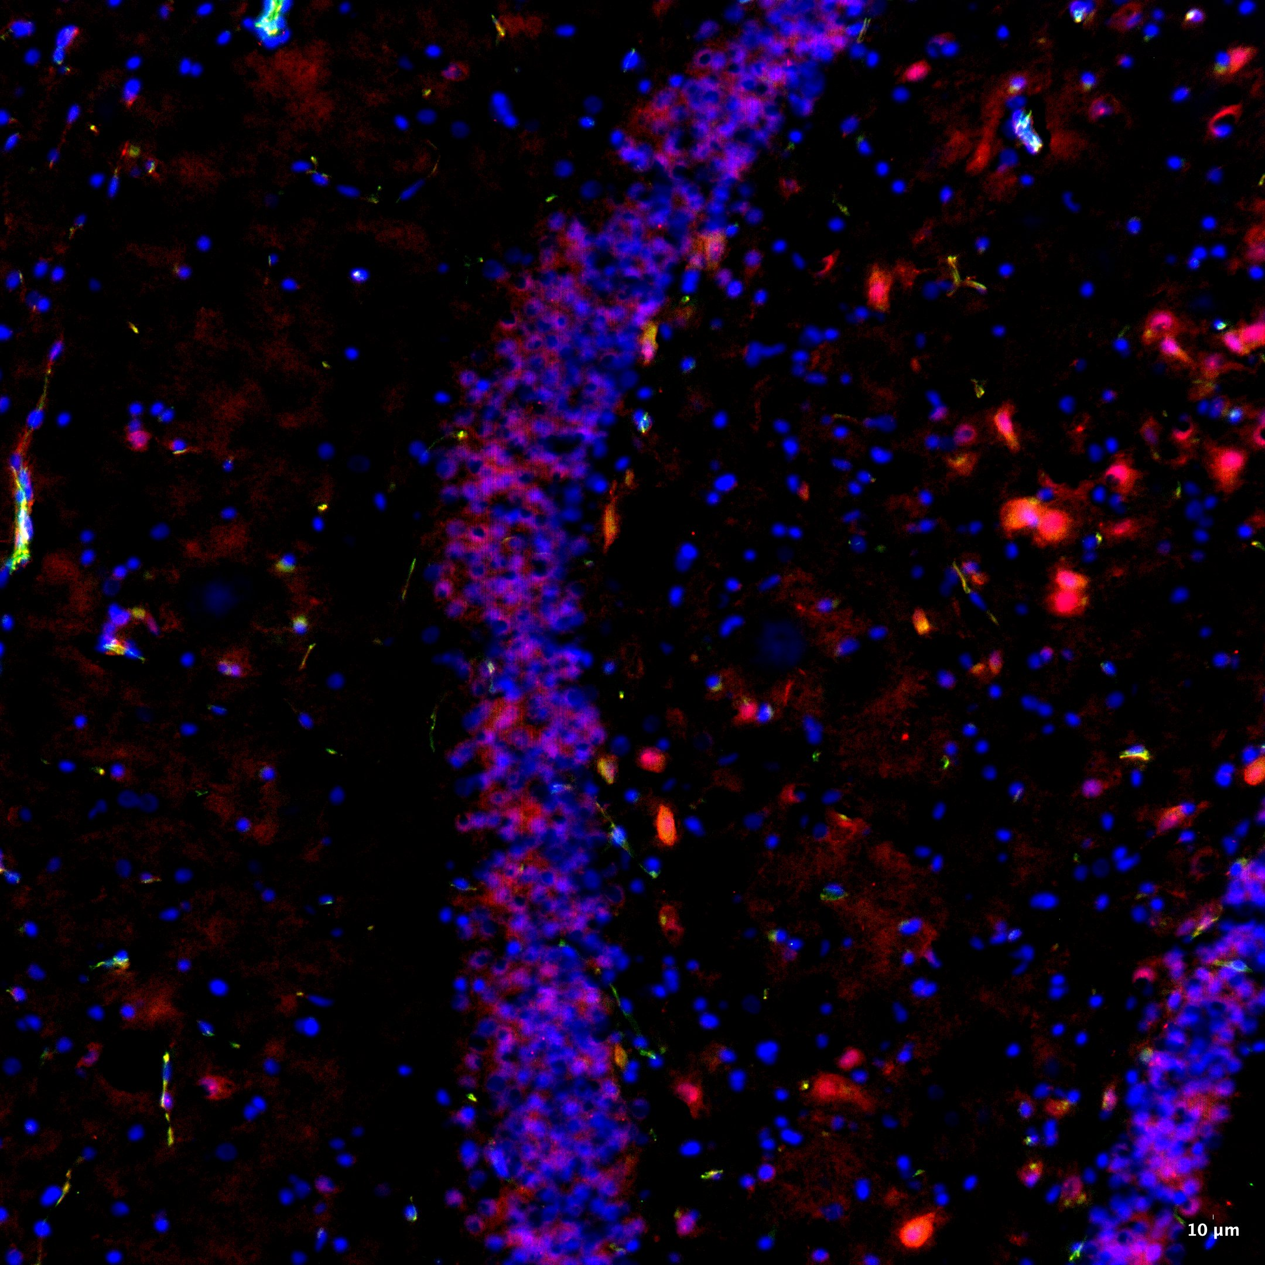
Tight Junctions
20x
DAPI
Claudin 5
Occludin
transgenic, 15 months
wildtype, 15 months

Slide 11
Tight Junction – Regional Heterogeneity 15 months
Prefrontal cortex compilation to come…
Entorhinal cortex compilation to come…
Notes:
What was the area density units? What are RFU? (I wasn’t sure whether we talked about changing it to just intensity during the lab meeting)

Slide 12
Roadblocks & Solutions (… in progress!)
Maintaining tissue integrity → change/tighten IHC protocol
Too much drying? Not enough drying?
Hyperhydration during washes?
Age of slide?
Imaging → give an image to analyze
Data is valid but may not be accurate
Shapes vs. true brain regions
Up next… cropping what imager gives & give back for analysis

Slide 13
References
Alzheimer's Association. (2023). On the Front Lines: Primary Care Physicians and Alzheimer’s Care in America. https://www.alz.org/media/Documents/alzheimers-facts-and-figures.pdf
Paxinos, G., & Watson, C. (2018). The rat brain in stereotaxic coordinates. Elsevier Academic Press.
Saido, T. (2013, April 26). TgF344-AD | ALZFORUM. www.alzforum.org. https://www.alzforum.org/research-models/tgf344-ad
Tsukita, S. (2013). Tight Junction - an overview | ScienceDirect Topics. Www.sciencedirect.com; Elsevier. https://www.sciencedirect.com/topics/medicine-and-dentistry/tight-junction

Slide 14
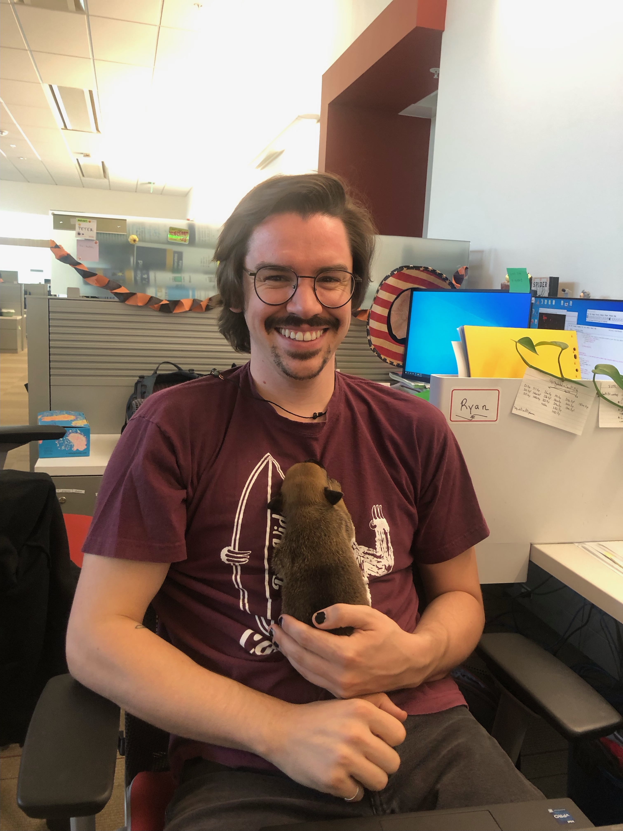
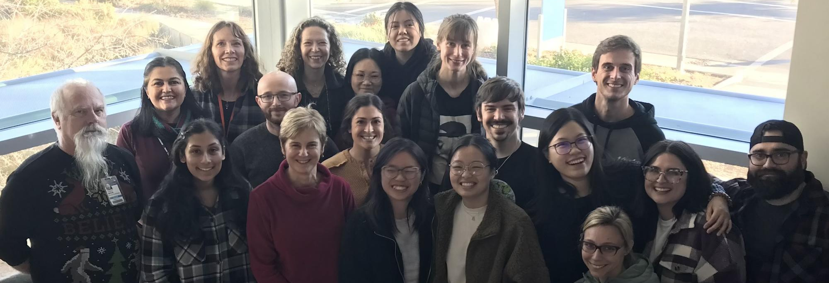
Experiences (& Thank Yous!)
Notes:
Pics of people who helped for more engagement (see lab photo on website)

