Slide 1
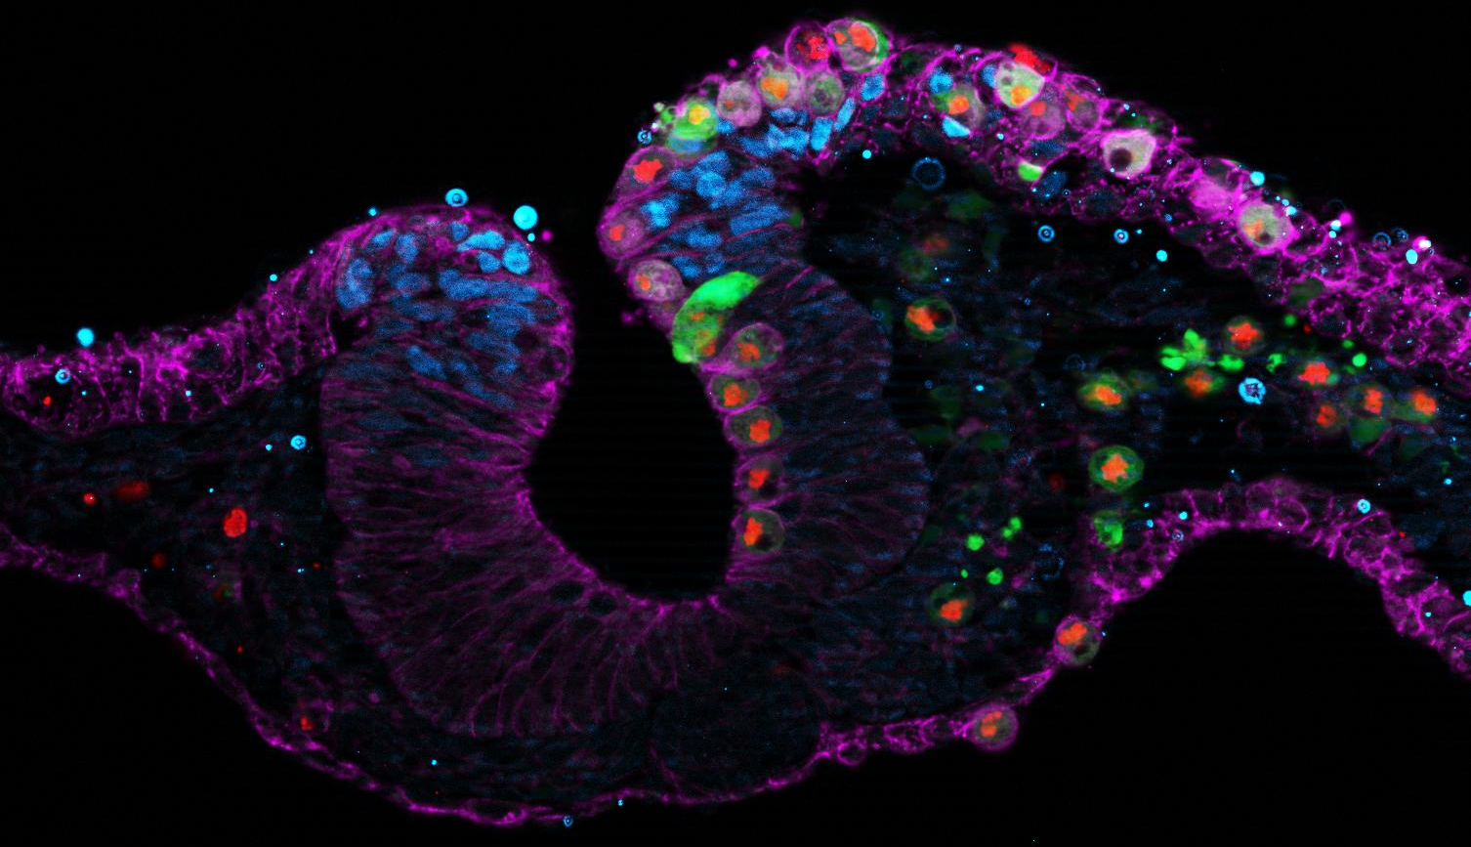
The Role of ꞵ-III Tubulin in Neural Crest Cell Proliferation, Migration and Differentiation into Craniofacial Neural Tissue
Raneesh Ramarapu
STAR 2022
Rogers Lab

Slide 2
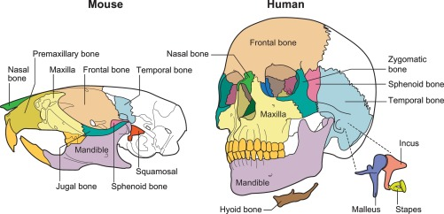
What do these cell types have in common?
Craniofacial cartilage and bone

Slide 3
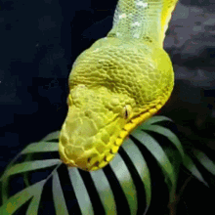
What do these cell types have in common?
Craniofacial cartilage and bone
Teeth

Slide 4
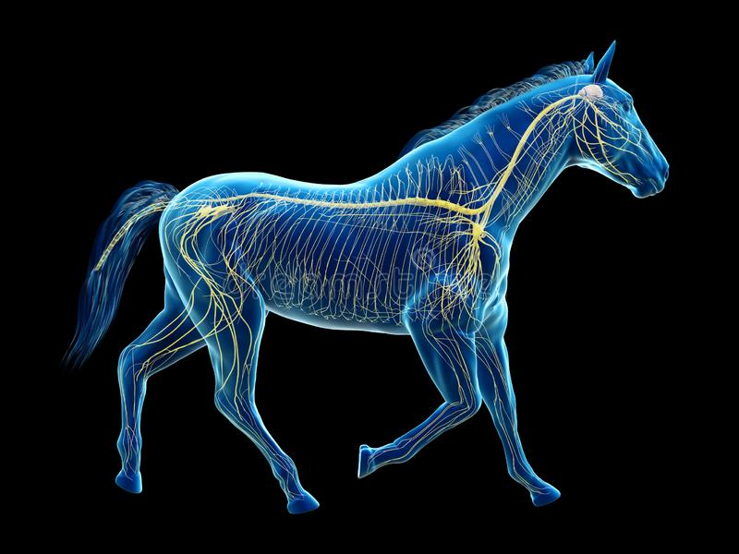
What do these cell types have in common?
Craniofacial cartilage and bone
Teeth
Peripheral Nervous system (including the enteric nervous system and cranial nerves)

Slide 5
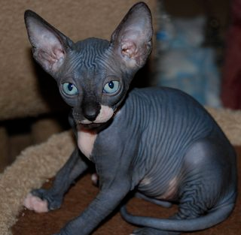
What do these cell types have in common?
Craniofacial cartilage and bone
Teeth
Peripheral Nervous system (including the enteric nervous system and cranial nerves)
Melanocytes

Slide 6
What do these cell types have in common?
Craniofacial cartilage and bone
Teeth
Peripheral Nervous system (including the enteric nervous system and cranial nerves)
Melanocytes
Adipocytes

Slide 7
They are all neural crest derived!

Slide 8
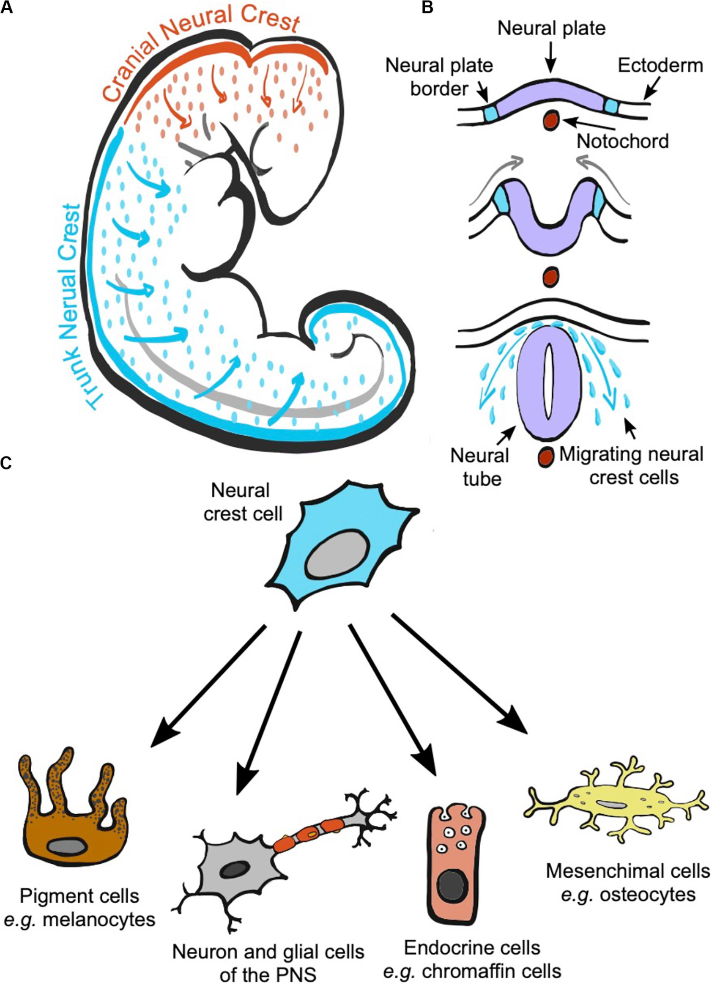
Neural crest? Who is she?
Transient multipotent stem cells that arise during neurulation (closing of the neural tube) in embryogenesis
Jose and Roulin, Front. Ecol. Evol., 02 September 2020

Slide 9
Neural crest? Who is she?
Transient multipotent stem cells that arise during neurulation (closing of the neural tube) in embryogenesis
They are an understudied but important cell type
They produce a plethora of cell types
Jose and Roulin, Front. Ecol. Evol., 02 September 2020

Slide 10
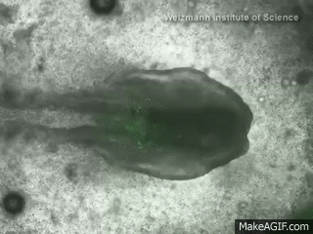
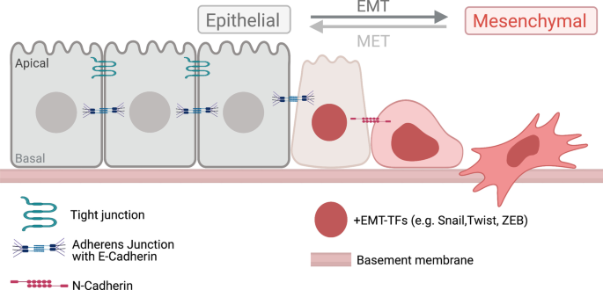
Neural crest formation
Amack, Cell Commun Signal, 2021

Slide 11
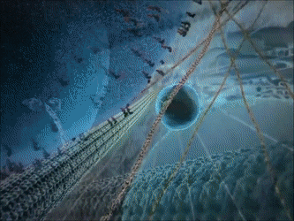
ꞵ-III Tubulin (TUBB3)
A microtubule subunit
Makes up the cytoskeleton (along with actin and intermediate filaments)

Slide 12
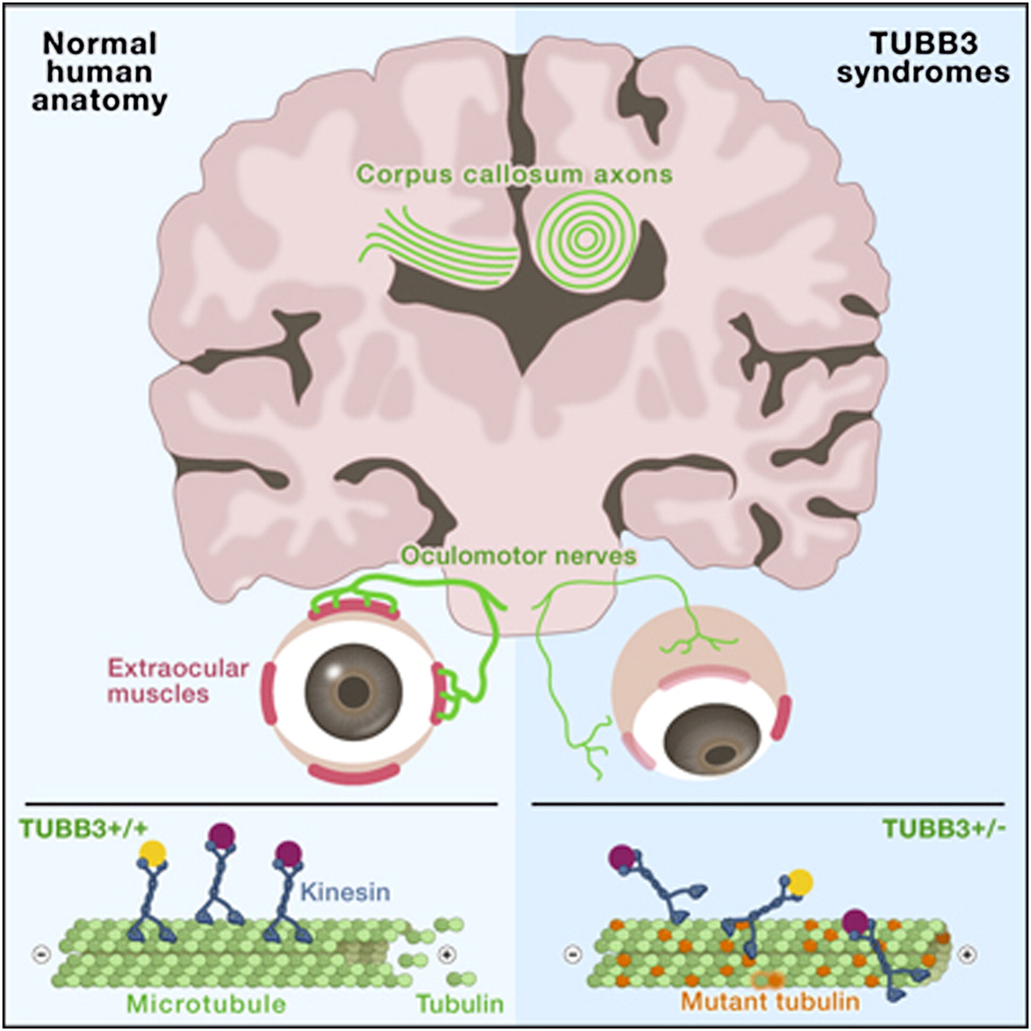
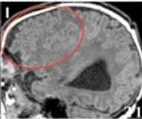
ꞵ-III Tubulin (TUBB3)
Clinical conditions associated with TUBB3 mutations
Whitman et al, AJMG, 2015
Cortical Malformations
Facial Palsy
Tischfield et al, Cell, 2010
Ptosis, extraocular muscle fibrosis

Slide 13
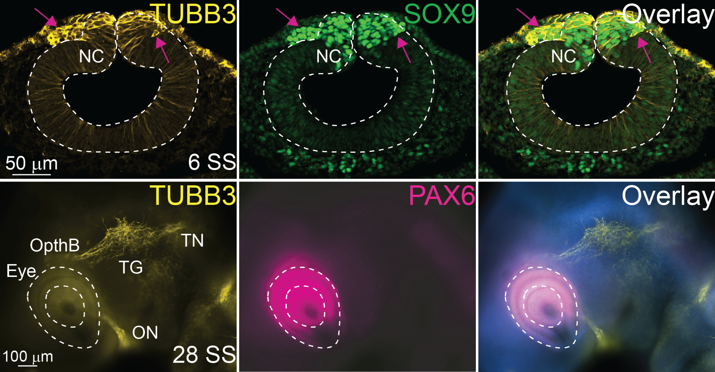
Traditionally TUBB3 is considered a neural marker
D
A
Chacon and Rogers, Gene Expr Patterns, 2019

Slide 14
TUBB3 is upregulated in neural crest cells prior to EMT
D
A
D
V
Chacon and Rogers, Gene Expr Patterns, 2019
Notes:
Why is it expressed here and what does its perturbations do

Slide 15
TUBB3 is upregulated in neural crest cells prior to EMT
D
A
D
V
How do perturbations of TUBB3 cause embryonic phenotypes?
Notes:
Why is it expressed here and what does its perturbations do

Slide 16
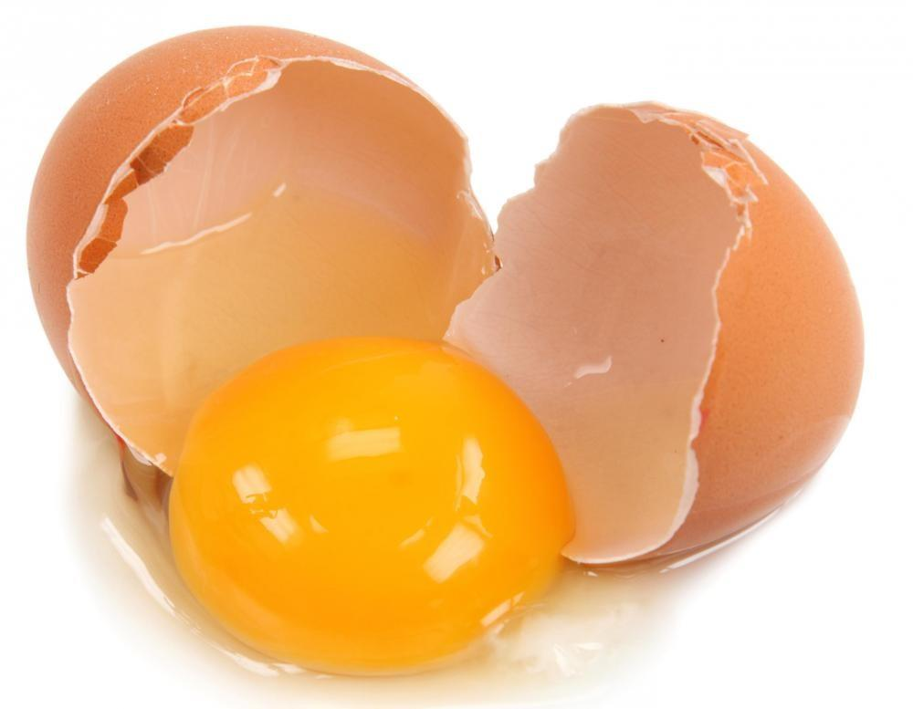
TUBB3 knock down using electroporation
Ex-Ovo injection at Hamburger-Hamilton (HH) stage 4 (i.e. gastrulation)

Slide 17
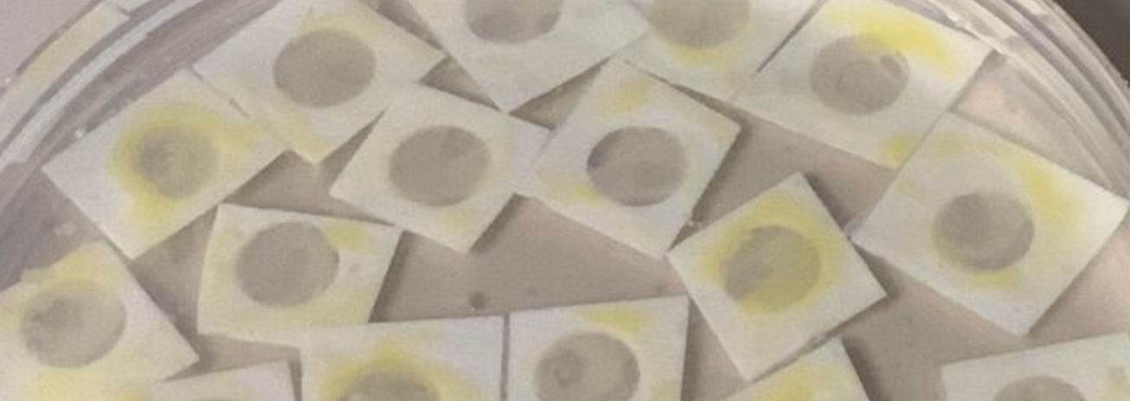
TUBB3 knock down using electroporation
Ex-Ovo injection at Hamburger-Hamilton (HH) stage 4 (i.e. gastrulation)

Slide 18
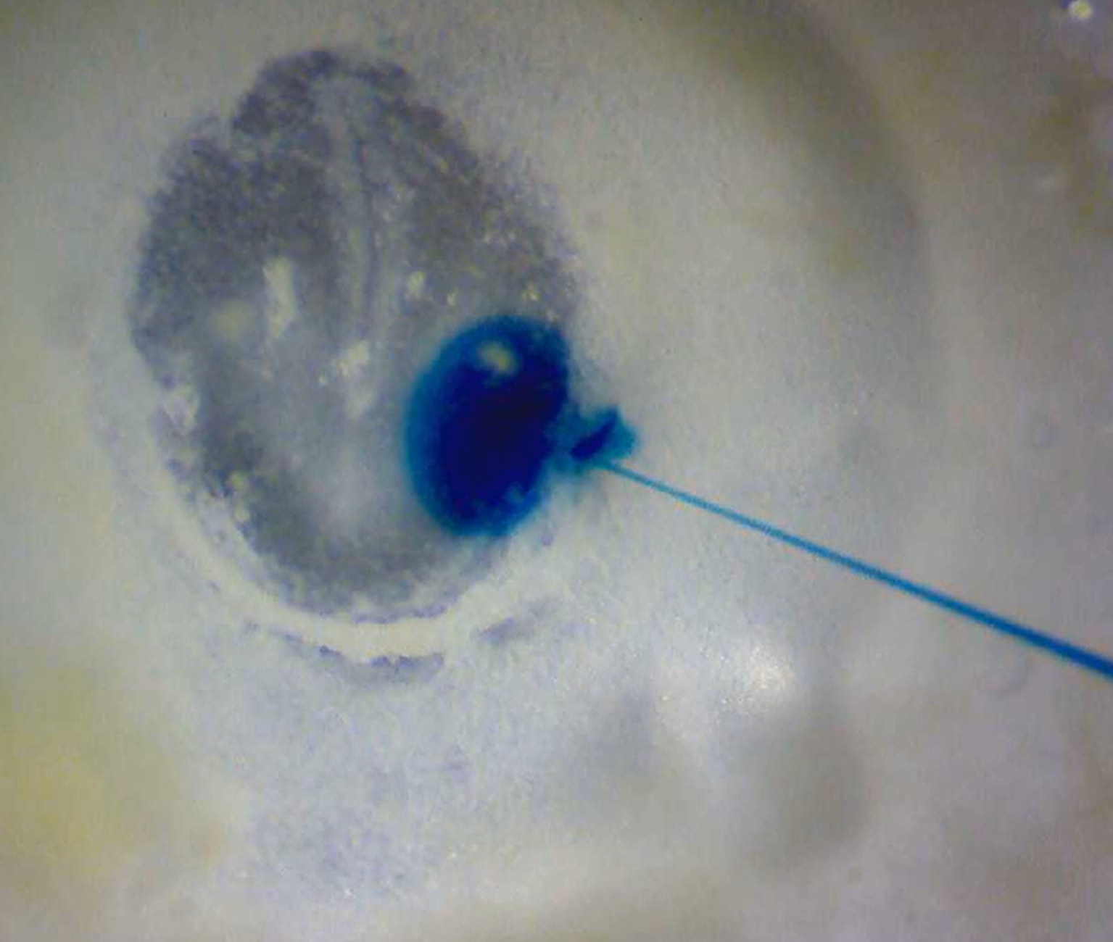
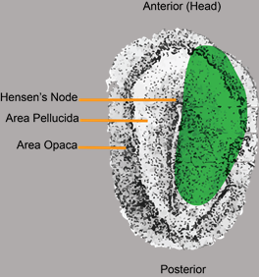
TUBB3 knock down using electroporation
Ex-Ovo injection at Hamburger-Hamilton (HH) stage 4 (i.e. gastrulation)

Slide 19
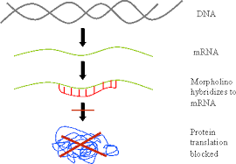
TUBB3 knock down using electroporation
Ex-Ovo injection at Hamburger-Hamilton (HH) stage 4 (i.e. gastrulation)

Slide 20
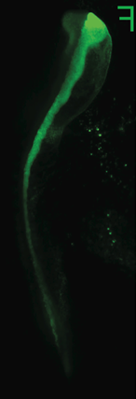
TUBB3 knock down using electroporation
Ex-Ovo injection at Hamburger-Hamilton (HH) stage 4 (i.e. gastrulation)
Incubate
Till Stage of interest
Immunohistochemistry

Slide 21
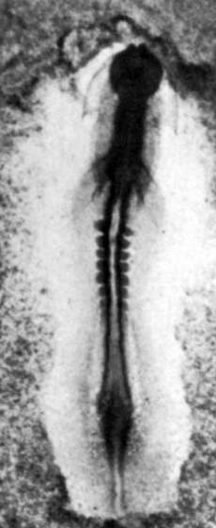
TUBB3 KD expands the neural crest population
Increases number of neural crest cells
Drives premature EMT
Maintains hyper-collective cadherin-mediated migration
D
V
Camilo echeverria

Slide 22
TUBB3 KD expands the neural crest population
Increases number of neural crest cells
Drives premature EMT
Maintains hyper-collective cadherin-mediated migration
Camilo echeverria
Notes:
TUBB3MO Explants- More SOX9 cells, the NC expands a further distance but migrate together (maintains the clump) unlike the

Slide 23
TUBB3 KD expands the neural crest population
Increases number of neural crest cells
Drives premature EMT
Maintains hyper-collective cadherin-mediated migration
Camilo echeverria
Notes:
TUBB3MO Explants- More SOX9 cells, the NC expands a further distance but migrate together (maintains the clump) unlike the

Slide 24
How does TUBB3 regulate neural crest EMT?
Amack, Cell Commun Signal, 2021

Slide 25
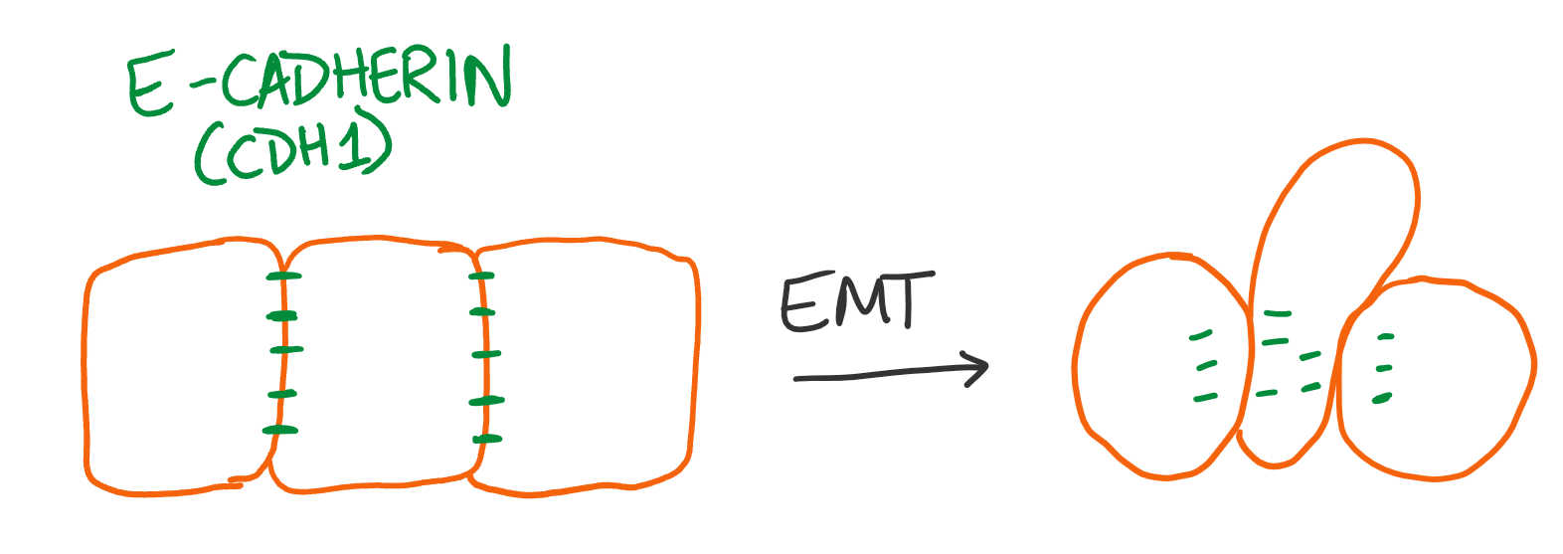
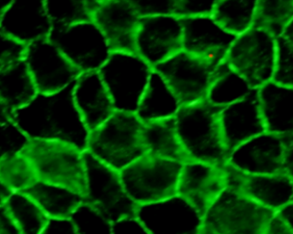
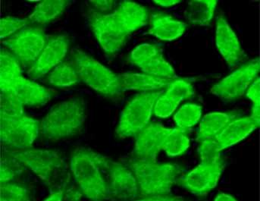
How does TUBB3 regulate neural crest EMT?
Amack, Cell Commun Signal, 2021

Slide 26
What would happen if we cranked up the TUBB3 in neural crest cells?
TUBB3

Slide 27
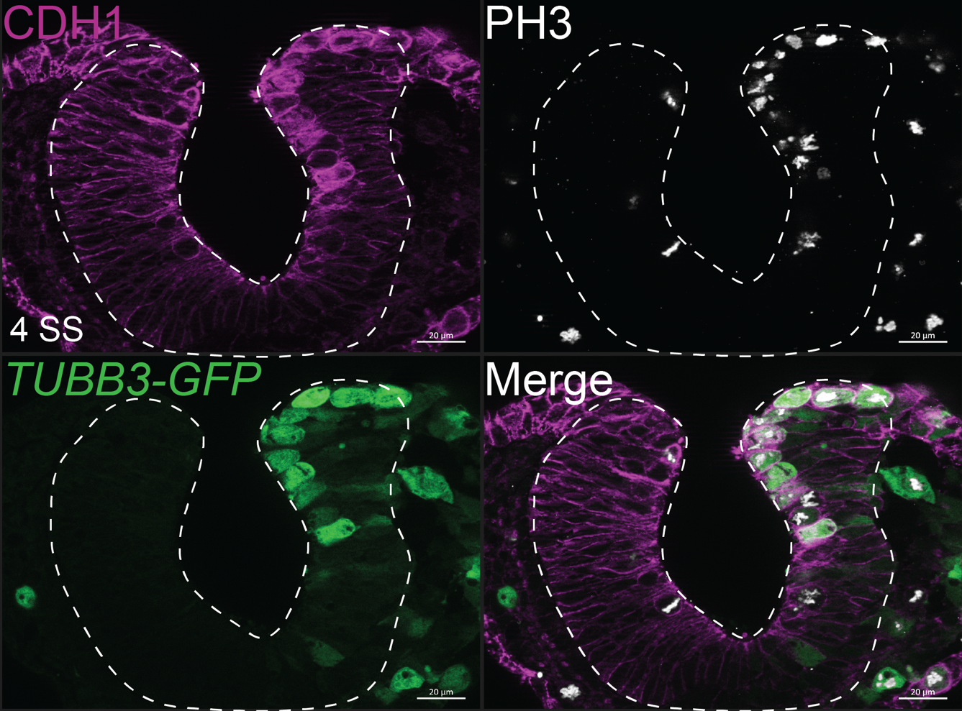
TUBB3 OE is sufficient to drive ectopic cell proliferation
Significantly higher proliferation and rounding
D
V

Slide 28
TUBB3 OE is sufficient to drive CDH1 internalization
Note the increased cytoplasmic fluorescence of CDH1 on the injected side
D
V

Slide 29
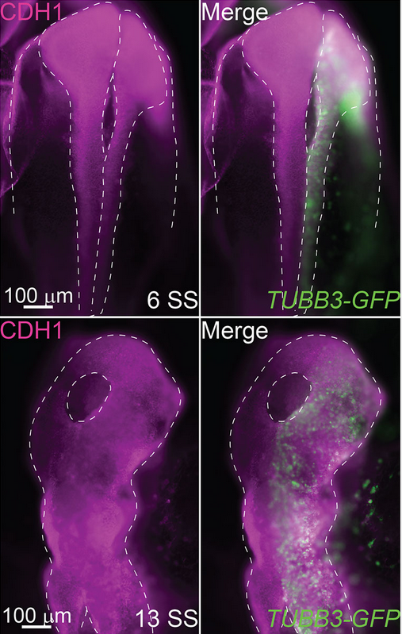
TUBB3 OE induces a “hole in the head” phenotype
Develops over time
Younger embryos appear to have normal neurulation
Older embryos exhibit cranial “holes” which progressively worsen
A
P

Slide 30
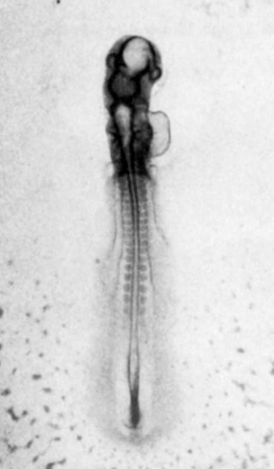
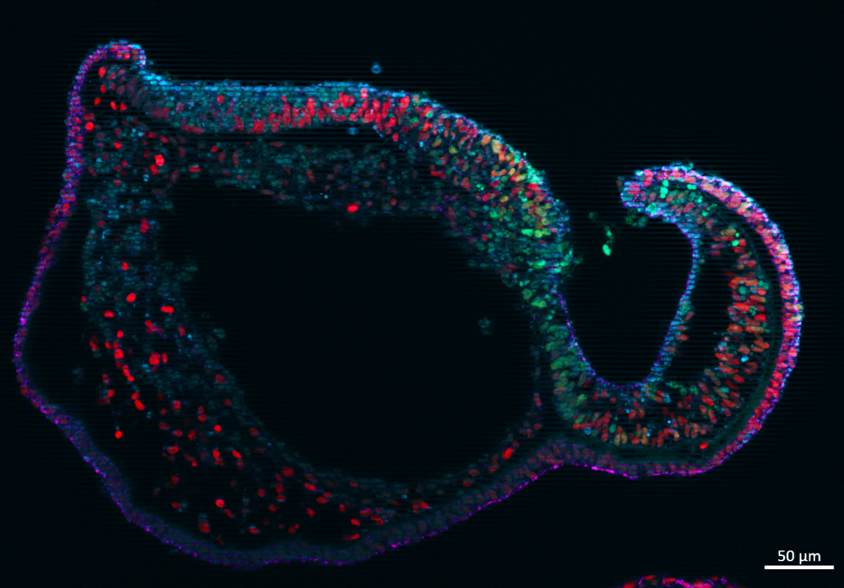
TUBB3 OE induces significant neural tube defects
Midline
TUBB3
CDH1 - Cell Adhesion
TUBB3-GFP
SOX9 - Neural Crest
D
V
Notes:
No cranial mesoderm

Slide 31
TUBB3 OE induces significant neural tube defects
Midline
Unknown Cell Type
TUBB3
CDH1 - Cell Adhesion
TUBB3-GFP
SOX9 - Neural Crest
D
V
Notes:
No cranial mesoderm

Slide 32
TUBB3 OE induces significant neural tube defects
Midline
Unknown Cell Type
TUBB3
CDH1 - Cell Adhesion
TUBB3-GFP
SOX9 - Neural Crest
D
Neuroepithelium with ectopic SOX9
V
Notes:
No cranial mesoderm

Slide 33
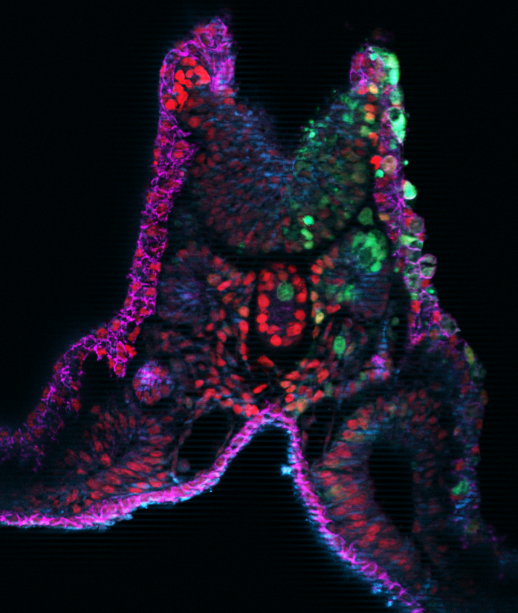
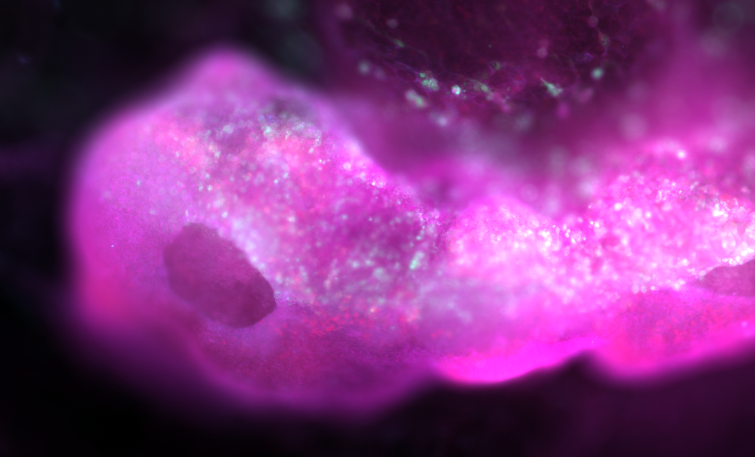
TUBB3 OE exhibit pattern defects in the trunk
D
TUBB3
CDH1 - Cell Adhesion
V
TUBB3-GFP
SOX9 - Neural Crest
Notes:
Lacks all but axial mesoderm

Slide 34
TUBB3 OE exhibit pattern defects in the trunk
TUBB3
CDH1 - Cell Adhesion
TUBB3-GFP
SOX9 - Neural Crest
Notes:
Lacks all but axial mesoderm

Slide 35
In-Ovo Injections
In-Ovo injection at Hamburger-Hamilton (HH) stage 8 i.e. neurulation for stages later than 12

Slide 36
In-Ovo Injections
In-Ovo injection at Hamburger-Hamilton (HH) stage 8 i.e. neurulation for stages later than 12

Slide 37
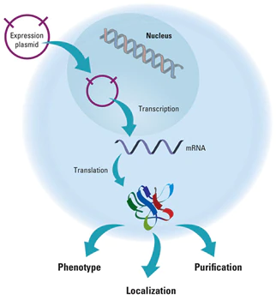
In-Ovo Injections
In-Ovo injection at Hamburger-Hamilton (HH) stage 8 i.e. neurulation for stages later than 12

Slide 38
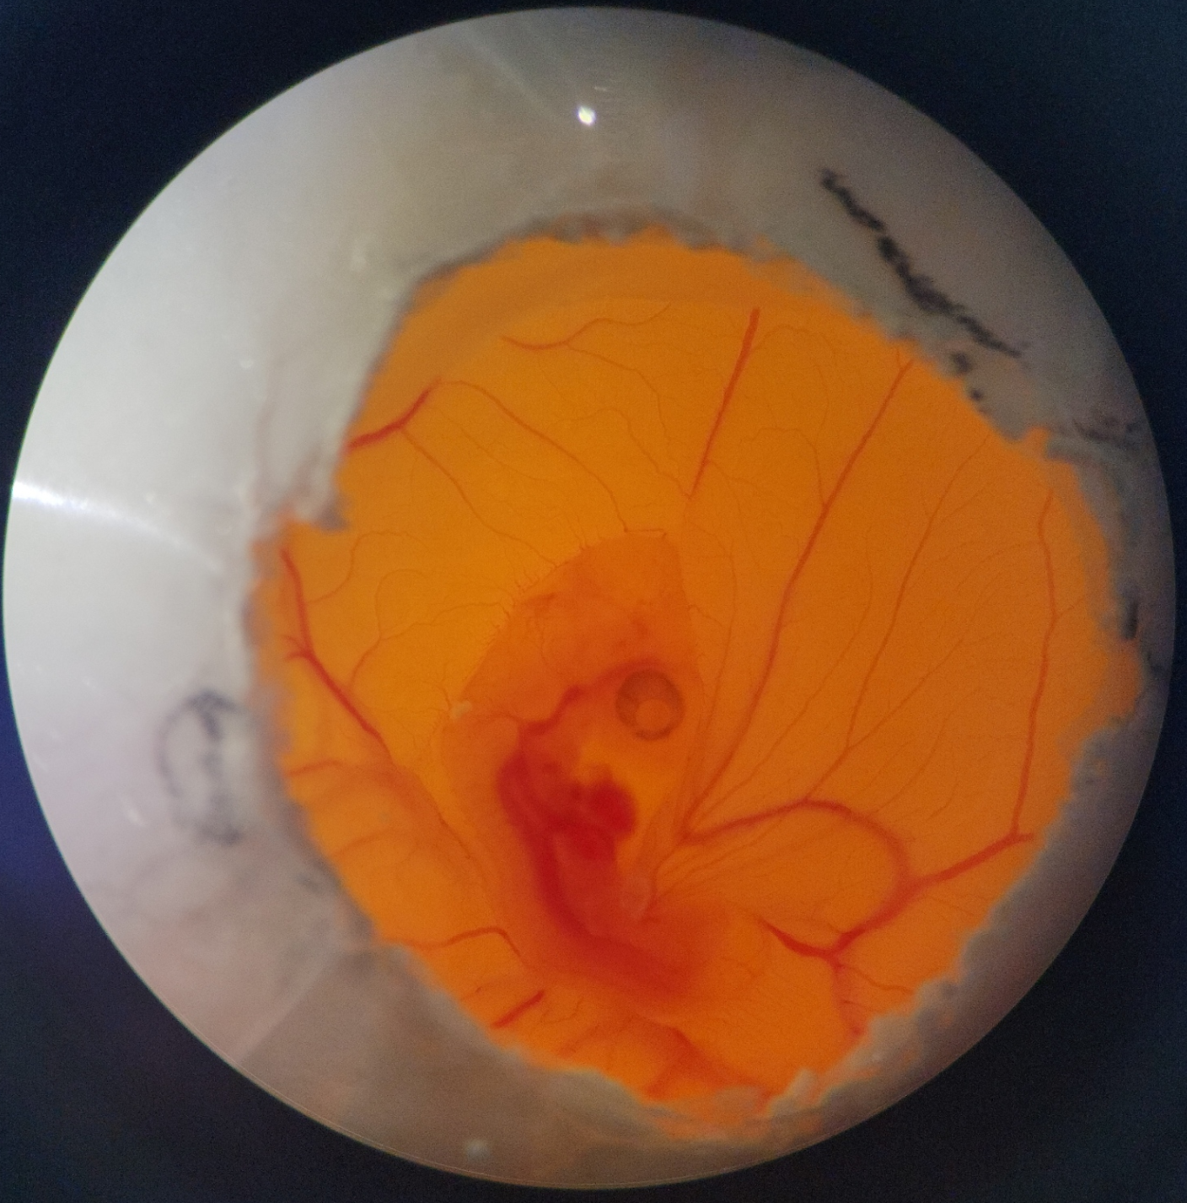
In-Ovo Injections
In-Ovo injection at Hamburger-Hamilton (HH) stage 8 i.e. neurulation for stages later than 12

Slide 39
What do we think TUBB3 is doing?
TUBB3 seems to be influencing the shuttling of CDH1 (E-cadherin)
Changes in cadherin localization influences EMT of neural crest cells

Slide 40
What do we think TUBB3 is doing?
TUBB3 seems to be influencing the shuttling of CDH1 (E-cadherin)
Changes in cadherin localization influences EMT of neural crest cells
However, TUBB3 influences shuttling and through a mechanism to be determined and also causes significant cell proliferation
This may explain the presence of material in the neural tube and neural tube defects

Slide 41
Biomedical relevance of TUBB3 perturbations
TUBB3 has been found to be upregulated in various types of cancers (Person et al 2017). This could be due to the role of TUBB3 in EMT and proliferation.
_{Acloque, J Clin Invest, 2009}

Slide 42
Biomedical relevance of TUBB3 perturbations
TUBB3 has been found to be upregulated in various types of cancers (Person et al 2017). This could be due to the role of TUBB3 in EMT and proliferation.
Understanding how TUBB3 influences proliferation and EMT in development can help inform understanding of tumorigenesis.

Slide 43
Biomedical relevance of TUBB3 perturbations
TUBB3 has been found to be upregulated in various types of cancers (Person et al 2017). This could be due to the role of TUBB3 in EMT and proliferation.
Understanding how TUBB3 influences proliferation and EMT in development can help inform understanding of tumorigenesis.
This type of study can also reveal potential targets for biomarkers of craniofacial anomalies and diseases

Slide 44
Biomedical relevance of TUBB3 perturbations
TUBB3 has been found to be upregulated in various types of cancers (Person et al 2017). This could be due to the role of TUBB3 in EMT and proliferation.
Understanding how TUBB3 influences proliferation and EMT in development can help inform understanding of tumorigenesis.
This type of study can also reveal potential targets for biomarkers of craniofacial anomalies and diseases
Changes in TUBB3 levels have been linked to nitrate exposure through ground water

Slide 45
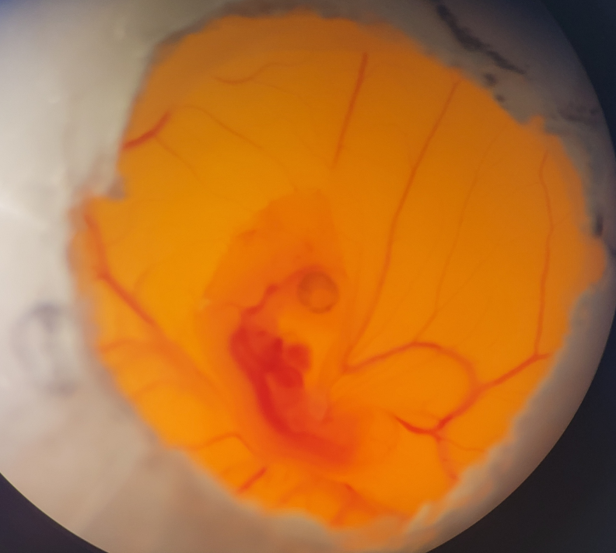
Future Directions
Investigating the fate of cells in late stage embryos with differing TUBB3 OE levels to better characterize the phenotypes (Ex: Caspase)
Live imaging to understand the mechanism of action of TUBB3 and effect of perturbations in live cells
Investigating the role of TUBB3 in non-avian animal models

Slide 46
Acknowledgements
Thank you Dr. Rogers, Camilo Echeverria and the Rogers lab for making this project so exciting and teaching me these super cool techniques
Financial support was provided by the Students Training in Advanced Research (STAR) Program through the NIH T35 OD010956-22 grant

