Slide 1
Evaluating the canine aryl hydrocarbon receptor’s role in osteosarcoma progression, metastasis, and chemotherapy resistance
STAR Student: Justin Ringhofer
Mentors: Dr. Dan York and Dr. Rob Rebhun
July 28th, 2021

Slide 2
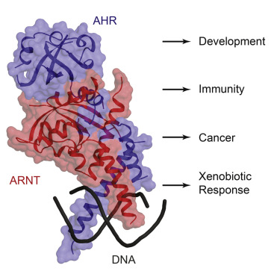
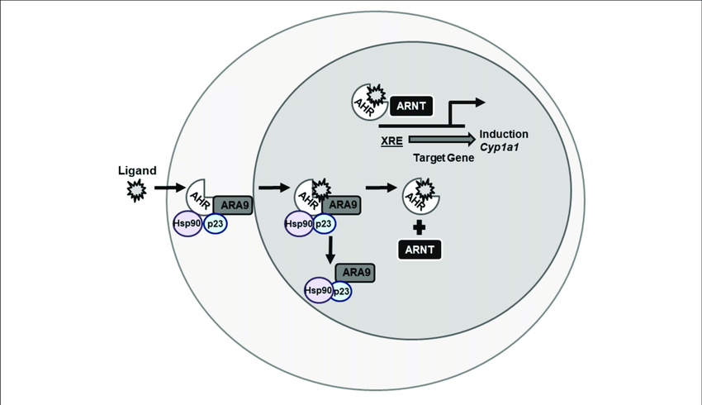
Background
Aryl hydrocarbon receptors (AHR) are cytosolic transcription factors that bind to certain DNA sequences and alter the activity of nearby genes
AHR can be activated by a large number of ligands
AHR was initially studied studied for its role in xenobiotic-induced toxicity and detoxification
AHR has been found playing a regulatory role in many biological process
Figure 1: Simplified version of AHR’s structure when connected to its nuclear translocator (ARNT)
Figure 2: CYP1A1 is one of the many genes that AHR may play a role in regulating

Slide 3
Rationale and Innovation
Exposure to exogenous toxic AHR ligands can lead to pathogenic conditions ¹
Increased AHR expression has been found in numerous canine cancers
AHR could be a target of therapeutic intervention in the future
Little is known about AHR and the genes it regulates in dogs
RNAseq data should provide novel information on genes associated with AHR in canine

Slide 4
Hypothesis and AIMs
Hypothesis: Activation of the canine AHR inhibits osteosarcoma (OSA) growth and migration by regulating oncogenes and tumor suppressor genes and contributes to the cytotoxic effects of chemotherapy
AIM 1. Determine the effect of AHR silencing on chemotherapy resistance in canine osteosarcoma cell lines
AIM 2. Evaluate the effects of AHR activating ligands Omeprazole and I3C on canine tumor migration
AIM 3. Identify genes regulated by canine AHR that are involved in tumor progression and metastasis

Slide 5
AIM 3 Methods
1. 3 OSA cell lines (Abrams, Gracie, and HMPOS) with varying levels of AHR expression were seeded into either 6 or 12 well plates
2. Cells were pretreated for 24 hours with control siRNA, AHR siRNA, or neither
3. Cells treated with DMSO (vehicle), I3C or TCDD (AHR ligands)
4. After treatment for 2 hours, cells were lysed using Trizol and RNA isolated using RNAeasy Plus kits
5. Some samples were tested for expression levels through qPCR
6. Currently sending in samples for RNAseq
Figure 3: Western blot performed on variety of OSA cell lines to measure AHR protein expression

Slide 6
AIM 3 Results
qPCR analysis shows that:
Exposure to TCDD and I3C increased CYP1 family expression which is known to be regulated by AHR
AHR siRNA worked properly and knocked down AHR and consequently CYP1 family expression in Abrams and HMPOS cell lines
Samples are being sent out for RNAseq to help identify what genes may be regulated by AHR and how these may change with different ligands

Slide 7
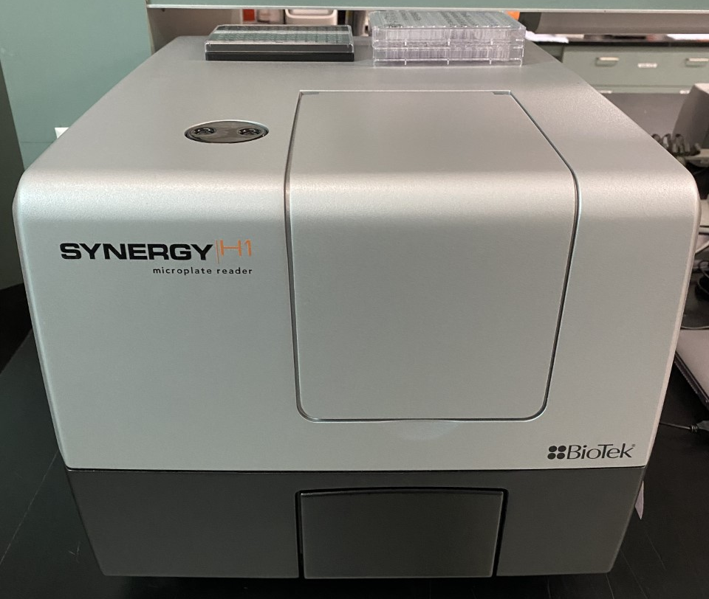
AIM 1 Methods – Proliferation Assay
1. 96 well plates were seeded with one of three OSA cell lines (Abrams, Gracie, and HMPOS)
2. Cells were then treated with control or AHR siRNA for 24 hours
3. Cells were washed and treated with standard chemotherapy doxorubicin or carboplatin for 24 hours
4. Cells were incubated without treatment for an additional 24 hours
5. Added alamarblue to wells then measured 2 hours later using the Synergy H1 microplate reader
Figure 4: Top = 96 well plate after addition of alamarblue.
Bottom = Synergy H1 microplate reader

Slide 8
AIM 1 Results
All cell lines show a major decrease in proliferation when treated with either Dox or Carbo
For both Abrams and Gracie:
Significant decrease in proliferation between the scramble siRNA and AHR siRNA groups
Significant decrease between the scramble siRNA + Dox or Carbo and the AHR siRNA + Dox or Carbo group respectively
For HMPOS:
No significant differences in proliferation were noted between comparison groups

Slide 9
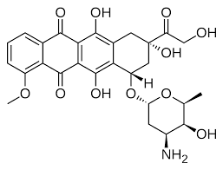
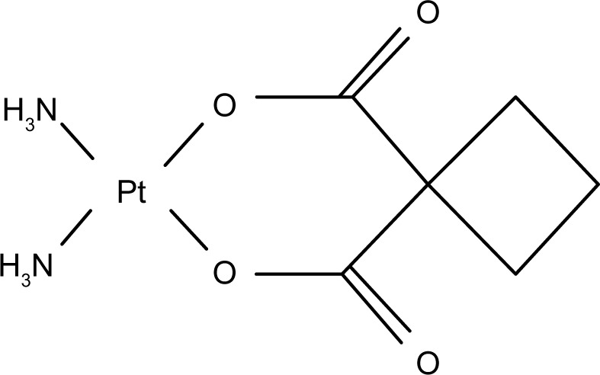
AIM 1 Result Interpretation
Doxorubicin and Carboplatin are (still) potent chemotherapy agents
Inhibition of AHR in highly expressed cell lines (Abrams and Gracie), resulted in decreased proliferation
AHR may play a factor in OSA chemotherapy resistance as shown when AHR expression decreased, Dox and Carbo had a greater effect on decreasing proliferation levels
HMPOS showed no significant decrease in proliferation when treated with AHR siRNA potentially due to its already low AHR expression levels
Figure 5: Top = Chemical structure of Doxorubicin
Bottom =Chemical structure of Carboplatin

Slide 10
AIM 2 Method – Scratch Assays
0 hour
1. 48 well plates were seeded with either Abrams, Gracie, HMPOS, or MDCK cells
2. Waited until cells were at or above 80% confluency prior to performing the scratch
3. Performed scratch using a P1000 micropipette tip and added either Omeprazole or I3C to the wells
4. Took images of the wells over time as the cells migrated and filled the scratch
5. Used ImageJ to measure the width of gap in each photo
22 hour
Figure 6: Abram’s vehicle group well migrating over a 22 hour time period

Slide 11
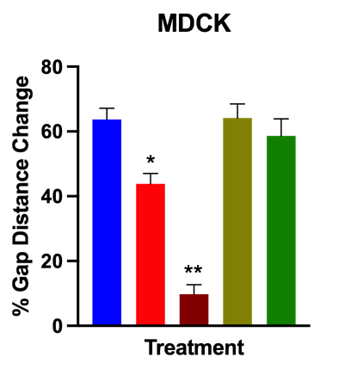
AIM 2 Results
For all 4 cell lines, omeprazole at 300µM shows significant decrease in migration compared to vehicle
In HMPOS and MDCK cell lines, Omeprazole at 100uM also shows significant decrease
In the Abrams cell line, I3C at 300uM shows a significant effect on migration

Slide 12
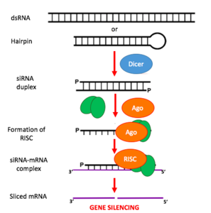
AIM 2 Result Interpretation
The significant decrease in all cell lines migration when treated with high concentration of omeprazole points to AHR playing a role in OSA cell migration
Similar data was found in glioma cell lines in which omeprazole decreased migration ²
Difficult to identify if the decrease in migration by omeprazole was AHR-specific
For example, omeprazole could instead be causing cell death that then affects migration
Further study using AHR siRNA or AHR knockout cell lines in the scratch assay would be useful
As seen previously in the lab, I3C also caused a significant decrease in migration for the Abrams cell line
Difficult to interpret why it did not have significance in the other cell lines
Replication of the scratch assay with higher concentrations of I3C may provide more insight
Figure 7: Simple depiction of how small interfering (si) RNA functions

Slide 13
Significance of Findings and Future Plans
AHR plays a role in canine OSA proliferation
Saw a decrease in proliferation when treated with AHR siRNA
Future studies should aim to repeat the data and potentially use AHR knock out cell lines
AHR expression could affect OSA chemotherapy resistance
Decrease in proliferation of cells treated with Dox or Carbo + AHR siRNA when compared to Dox or Carbo + Scramble siRNA
Migration and wound healing of OSA may be affected by AHR
Decrease in migration when treated with AHR ligand (omeprazole)
Future study should attempt to gather more RNAseq data on a wide variety of known AHR ligands
Also, identify if the effects seen in the scratch assay are AHR-specific
Study further the effects of chemotherapy agents in combination with high or low AHR levels

Slide 14
Acknowledgments
CCAH and NIH for providing funding for the project
Financial support was provided by the Students Training in Advanced Research (STAR) Program
Everyone in the STAR Program for a wonderful experience
My mentors Dr. Dan York and Dr. Rob Rebhun

Slide 15
Works Cited
What questions do you have?
THANK YOU
1.Kawajiri K, Fujii-Kuriyama Y. The aryl hydrocarbon receptor: a
multifunctional chemical sensor for host defense and homeostatic maintenance. Experimental Animals. 2017;66(2):75-89. doi: 10.1538/expanim.16-0092. PubMed PMID: WOS:000399862500001.
2. Jin UH, Michelhaugh SK, Polin LA, Shrestha R, Mittal S, Safe S.
Omeprazole Inhibits Glioblastoma Cell Invasion and Tumor
Growth. Cancers. 2020;12(8). doi: 10.3390/cancers12082097.
PubMed PMID: WOS:000578969700001.

