Slide 1
Assessment of beta-hydroxybutyric acid (BHBA) as a plasma biomarker for hepatic lipidosis in bearded dragons (Pogona vitticeps)
Lisa P. Pacumio, Danielle K. Tarbert, Kevin Keel, Melanie Ammersbach, Hugues Beaufrère
Department of Medicine and Epidemiology, Veterinary Medical Teaching Hospital, Pathology, Microbiology, and Immunology, School of Veterinary Medicine, University of California Davis, Davis, CA.

Slide 2
Introduction

Slide 3
HEPATIC LIPIDOSIS
Also known as fatty liver disease
Affects 38.3% of pet beardies!¹
Suspected risk factors: Diet, breeding status, brumation status, stress, activity levels²
PATHWAY:
Pathologic accumulation of triacylglycerols in hepatocytes
↓
Impaired liver function
↓
Clinical signs (lethargy, anorexia, etc.)

Slide 4
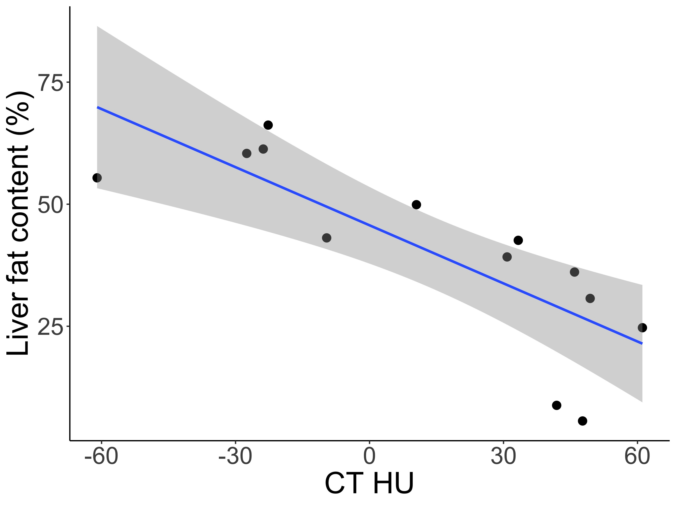
DIAGNOSING HEPATIC LIPIDOSIS²
What doesn’t work²
  Routine bloodwork/hematologic analysis
  Radiographs
  Coelomic ultrasound
  What does work²
  Computed tomography (CT)
    Expensive
  Liver biopsy and histopathology
    Expensive
    Invasive
Notes:
Chart: Negative relationship, fattier liver = darker on CT (measured in HU)
Histopath: Look for different characteristic microscopic features of disease
- Based on your findings, grade the presence/severity of disease

Slide 5
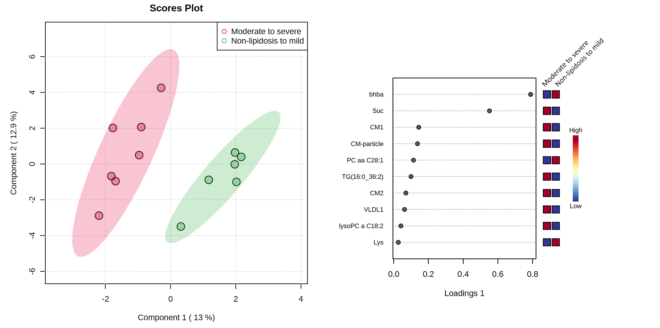
BACKGROUND
2021: Pilot study identified BHBA as a candidate biomarker for hepatic lipidosis in a cohort of 14 bearded dragons²
Discovery: exploratory plasma metabolomics
Validation: comparison of BHBA to severity of disease
  Lower BHBA = more disease
Notes:
PCA: Clusters of HL severity

Slide 6
AIMS:
A) Further assess the usefulness of BHBA as a plasma biomarker for the diagnosis and screening of hepatic lipidosis on a larger sample size (n=48) of bearded dragons that were matched for age.
B) Assess the reliability of a point-of-care BHBA meter for in-hospital diagnosis.
Notes:
BHBA meters do exist, mainly for livestock. We would love to be able to use these for cheap/quick/easy in-house readings

Slide 7
HYPOTHESES:
A) Plasma BHBA concentrations are associated with the degree of hepatic lipid accumulation in bearded dragons.
B) A BHBA point-of-care analyzer shows good agreement with a reference analyzer.

Slide 8
METHODS
CT
Blood collection
necropsy

Slide 9
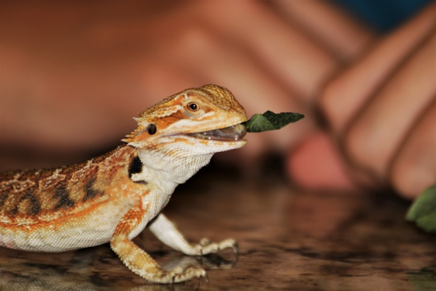
BEARDIE ACQUISITION
Large breeding facility in Chico, CA
N=48 (25 female, 23 male)
  Age:
    24 1.5-3 years old
    24 4-7 years old
  Sex:
    25 female
    23 male

Slide 10
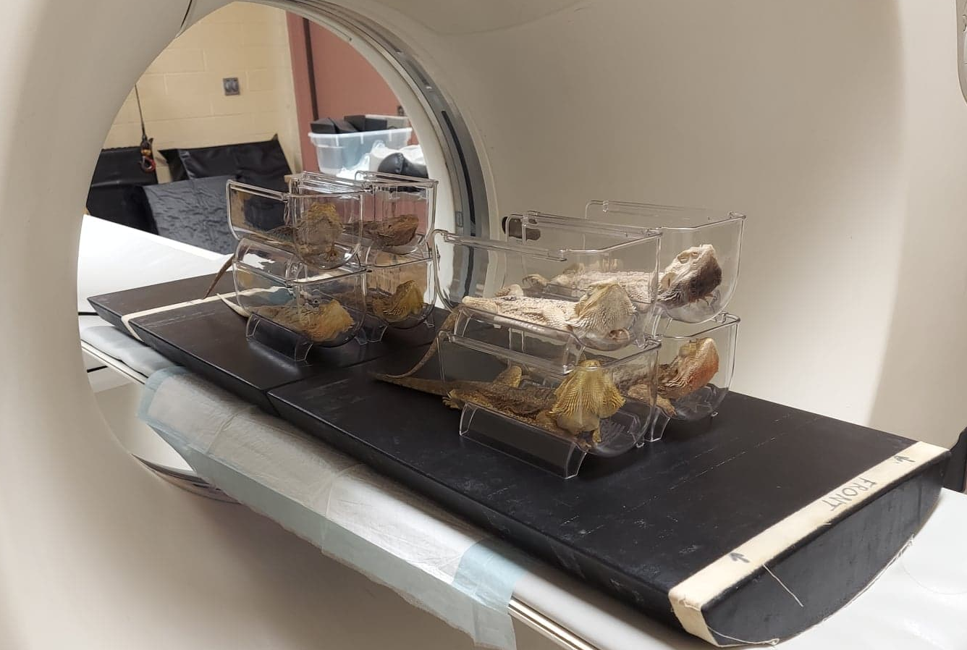
Step 1: CT
Sedate/anesthetize using 10-15 mg/kg alfaxalone SQ
Whole body scan in groups of 8
Notes:
Sample collection was on 8 beardies at a time
Basically we gathered HU from both left and right lobes and averaged those out to get a representative value for the entire organ.

Slide 11
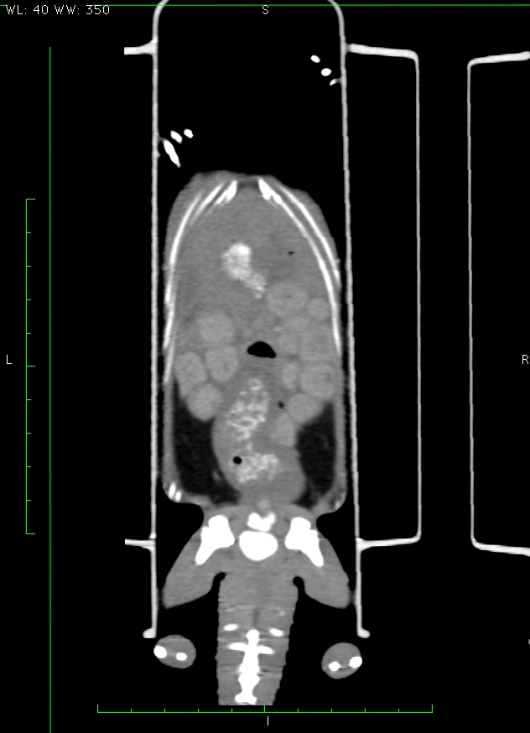
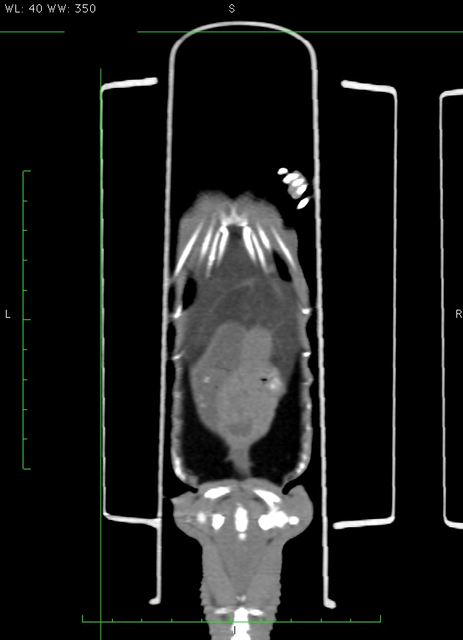
CT INTERPRETATION!
Normal:
Lipidotic:
Notes:
Calculate average hepatic density/HU from standardized right/left ROI

Slide 12
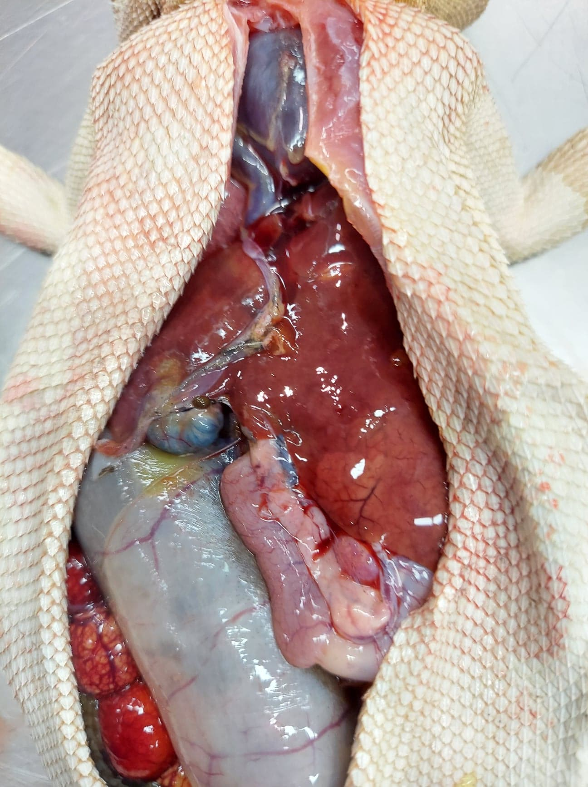
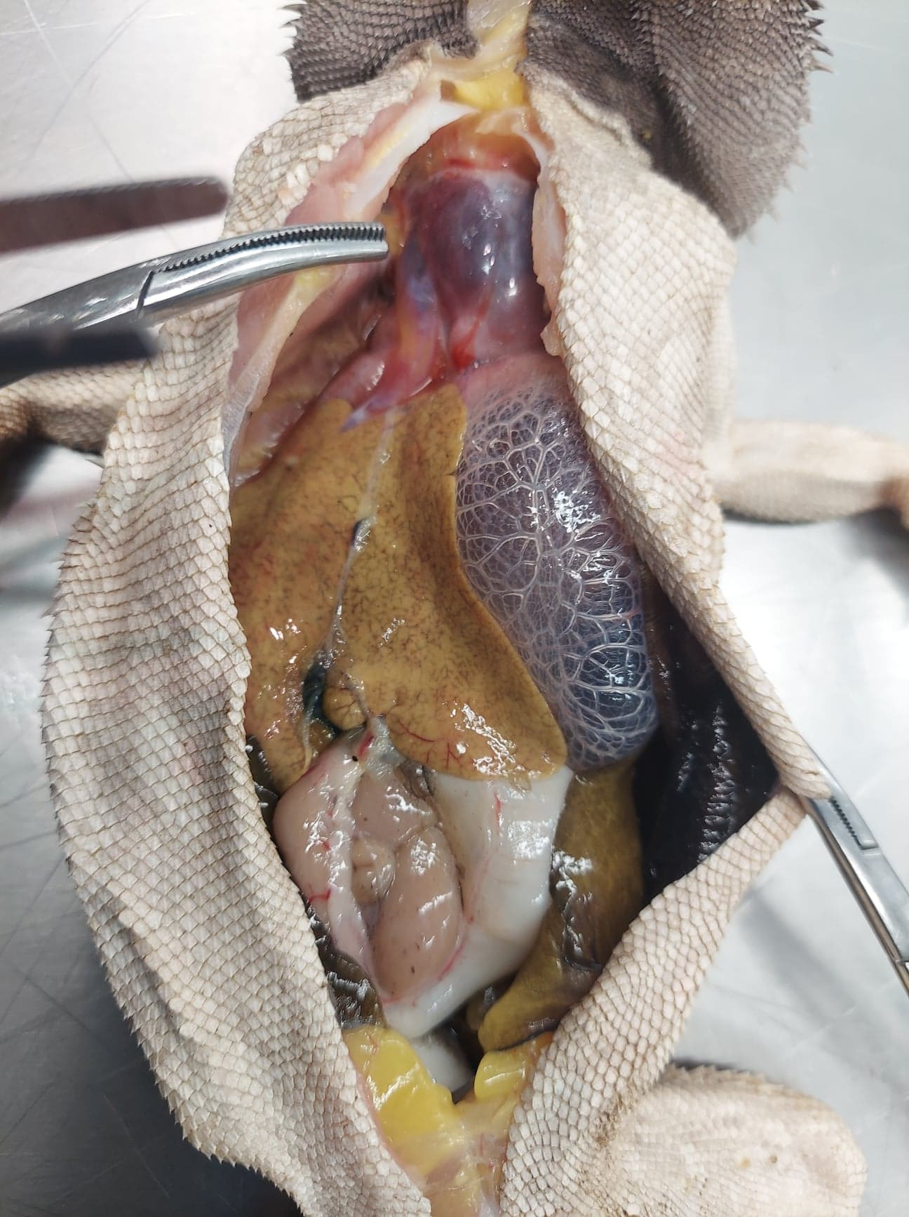
CT INTERPRETATION!
Normal:
Lipidotic:
Notes:
Recap: CT step of the process – used to officially diagnose HL

Slide 13
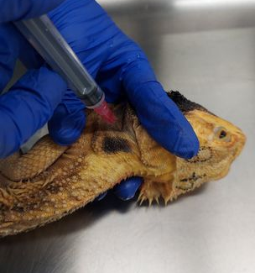
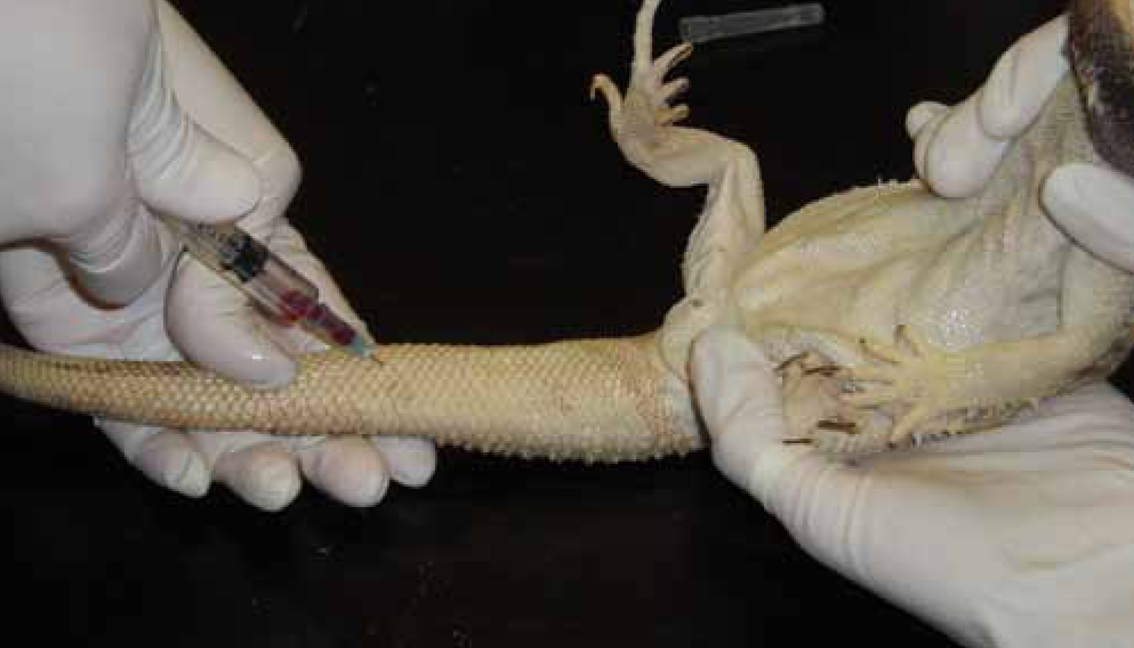
STEP 2: Blood collection!
2-3 mL from caudal tail vein or jugular vein
Notes:
Next step: Gather blood BHBA values to compare to official diagnostics to see if there’s a significant enough relationship to say that BHBA can be used to diagnose INSTEAD of current methods

Slide 14
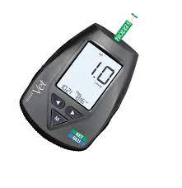
WHAT WE DO WITH THE BLOOD?
BHBA data collection:
A) Point-of-care BHBA reading
Nova VetTM Ketone/Glucose meter
B) BHBA reference analyzer
Vitros 5600 Analyzer, University of Miami Avian and Wildlife Laboratory
Other analyses:
C) Surplus blood saved for future analyses (e.g. metabolomics)
Notes:
There’s a lot of different things to do with the blood to accomplish BOTH of our aims (validation of the BHBA biomarker AND POC ketone meter)
Point of care meter – AT THAT MOMENT we don’t know if it’s accurate, but it goes in line with second aim (want to compare to reference analyzer)
Asdf
Screen for abnormalities/unexpected liver values/patterns
RECAP AGAIN: We did CT
We got our BHBA readings from both the POC and the reference analyzer
We did standard biochemistry and saved some extra

Slide 15
STEP 3: POST-MORTEM TISSUE COLLECTION
Necropsy: Liver removed, stored in formalin
Cross-section of liver trimmed for sectioning/H&E staining
  Grade hepatic lipidosis based on histologic features
Results in progress
Notes:
Yes, biopsy can be done when animal is still alive BUT this study was terminal anyways
Get tissues post-mortem for very large and very consistent samples of liver
So after euthanasia for consistency we took a very large cross sectional sample of each liver
Going to be put on microscope slides and stained
Results in progress – waiting to get grading of presence/severity of HL
We already have CT data and blood collection/BHBA data so we can still go on to analysis/results

Slide 16
ANALYSIS + RESULTS

Slide 17
Assessment of BHBA as a plasma biomarker for hepatic lipidosis
PART 1:

Slide 18
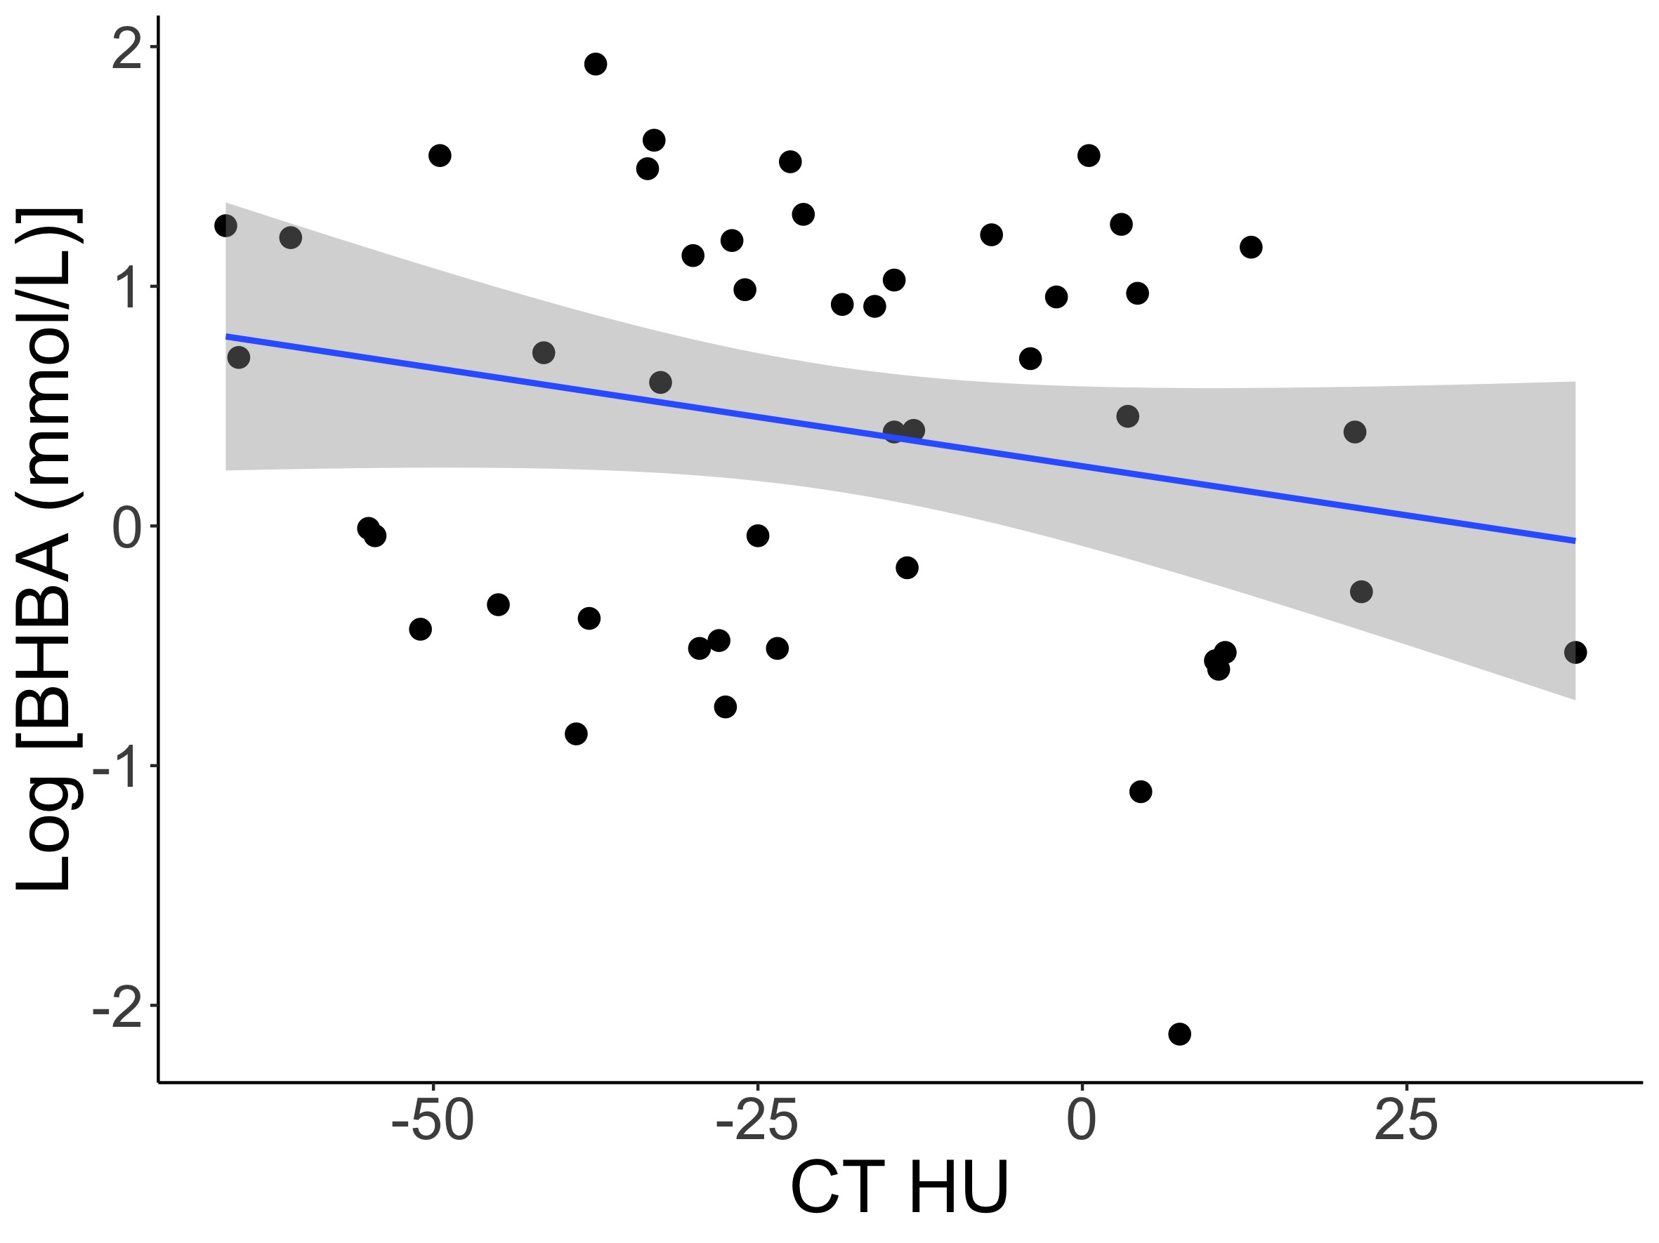
BHBA concentration vs. CT HU
R² = 0.05
P-value = 0.12
No significant association

Slide 19
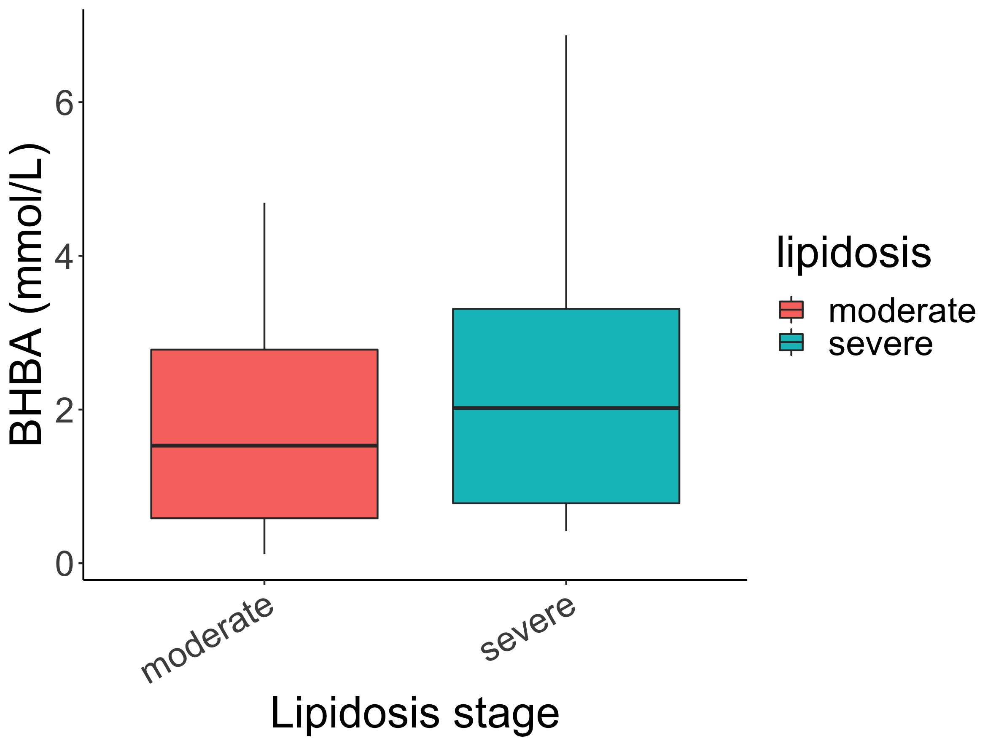
BHBA concentration vs. degree of hepatic lipidosis
Moderate:
  n = 16
  Median BHBA = 1.53 mmol/L
Severe:
  n = 32
  Median BHBA = 2.56
Notes:
Wasn’t sensitive to detecting presence, nor severity
That’s what we have currently based on our CT/BHBA data – histopath is going to be similar but is still in progress

Slide 20
Methods comparison of point-of-care meter vs. reference analyzer for BHBA
PART 2:

Slide 21
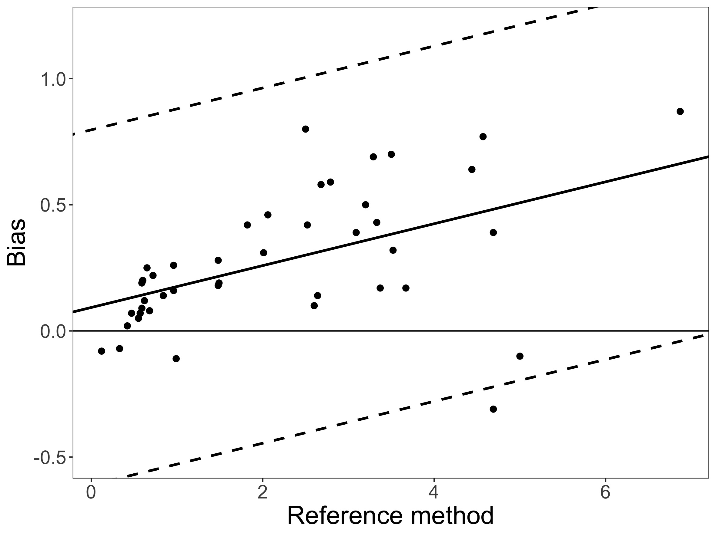
POC % bias vs. reference
Significant proportional bias
POC meter tended to underestimate reference analyzer readings, but was still precise^{4,5}
Agreement was within 30% of reference analyzer
Notes:
Bias = reference – POC
-> positive bias = POC was less than reference
No constant bias (similar slope to reference)
Want to hit 8 minute mark by now

Slide 22
DISCUSSION + CONCLUSION
BHBA is not an adequate biomarker for hepatic lipidosis in bearded dragons
  No significant association
  Husbandry practices?
POC meter acceptable for clinical use, use with caution
  Adequately precise, with observed error in acceptable ranges
  However, proportional bias (POC meters tended to underestimate)
Future metabolomics data pending
  Exploration for new biomarkers

Slide 23

ACKNOWLEDGEMENTS
Financial support for this project:
Students Training in Advanced Research (STAR) Program through the NIH T35 OD010956-22 grant
Boehringer Ingelheim Veterinary Scholar Fellowship
Special thanks to:
Animal Specialty Inc. for supplying animals
Dr. Paula Rodriguez for technical support

Slide 24
CITATIONS
Barboza, T., Susta, L., Reavill, D., & Beaufrère, H. (2022). Prevalence and risk factors of hepatic lipid changes in bearded dragons (Pogona vitticeps). Veterinary pathology, 3009858221105058. Advance online publication. https://doi.org/10.1177/03009858221105058
Barboza T. Hepatic lipidosis in the bearded dragon (Pogona vitticeps): diagnostic and therapeutic investigations. DVSc Thesis. University of Guelph; 2021.
Parkinson LA, Mans C. Investigation of the effects of cricket ingestion on plasma uric acid concentration in inland bearded dragons (Pogona vitticeps). Journal of the American Veterinary Medical Association. 2020;257(9):933-936. doi:10.2460/javma.257.9.933
Harr, K. E., Flatland, B., Nabity, M., &amp; Freeman, K. P. (2013). ASVCP guidelines: Allowable total error guidelines for biochemistry. Veterinary Clinical Pathology, 42(4), 424–436. https://doi.org/10.1111/vcp.12101
Meade, S. M., Di Girolamo, N., Cray, C., Aquilino, N., DiGeronimo, P. M., &amp; Brandão, J. (2022). Point-of-care ketone meters may be used to estimate serum β-hydroxybutyrate concentrations in healthy African penguins (spheniscus demersus). American Journal of Veterinary Research, 83(6). https://doi.org/10.2460/ajvr.21.11.0192

Slide 25
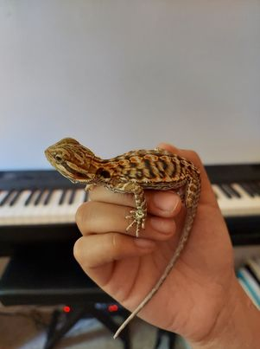
QUESTIONS?

