Slide 1
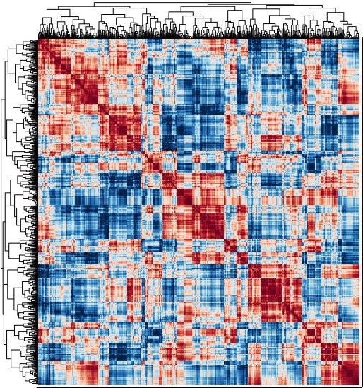
The role of bacteria in the formation of the struvite equine enterolith
Ashleigh Flores, MS, PhD/DVM Student
PI: Bart Weimer, PhD

Slide 2
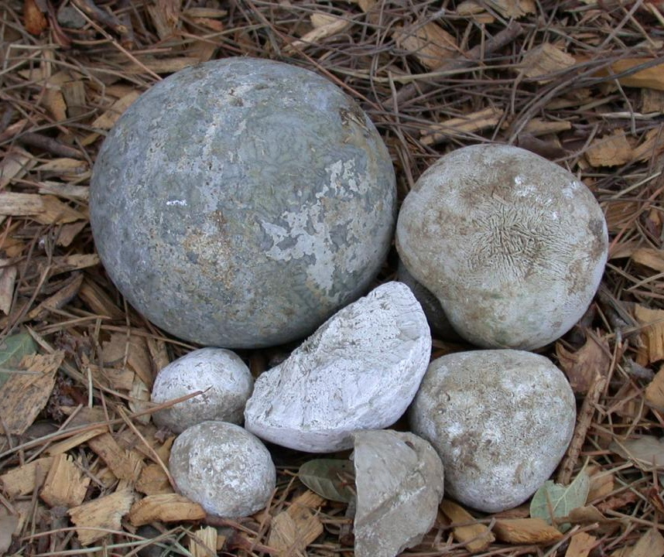
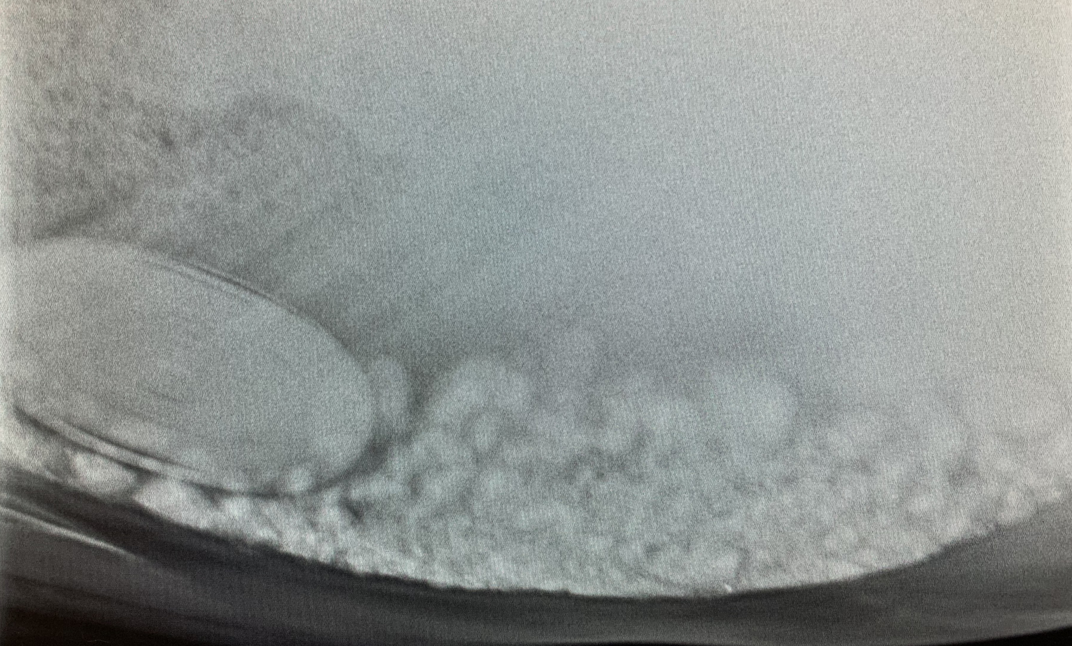
Introduction
Enteroliths: Endogenously produced mineral concretions that form in right dorsal colon
Important cause of colic in certain geographical regions
Cause complete or intermittent obstruction with risk of causing pressure necrosis and intestinal rupture
Photo credit: Julie Dechant, DVM, DACVECC, DACVS
Notes:
Enterolithiasis: The presence of calculi in the intestine.
It is an important cause of equine colic in certain geographical regions, and particularly in California.
Enteroliths cause colic by completely or intermittently obstructing the lumen of the right dorsal colon, transverse colon, or small colon. In addition to physically impeding passage of ingesta, enteroliths have the risk of causing pressure necrosis and subsequent intestinal rupture.

Slide 3
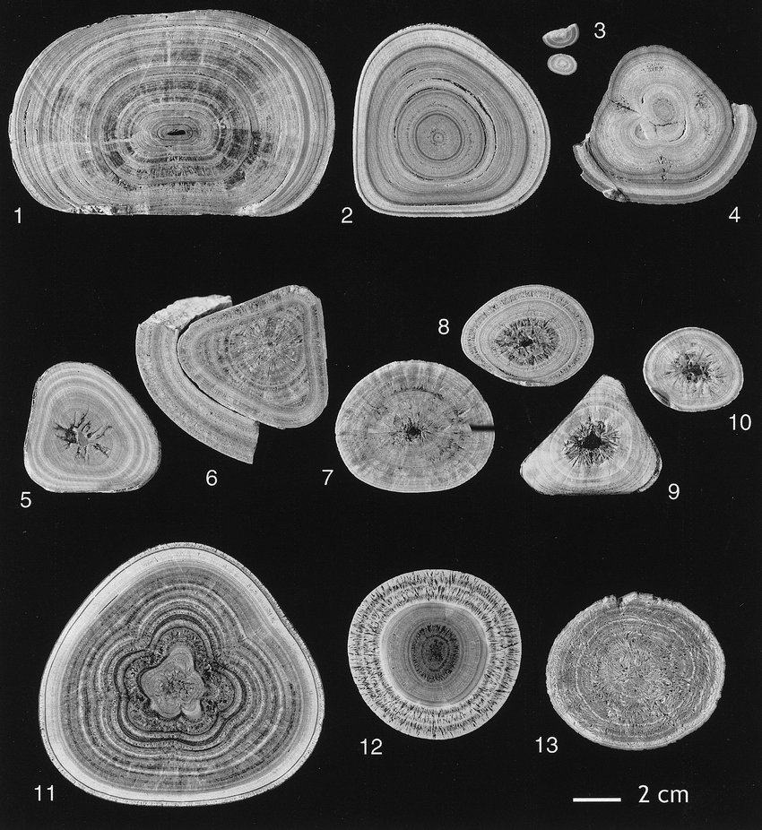
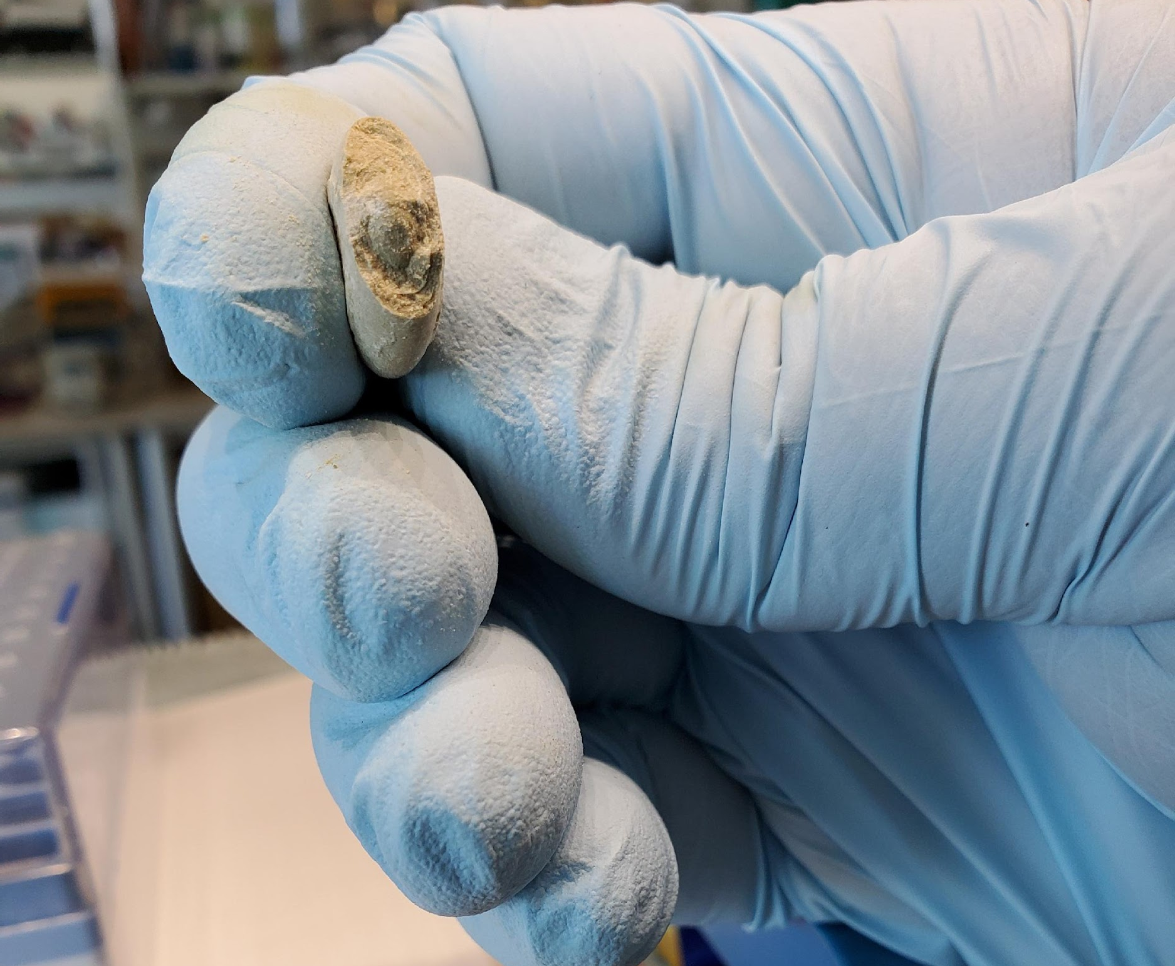
Previous studies have found concentric ring structures in enteroliths
We also observed layers that helped guide our approach
(Hassel et al., 2004)
Notes:
Previous research has identified enteroliths as having a unique concentric ring structure that begins with a central nidus and layers grow outward, much like that of rings on a tree. This information helped guide our approach.

Slide 4
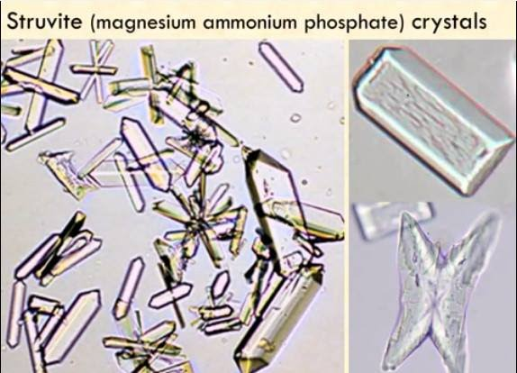
Struvite Chemistry
Struvite:
A composite of magnesium ammonium phosphate hexahydrate [(NH4)MgPO4•6H2O)]
Not very soluble in alkaline/neutral conditions
Highly soluble in acidic conditions
Horses with enterolithiasis have been shown to have a higher colonic pH than in healthy individuals, a favorable condition for struvite formation.
https://www.medical-labs.net/struvite-crystals-1279/&ust=1565838546235752

Slide 5
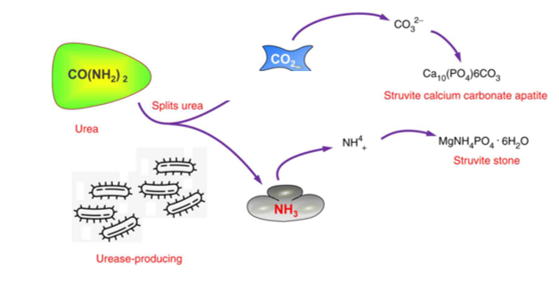
Microbial Metabolism
Microbiome; individual isolates
https://images.app.goo.gl/TEMg6jp1CG4A3WeX8
Notes:
The enzyme Urease metabolizes urea into NH3 and CO2. The ammonia released is converted to NH4 ions increasing the pH. As pH increases, calcium and magnesium phosphates begin to precipitate out of solution, leading to the formation of struvite (magnesium ammonium phosphate) and apatite crystals. Further, urease increases the rate of hydrolysis of urea by 10^14, magnifying the abovementioned processes.
In urine, research has shown that the increased NH3 production and elevated pH necessary for sustained struvite formation can only occur when urease producing organisms are present which suggests that urease producing bacteria are a critical component in struvite stone formation.

Slide 6
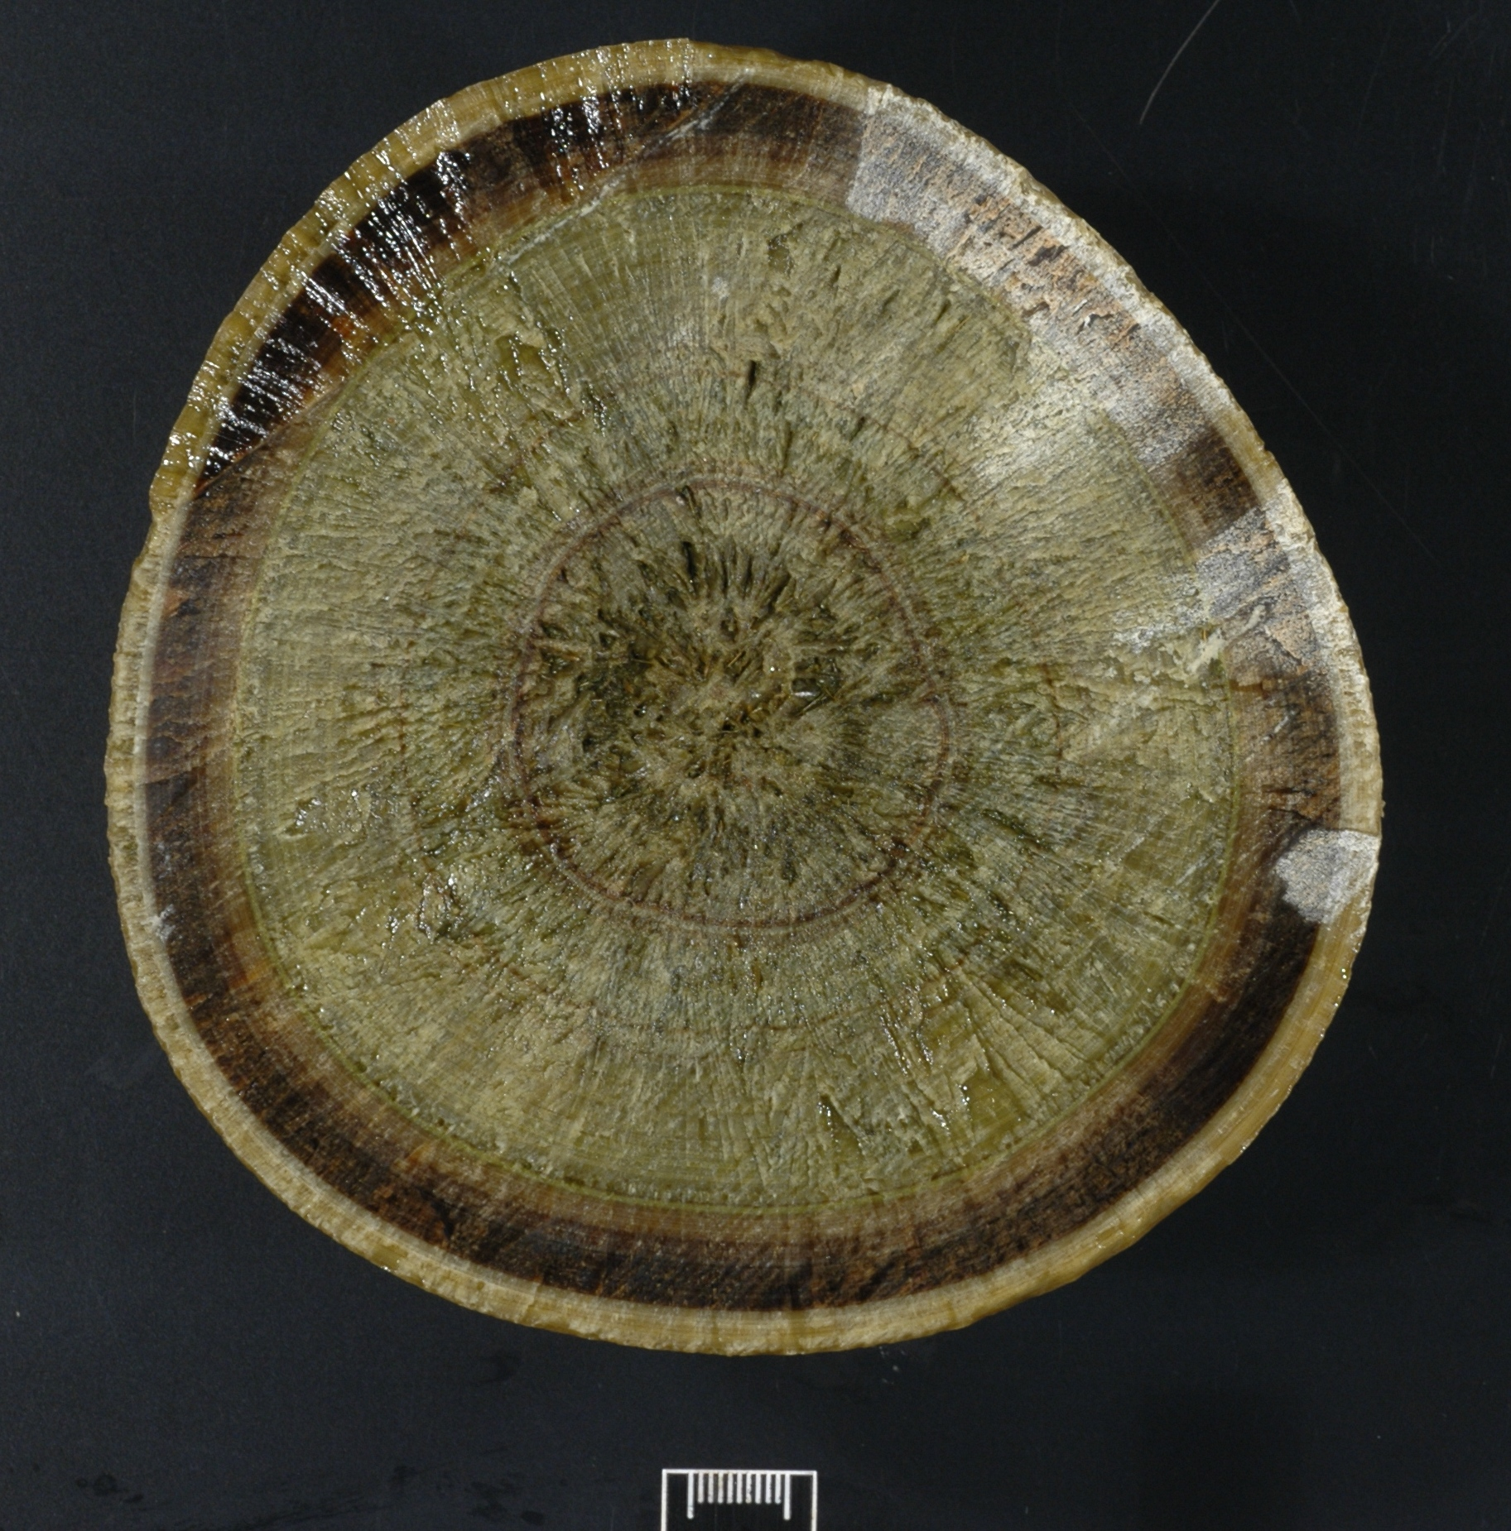
Project Significance
It is an understudied disease despite having a disproportionately high rate of occurrence in CA compared to other areas worldwide.
Disease insights come from decades-old research that examined the symptoms and lacks causal linkage
The potential connection between the gut microbiome and the disease has yet to be investigated
Potential applications to human and small animal veterinary medicine with struvite kidney/urinary stones.
Photo credit: Julie Dechant, DVM, DACVECC, DACVS

Slide 7
Objectives and Hypothesis
Hypothesis: A microbial community exists (microbiome) within equine enteroliths and contribute to enterolith formation.
Aim 1: Identify the microbiome of enteroliths using deep RNA metagenomic sequencing.
Aim 2: Determine whether struvite production is a result of a microbial catabolism of urea that ultimately results in excess ammonia within the colonic environment.

Slide 8
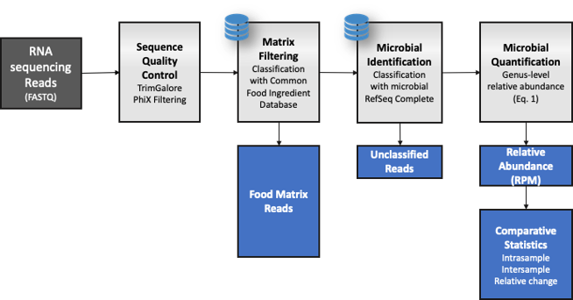
Materials and Methods
1. Enterolith Separation
2. Dissolve in Buffer
3. RNA Isolation
4. Quality Control
5. Metagenome Sequencing
6.
Sequence
Analysis
Beck et al. (2020)
Notes:
Enterolith separated into layers and pulverized to maximize particle surface area
Mineral and organic material dissolved via sodium citrate buffer solution
Performed quality control in preparation for metagenomic sequencing
We then sequenced RNA to identify names of active microbial organisms within the different layers of the enterolith

Slide 9
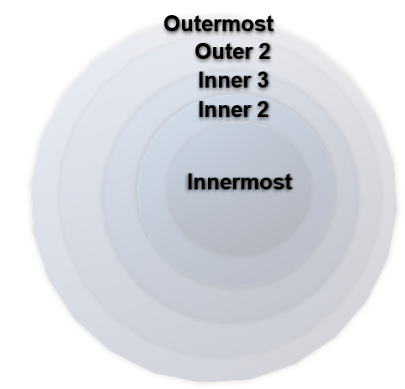
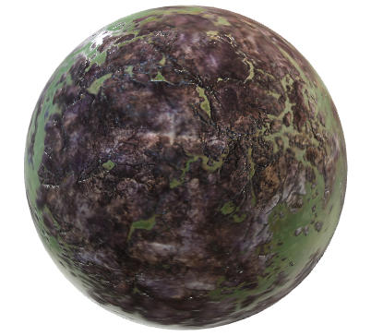
Results
4,390 Microbes
Group 1= Inner Group 2= Outer
Notes:
Following metagenomic sequencing, we determined based on the graphs above that there are in fact notable differences in the relative abundance of microbes present within the outer vs. the inner layers.

Slide 10
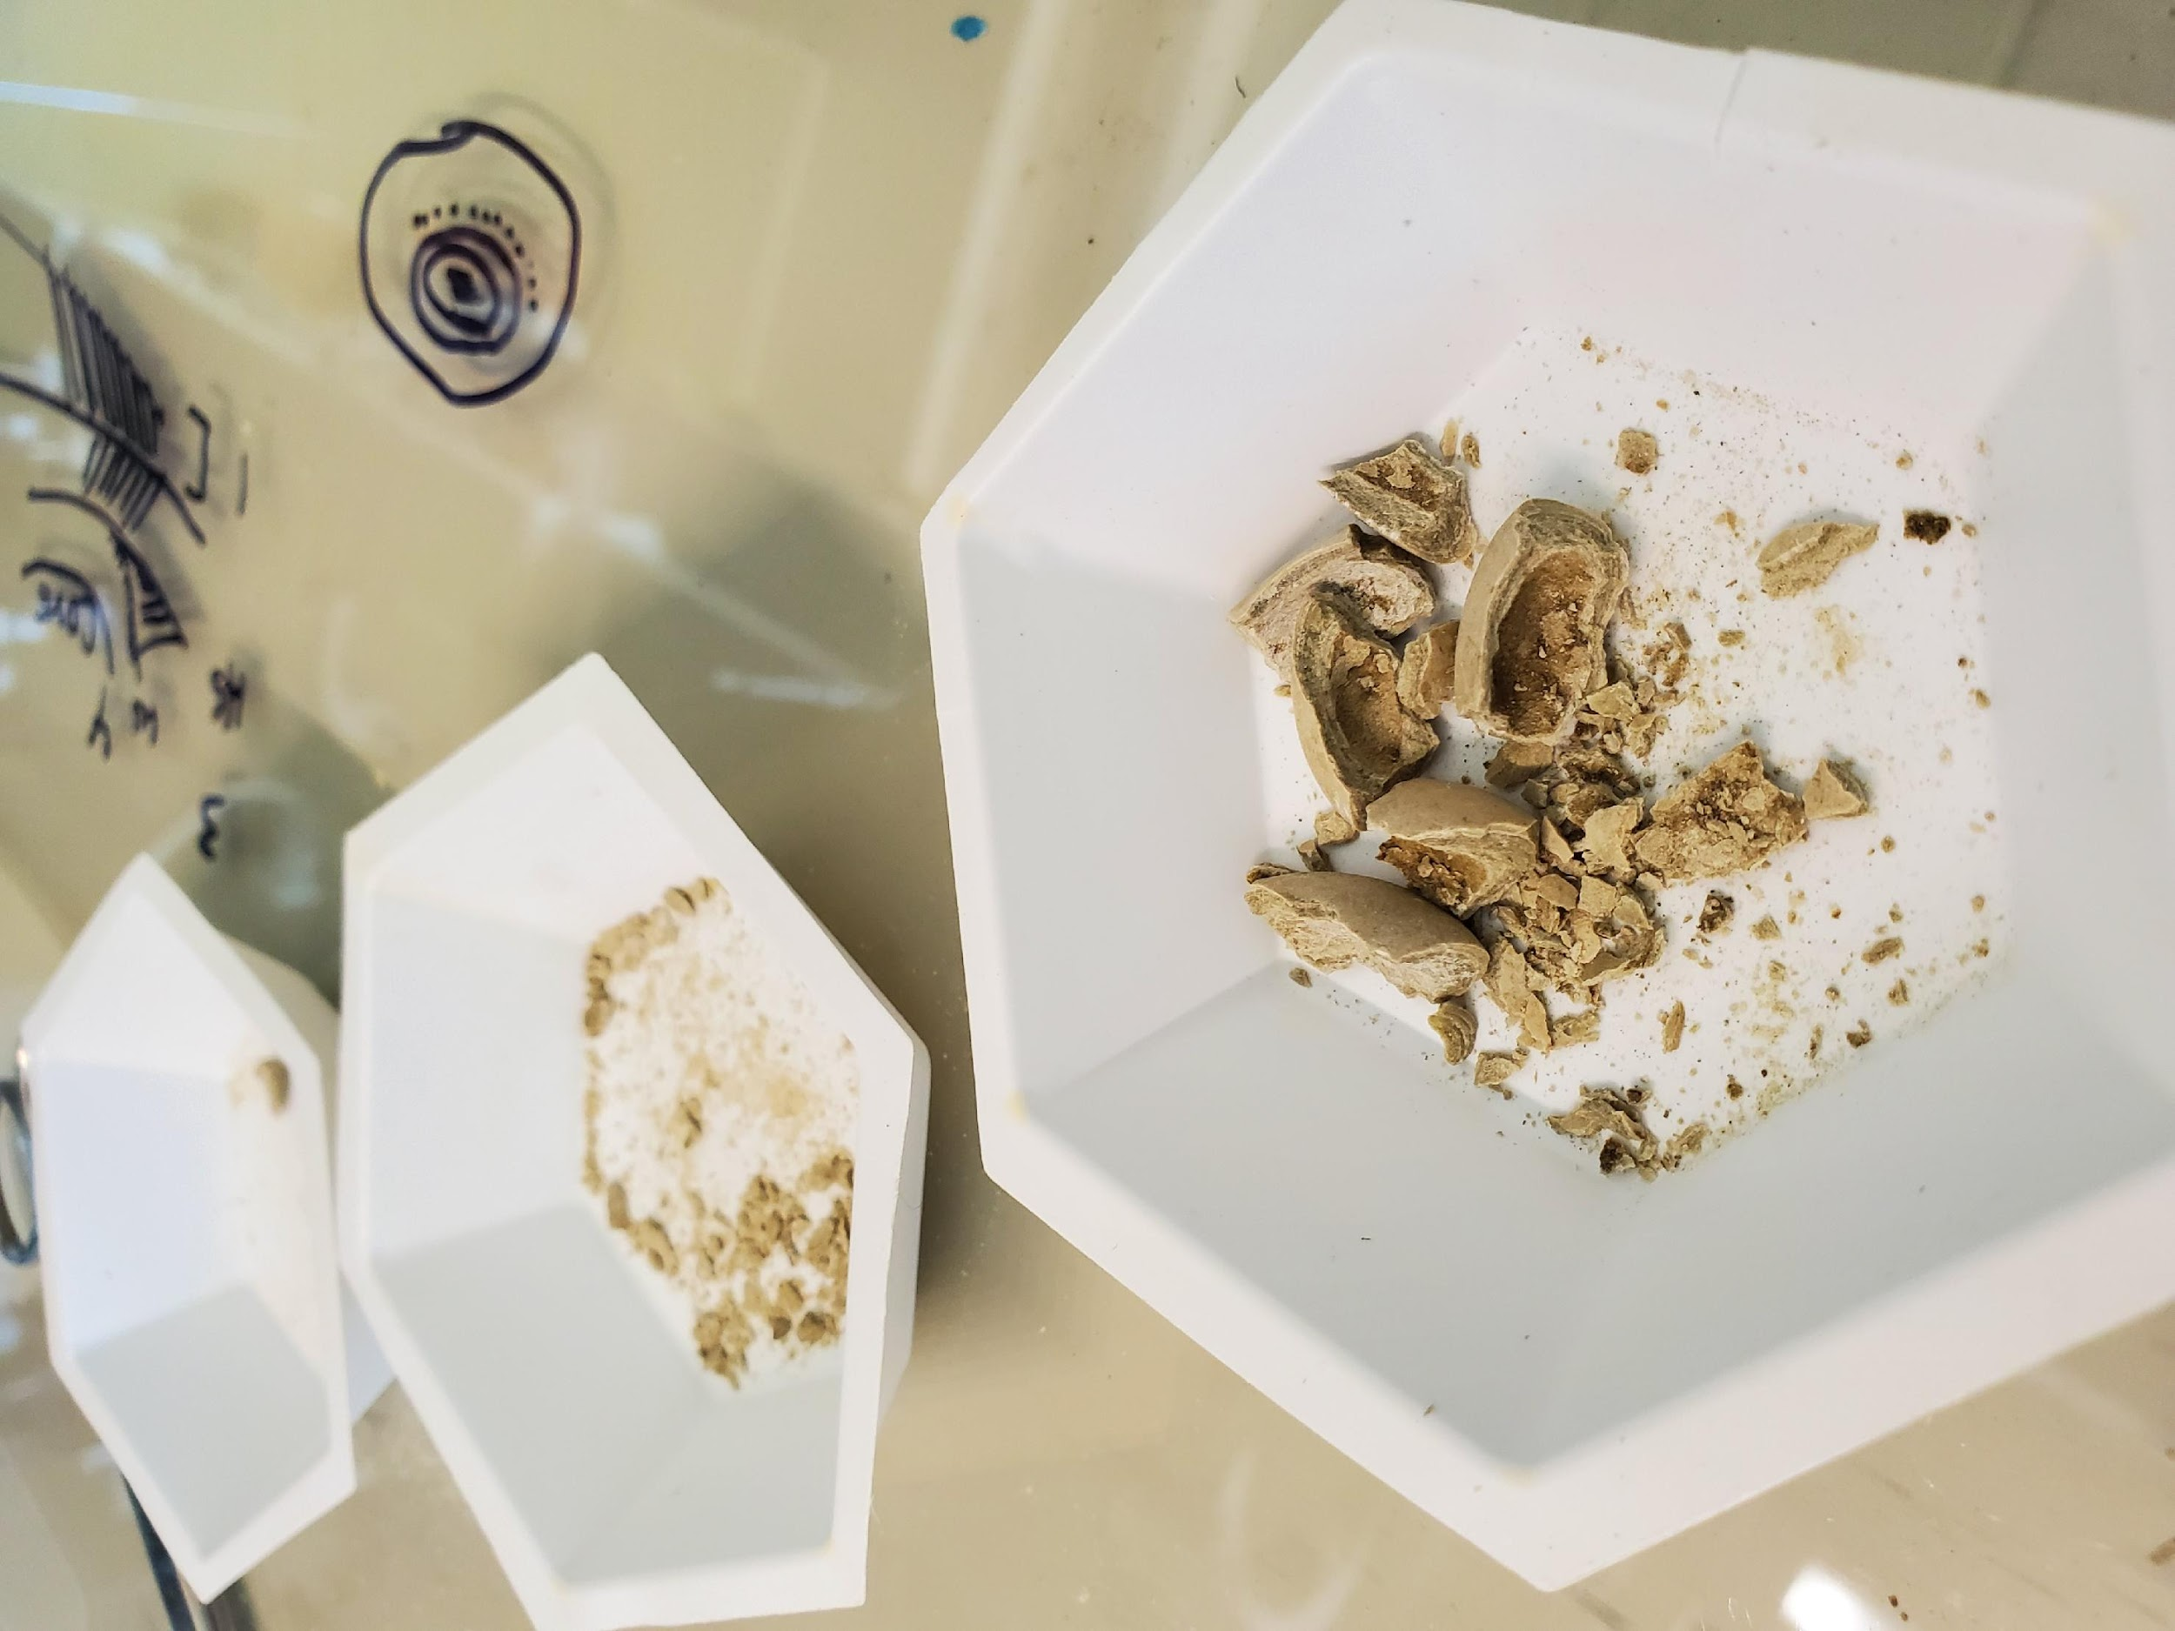
Notes:
Not only does the total microbial population change by depth, but individual organisms also vary by layer within the enterolith as demonstrated by this figure shows how the total relative abundance of organisms associated with struvite production changes with each enterolith layer. When they change by layer it changes the overall microbiome for that layer.

Slide 11
(Schwaderer and Wolfe, 2016)
(Flores-Mireles et al., 2015)
(Rekha et al., 2020)
(Gambaro, 2021)
Notes:
In the literature, these organisms have been identified as contributors to struvite stone formation in vivo. The graph shows how these notable struvite producers change within the layers of the enterolith microbiome layer within the enterolith microbiome. Staphylococcus aureus was found to be the most prevalent overall followed by pseudomonas aeruginosa….

Slide 12
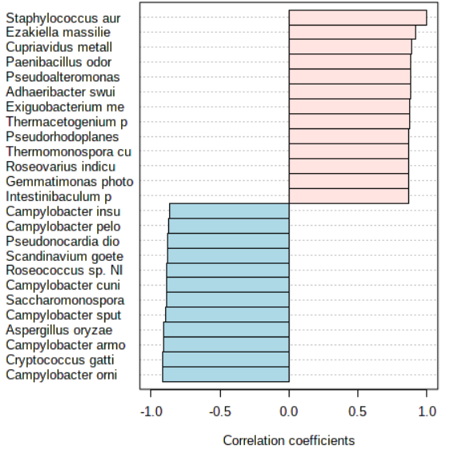
Staphylococcus aureus
Other urease-producing species that increase in concert with S. aureus
Microorganism Name | Urease Producer | Change relative to Increases in Staphylococcus aureus
Cupriavidus metallidurans | 🗹 | Increases
Campylobacter sputorum | 🗹
Paenibacillus odorifer | 🗹
Pseudoalteromonas piratica | 🗹
Exiguobacterium mexicanum | 🗹
Notes:
Because staphylococcus aureus was the highest known struvite producer overall within our data set. We next examined how changes in this prevalent organism affect the membership of the microbial community. As this struvite producer increases you can see that it is brining along other organisms that contribute to struvite formation via urease production. This shows that the membership of the microbial community is changing, and it is driven by the membership itself. This presents the idea that community metabolism is occurring, that is there is cooperation of microbial community members during stone formation because they are contributing to urea catabolism together.
Cooccurance , possible synergistic effect of the micribiome? Community metabolism,

Slide 13
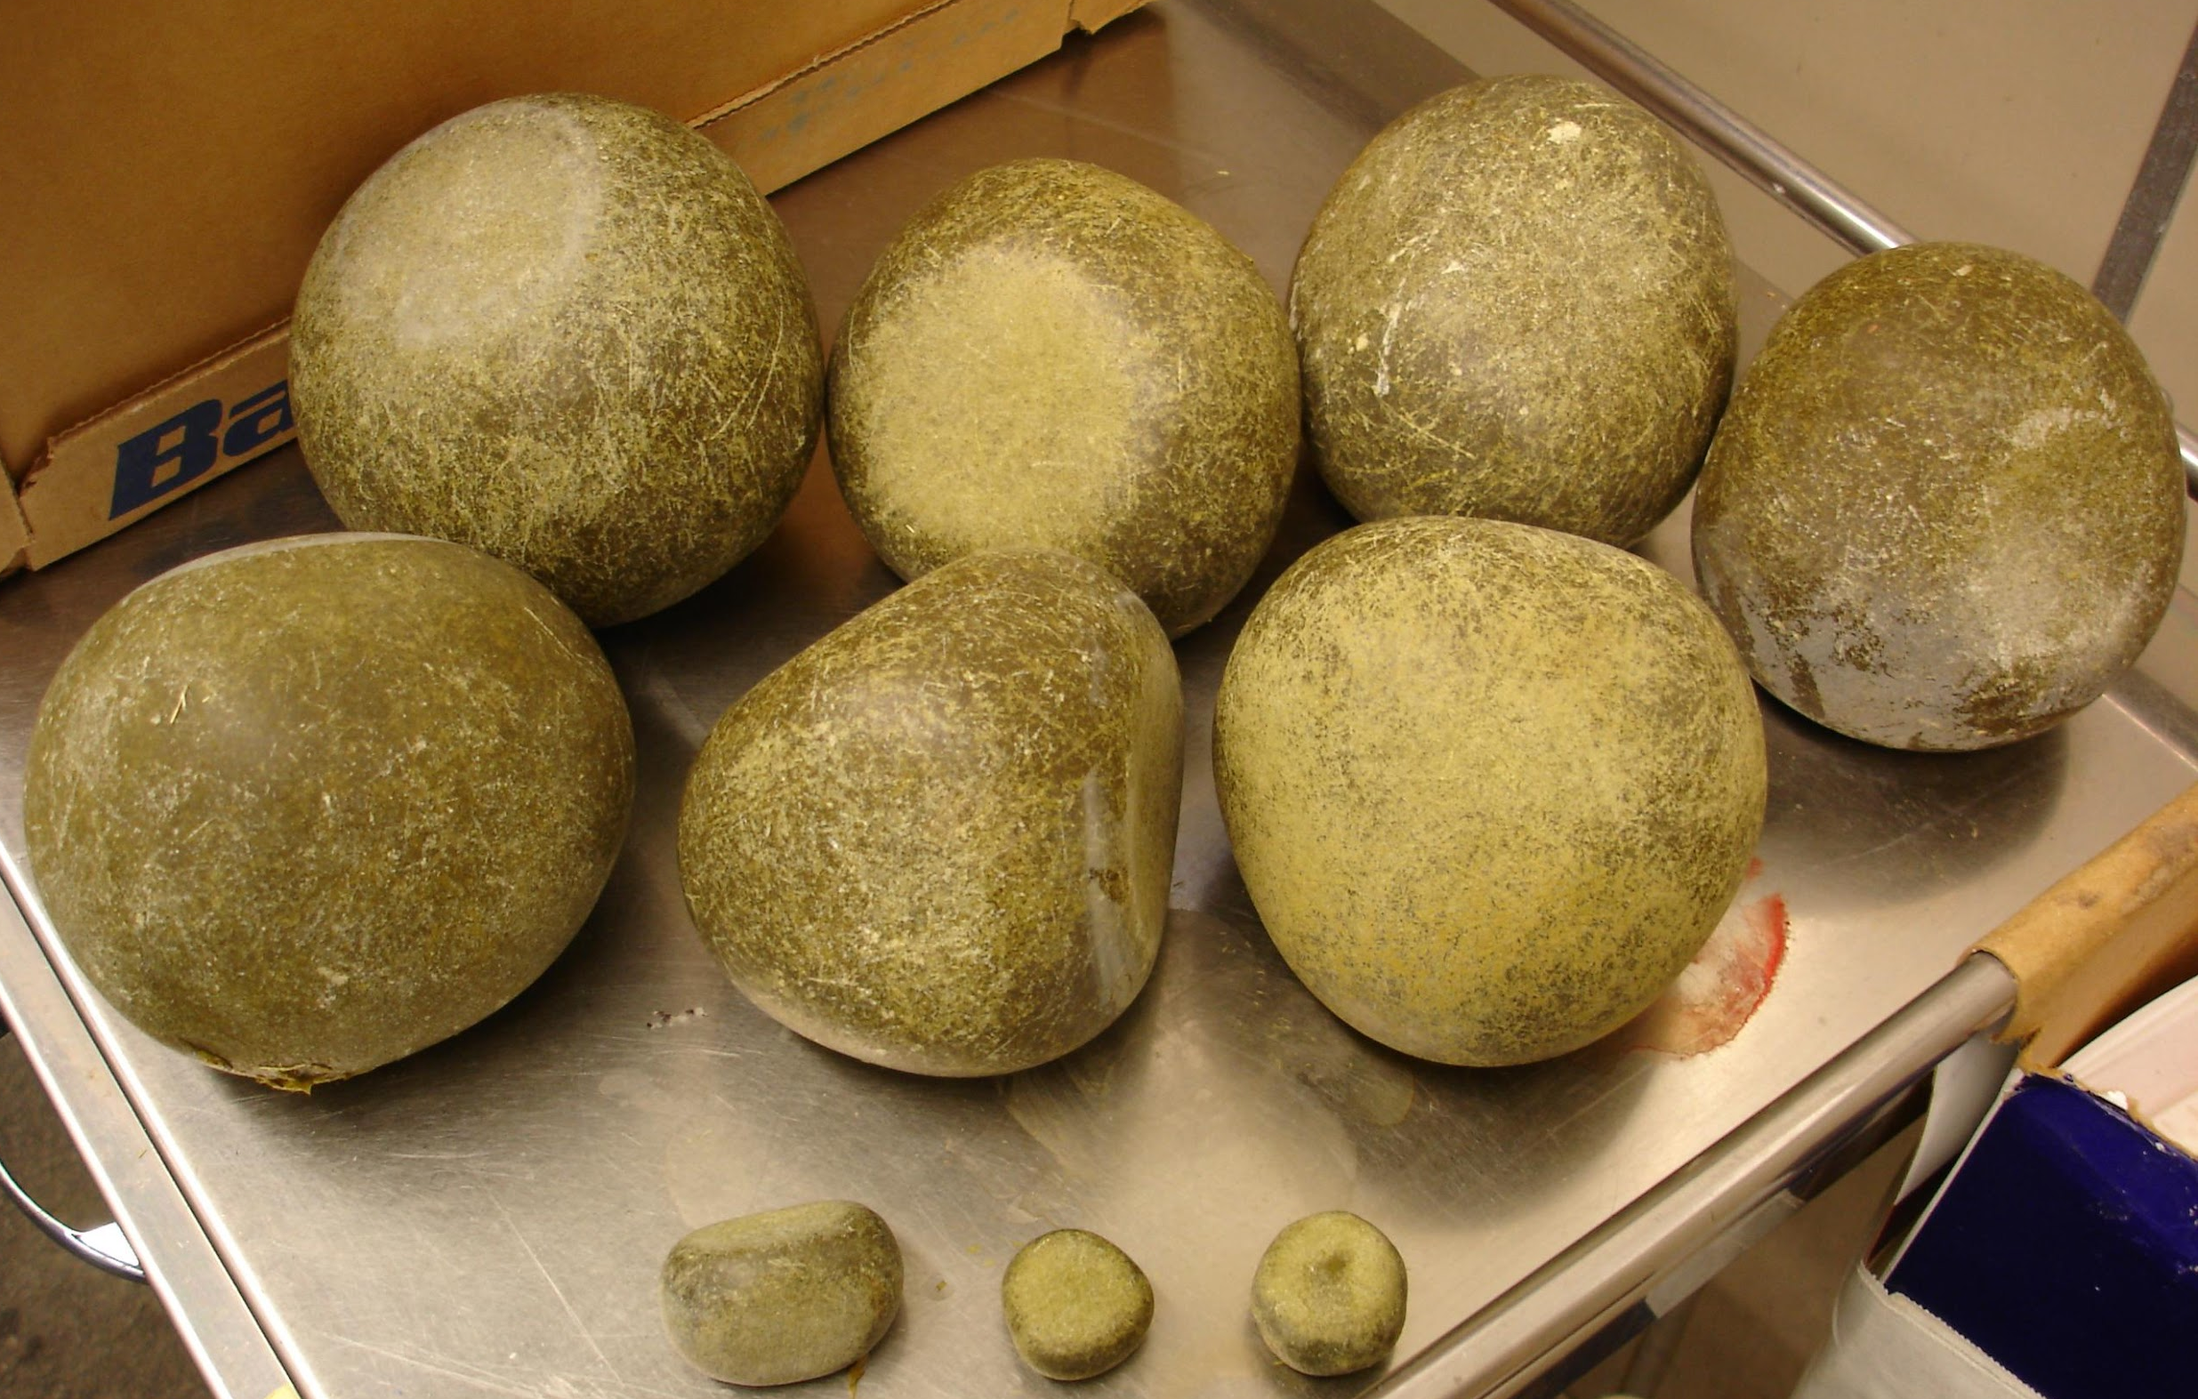
Conclusions
An active microbiome is in fact present within equine enteroliths
Microbial species differentially occur between the layers
Urease producing bacteria are present in multiple
Together, these data suggest that struvite formation is a microbiome activity in equine enteroliths
Photo credit: Julie Dechant, DVM, DACVECC, DACVS

Slide 14
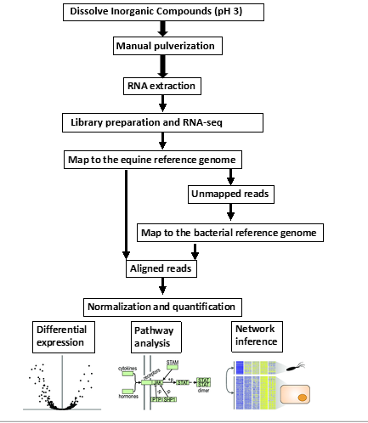
Next Steps
Based on these findings we can now work to determine function using transcripts from the metagenome
The transcripts allow identification of genes associated urease, but also broader ammonia and carbon dioxide metabolism associated with struvite formation

Slide 15
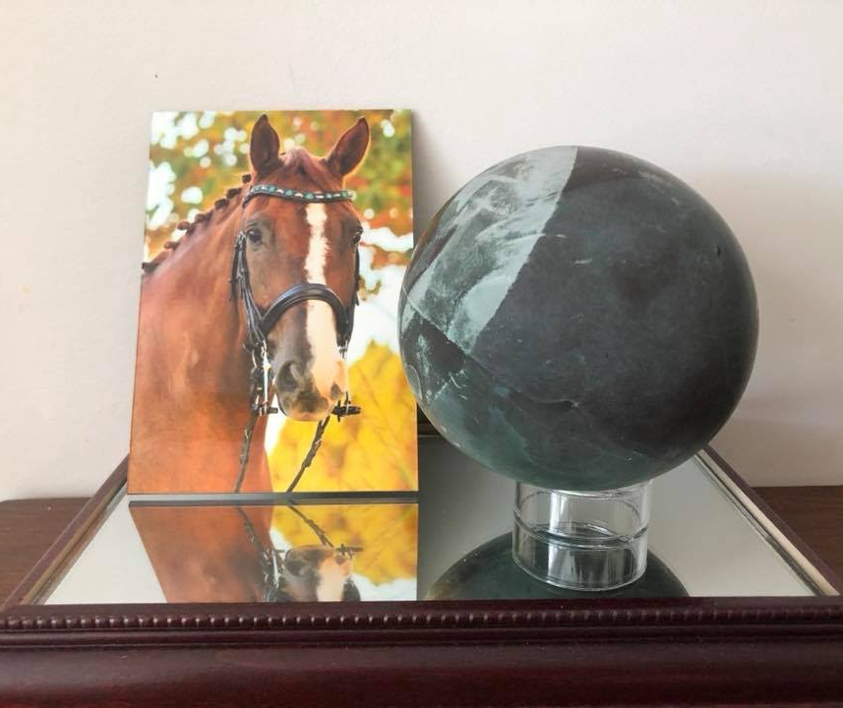
Acknowledgments
Special thanks to:
Bart Weimer, PhD
Members of the Weimer MicroLab
Carol Huang
Cory Schlesener
Julie Dechant, DVM, DACVECC, DACVS
Financial support was provided by:
Students Training in Advanced Research (STAR) Program from Boehringer Ingelheim, an endowment in the SVM

Slide 16
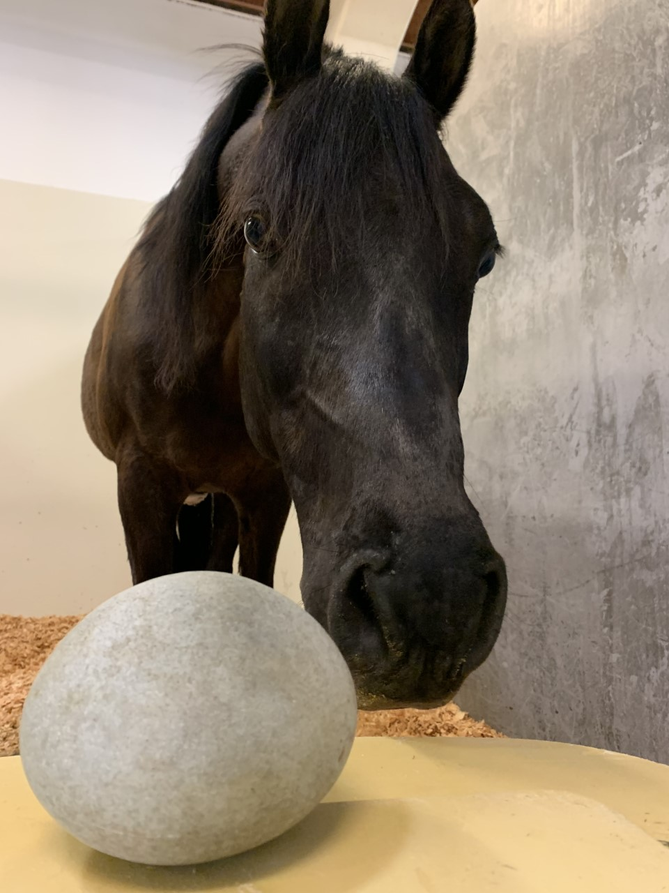
Thank you for your attention! Any questions?
Photo credit: Julie Dechant, DVM, DACVECC, DACVS
Notes:
Thank you for your attention. I am happy to address any questions.

Slide 17
References
Hassel DM, Spier SJ, Aldridge BM, Watnick M, Argenzio RA, Snyder JR. Influence of diet and water supply on mineral content and pH within the large intestine of horses with enterolithiasis. Vet J. 2009;182(1):44-49. doi:10.1016/j.tvjl.2008.05.016
Hassel, D. M., Schiffman, P. S., & Snyder, J. R. (2001). Petrographic and geochemic evaluation of equine enteroliths, American Journal of Veterinary Research, 62(3), 350-358. Retrieved Jul 27, 2022, from https://avmajournals.avma.org/view/journals/ajvr/62/3/ajvr.2001.62.350.xml
Prywer, Jolanta, Ewa Mielniczek-Brzóska, Marcin Olszynski. Struvite crystal growth inhibition by trisodium citrate and the formation of chemical complexes in growth solution. Journal of Crystal Growth. 2015;418:92-101. doi:10.1016/j.jcrysgro.2015.02.027.
Schwaderer AL, Wolfe AJ. The association between bacteria and urinary stones. Ann Transl Med. 2017;5(2):32. doi:10.21037/atm.2016.11.73
Flannigan RK, Battison A, De S, et al. Evaluating factors that dictate struvite stone composition: A multi-institutional clinical experience from the EDGE Research Consortium. Can Urol Assoc J. 2018;12(4):131-136. doi:10.5489/cuaj.4804
Flores-Mireles AL, Walker JN, Caparon M, Hultgren SJ. Urinary tract infections: epidemiology, mechanisms of infection and treatment options. Nat Rev Microbiol. 2015;13(5):269-284. doi:10.1038/nrmicro3432
Gambaro G. Renal Stones and Infections. Oral presentation at: The 30th Budapest Nephrology School; August 2021; Budapest, Hungary.
Rekha PD, Hameed A, Manzoor MAP, Suryavanshi MV, Ghate SD, Arun AB, Rao SS, Athmika, Bajire SK, Mujeeburahiman M, Young C-C. First Report of Pathogenic Bacterium Kalamiella piersonii Isolated from Urine of a Kidney Stone Patient: Draft Genome and Evidence for Role in Struvite Crystallization. Pathogens. 2020; 9(9):711. https://doi.org/10.3390/pathogens90907111
Dornbier RA, Bajic P, Van Kuiken M, et al. The microbiome of calcium-based urinary stones. Urolithiasis. 2020;48(3):191-199. doi:10.1007/s00240-019-01146-w
Parkhomenko E, De Fazio A, Tran T, Thai J, Blum K, Gupta M. A Multi-Institutional Study of Struvite Stones: Patterns of Infection and Colonization. J Endourol. 2017;31(5):533-537. doi:10.1089/end.2016.0885

