Slide 1
Coronavirus infections in companion animals: virology, epidemiology, clinical and pathologic features
Christine Haake
Murphy Lab
NIH-funded STAR Project
July 30th, 2020

Slide 2
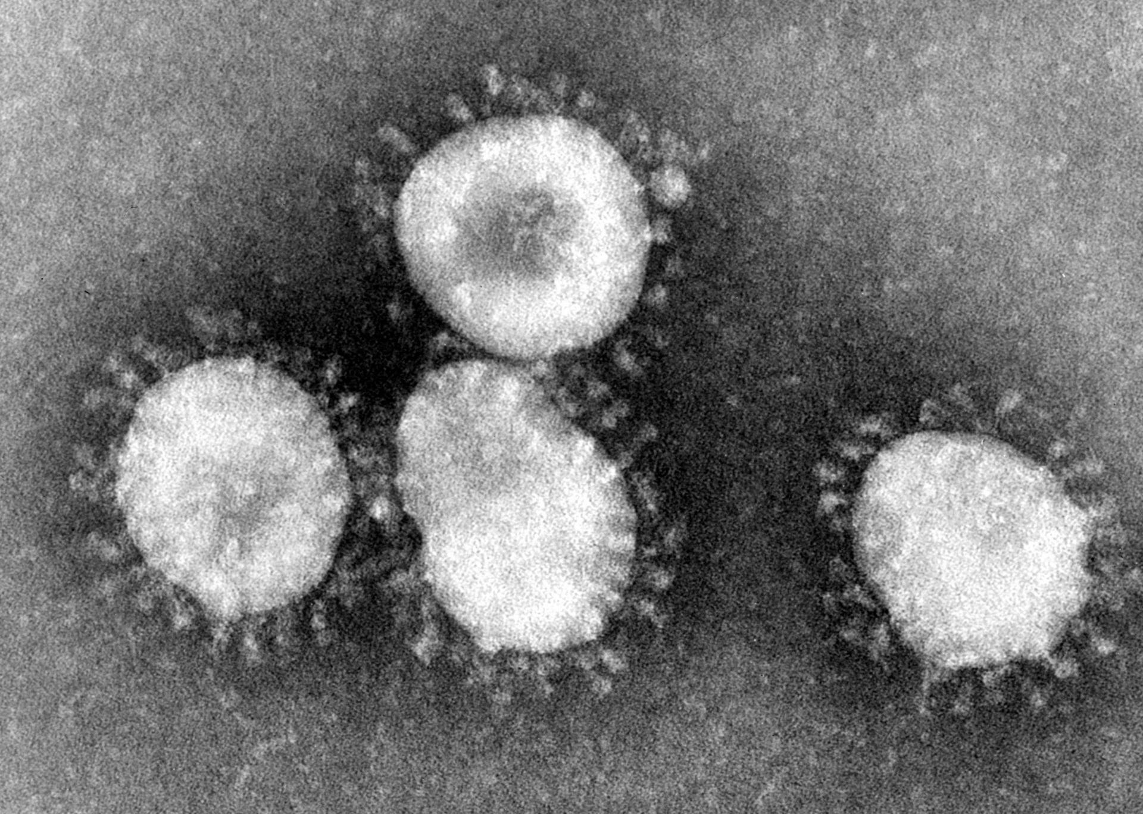
Coronavirus Basics
Coronaviruses
Enveloped, RNA viruses
Single-stranded, huge 26-32 kb RNA genome
High frequency of recombination and point mutations
Generally cause either respiratory or intestinal disease
Photo Credit: CDC/Dr. Fred Murphy
Notes:
Coronaviruses are spherical, enveloped, single-stranded, positive sense RNA viruses that infect humans and many other mammalian and avian species, generally causing either intestinal or respiratory disease, with some that can cause neurologic or widespread systemic disease. Coronaviruses are among the largest of the RNA viruses, with genomes spanning 27 to 32 kilobases (kb) in length, which is about three times the size of most retroviruses.
The genetic diversity of coronaviruses is a result of point mutations, genetic recombination, and the incorporation of genes from other viruses, all of which likely contribute to the emergence of new viruses with altered virulence, novel host species range and tissue tropism.
Genetic recombination is a direct result of the discontinuous transcriptional activity of the coronaviral polymerase, and likely contributes to the emergence of new viruses with altered virulence, novel host species range and novel tissue tropism.

Slide 3
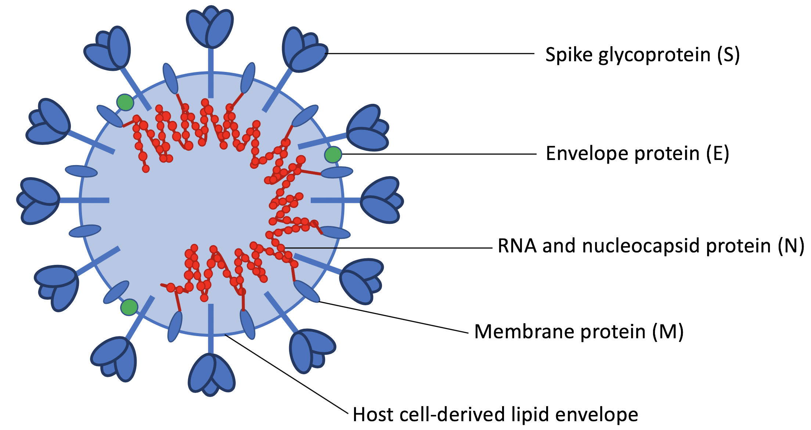
Coronavirus Structure
Structural proteins
Nucleocapsid (N)
Spike (S)
Membrane (M)
Envelope (E)
Notes:
Major structural proteins include the nucleocapsid (N), spike (S), membrane (M), and envelope (E) proteins. The trimeric Spike protein is the primary binding protein and it also mediates membrane fusion and viral entry into cells. The N protein, in association with genomic viral RNA, forms the helical nucleocapsid, which is stabilized by binding to the membrane protein. The viral genome and nucleocapsid are surrounded by a host-derived lipid bilayer, in which the Spike, Envelope, and Membrane proteins are anchored.
The Envelope and Membrane proteins are involved virion assembly and budding.

Slide 4
Coronavirus Genera
Feline enteric coronavirus
Feline infectious peritonitis virus
Canine enteric coronavirus
Ferret enteric coronavirus
Ferret systemic coronavirus
Alphacoronavirus
Betacoronavirus
Gammacoronavirus
Deltacoronavirus
Canine respiratory coronavirus
Equine coronavirus
SARS-CoV-1
MERS-CoV
SARS-CoV-2
Notes:
On the basis of comparative genome sequence analysis, coronaviruses are subdivided into four genera: alpha, beta, gamma, and delta. Alpha- and betacoronaviruses originate from bats and mainly infect mammals, while gamma- and deltacoronaviruses originate from birds and are capable of infecting both bird and mammal species [6]. Major coronaviruses of companion animals include feline enteric coronavirus (FECV), feline infectious peritonitis virus (FIPV), canine enteric coronavirus (CECoV) and the ferret coronaviruses (FRECV), which are all alphacoronaviruses, while canine respiratory coronavirus (CRCoV) and equine coronavirus (ECoV), are betacoronaviruses. Also belonging to the betacoronavirus genus are SARS, MERS, and SARS-CoV-2, all significant zoonotic viruses that have transferred from animal to human populations [7], demonstrating the high zoonotic potential of coronaviruses.
Currently, the significance of SARS-CoV-2 for infection of companion animals is poorly understood, although preliminary studies indicate that ferrets and cats are permissive for SARS-CoV-2 infection, while the virus has been shown to replicate poorly in dogs, pigs, chickens, and ducks.
So we are going to do a whirlwind tour of these seven major coronaviruses of companion animals…

Slide 5
Feline coronaviruses
Serotype I
Serotype II
80-90% of naturally occurring clinical cases
Difficult to propagate in cell culture
Rare
Recombination between feline coronavirus serotype I and canine enteric coronavirus serotype II
Target receptor = APN
Terada Y, Matsui N, Noguchi K, Kuwata R, Shimoda H, Soma T, et al. (2014) Emergence of Pathogenic Coronaviruses in Cats by Homologous Recombination between Feline and Canine Coronaviruses. PLoS ONE 9(9): e106534.
Notes:
Feline coronaviruses are alphacoronaviruses, and are divided into two serotypes, I and II. Serotype I is more prevalent in nature, responsible for the majority of naturally occurring clinical cases. Serotype II is more rare, having emerged as a result of recombination events between the feline serotype I and canine enteric coronavirus serotype II, following cross-species transmission of the canine coronavirus to cats.
The target receptor for cellular entry of serotype II feline coronaviruses has been identified as feline aminopeptidase N (fAPN) [82], which is a membrane peptidase expressed on the brush border of small intestine and renal tubule microvilli, as well as by cells of myeloid origin, including monocytes, macrophages, and granulocytes

Slide 6
Feline enteric coronavirus and feline infectious peritonitis virus
FECV
mutation
FIPV
Endemic in domestic cat populations
Infects intestinal enterocytes
Mild enteric clinical signs or subclinical infections
Systemic, 100% fatal disease
Infects monocytes and macrophages
Purebred cats at higher risk
Young cats, old, or immunosuppressed
Infects enterocytes
Infects monocytes/macrophages
Monocyte
https://www.vetfolio.com/learn/article/fip-clinical-concerns
https://mmegias.webs.uvigo.es/02-english/8-tipos-celulares/enterocito.php
Notes:
Feline enteric coronavirus is endemic in domestic cat populations and primarily infects intestinal enterocytes, typically resulting in mild enteric clinical signs or subclinical infection. Subclinical carriers play an important role in shedding and transmitting the virus to other cats via the fecal-oral route, especially in those living in multi-cat environments.
The closely related FIP virus causes a highly inflammatory, systemic disease, which is nearly 100% fatal once clinical signs develop. FIP virus is thought to arise from spontaneous mutation in the feline enteric coronavirus genome, which causes a tropism switch from enterocytes to macrophages, and allows the virus to spread systemically.

Slide 7
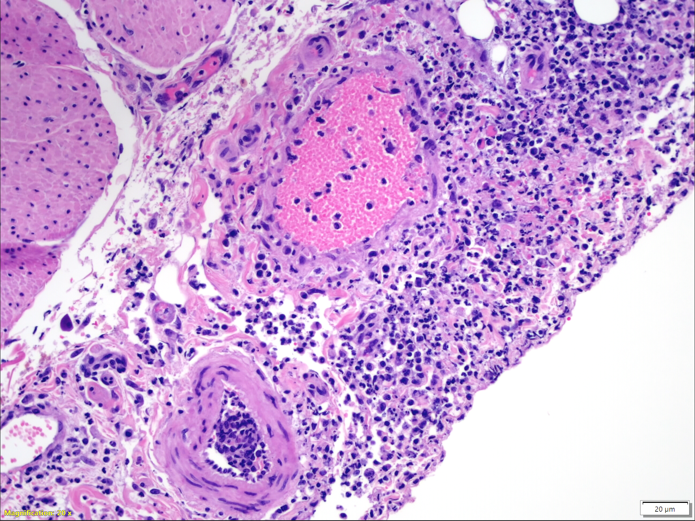
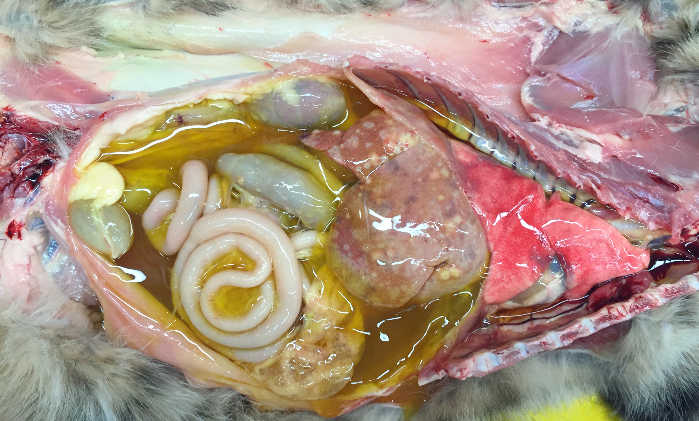
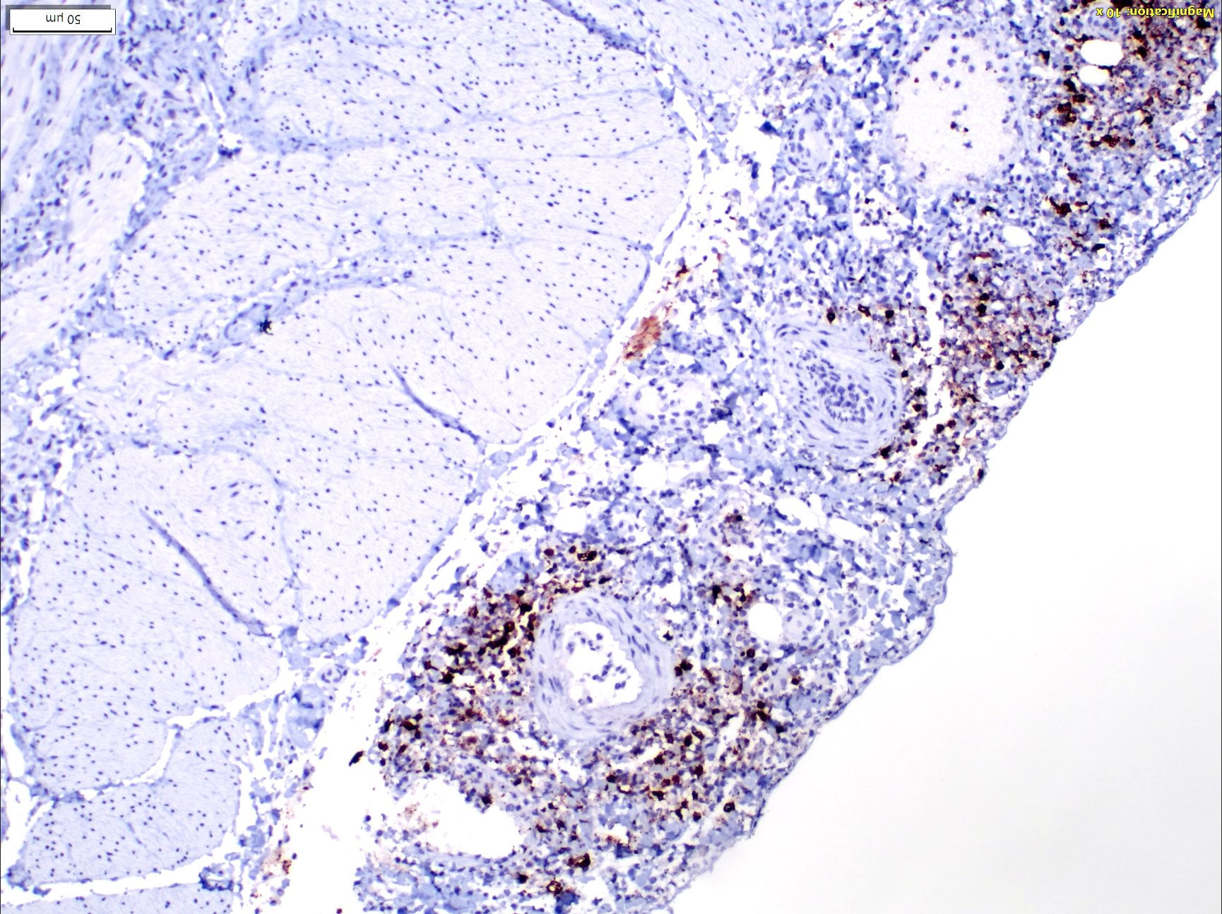
Feline infectious peritonitis
Feline infectious peritonitis (FIP), urinary bladder serosal surface, cat, FCoV immunohistochemistry. Frequent, positive immunoreactivity for FCoV antigen.
Feline infectious peritonitis (FIP), urinary bladder serosal surface, cat, hematoxylin and eosin (HE). Severe, necrotizing, pyogranulomatous and lymphoplasmacytic serositis and vasculitis.
Gross lesions of wet FIP. “Straw-colored” peritoneal effusion, fibrinous and granulomatous serositis and granulomatous lesions in the liver. Image courtesy of Chrissy Eckstrand.
Notes:
Grossly, the classic wet form of FIP is characterized by a “straw-colored,” protein-rich peritoneal effusion and inflammation centered on small and medium sized veins, resulting in vascular injury and leakage. These inflammatory lesions occur in the omentum and serosal surfaces of the liver, spleen, intestines, kidneys, and lungs, and are composed primarily of macrophages in combination with smaller numbers of neutrophils and lymphocytes, which is known as pyogranulomatous inflammation.
Here we have some images of the serosal surface of the urinary bladder in a cat with FIP. You can see all these macrophages and lymphocytes really localized to the serosal surface of the bladder and around veins in particular. On the right you can see some immunohistochemistry showing frequent positivity for feline coronaviral antigen within these inflammatory lesions.
Other frequently affected organs in dry FIP include the mesenteric and mediastinal lymph nodes, omentum, intestinal walls, and liver. Perivascular inflammatory lesions contain aggregates of macrophages, which are surrounded by dense infiltrates of primarily B lymphocytes and plasma cells extending into surrounding tissues.

Slide 8
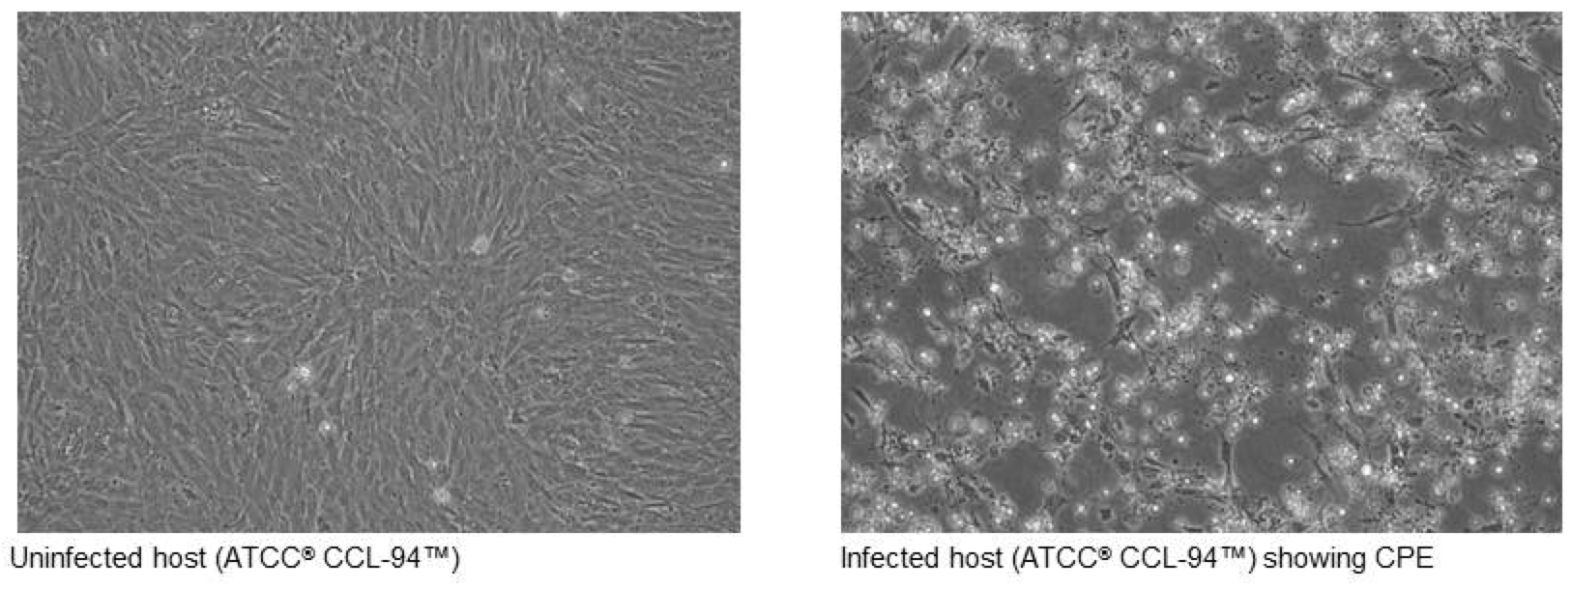
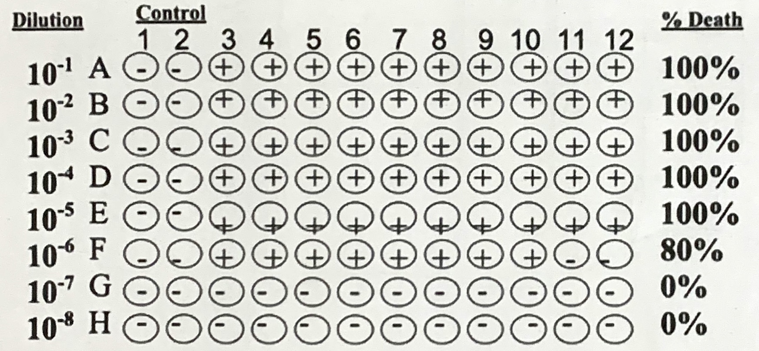
FIP viral titer
Uninfected CRFK cells
CRFK cells infected with FIPV
qRT-PCR = quantitative reverse transcription polymerase chain reaction → measures viral RNA
https://www.atcc.org/~/media/PDFs/Culture%20Guides/Virology_Guide.ashx
TCID₅₀ = the tissue culture infectious dose is the concentration at which 50% of the infected cells display cytopathic effects (CPE).
Notes:
One of the things I got to do in the lab this summer was to actually grow FIP virus in cell culture and then harvest the virus. To then figure out the concentration, we run two different assays. We measure viral RNA using quantitative RT-PCR, and we also determine the tissue culture infective dose or TCID50 by plating cells and then infecting them with the virus at different dilutions, shown here in red. After 72 hours, we score each well for cytopathic effects, and use that to determine the TCID50, which is a measure of the infectivity of the virus. You can see an example up here: on the left are uninfected cells, and on the right, this is what the cytopathic effects look like after FIP virus infection.
Crandell-Rees Feline Kidney Cell (CRFK) is a cell line derived from feline kidney cell, that have been found to work well to propagate FIP virus.

Slide 9
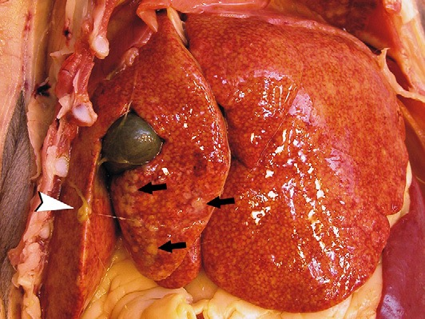
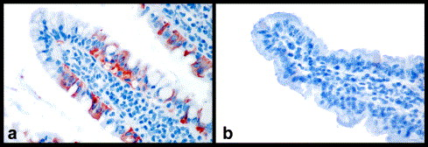
Ferret enteric coronavirus and ferret systemic coronavirus
Ferret Enteric Coronavirus
Ferret Systemic Coronavirus
Causes epizootic catarrhal enteritis, AKA “green slime disease”
High morbidity, low mortality
Lesions restricted to the GI tract
Fatal, inflammatory disease
Weight loss, anorexia, diarrhea, palpable abdominal masses, neurologic disease
Granulomatous lesions in multiple organs
Detection of coronavirus antigen (red) in enterocytes by immunohistochemistry.
Wise, Annabel G., Matti Kiupel, and Roger K. Maes. "Molecular characterization of a novel coronavirus associated with epizootic catarrhal enteritis (ECE) in ferrets." Virology 349.1 (2006): 164-174.
Murray J, Kiupel M, Maes RK. Ferret coronavirus-associated diseases. Vet Clin North Am Exot Anim Pract. 2010;13(3):543-560.
Notes:
Moving on to ferrets. Similar to feline, infection with ferret coronaviruses can result in enteric or systemic disease [91]. Ferret enteric coronavirus (FRECV) causes epizootic catarrhal enteritis (ECE), originally called “green slime disease” due to the bright green, mucus-laden diarrhea it causes [92]. Lesions are restricted to the GI tract, and disease is high morbidity but low mortality.
A genetically distinct coronavirus called ferret systemic coronavirus (FRSCV) causes a progressive, fatal, and systemic inflammatory disease, similar to FIP. Clinical signs include chronic weight loss, anorexia, diarrhea, abdominal masses, and neurologic disease [95].
On the right you can see the liver of a ferret with characteristic lesions of the systemic coronavirus. You can see thick strands of fibrin and multifocal, firm, whitish nodules distributed over the serosal surface of the liver.
Ferret systemic coronavirus is associated with granulomatous inflammation in the spleen, mesenteric lymph nodes, intestines, kidneys, liver, lungs, and brain [98]. These granulomatous lesions are similar to FIP both in immune cell composition and presence of virus within the macrophage cytoplasm.

Slide 10
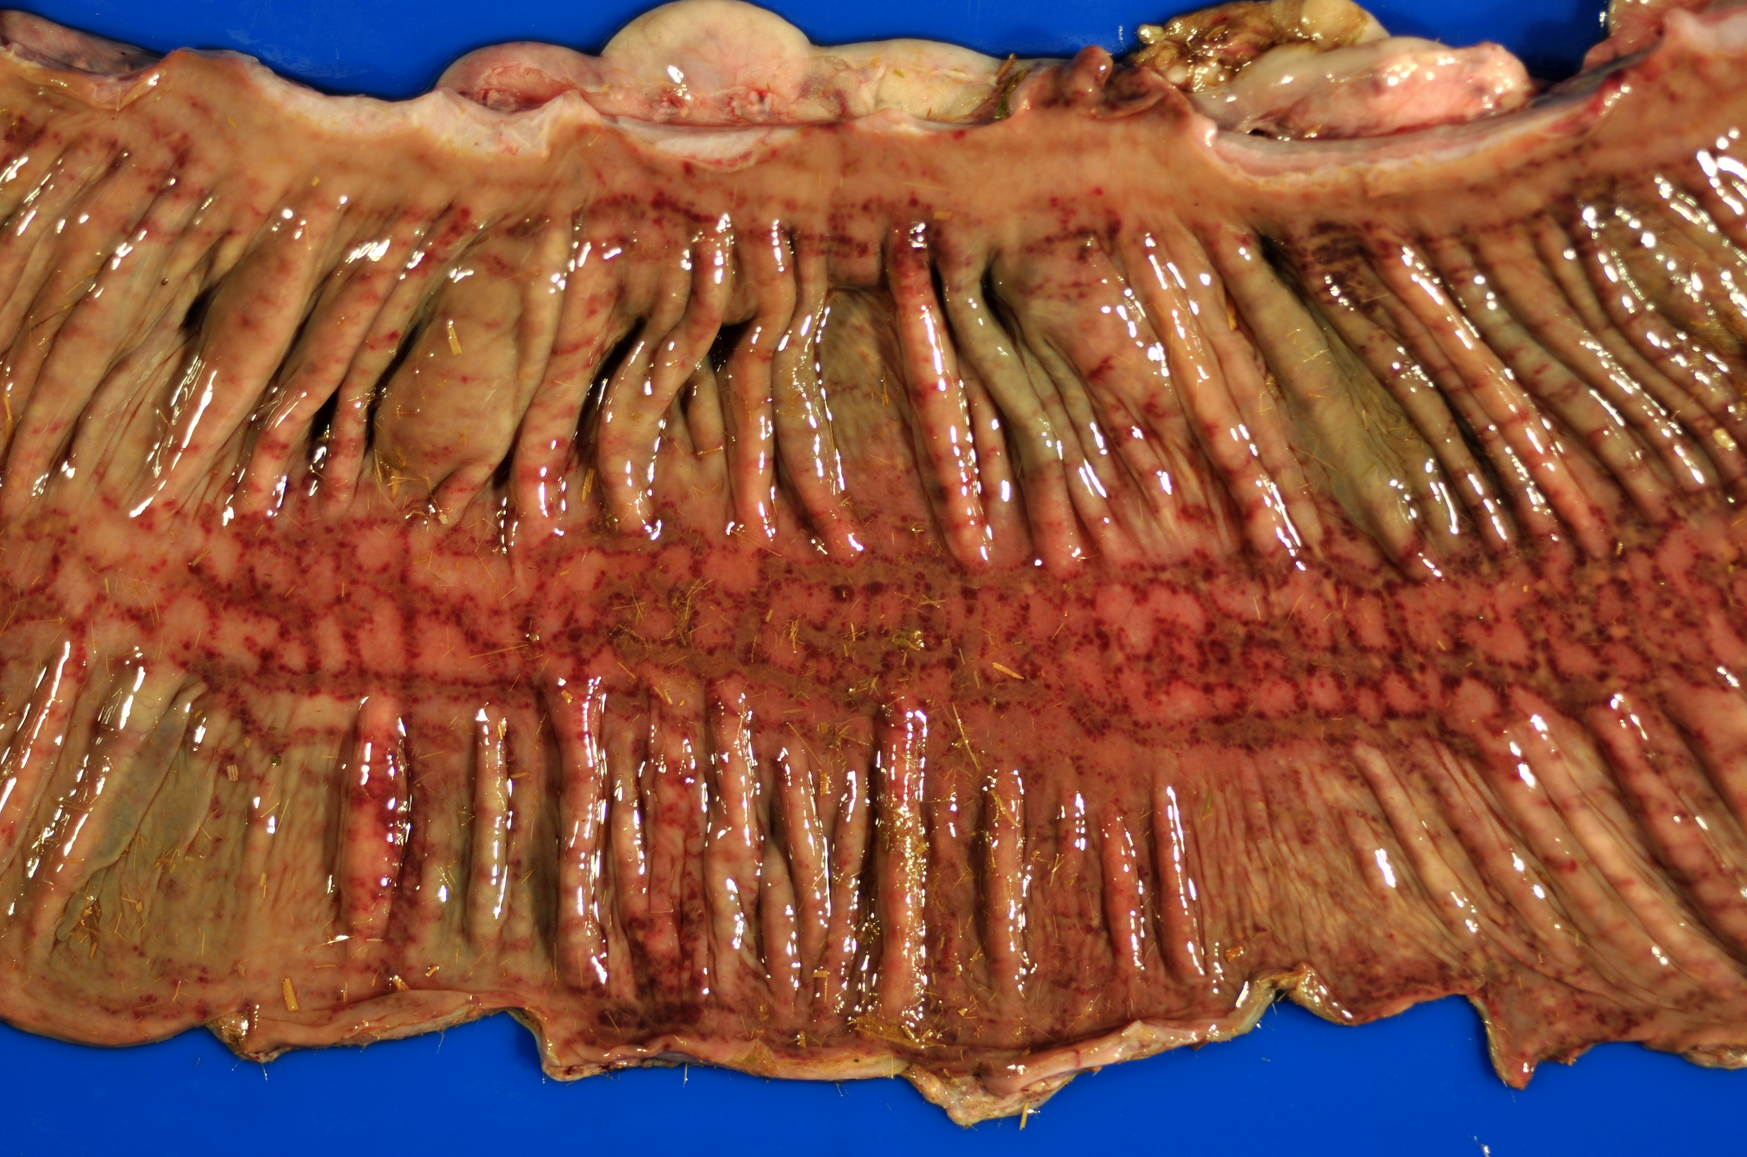
Equine coronavirus
Clinical signs: anorexia, lethargy, fever, diarrhea, colic and neurologic signs
Young foals with enteritis in the USA, Europe, Japan
Pathology: villous attenuation, necrosis of apical enterocytes and crypts, hemorrhage and microthromboses within the mucosa and submucosa
Equine coronavirus-associated colitis, colon, horse. Moderate, necrohemorrhagic colitis. Image courtesy of Silvia Siso.
Notes:
Equine coronavirus (ECoV) is an enteric coronavirus clinically associated with anorexia, fever, lethargy, diarrhea, colic and neurologic signs.
Here we have a gross image to illustrate the necrohemorrhagic colitis of a horse with equine coronavirus. While infections are usually self-limiting, severe damage to the intestinal mucosa and loss of barrier function can lead to septicemia and encephalopathy associated with increased levels of ammonia in the blood. Signs of encephalopathy are reported in about 3% of clinical cases, and include circling, head pressing, ataxia, and seizures.
also proprioceptive deficits, nystagmus, recumbency, Hyperammonemia may be caused by increased ammonia production due to bacterial microbiome changes associated with ECoV infection or increased absorption of ammonia from the gastrointestinal tract due to breakdown of the normal intestinal mucosal barrier function )
originally reported in neonatal foals with enterocolitis [128]. Sporadic outbreaks in riding, racing, and show horses are reported in the US, Europe, and Japan with increasing frequency. While mainly affecting adult horses, infection in foals is associated with more severe gastrointestinal disease.

Slide 11
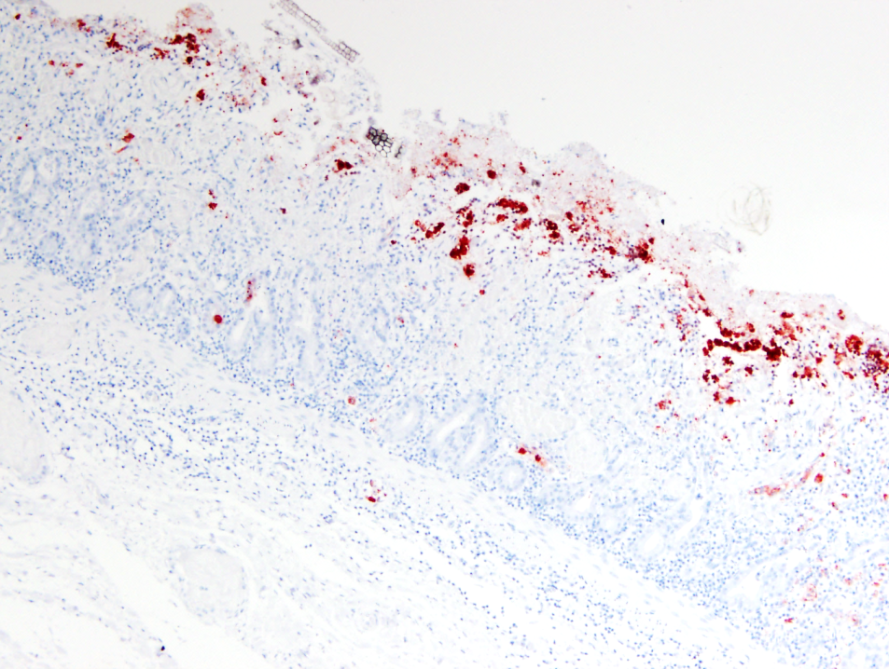
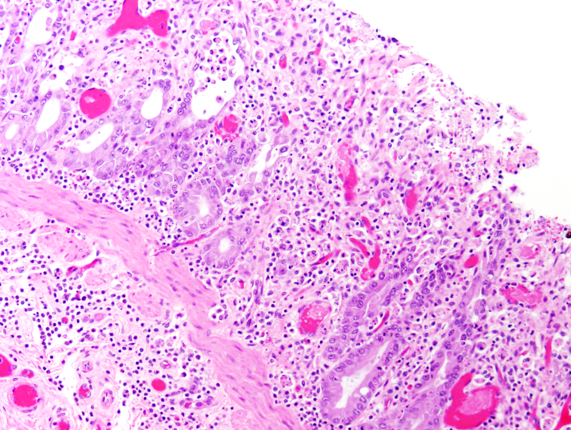
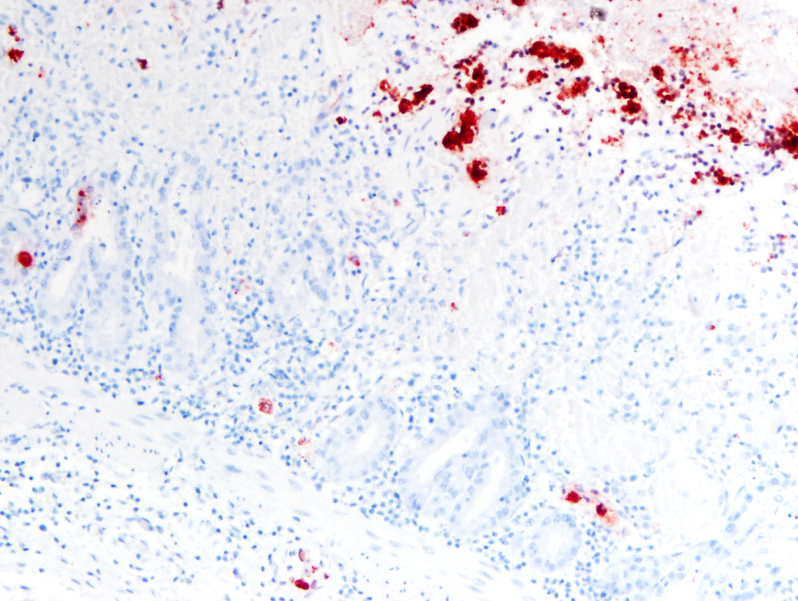
Equine coronavirus histopathology
Equine coronavirus-associated enteritis, jejunum, horse. Diffuse immunoreactivity at the tips of necrotic villi using Bovine Coronavirus antiserum (immunohistochemistry). Image courtesy of Federico Giannitti.
Equine coronavirus-associated enteritis, jejunum, horse. Mixed inflammatory enteritis with crypt ectasia and necrosis (crypt “abscesses”) and microvascular thrombi. Image courtesy of Federico Giannitti.
Notes:
Here is an example of equine coronavirus histopathology, which is characterized by villous attenuation, necrosis of apical enterocytes and crypts, and microvascular thrombi.
Here you can see diffuse immunoreactivity at the tips of necrotic villi, illustrating the distribution of the coronavirus localized to the tips of enterocytes.

Slide 12
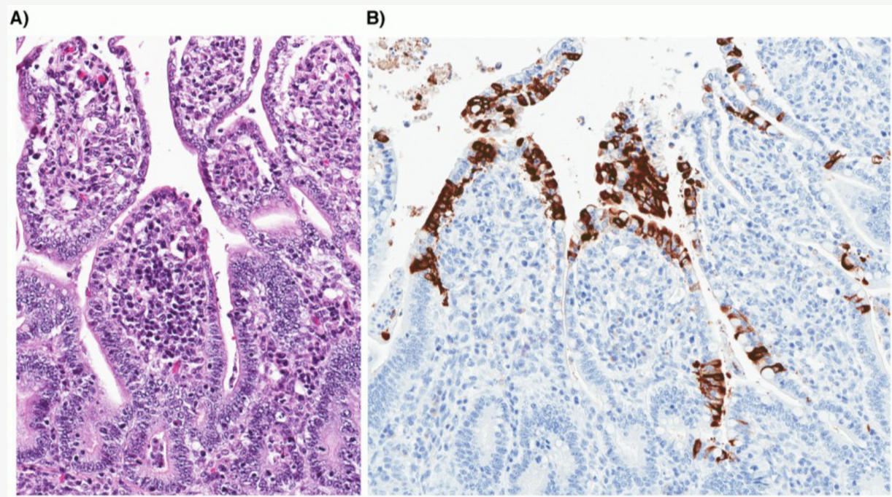
Canine enteric coronavirus
Disease in young puppies < 6 weeks of age, self-limiting diarrhea
Synergism with canine parvovirus (CPV-2)
Rare pantropic strains can cause systemic disease
(A) Severe atrophy of intestinal villi (HE stain). (B) Coronavirus antigen present within the cytoplasm of infected villous enterocytes (IHC)
Licitra, Beth N., Gerald E. Duhamel, and Gary R. Whittaker. "Canine enteric coronaviruses: emerging viral pathogens with distinct recombinant spike proteins." Viruses 6.8 (2014): 3363-3376.
Notes:
Similar to the other enteric coronaviruses, Canine enteric coronavirus causes mild, self-limiting diarrhea in dogs, especially young puppies. It has a synergistic effect with canine parvovirus, increasing severity of enteric disease [105]. Rare pantropic strains have been reported to cause a fatal systemic disease involving lethargy, inappetence, vomiting, hemorrhagic diarrhea, ataxia, and seizures. Canine enteric coronavirus has also been detected in a number of wild canids, including foxes, raccoon dogs, and wolves.
Sequences of the CCoVs found in wild canids were highly homologous to known CCoV sequences isolated from domestic dogs.

Slide 13
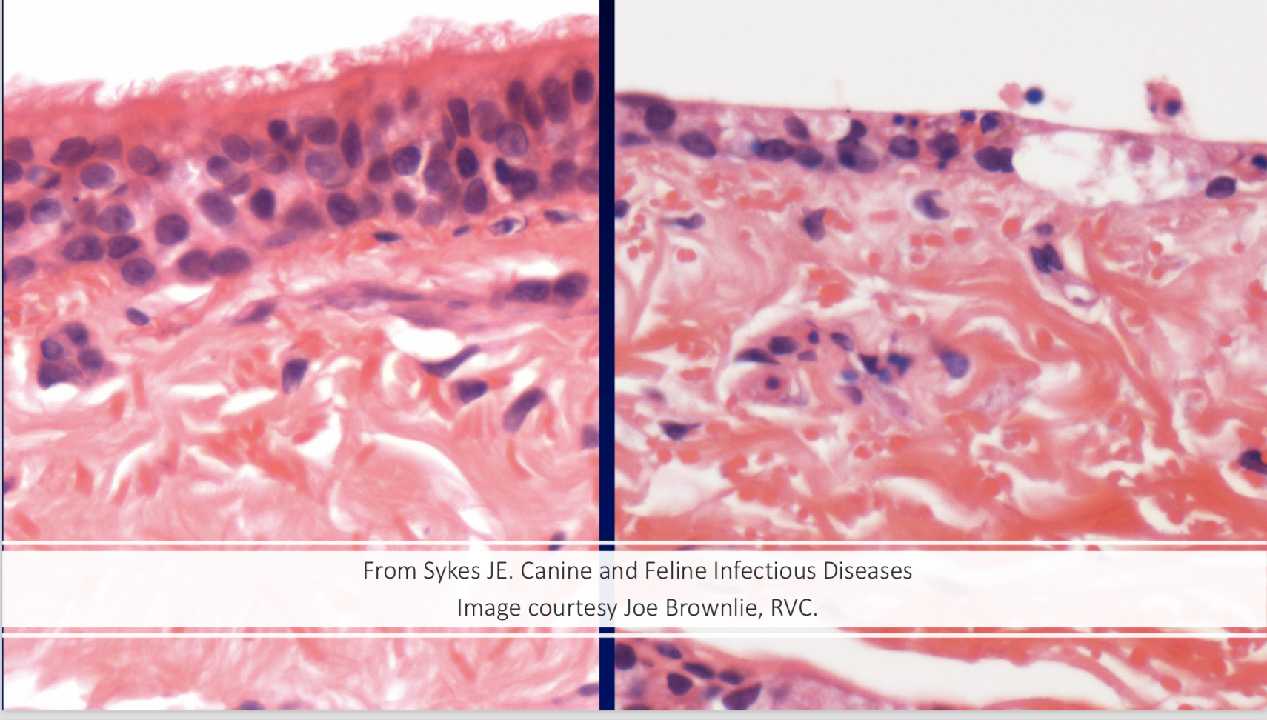
Canine respiratory coronavirus
Worldwide
Shelters, boarding facilities
Spread by aerosol and direct contact
Canine Infectious Respiratory Disease (CIRD) Complex pathogen (aka Kennel Cough)
Infects and destroys the cilia of respiratory epithelium
the ”Lawn mower virus”
Co-infections with other respiratory pathogens contribute to disease severity
cilia are destroyed
Notes:
Canine respiratory coronavirus (CRCoV) is distributed worldwide, and a significant component of canine infectious respiratory disease or CIRD. CIRD is highly contagious and is transmitted between dogs housed in high-density groups, like shelters or kennels. Canine respiratory coronavirus is thought to play a role in early CIRD infection by causing damage to ciliated respiratory epithelium, impairing the function of the mucociliary escalator and predisposing individuals to secondary bacterial infection of the lungs.
CRCoV is spread by aerosol transmission and is most commonly associated with mild signs of upper respiratory disease, including nasal discharge, sneezing and coughing, though it can also be associated with more severe clinical signs, inappetence and bronchopneumonia. Disease occurs most frequently in fall to winter months, and populations most at risk are dogs densely housed in shelter, kennel, or group environments.
Histopathological changes are most significant in the trachea and nasal cavity, where infection with canine respiratory coronavirus causes inflammation and damage to the ciliated respiratory epithelium, …Histological examination following experimental infection with canine respiratory coronavirus demonstrates that the epithelia of the nares and trachea is disordered, devoid of cilia and goblet cells, and inflammatory cells infiltrate within the epithelium and subjacent lamina propria [4].

Slide 14
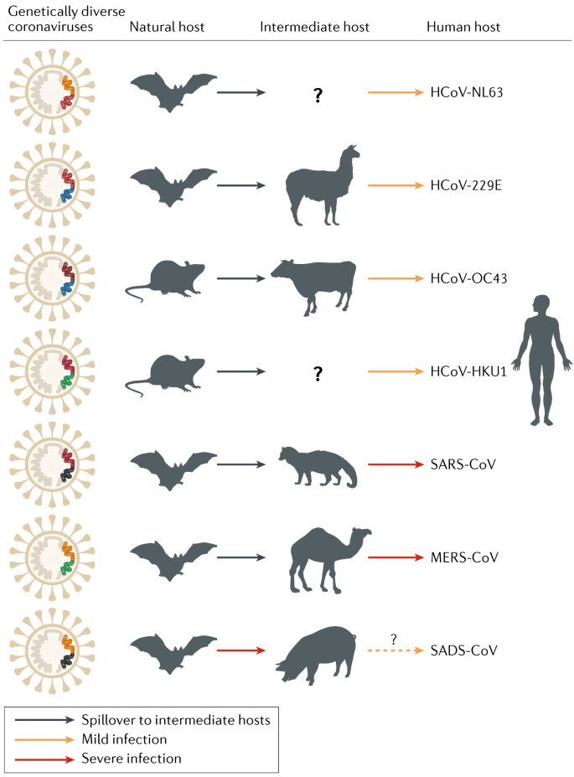
Zoonotic coronaviruses
Polymerase error-driven point mutations
Genetic recombination between different strains and species of coronaviruses
Incorporation of genes from other viruses
High genome plasticity → ability to “jump species”
Cui, J., Li, F. & Shi, Z. Origin and evolution of pathogenic coronaviruses. Nat Rev Microbiol 17, 181–192 (2019).
Notes:
The high plasticity of coronaviral genomes is a result of point mutations, genetic recombination between different strains and species of coronaviruses, and the incorporation of genes from other viruses via nonhomologous recombination [136], all of which likely contribute to the emergence of new viruses with altered virulence, novel host species range and tissue tropism. Over the past 20 years, three human coronaviral pandemics (SARS, MERS, and currently, COVID-19, which are all thought to originate from bat coronaviruses) demonstrate the zoonotic potential of coronaviruses, and their capacity to have devastating impacts on both animal and human health.
In accordance with the ‘One Health,’ concept, a more thorough understanding of the coronaviruses of companion animals, their biological properties, their ability to recombine, and their capacity for cross-species transmission has the potential to improve prevention and control measures for future emerging zoonotic coronaviruses.

Slide 15
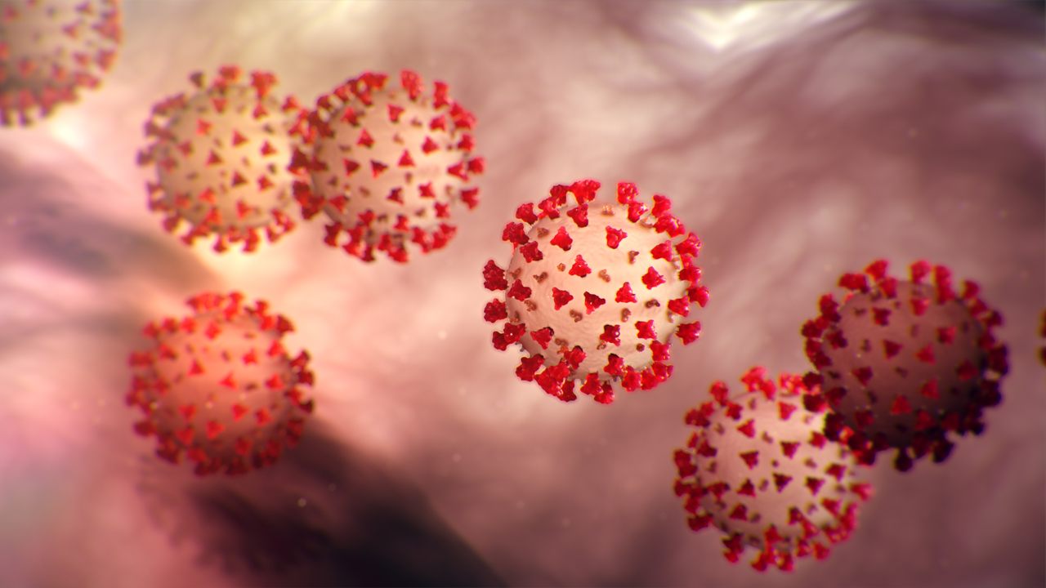
Acknowledgements
Murphy Lab
Brian Murphy
Sarah Cook
Diego Castillo
Financial support was provided by the Students Training in Advanced Research (STAR) Program.
Additional thanks to Nicola Pusterla, Chrissy Eckstrand, and Federico Giannitti for contributing gross and histopathology images.
https://www.portalamlar.org/2020/04/23/covid-19-tsunami-el-primer-caso-de-un-paciente-con-lesion-medular-en-italia/outbreak-coronavirus-world-1024x506px/
Notes:
Thank you so much to Dr. Murphy, Sarah, and Diego, all of whom were super helpful both in writing my review paper and in teaching me in the lab this summer.

Slide 16
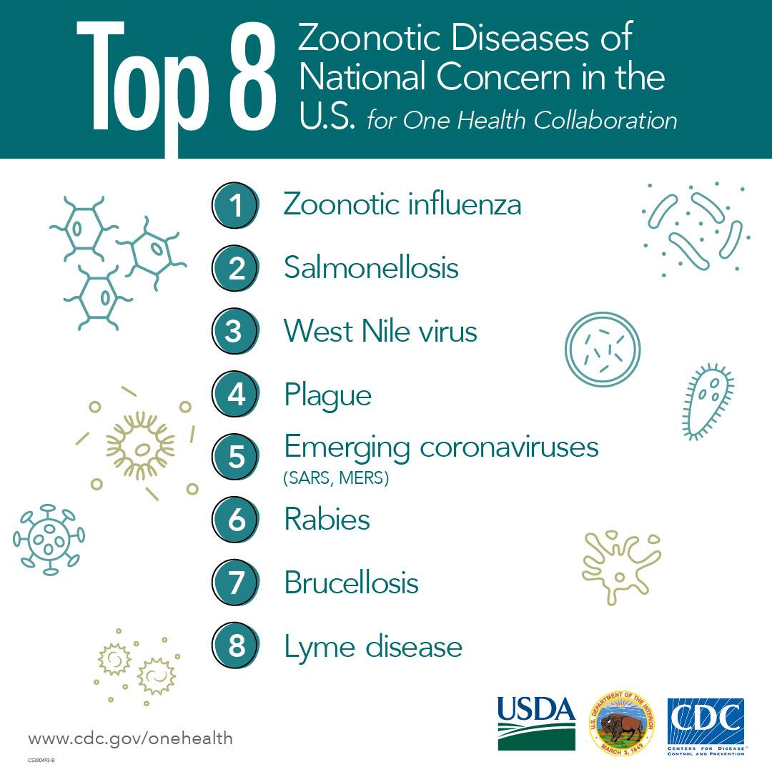
Zoonotic coronaviruses
Polymerase error-driven point mutations
Genetic recombination between different strains and species of coronaviruses
Incorporation of genes from other viruses
High genome plasticity → ability to “jump species”
Notes:
The high plasticity of coronaviral genomes is a result of point mutations, genetic recombination between different strains and species of coronaviruses, and the incorporation of genes from other viruses via nonhomologous recombination [136], all of which likely contribute to the emergence of new viruses with altered virulence, novel host species range and tissue tropism. Over the past 20 years, three human coronaviral pandemics (SARS, MERS, and currently, COVID-19, all thought to originate from bat coronaviruses) demonstrate the zoonotic potential of coronaviruses, and their capacity to have devastating impacts on both animal and human health.
In accordance with the ‘One Health,’ concept, a more thorough understanding of the coronaviruses of companion animals, their biological properties, their ability to recombine, and their capacity for cross-species transmission has the potential to improve prevention and control measures for future emerging zoonotic coronaviruses.

