Slide 1

Development of a corneal model as a tool for assessing ocular surface health
Sam McCuskey, Brian C Leonard
MRLT Vision Science Lab

Slide 2
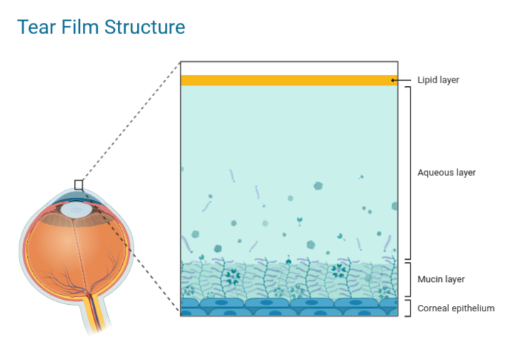
Introduction & Background
Tear Film Layers:
Outer lipid
Middle aqueous
Inner mucin
Notes:
These layers dynamically interact to maintain ocular surface health

Slide 3
Introduction & Background
Mucin Layer:
Lubrication
Water retention
Allergen, microbe, debris trapping
Membrane-Associated Mucins:
Integral components of the glycocalyx.
Essential role in tear film stability.
Notes:
Mucin Layer: Secretory glycoproteins and membrane-associated mucins (MAMs)
function to lubricate, retain water, and trap allergens, microbes, and debris for clearance
Family of High molecular weight glycoproteins
Believed to have an essential role in tear film stability

Slide 4
Introduction & Background
Dry Eye Disease: A multifactorial disease of the ocular surface characterized by a loss of tear film homeostasis.
Notes:
Resource: everyday health, accessed: 7/28/22
Resource: Merck Vet Manual, accessed 7/28/22
5-30% prevalence worldwide
Historically challenging to diagnose with many patients presenting with symptoms of the disease without having diagnosable clinical signs.

Slide 5
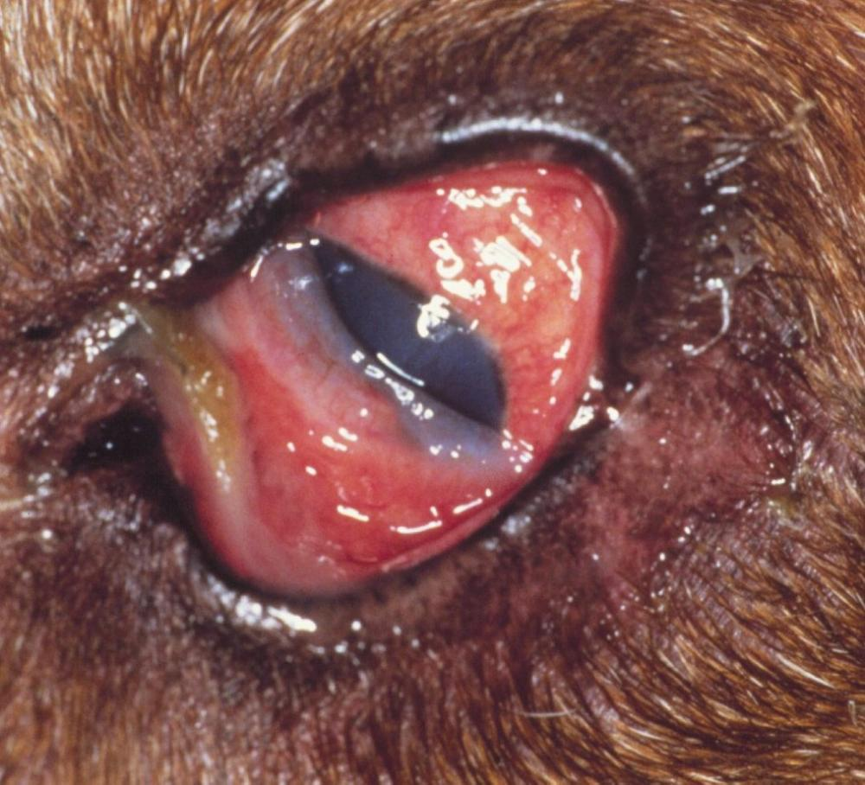
Introduction & Background
Dry Eye Disease: A multifactorial disease of the ocular surface characterized by a loss of tear film homeostasis.
KCS, dog
Notes:
Resource: everyday health, accessed: 7/28/22
Resource: Merck Vet Manual, accessed 7/28/22
5-30% prevalence worldwide
Historically challenging to diagnose with many patients presenting with symptoms of the disease without having diagnosable clinical signs.

Slide 6
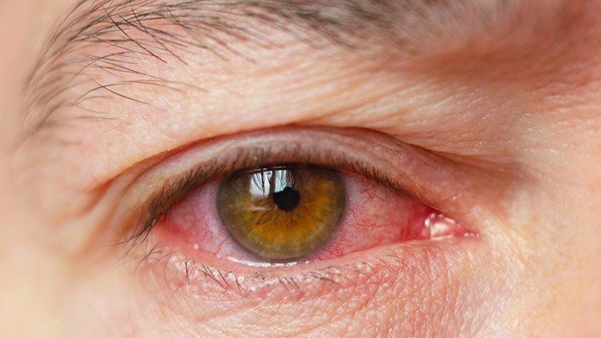
Introduction & Background
Dry Eye Disease: A multifactorial disease of the ocular surface characterized by a loss of tear film homeostasis.
KCS, dog
DED, human
Notes:
Resource: everyday health, accessed: 7/28/22
Resource:
5-30% prevalence worldwide
Historically challenging to diagnose with many patients presenting with symptoms of the disease without having diagnosable clinical signs.

Slide 7
Introduction & Background
How DED relates to MAMs:
Changes in the quality and quantity of MAMs are known to occur in DED, there is no agreement on the degree and direction of these changes.
Currently, there are no in vivo methods for assessing the MAMs of the ocular surface.

Slide 8
Introduction & Background
DED & MAMs:
While changes in the quality and quantity of MAMs are known to occur in DED, there is no agreement on the degree and direction of these changes.
Currently, there are no in vivo methods for assessing the MAMs of the ocular surface.
Ultimate Goal: Prove that changes in MAMs can be used to diagnose early stages of DED and develop a diagnostic tool to detect these changes.

Slide 9
Aim/Hypothesis
Aim: Develop a model system that can be used to optimize the labeling and imaging of membrane-associated mucins (MAMs) on the ocular surface.

Slide 10
Aim/Hypothesis
Aim: Develop a model system that can be used to optimize the labeling and imaging of membrane-associated mucins (MAMs) on the ocular surface.
Hypothesis: Fluorescent imaging of in vitro and ex vivo models of the cornea will detect the distribution of MAMs and serve as proof of concept in the development of an in vivo mucin imaging modality for the assessment of ocular surface health.

Slide 11
Methods – Ex Vivo Model
Tissue Collection:
Eyes were enucleated from rabbits promptly after euthanasia then used within ~1hr.
Superficial keratectomies were performed to remove a section of the cornea thin enough for imaging on a glass slide.
Warning: slightly graphic eye images on next slide
Notes:
using a dissecting microscope and ophthalmic surgical instruments
approximately 135 µm
Can say this mimics preliminary work that has been done in the lab before

Slide 12
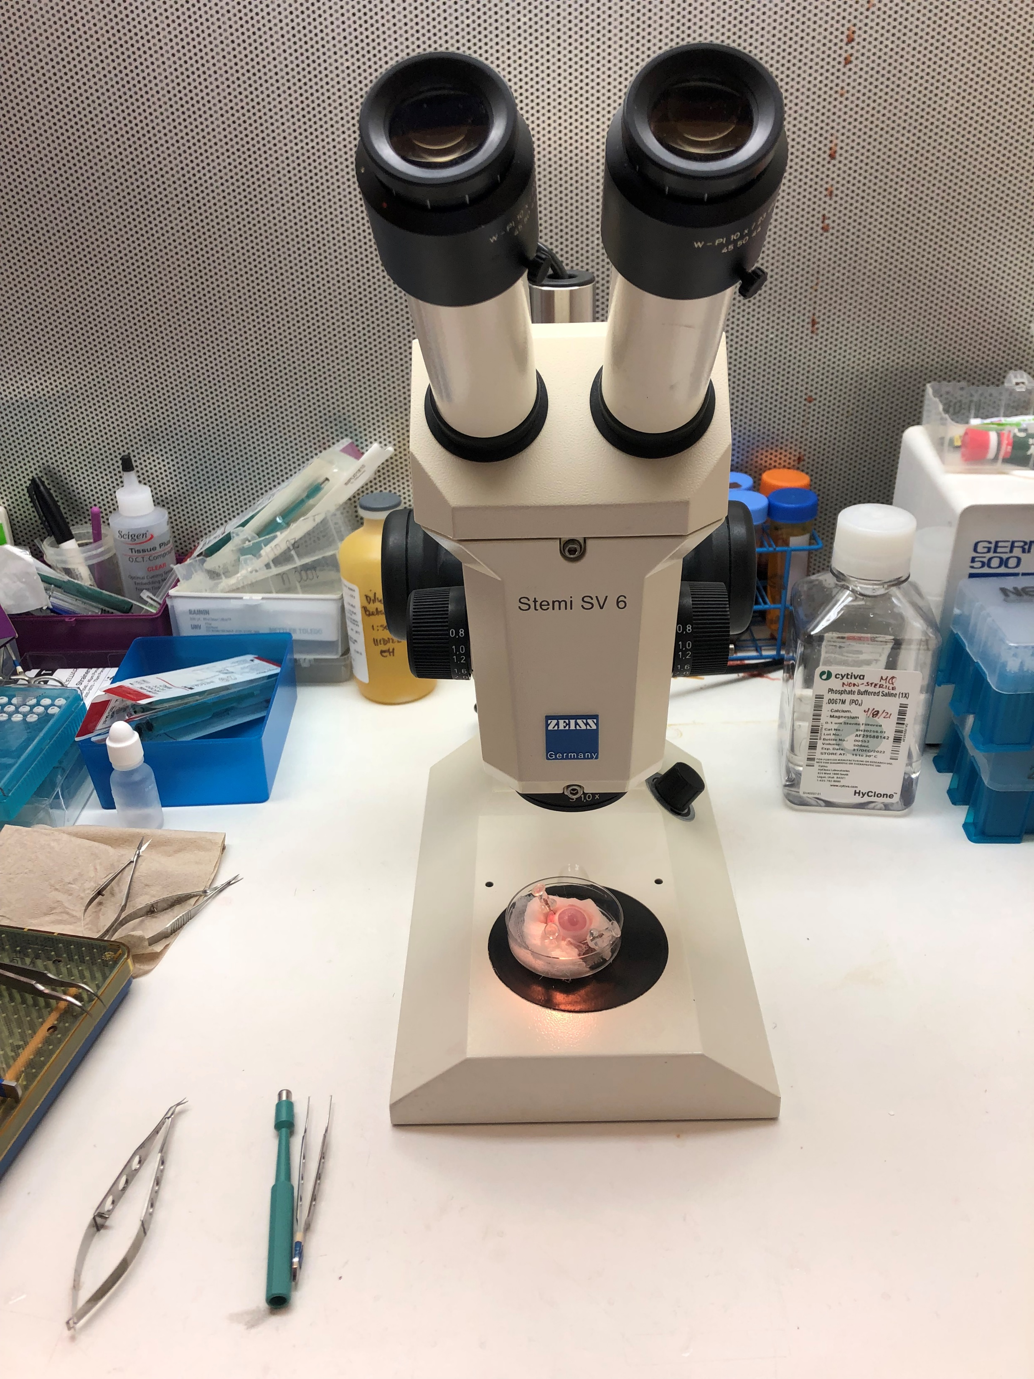
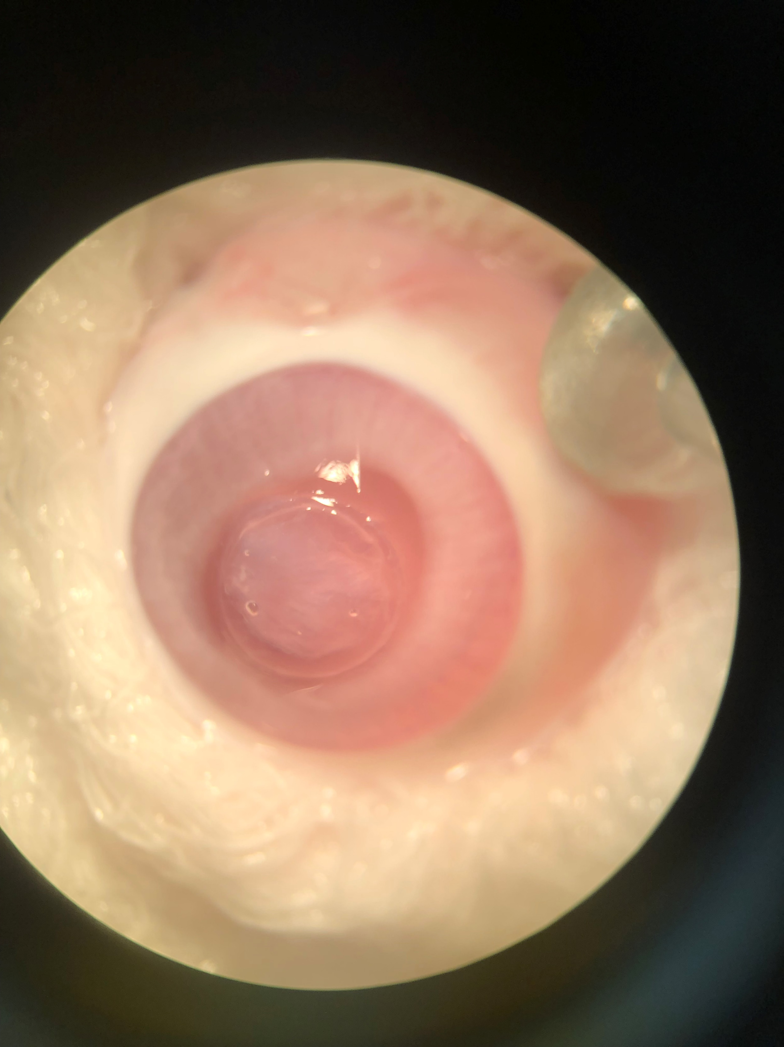
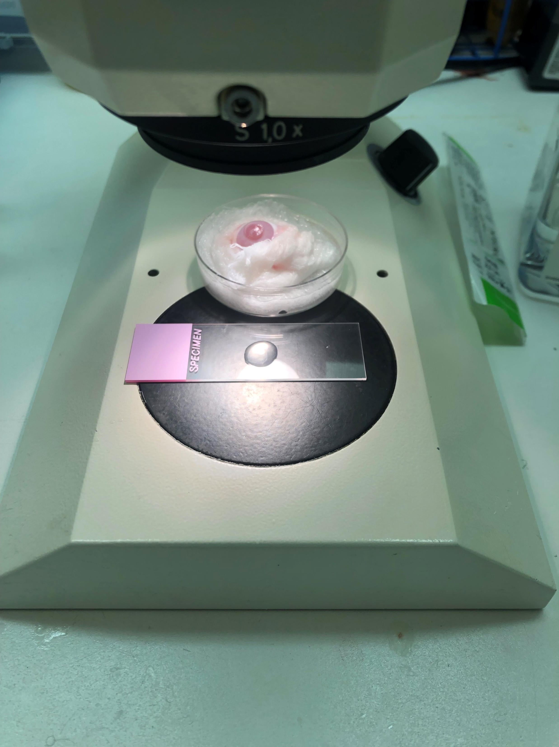
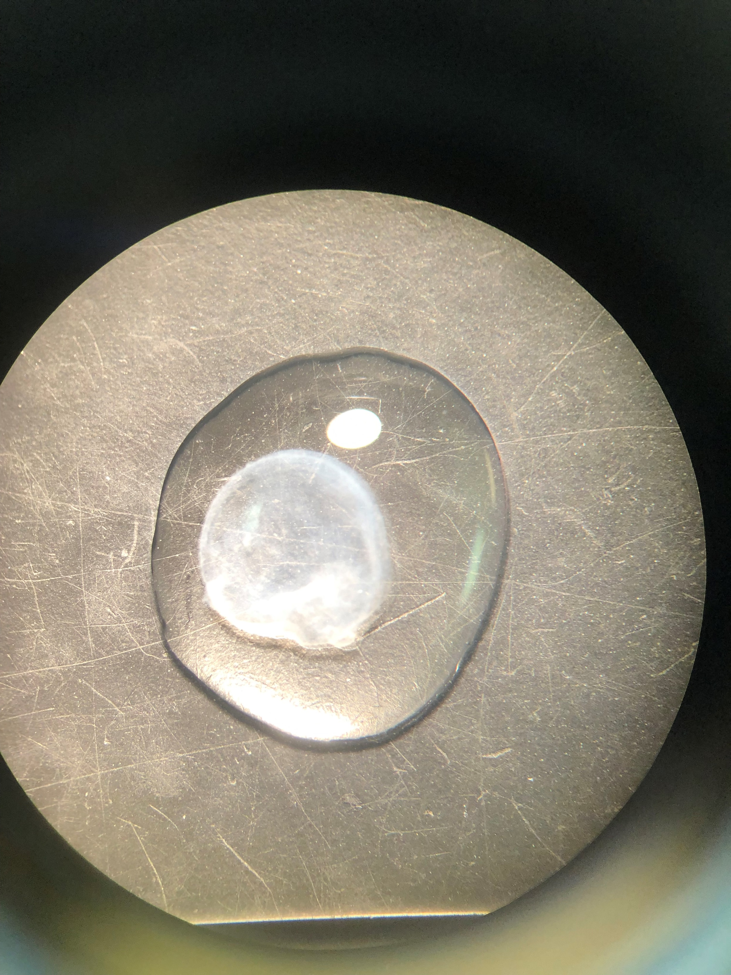
Methods – Rabbit Eye Prep
Notes:
First panel: dissecting scope with rabbit eye
Second panel: eye through scope. Superficial layer of the cornea has already been undermined and is ready to be placed on a slide
Third panel: cornea layer on a glass slide
Four: layer of cornea through the scope
Concanavalin-A (Con A), wheat germ agglutinin (WGA), Ricinus communis agglutinin I (RCA1), Ulex europaeus agglutinin (UEA1), and soybean agglutinin (SBA)
Thinner the section the better the image resolution
Can talk about galectin-3 (expensive)
I did many different variations of the labeling procedure and sometimes I would incubate the cornea with the labeling reagents on the slide and other times I would incubate the whole eye first and then do the superficial keratectomy

Slide 13
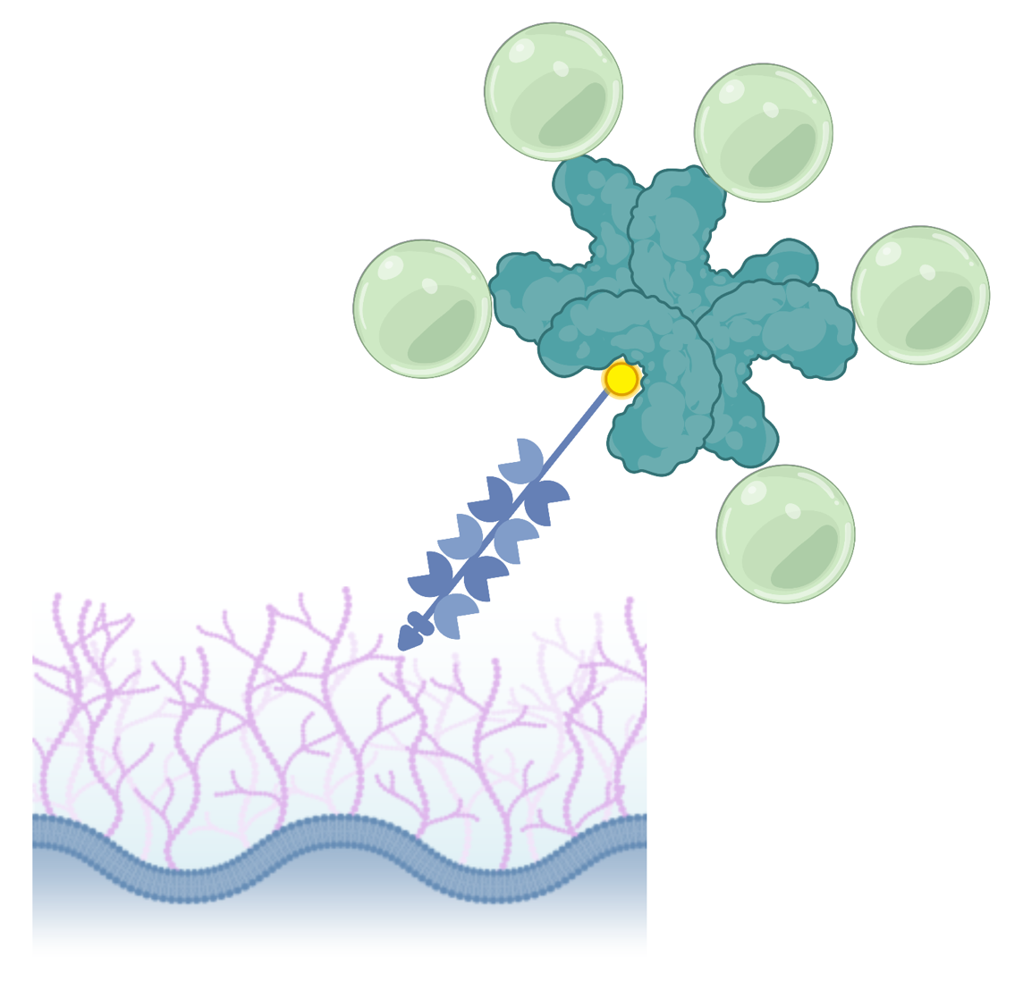
Methods – Mucin Labeling
Qdot
Biotin →
←Streptavidin
Jacalin
MAMs
Notes:
The first reagent I used was Biotinylated Jacalin: Plant protein with a high affinity for sugars bound to oxygen containing amino acids on glycoproteins ie o-glycosylations
The second reagent I used was a fluorescent marker called a Quantum dot (or Qdot) conjugated to streptavidin: high affinity for biotin.
I attempted many variations of the labeling technique. Using the Blocking kit, galactose. Various concentrations of jacalin and Qdots. Labeling before and after performing the superficial keratectomy.

Slide 14
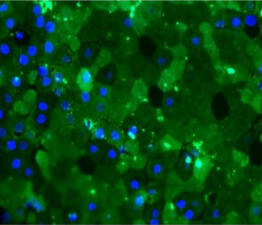
Preliminary Study Results
Jacalin
DAPI
Notes:
Taken with an epifluorescence microscope

Slide 15
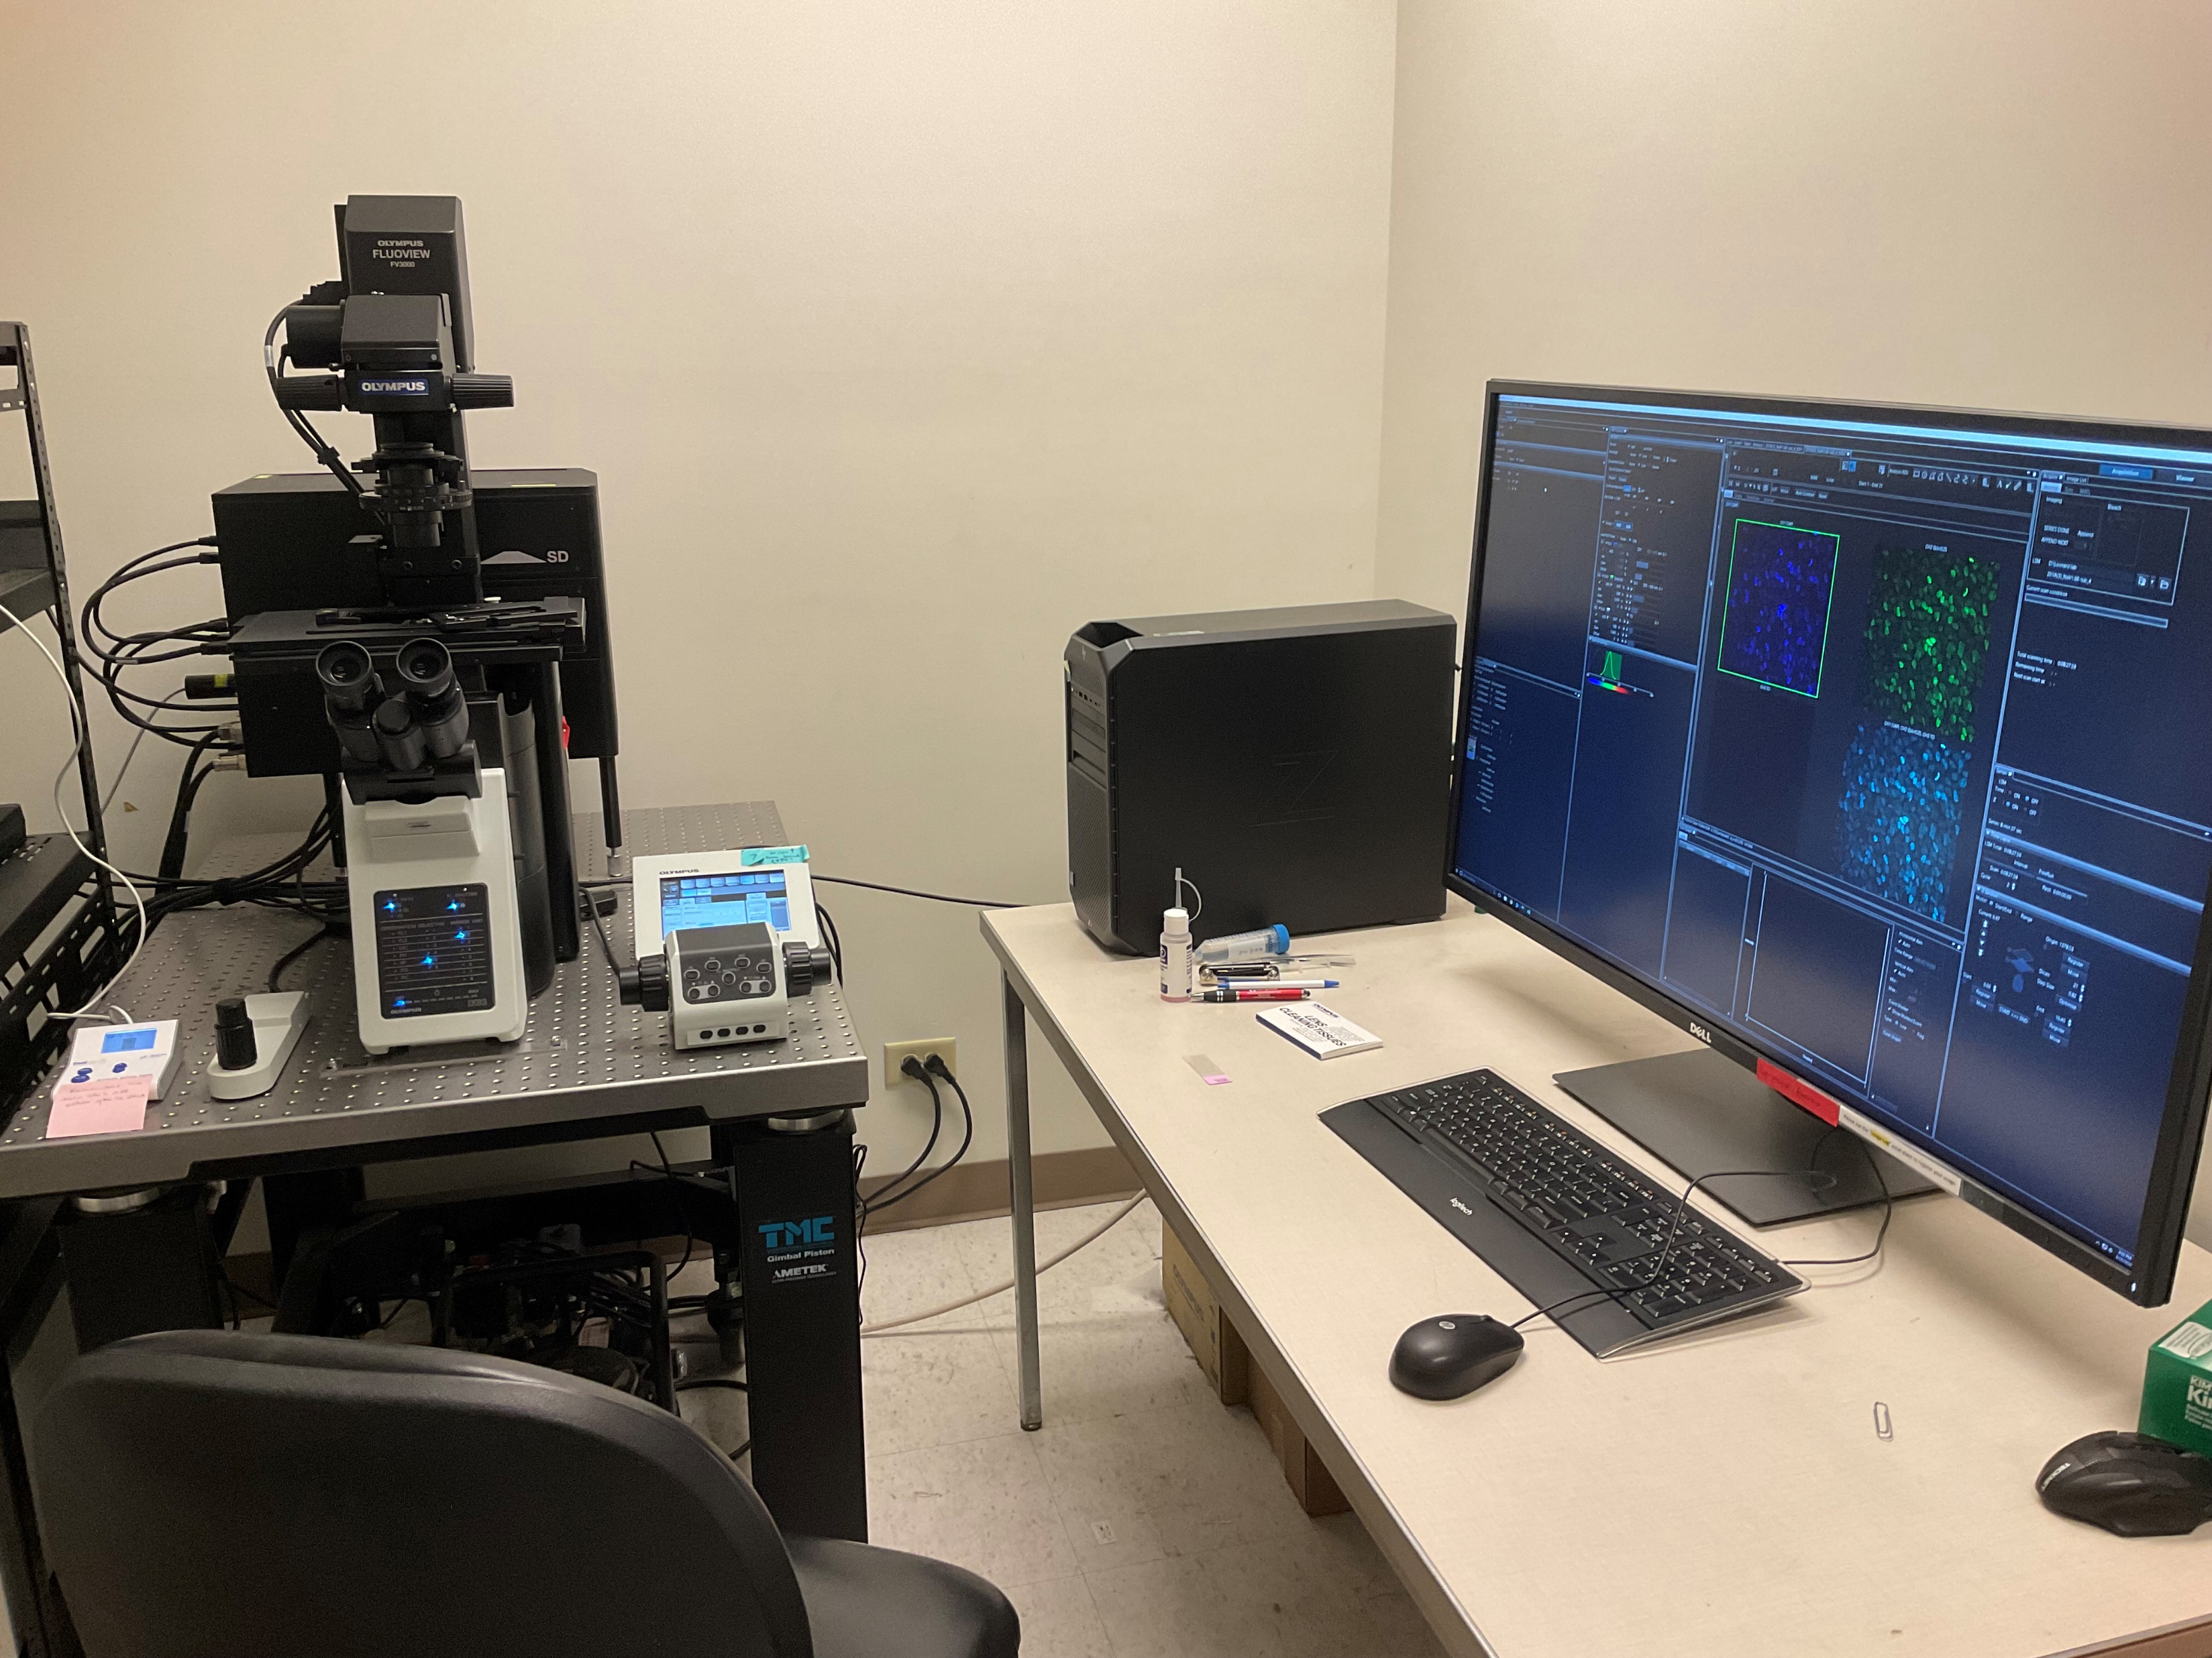
Methods – Imaging
Olympus FV3000 confocal laser scanning microscope
Notes:
was used to assess the efficacy of the labeling techinque and the model designs in the expression and detection of MAMs.

Slide 16
Results – Ex Vivo
Rabbit corneal epithelial cells 20x
DAPI
Qdot
Composite Image
Notes:
Apparent non-specific fluorescents of nuclear structures

Slide 17
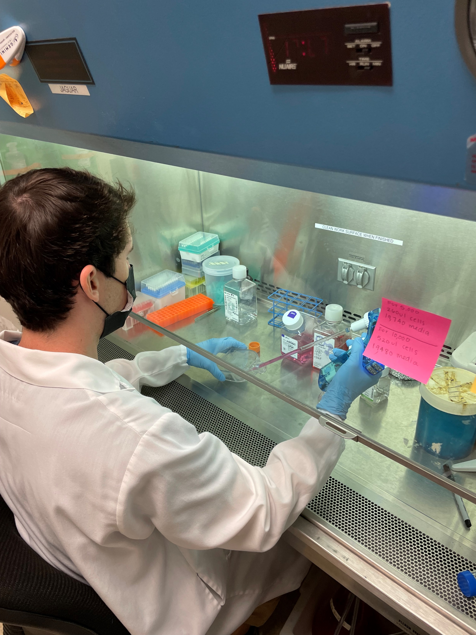
Methods – In Vitro Model
Cell Culture:
Immortalized human corneal epithelial cells (hTCEpi).
Notes:
in EpiLife media
Dulbecco modified Eagle media/F12 (DMEM/F12)
were grown to confluence on transwell plates

Slide 18
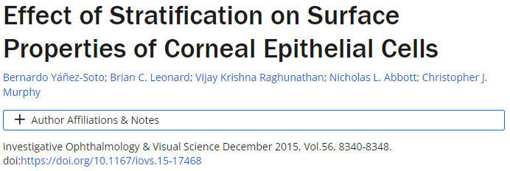
Methods – In Vitro Model
Cell Culture:
Immortalized human corneal epithelial cells (hTCEpi).
At confluence, the cultures were switched to stratification media for 7 days to induce mucin expression.
Notes:
in EpiLife media
Cells were examined daily with phase contrast microscopy to document growth kinetics.

Slide 19
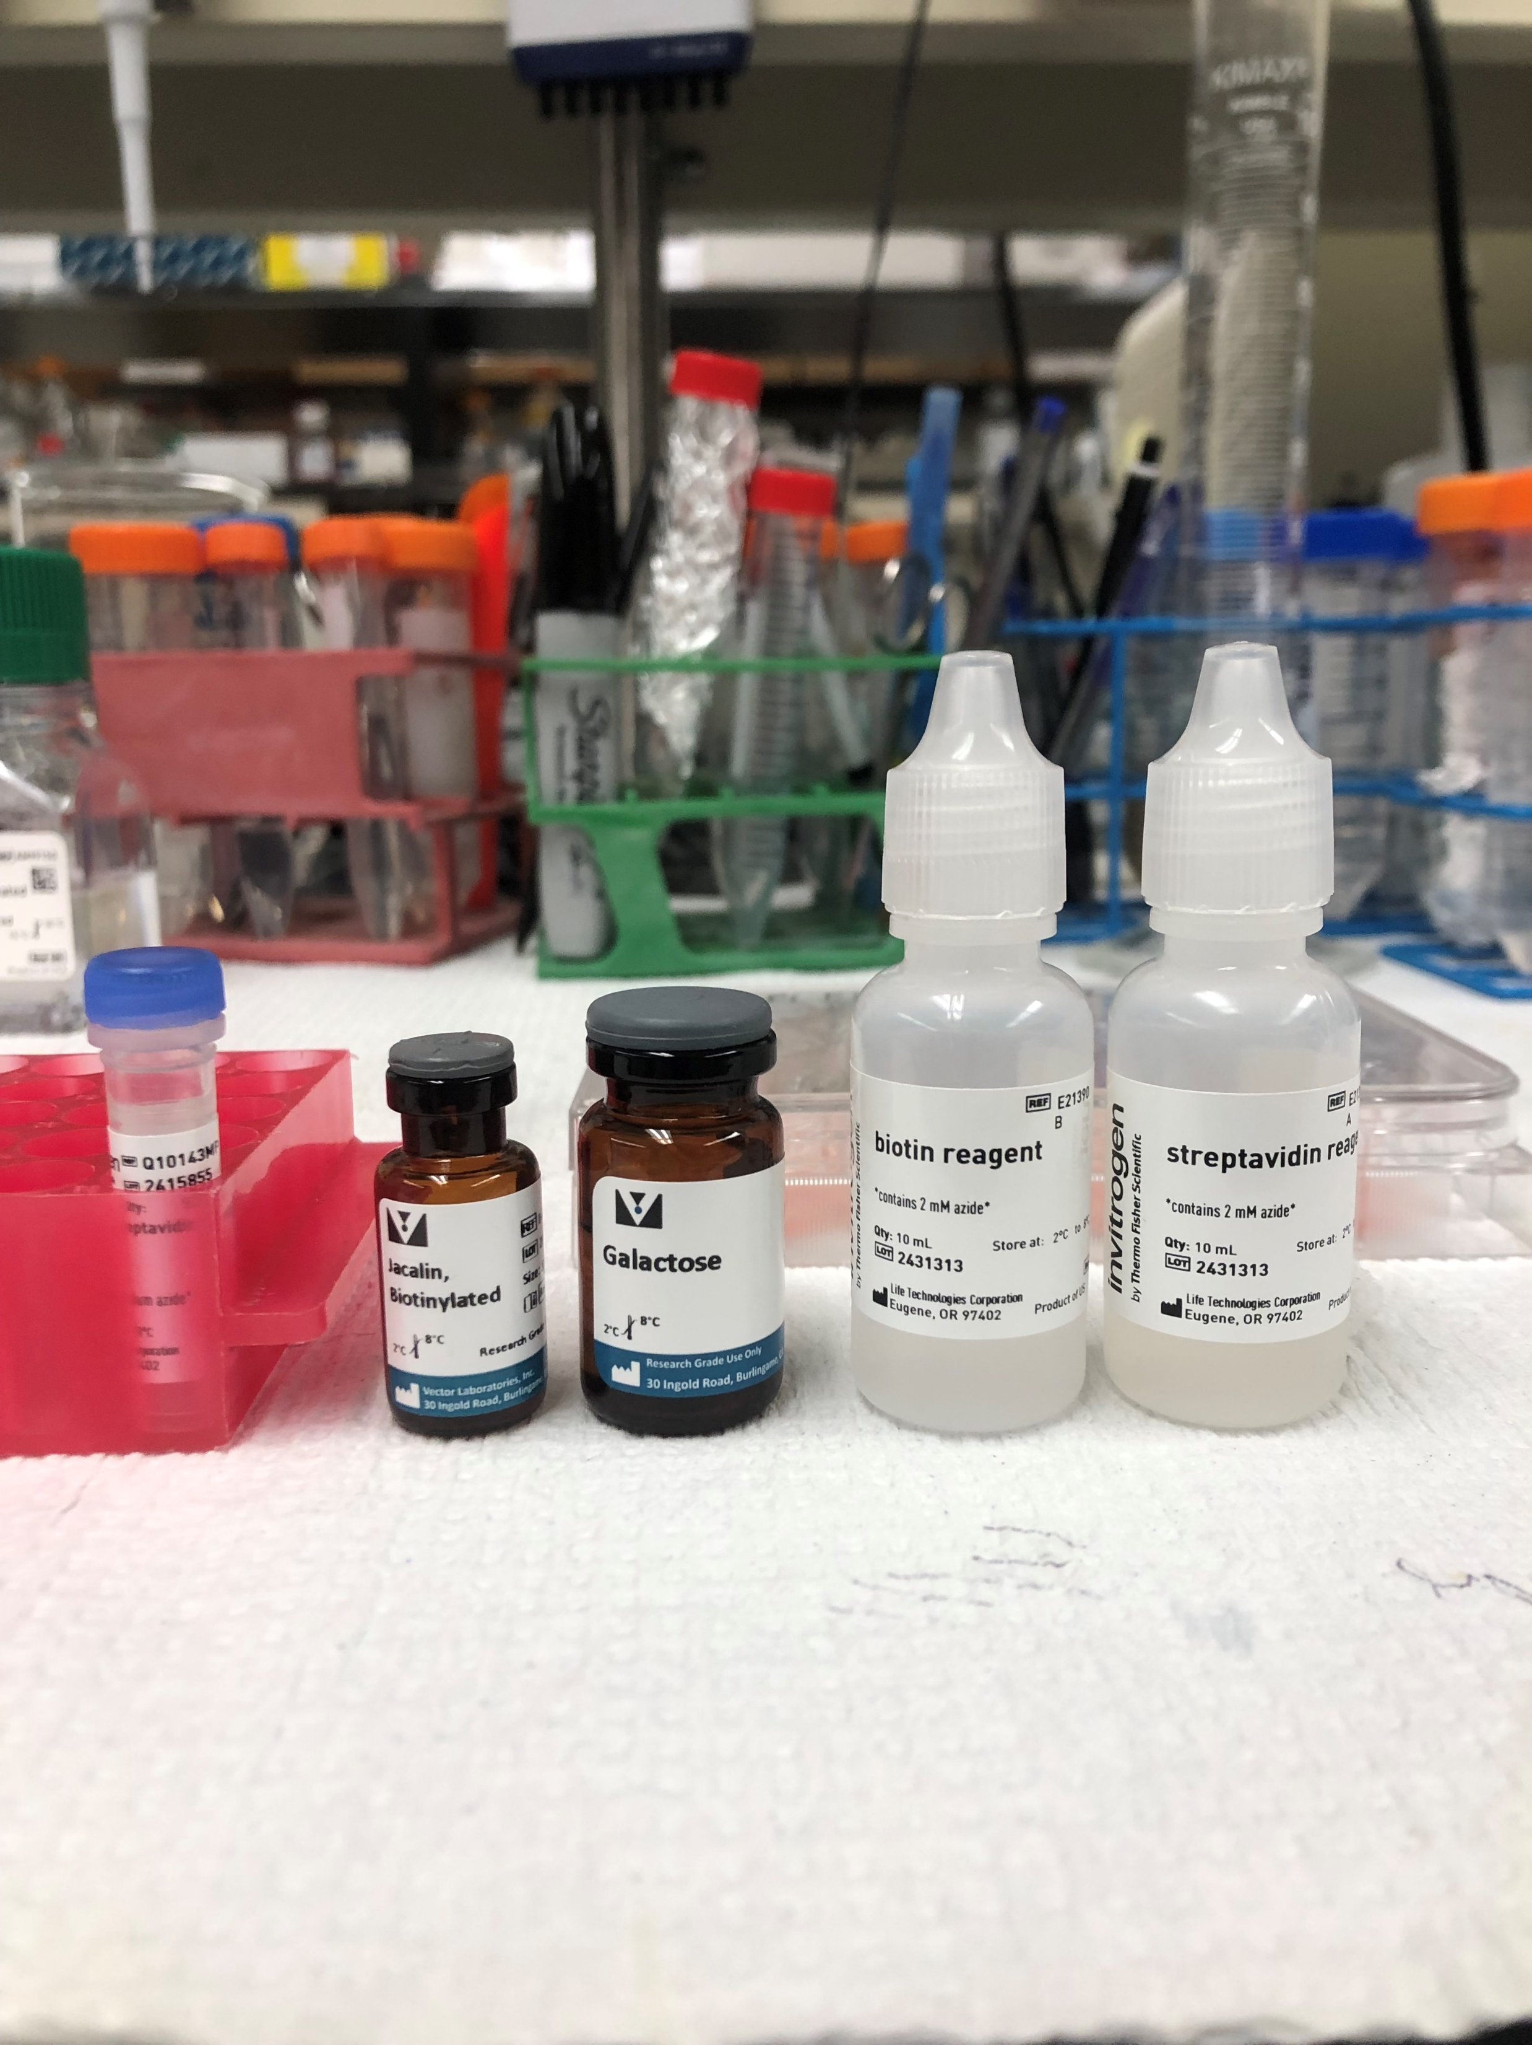
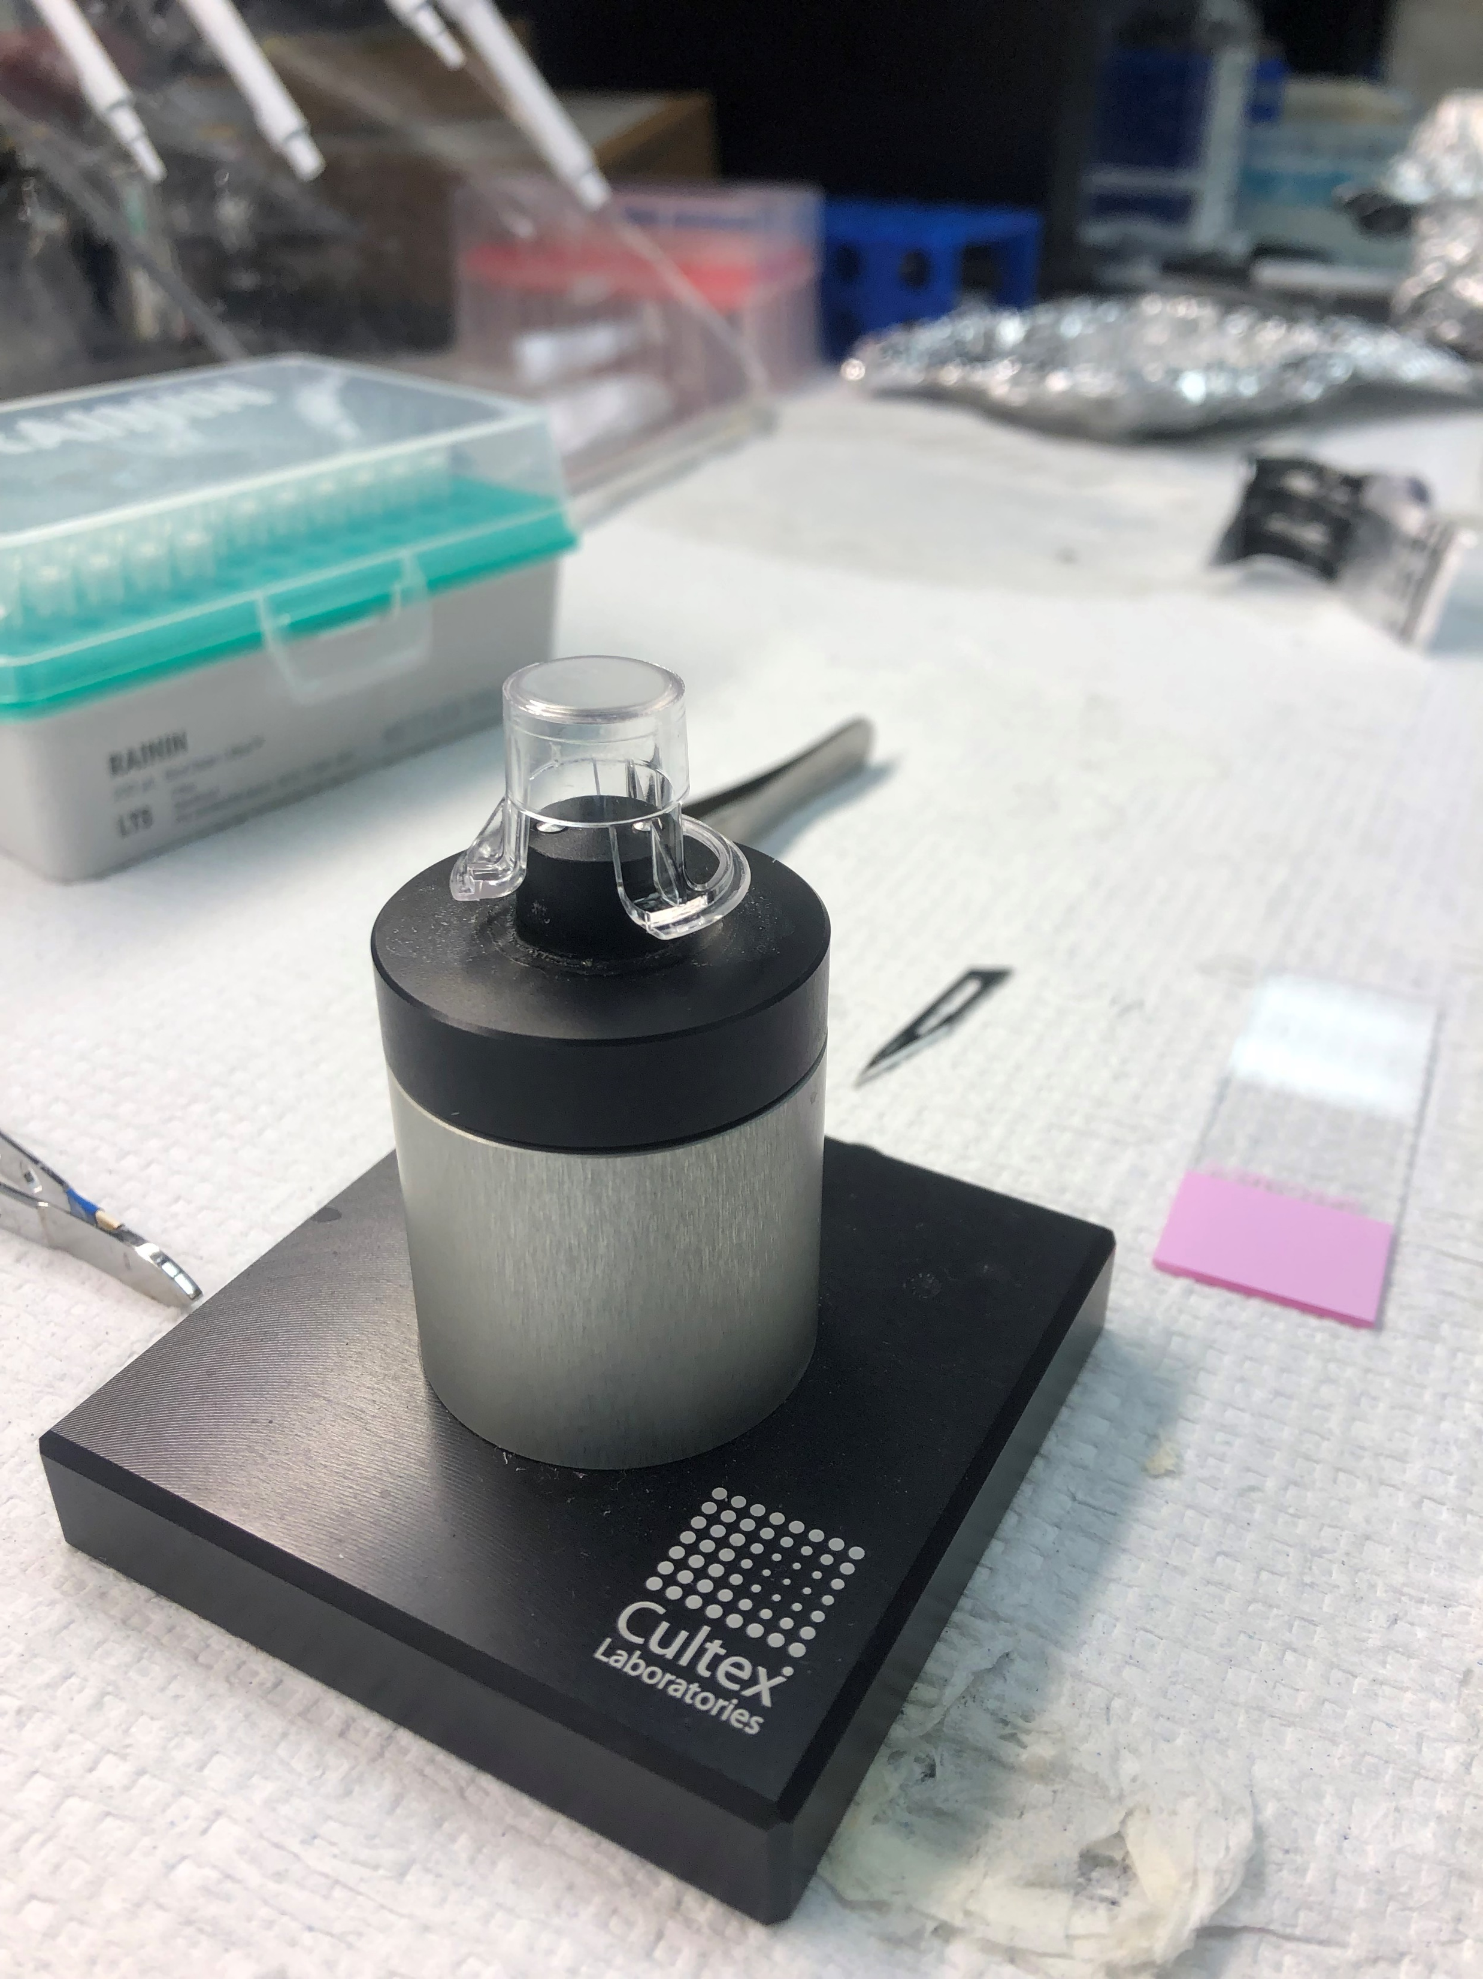
Methods – In Vitro Model
Cell Culture:
hTCEpi cells were labeled on transwell membranes.
Membranes were then cut out and placed on glass slides.
Notes:
following the same procedure as the ex vivo model.

Slide 20
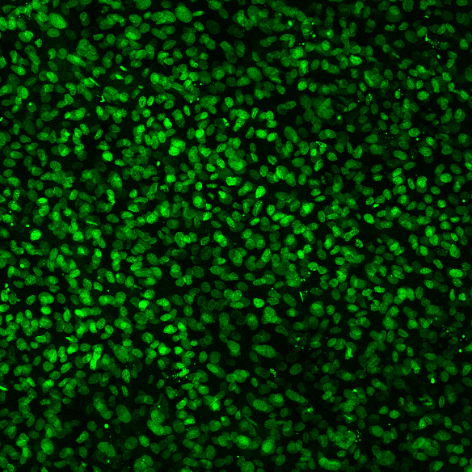
Results – In Vitro hTCEpi cells 10x
DAPI
Qdot
Composite Image

Slide 21
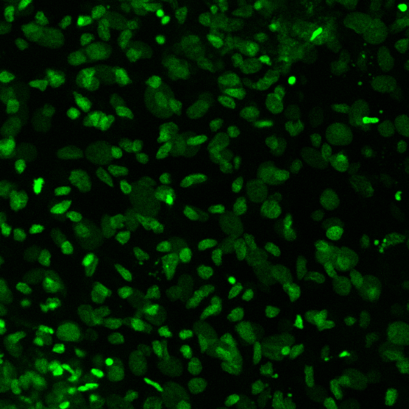
Results – In Vitro hTCEpi cells 20x galactose control
DAPI
Qdot
Composite Image
Notes:
Even with jacalin supposedly blocked, there was still green fluorescence, when there should be none
Suggests either Qdot is non-specifically binding to nuclear structures, or that the DAPI stain is causing coemission in the green sprectrum

Slide 22
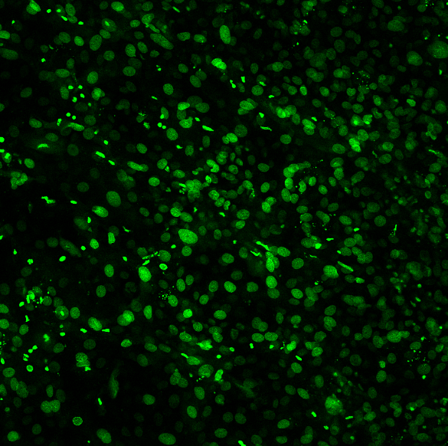
Results – In Vitro hTCEpi cells 10x no jacalin
DAPI
Qdot
Composite Image
Notes:
Same results even when jacalin was left out of the labeling procedure
Bleeding in of the blue channel when we were looking at the green
Coexcitation and emission at the same time

Slide 23
Conclusion (so far)
The current labeling technique failed to detect MAMs in both in vitro and ex vivo models.
Further manipulation of the labeling procedure is required to uncover the cause of the failure.

Slide 24
Conclusion (so far)
The current labeling technique failed to detect MAMs in both in vitro and ex vivo models.
Further manipulation of the labeling procedure is required to uncover the cause of the failure.
Possible causes:
Non-specific binding of Qdots
Failure of jacalin-Qdot binding
Altered filter setting
Cell damage leading to MAM lose
MAM not expressed in models
Flawed commercial reagents

Slide 25
Conclusion (so far)
The current labeling technique failed to detect MAMs in both in vitro and ex vivo models.
Further manipulation of the labeling procedure is required to uncover the cause of the failure.
Possible causes:
Non-specific binding of Qdots
Failure of jacalin-Qdot binding
Altered filter settings
Cell damage leading to MAM lose
MAM not expressed in models
Flawed commercial reagents
Further troubleshooting:
Verify binding between jacalin and Qdot reagents using Western Blot
Replace labeling reagents with fluorescein conjugated jacalin
Image model that hasn’t been labeled with Qdots
qPCR and Western Blot for MAMs
Notes:
Very rare for commercial reagents to not work
The reagents that were used in this experiment were fresh and not the ones used in preliminary study
Altered filter settings leading to coemission of both blue and green WL from the DAPI

Slide 26
Challenges
hTCEpi cell growth
Limited supply of rabbit eyes (one pair a week)
Limited confocal microscope availability
Lab technique learning curve
Notes:
Growth factors needed for hTCEpi cell growth were on back order for the first half of the summer
Some cells brought out of cryochamber didn’t grow properly despite following proven growth protocols
It takes a week to two weeks to grow the in vitro model
Mind map of lab techniques

Slide 27
Skills Learned
Cell culture:
Splitting cells
Assessing growth kinetics
Making growth media
Lab techniques:
Confocal Microscopy
Epifluorescence microscopy
PCR
Tissue Handling:
Superficial keratectomy
Enucleation
Notes:
Lab techniques learned: cell culture (changing media, splitting cells, assessing cell health, cryochamber), superficial keratectomy, enucleation (rabbit and mouse), PCR, microscopy (epifluorescence, confocal laser scanning, slide prep)

Slide 28
Future Directions/Significance
Develop both health and disease state ex vivo models to compare mucin distributions
Incorporate a collagen scaffolds that mimics the curvature and dimensions of the human cornea into the in vitro model.
Notes:
The MRLT lab currently has a colony of knock out mice with the phenotype of human DED.
This could be used to help troubleshoot the challenges associated with microscopy of a curved surface.
The MRLT lab currently has molds that can be used to make these scaffold.

Slide 29
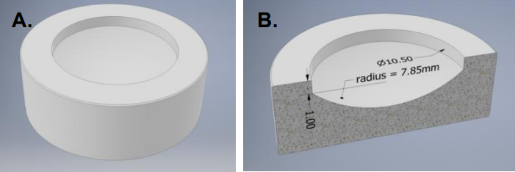
Future Directions/Significance
Develop both health and disease state ex vivo models to compare mucin distributions
Incorporate a collagen scaffolds that mimics the curvature and dimensions of the human cornea into the in vitro model.
Notes:
The MRLT lab currently has a colony of knock out mice with the phenotype of human DED.
This could be used to help troubleshoot the challenges associated with microscopy of a curved surface.
The MRLT lab currently has molds that can be used to make these scaffold.

Slide 30
Future Directions/Significance
Develop both health and disease state ex vivo models to compare mucin distributions
Incorporate a collagen scaffolds that mimics the curvature and dimensions of the human cornea into the in vitro model.
Overarching hypothesis: Imaging of MAMs on the ocular surface can be used to distinguish health from disease.
Ultimate goal: Develop an imaging system that can be used as a better diagnostic tool for DED than what is currently available.
Notes:
The MRLT lab currently has a colony of knock out mice with the phenotype of human DED.
This could be used to help troubleshoot the challenges associated with microscopy of a curved surface.
The MRLT lab currently has molds that can be used to make these scaffold.

Slide 31

Acknowledgements
UC Davis School of Veterinary Medicine Students Training in Advanced Research (STAR) Program
NIH T35 Training grant T35OD010956-23
MRLT Main Lab Team
UC Davis School of Medicine Department of Ophthalmology & Vision Science

Slide 32
Questions?

