Slide 1
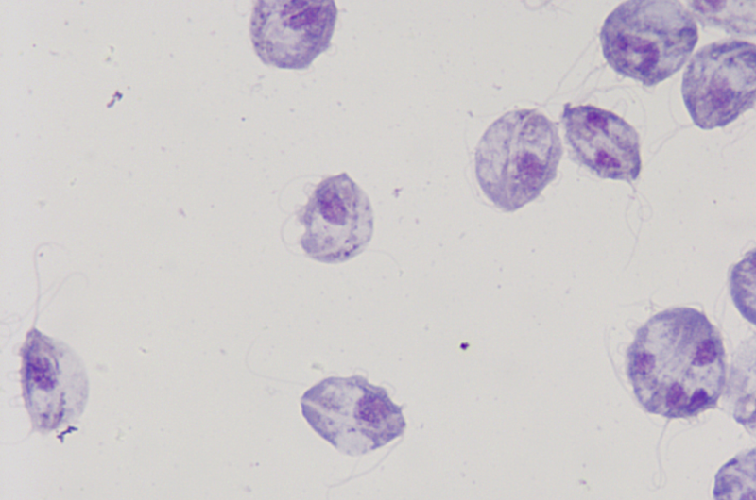
Molecular Detection of Tritrichomonas in Domestic Cats
Mary Garrison
Mentors: Dr. Karen Shapiro & Dr. Lauren Camp
7/29/2022

Slide 2
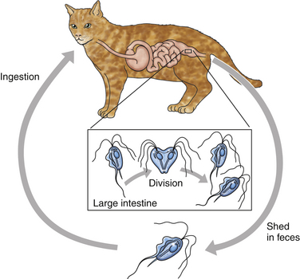
Background - Tritrichomonas
Flagellated protozoan parasite
Important pathogen in cows & cats
Infects reproductive tract in cows
Causes spontaneous abortions & infertility
Infects large intestine in cats
Causes chronic large-bowel diarrhea
Fecal-oral transmission
Most common in young cats (<1 year)
Cats in multi-cat environments at highest risk
Arranz-Solis et al. 2016,
Gookin et al. 2017
Notes:
3. Infertility in bulls
4.
Causes chronic large-bowel diarrhea, although older cats are often asymptomatic
As seen in the diagram, Tritrichomonas is transmitted directly through a fecal-oral route because it does not have a cyst form
Younger cats are more often infected
Cats in multi-cat environments, such as shelters and rescues, are at the highest risk of infection because of these factors

Slide 3
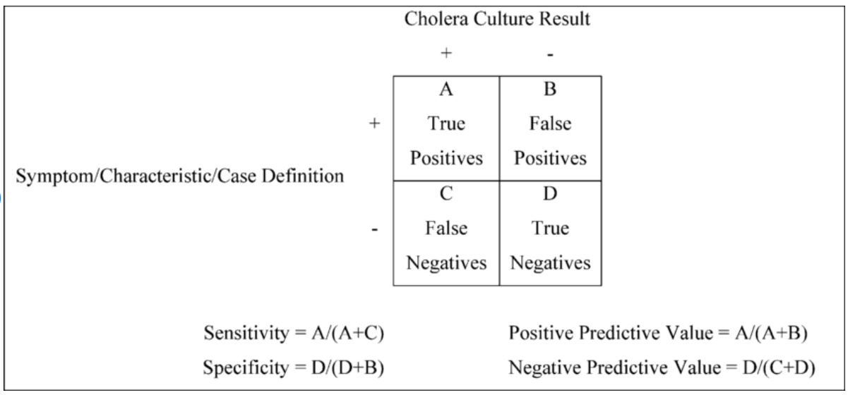
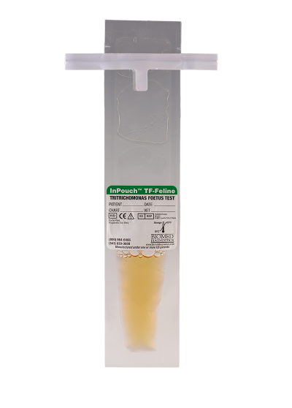
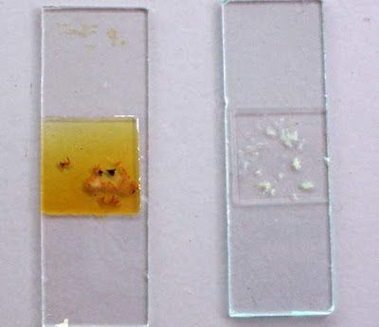
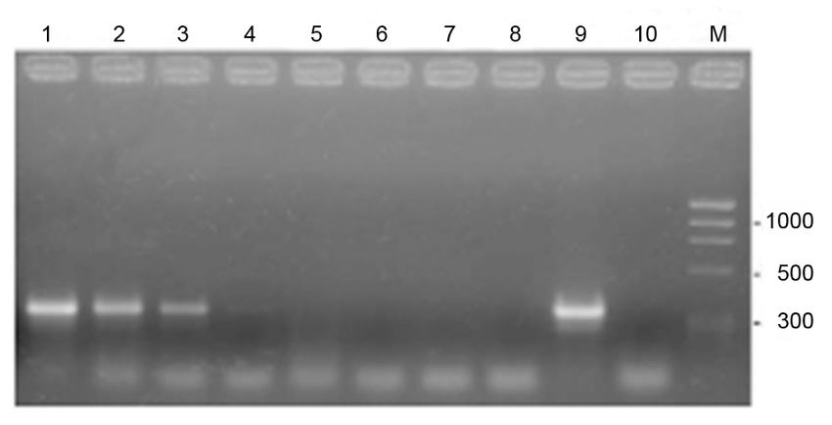
Background – Diagnostic Approaches
Fecal Smear
Easiest
Least sensitive (2.6-14%)
Fecal Culture
More sensitive (55%)
Results take 12 days
PCR
Most sensitive & specific
Not as accessible & affordable
Gookin et al. 2017
Notes:
Fecal Smear
Easiest, clinics can readily perform this test
Fecal culture
More sensitive than a smear
However, results take 12 days because the InPouch must be incubated
PCR
Most sensitive and specific of the three
Not as accessible and affordable for clients and clinics

Slide 4
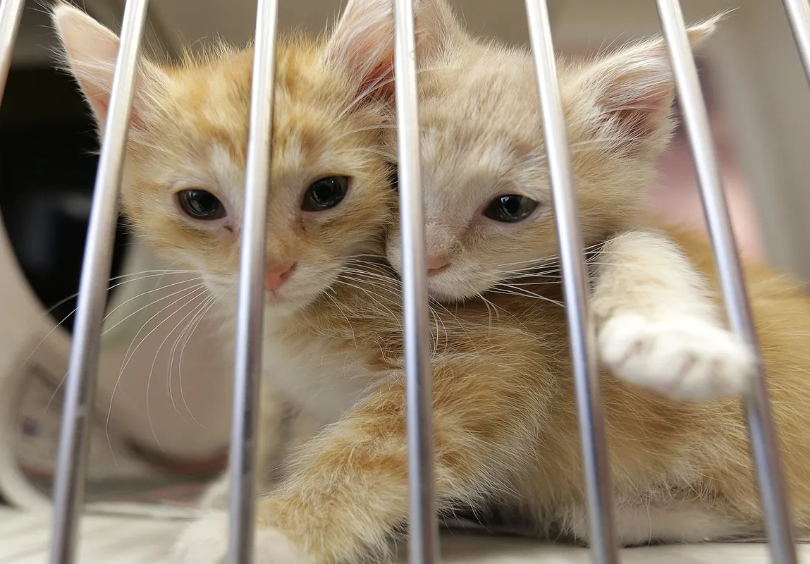
Rationale & Innovation
Lack of overall knowledge about Tritrichomonas in cats and readily available tests.
Difficult to manage
Establish prevalence to better understand epidemiology and how to mitigate its spread
Develop a molecular test to provide a useful resource for clients of the VMTH
Notes:
We wanted to do this study because the lack of knowledge and lack of readily available tests to detect infection
Therefore, making the infections difficult to manage in environments with many cats
2. We want to establish a prevalence
3. And develop a molecular test to provide a useful resource for clients that care for high-risk cats

Slide 5
Hypotheses
1. Molecular testing of Tritrichomonas in cats will provide a more sensitive method of detection than fecal culture
2. Tritrichomonas will have a higher prevalence in shelter-derived cats than previously determined in this region
Notes:
Part 2:
The only study that has determined a prevalence area did not focus on high-risk populations
But they did find the prevalence to be around 4%

Slide 6
Aims
Collect fecal samples from 100 shelter-derived cats, either diarrhetic or non-diarrhetic, ranging from 1 month – 10 years of age
01
Extract DNA from fecal samples (pre- and post-fecal culture) and detect Tritrichomonas DNA using PCR
02
Compare the ability of PCR and fecal culture to detect Tritrichomonas in cat feces and establish a study population prevalence in sampled cats
03

Slide 7
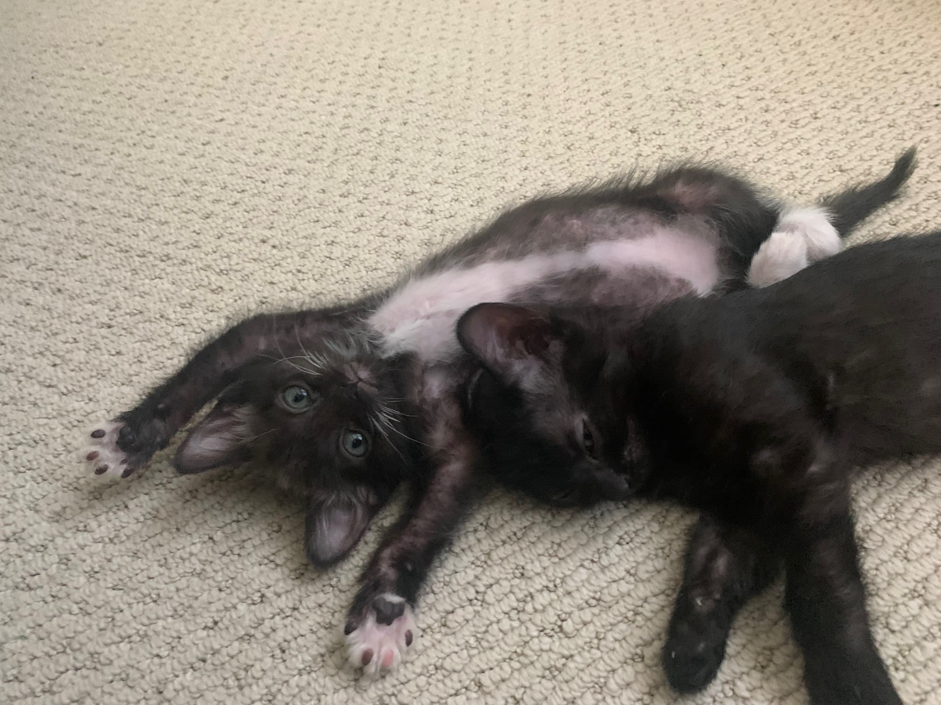
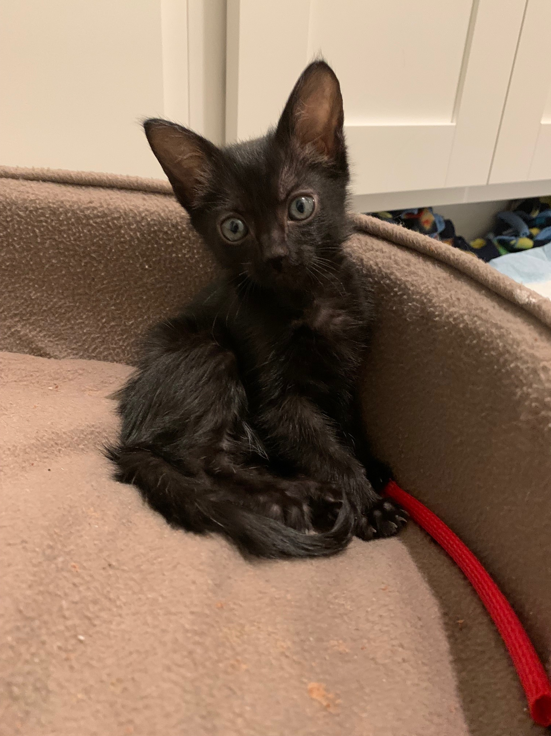
Aim 1 Methods
Recruited fosters from local shelters and rescues
Made video instructions and quiz to train fosters in sample collection
Fosters collected fresh (<2 hours) fecal samples and inoculated InPouch fecal cultures
History forms with cat’s name, age, diet, history of diarrhea/health, the time/date of collection, and fecal score collected
Notes:
First we recruited fosters with the help of Dr. Karen Vernau, the faculty advisor for OKP who also works closely with many shelters
Then we made video instructions and a quiz to train the fosters to collect samples and inoculate InPouches
-
We lastly collected history forms detailing important information about each cat
- And on the right are some of the kittens that we collected samples from

Slide 8
Aim 1 Results - Samples
Classifications |  | Number of Cats
Age | Kitten (>1 year) | 32
 | Adult (<1 year) | 2
Gender | Female | 16
 | Male | 18
Health Status | Symptomatic (Diarrhetic) | 25
 | Asymptomatic | 9
Total | Collected | 34
 | Collected + Banked | 58
Notes:
This is a table summarizing my results from Aim 1
I separated the sampled cats into major categories of Age, Gender, and Health Status (being symptomatic/diarrhetic vs. asymptomatic)
Majority of our sampled cats were younger than 1 year old
There was a fairly even distribution of males and females
And most of our sampled cats were diarrhetic, although we were not aiming to collect more from one or the other
During my time on the project, I collected a total of 34 samples from 34 cats
And in addition to the banked samples we had, we worked with 58 samples this summer

Slide 9
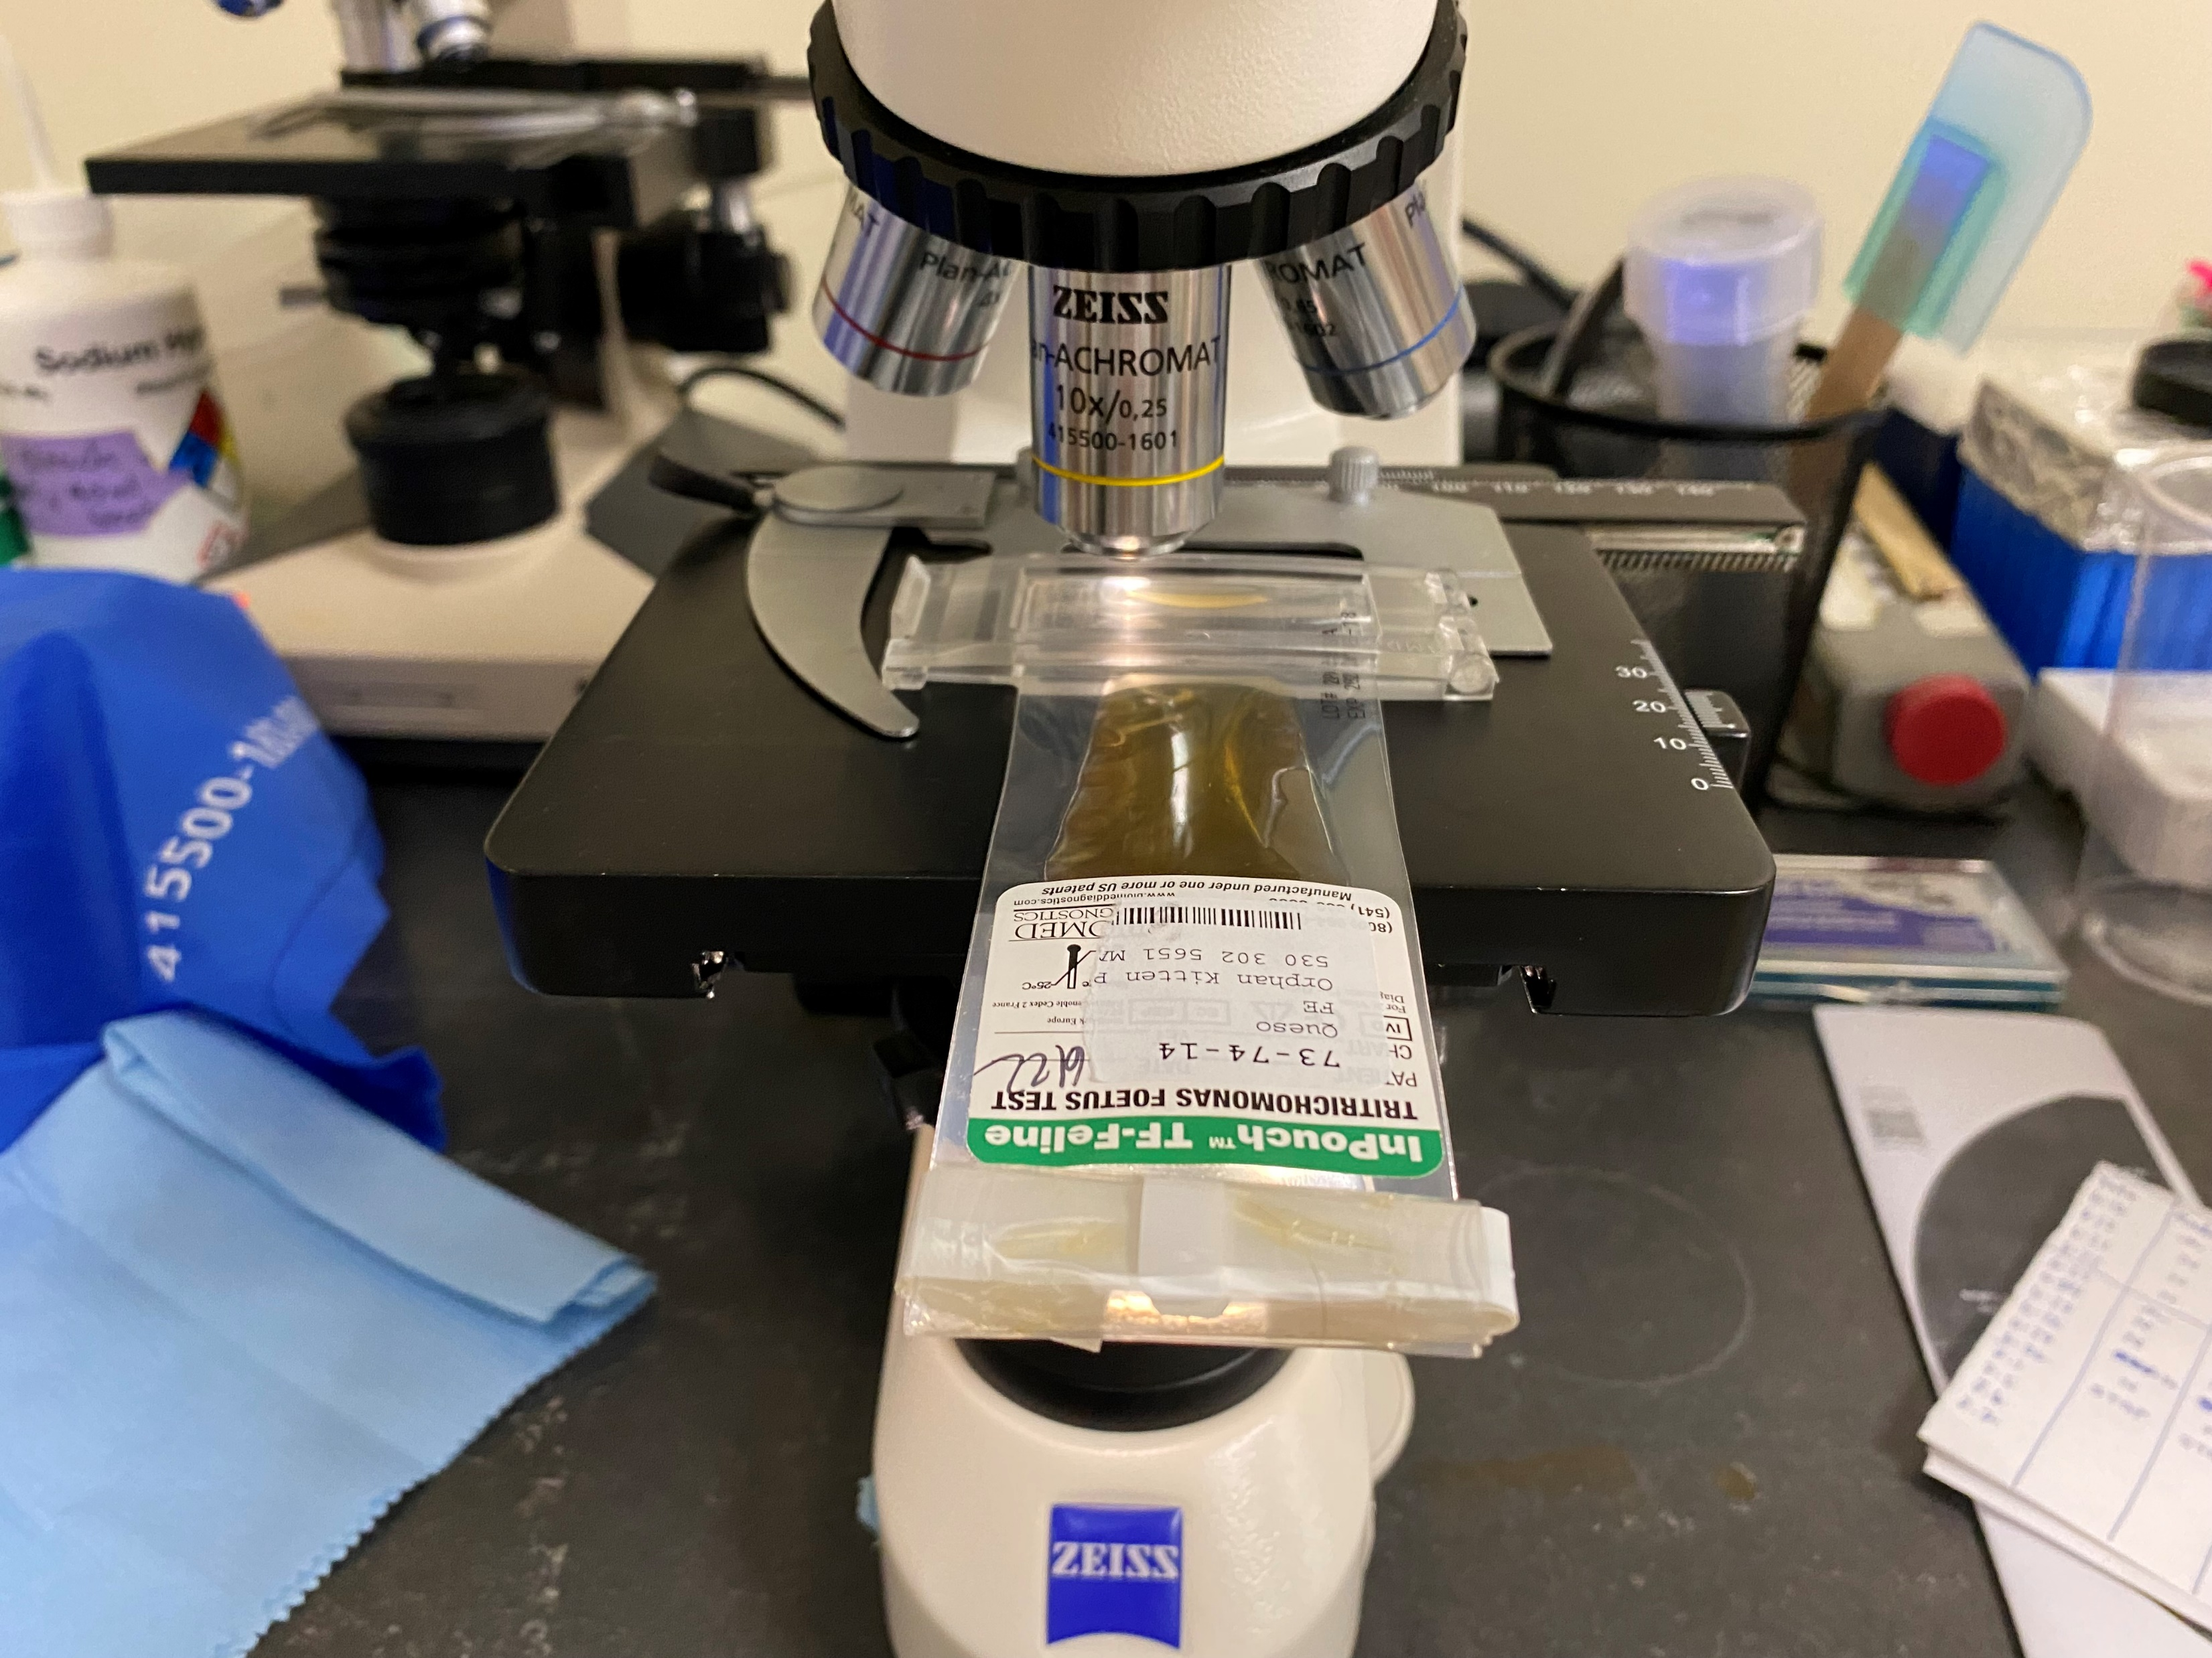
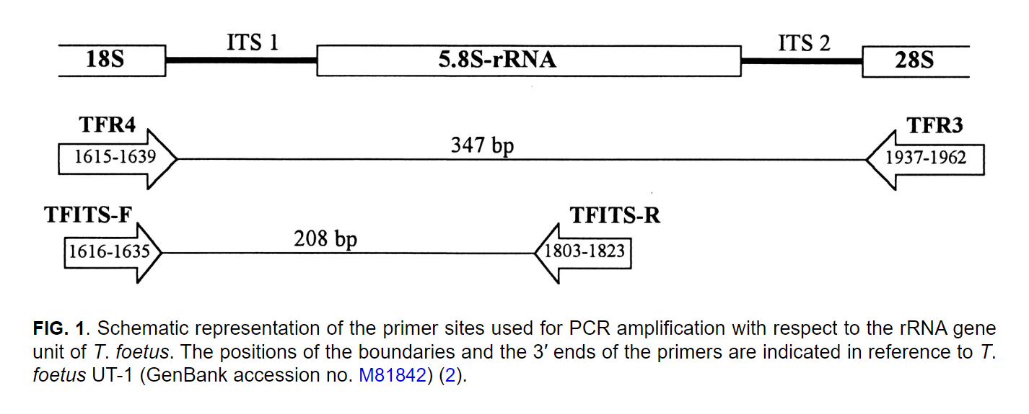
Aim 2 Methods
Pre-culture PCR:
Extracted fecal DNA with Qiagen DNeasy Blood & Tissue Kit
Ran nested PCR assays with external + internal primers
Post-culture PCR:
InPouches incubated for 12 days
Checked under microscope daily
Culture media aspirated, centrifuged, and underwent DNA extraction and PCR
- Amplification products that were the same size as the positive control were extracted & sequenced
Gookin et al. 2002
Notes:
Pre-culture:
We extracted DNA from the 200 mg fecal samples with the Qiagen Dneasy Blood & Tissue Kit
Then ran nested PCR assays on the extracted DNA with external and internal primers
These primers were previously studied and developed to isolate Tritrichomonas DNA
The external primers in the middle will cut a larger portion of the DNA, then the internal primers will cut a smaller portion to isolate the ITS1 gene
Post-culture:
We also performed post-culture PCR’s with the InPouches
So, the InPouches were first incubated in the dark and at 37 degrees C for 12 days
Looked at under a microscope daily to observe the presence of Tritrichomonas
Then after the 12-day period, the culture media was aspirated, centrifuged, and underwent DNA extraction and nested PCR’s as well
If we were to find any amplification products that had the same sized bands with our positive Tritrichomonas control, we planned to extract that DNA and have it sequenced to confirm the presence of Tritrichomonas

Slide 10
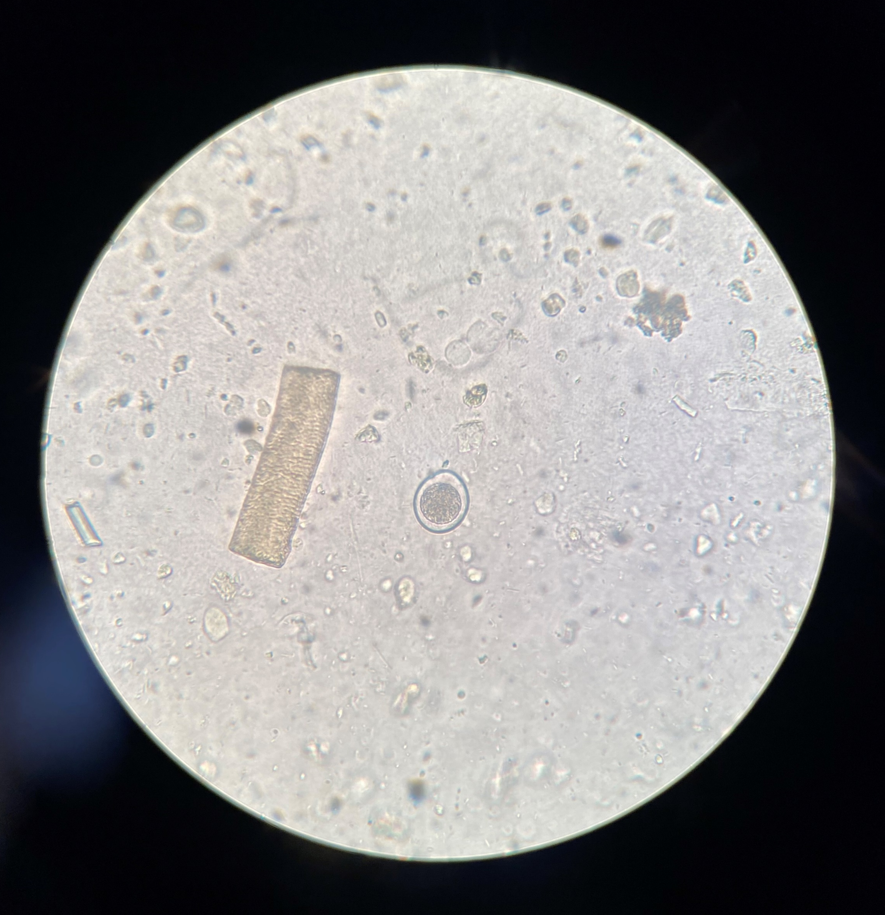
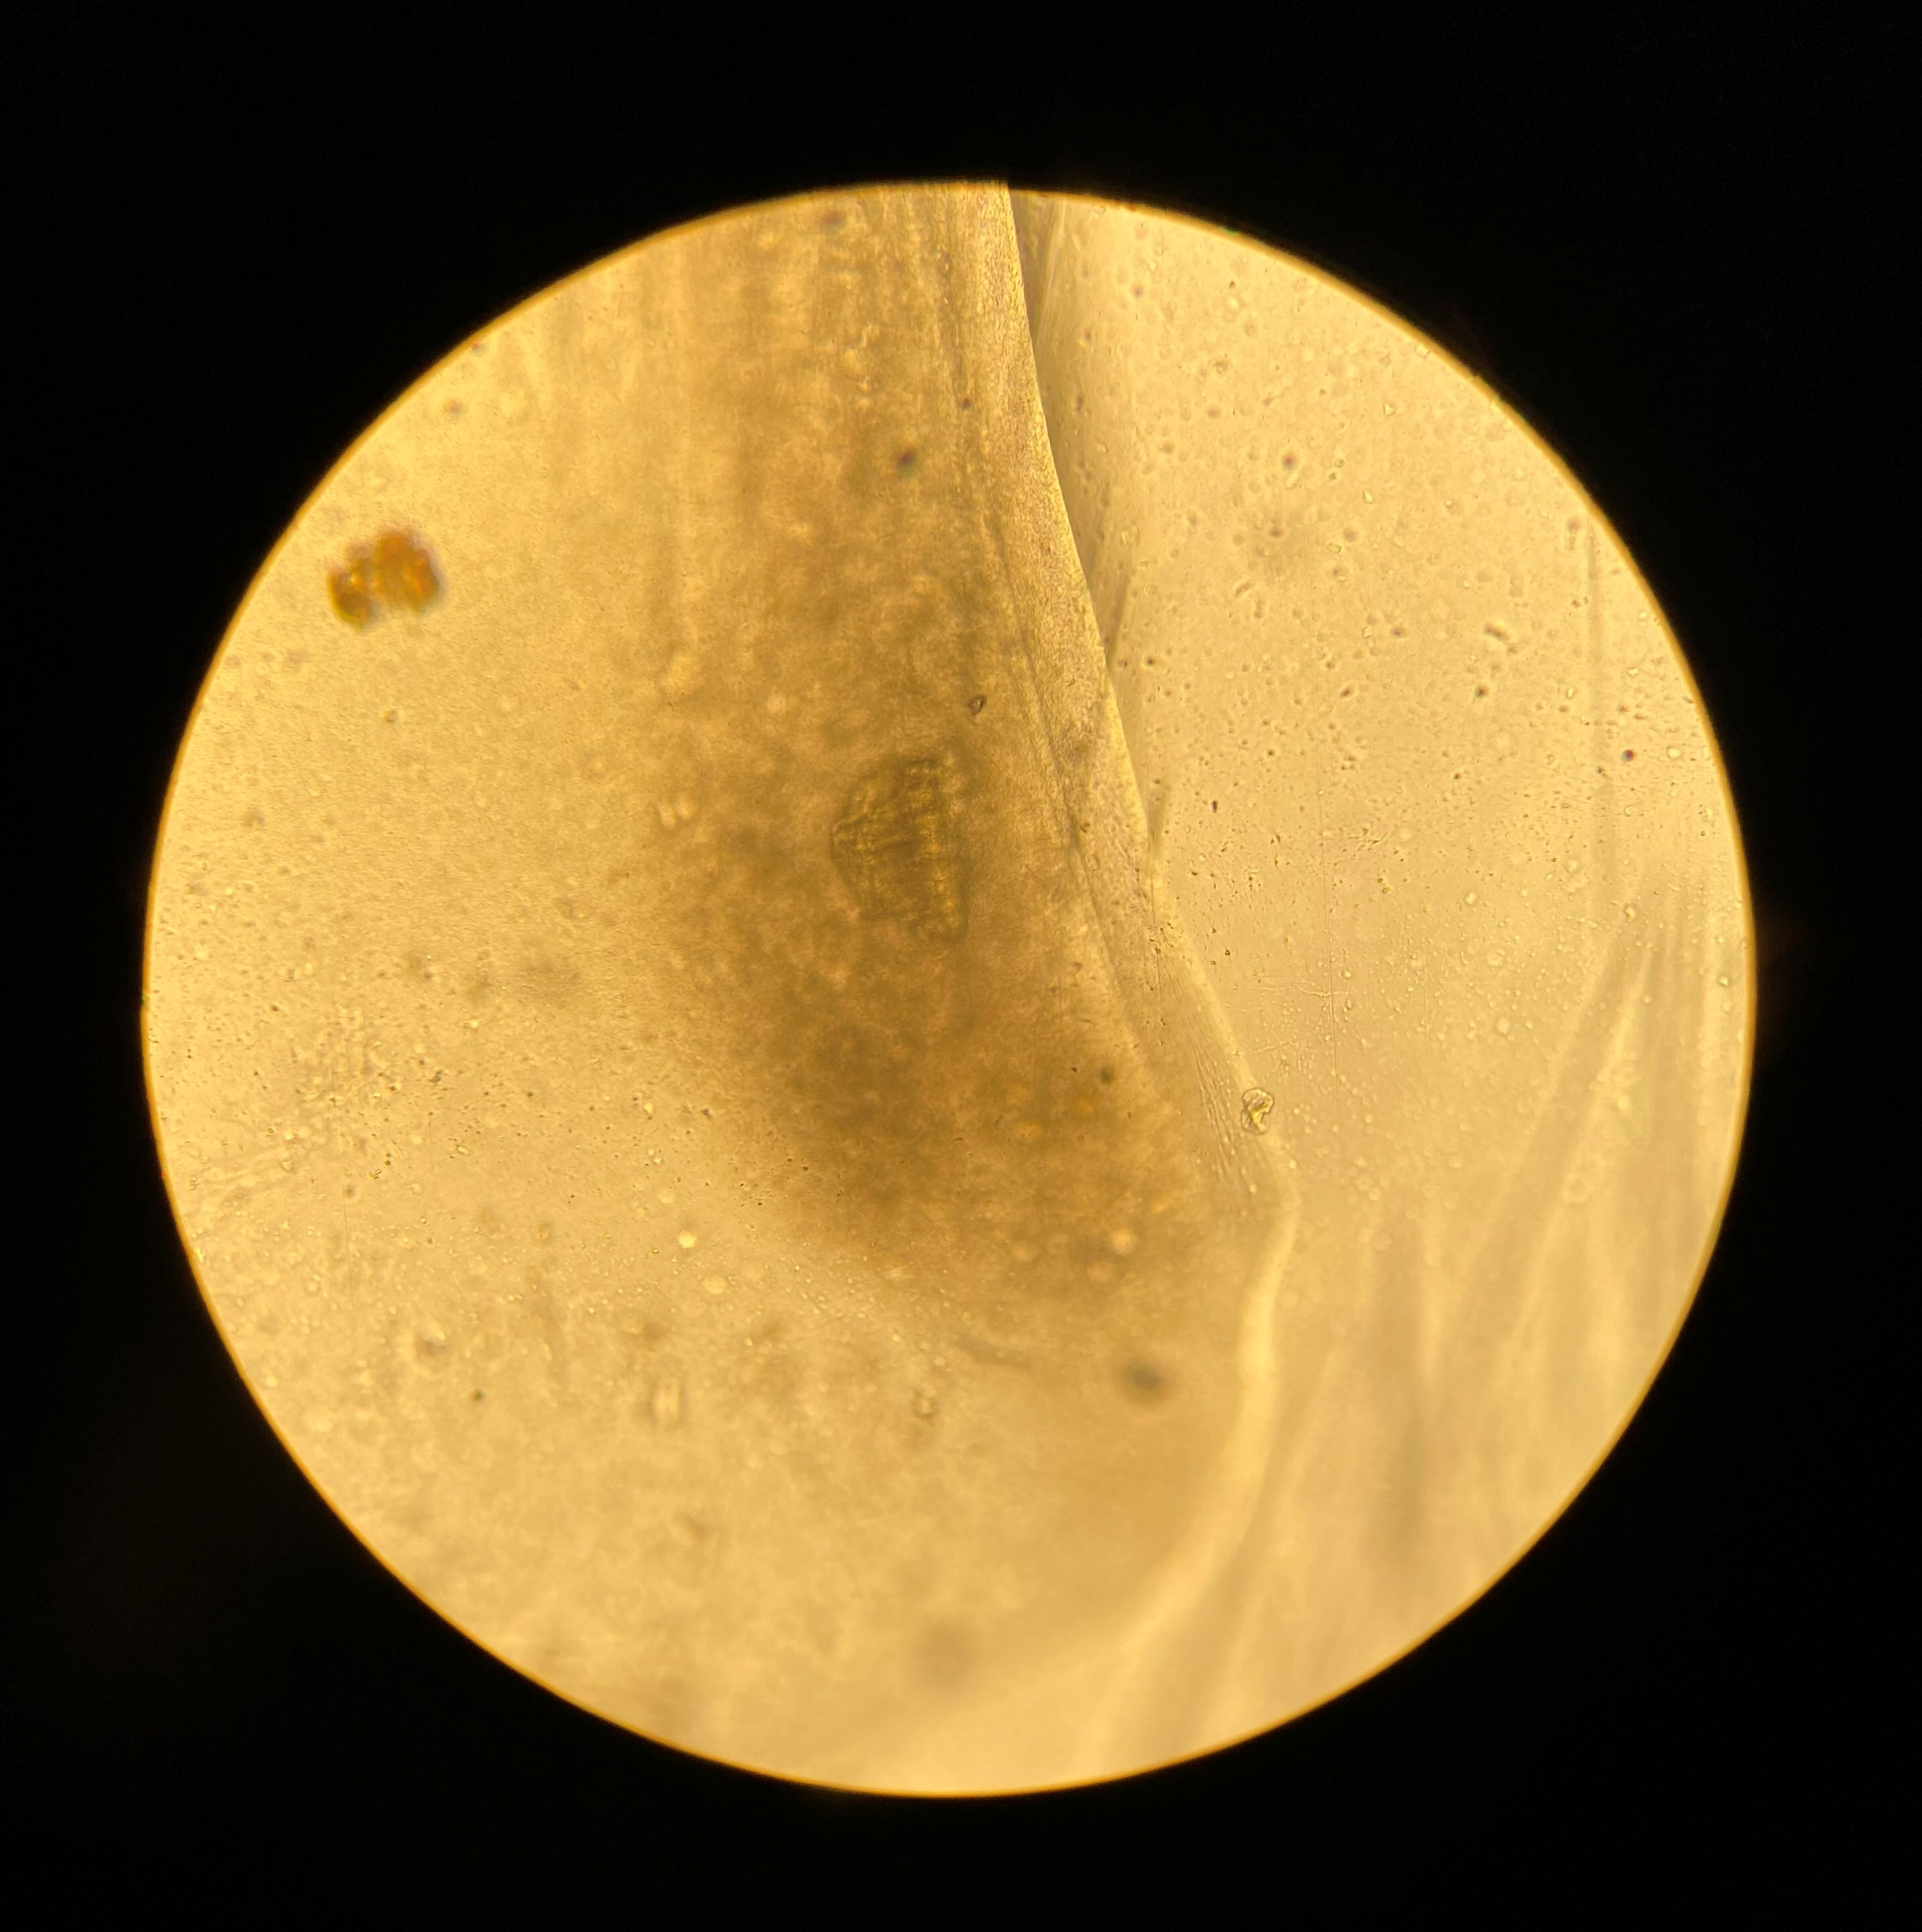
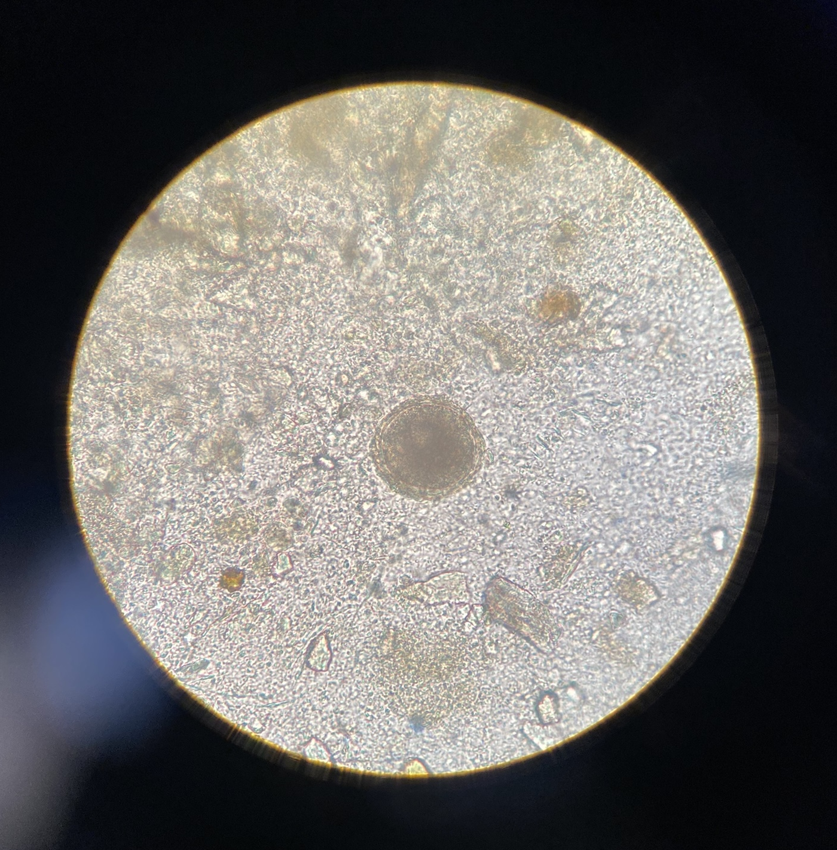
Aim 2 Results – Fecal Cultures
38 total fecal cultures collected
21 fecal culture results finalized
No Tritrichomonas seen in all 21 fecal cultures
Observed Cystoisospora felis oocysts and Toxocara cati ovum

Slide 11
Aim 2 Results – PCR (In progress)
Notes:
As for PCR results, we unfortunately ran into issues with contamination early on in our project and have yet to be able to solve this issue despite replacing all of our primers and reagents and implementing new safety procedures
Troubleshooting of this problem is still ongoing,

Slide 12
Aim 3 Methods (In progress)
Data Analysis
Determine prevalence
( $\frac{positive samples}{total samples}$ )
Compare fecal culture vs. pre-culture PCR
via McNemar chi-square test statistic
Compare results to previous prevalence study
Notes:
Aim 3 is still a work in progress because of the lack of PCR results
But once we start obtaining those, we plan to determine a prevalence of Tritrichomonas in our study population
We would do this by simply dividing the number of positive samples by the number of total collected samples
We would then compare the ability of fecal culture vs the pre-culture PCR’s to detect Tritrichomonas
This will be done using a McNemar chi-square test statistic
- After determining our prevalence, we will then compare it to that of the previous study done in Northern California

Slide 13
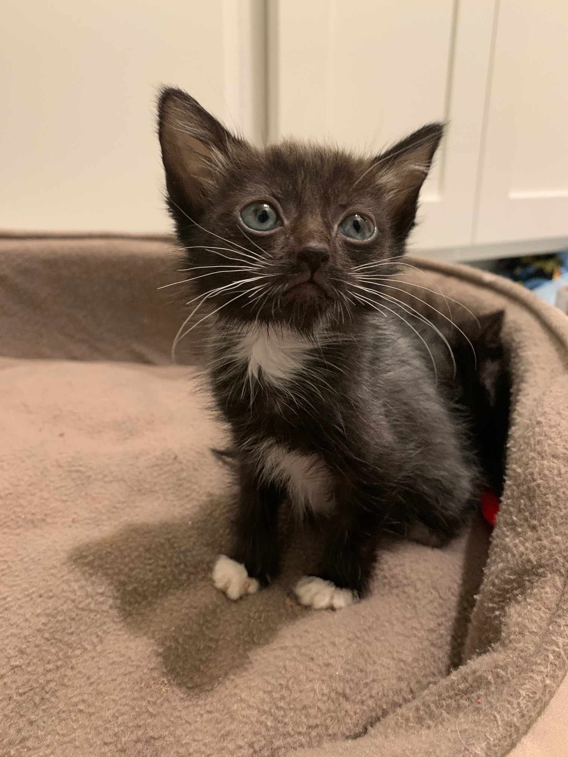
Discussion
Prospective study
Aim 1 was the main focus
Challenges with sample collection
Communication, fresh samples, InPouch inoculations
Built a foundation for the future
Ongoing project
Goal of 180 fecal samples/cats
Results so far
No positive fecal cultures
Can’t rule out Tritrichomonas in this population yet
Not enough cats to determine true prevalence
Notes:
To wrap up my presentation, I wanted to discuss some of the takeaways from my STAR project
Because this study was a prospective study, Aim 1 was a major focus for my role on the project this summer
I was responsible for communicating with Dr. Karen Vernau, shelter organizations (such as OKP, Yolo County SPCA) and their fosters to coordinate recruitment, training, and sample collections & drop-offs
With this, came many challenges
For one, communication was sometimes difficult with fosters, delaying sample collection
And with needing very fresh samples, some fosters were unable to collect samples for us
And InPouches also proved difficult to inoculate perfectly for some fosters because they only need a very small amount of feces otherwise it was hard to visualize anything under the microscope
As the STAR student for this project, I was successfully able to build a foundation for this project to work off of in the future
With the quiz, history forms, and numerous google sheets that I designed for sample collection, it has become easier to recruit fosters and collect samples from the community
Lastly, this is an ongoing project at least until next summer so we are hopeful that we will reach our goal of 180 fecal samples from 180 cats
As for our results so far,
Although we have had no positive fecal cultures yet, we cannot rule out Tritrichomonas in this population yet
And we do not have enough cats to determine a true prevalence

Slide 14
Acknowledgements
Financial support was provided by Boehringer Ingelheim & CCAH
My mentors Dr. Karen Shapiro and Dr. Lauren Camp
Dr. Karen Vernau and Dr. Sina Marsilio
Members of the Shapiro Lab
Minji Kim, Devinn Sinnott
The Students Training in Advanced Research (STAR) Program for an amazing research experience
Notes:
These are some acknowledgements I wanted to make that have made my STAR project possible

Slide 15
Thank You!
References
Arranz-Solís, D. et al. 2016. Tritrichomonas foetus infection in cats with diarrhea from densely housed origins. Vet. Parasitol. 221, 118–122.
Gookin, J.L. et al. 2002. Single-Tube Nested PCR for Detection of Tritrichomonas foetus in Feline Feces. J. Clin. Microbiol. 40, 4126–4130.
Gookin, J.L. et al. 2017. The conundrum of feline Trichomonosis. J. Feline Med. Surg. 19, 261–274.
Levy, M.G. et al. 2003. Tritrichomonas foetus and not Pentatrichomonas hominis is the etiologic agent of feline trichomonal diarrhea. J. Parasitol. 89, 99–104.
Queen, E.V. et al. 2012. Prevalence of Selected Bacterial and Parasitic Agents in Feces from Diarrheic and Healthy Control Cats from Northern California. J. Vet. Intern. Med. 26, 54–60.

