Slide 1



Inhibitory effects of dual antithrombotic therapy by rivaroxaban and clopidogrel on platelet function in cats
Sara Lo
R Li, DVM, PhD, DACVECC
J Stern, DVM, PhD, DACVIM
Students Training in Advanced Research
July 31st, 2020

Slide 2
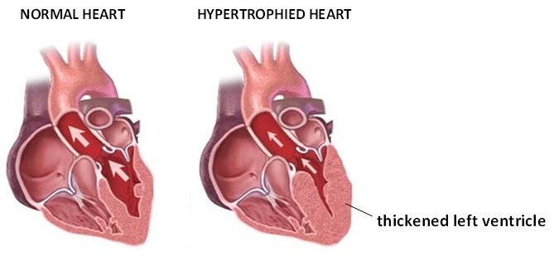
Hypertrophic Cardiomyopathy
Introduction Methods Results Discussion Conclusion
Most common heart disease in cats
https://nives24h.com/pet-health/hypertrophic-cardiomyopathy.php
Notes:
HCM is the most common feline cardiac disease with a prevalence of 15%
Genetic condition that causes muscular walls of cat’s left ventricle to thicken, inducing diastolic dysfunction
Cats with HCM also shown to have hypercoagulable platelets, leading to clot formation

Slide 3
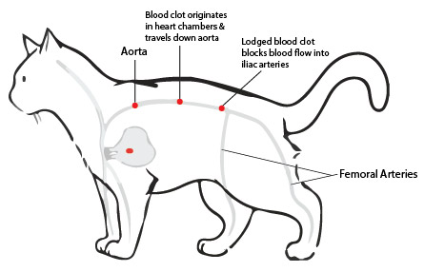
Arterial Thromboembolism
Introduction Methods Results Discussion Conclusion
Cats with HCM are at risk of arterial thromboembolism
https://www.greensidevet.co.za/my-cat-has-suddenly-gone-lame-in-her-hindquarters-and-seems-to-be-in-a-lot-of-pain/
Notes:
Clots can break free and lodge in arteries (arterial thromboembolism), leading to painful and lethal consequences
Major clinical sign includes hind limb paralysis
35% survival rate and poor prognosis
Cats with HCM are at higher risk (12-17%) because their platelets are procoagulant, largely due to blood stasis/endothelial damage
Current mainstay of ATE prevention is antithrombotic therapy but there is minimal clinically effective treatment

Slide 4

Antithrombotics
Introduction Methods Results Discussion Conclusion
Clopidogrel
Rivaroxaban
Extrinsic pathway
Intrinsic pathway
P2Y₁₂
Factor Xa
Platelet activation
prothrombin
thrombin
fibrinogen
fibrin
Notes:
Primary hemostasis (platelet plug) and secondary hemostasis (coagulation factors in the coagulation cascade, form fibrin clot)
Platelets link both, not separate processes
2 methods of preventing clot formation: lower platelet function, inhibit coagulation factors
Clopidogrel = commonly prescribed antiplatelet drug which prevents platelet activation by irreversibly inhibiting P2Y12 platelet ADP receptor
Rivaroxaban = inhibits activated factor X, preventing thrombin generation

Slide 5
Objective
Introduction Methods Results Discussion Conclusion
To examine the safety and efficacy of dual antithrombotic therapy using rivaroxaban and clopidogrel in comparison to either single agent rivaroxaban or clopidogrel treatment
Rivaroxaban
Dual Therapy
Clopidogrel
Notes:
Dual rivaroxaban and clopidogrel therapy has been shown to be superior to single agent therapy in humans with acute cardiovascular events
Anecdotal clinical success but no study has been done
Little known about synergistic inhibitory effects of these drugs on platelet function

Slide 6
Hypothesis
Introduction Methods Results Discussion Conclusion
Dual antithrombotic therapy of rivaroxaban and clopidogrel safely reduces platelet-dependent thrombin generation, platelet activation, and platelet aggregation more effectively than single agent treatment of rivaroxaban or clopidogrel in cats

Slide 7
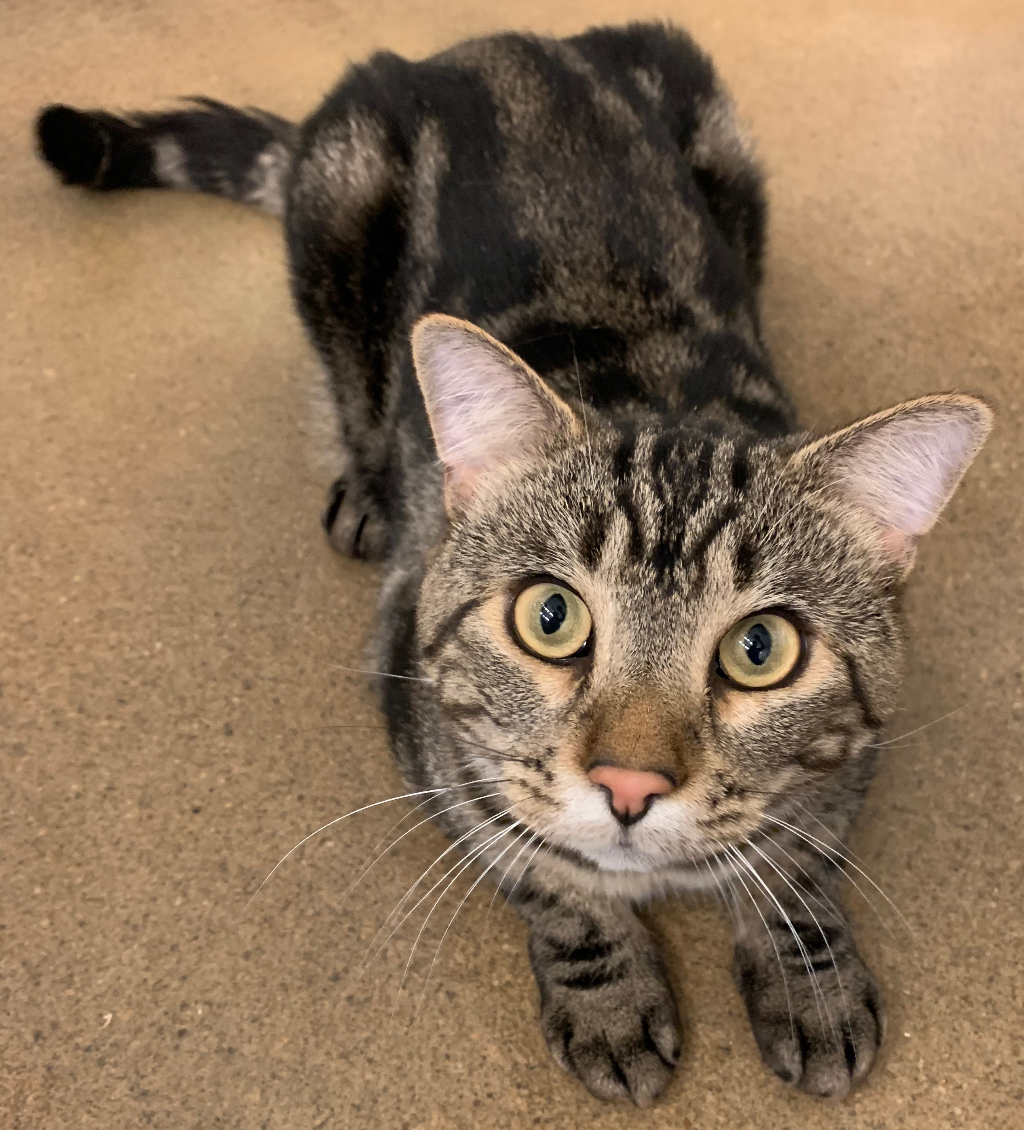
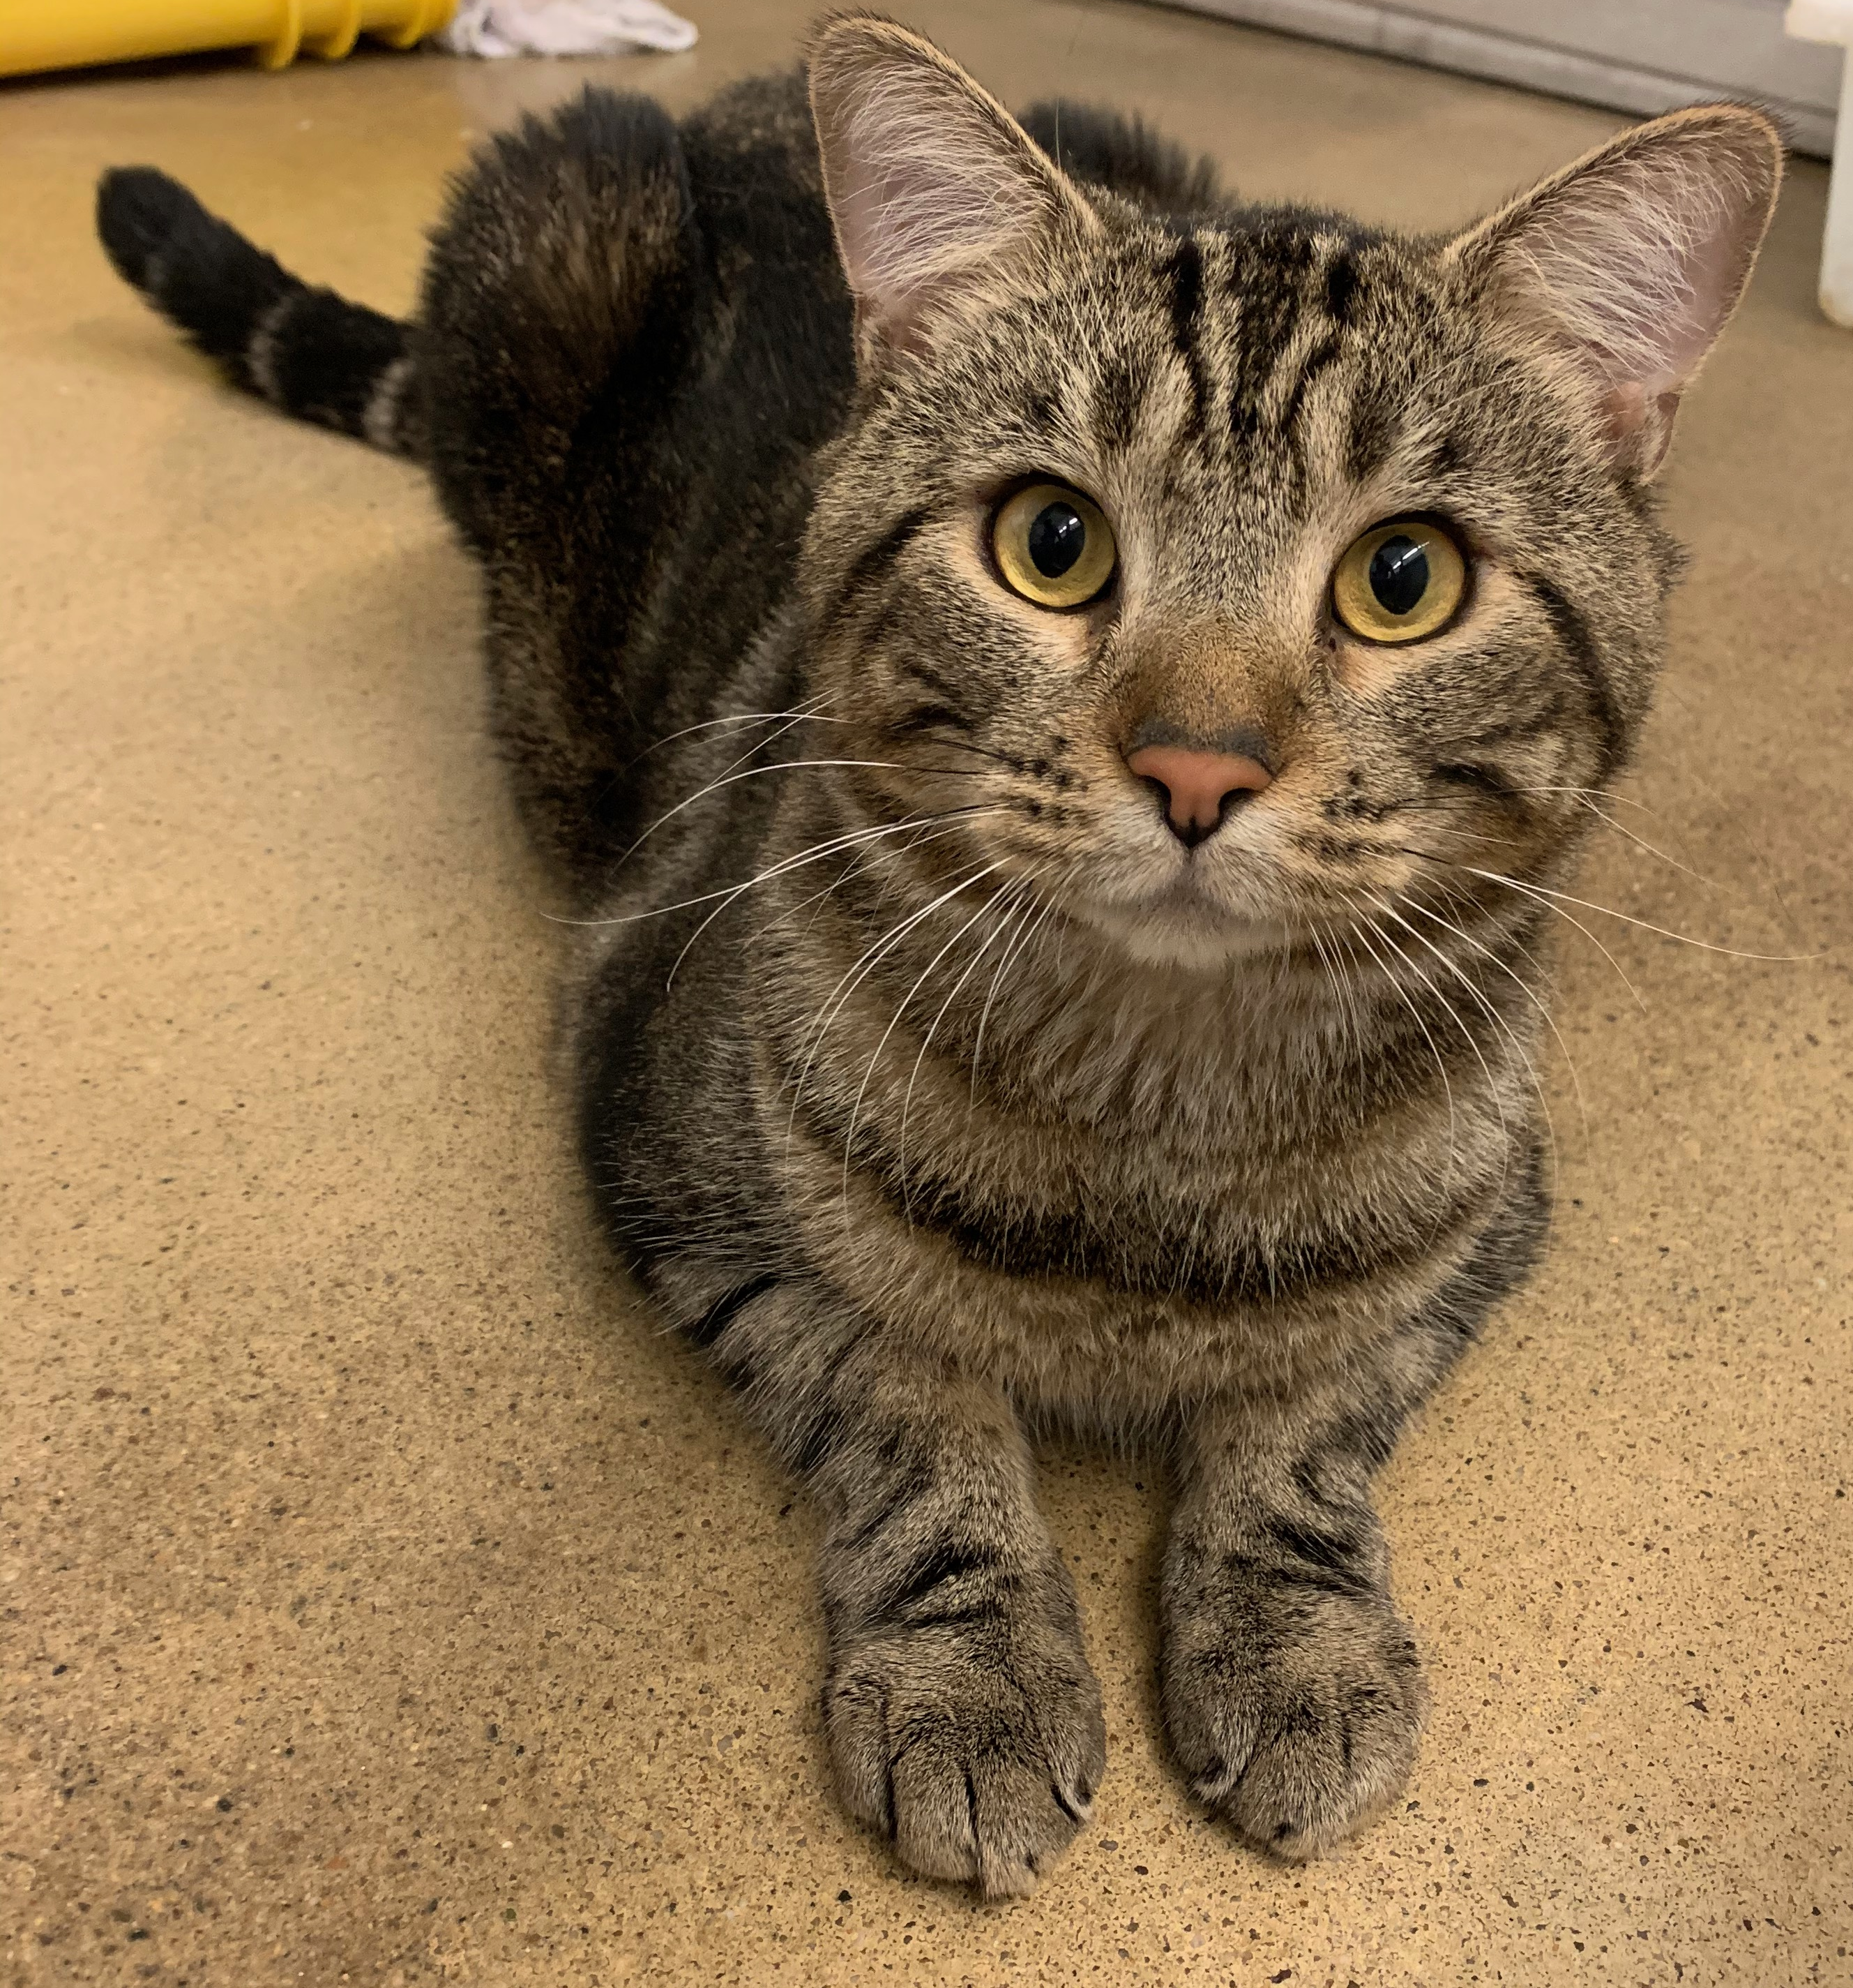
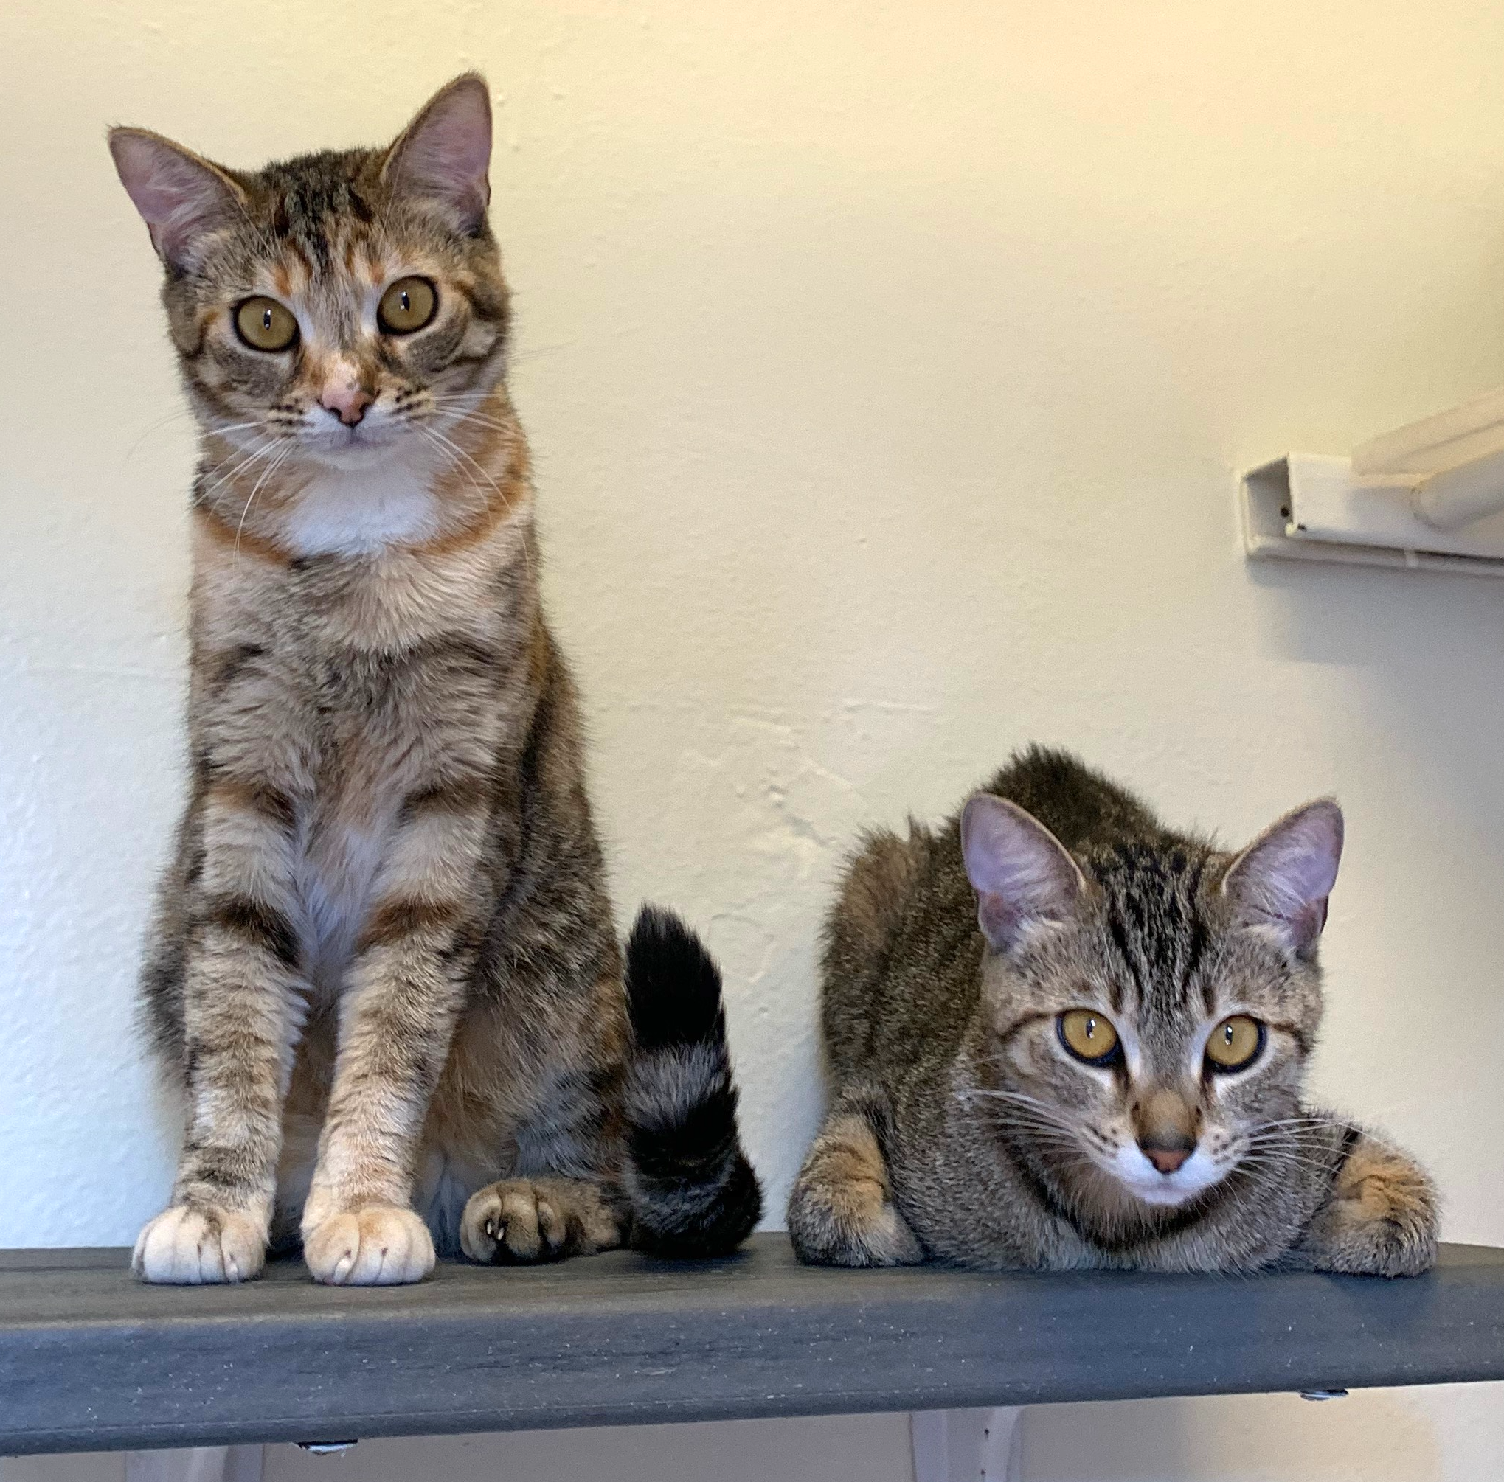
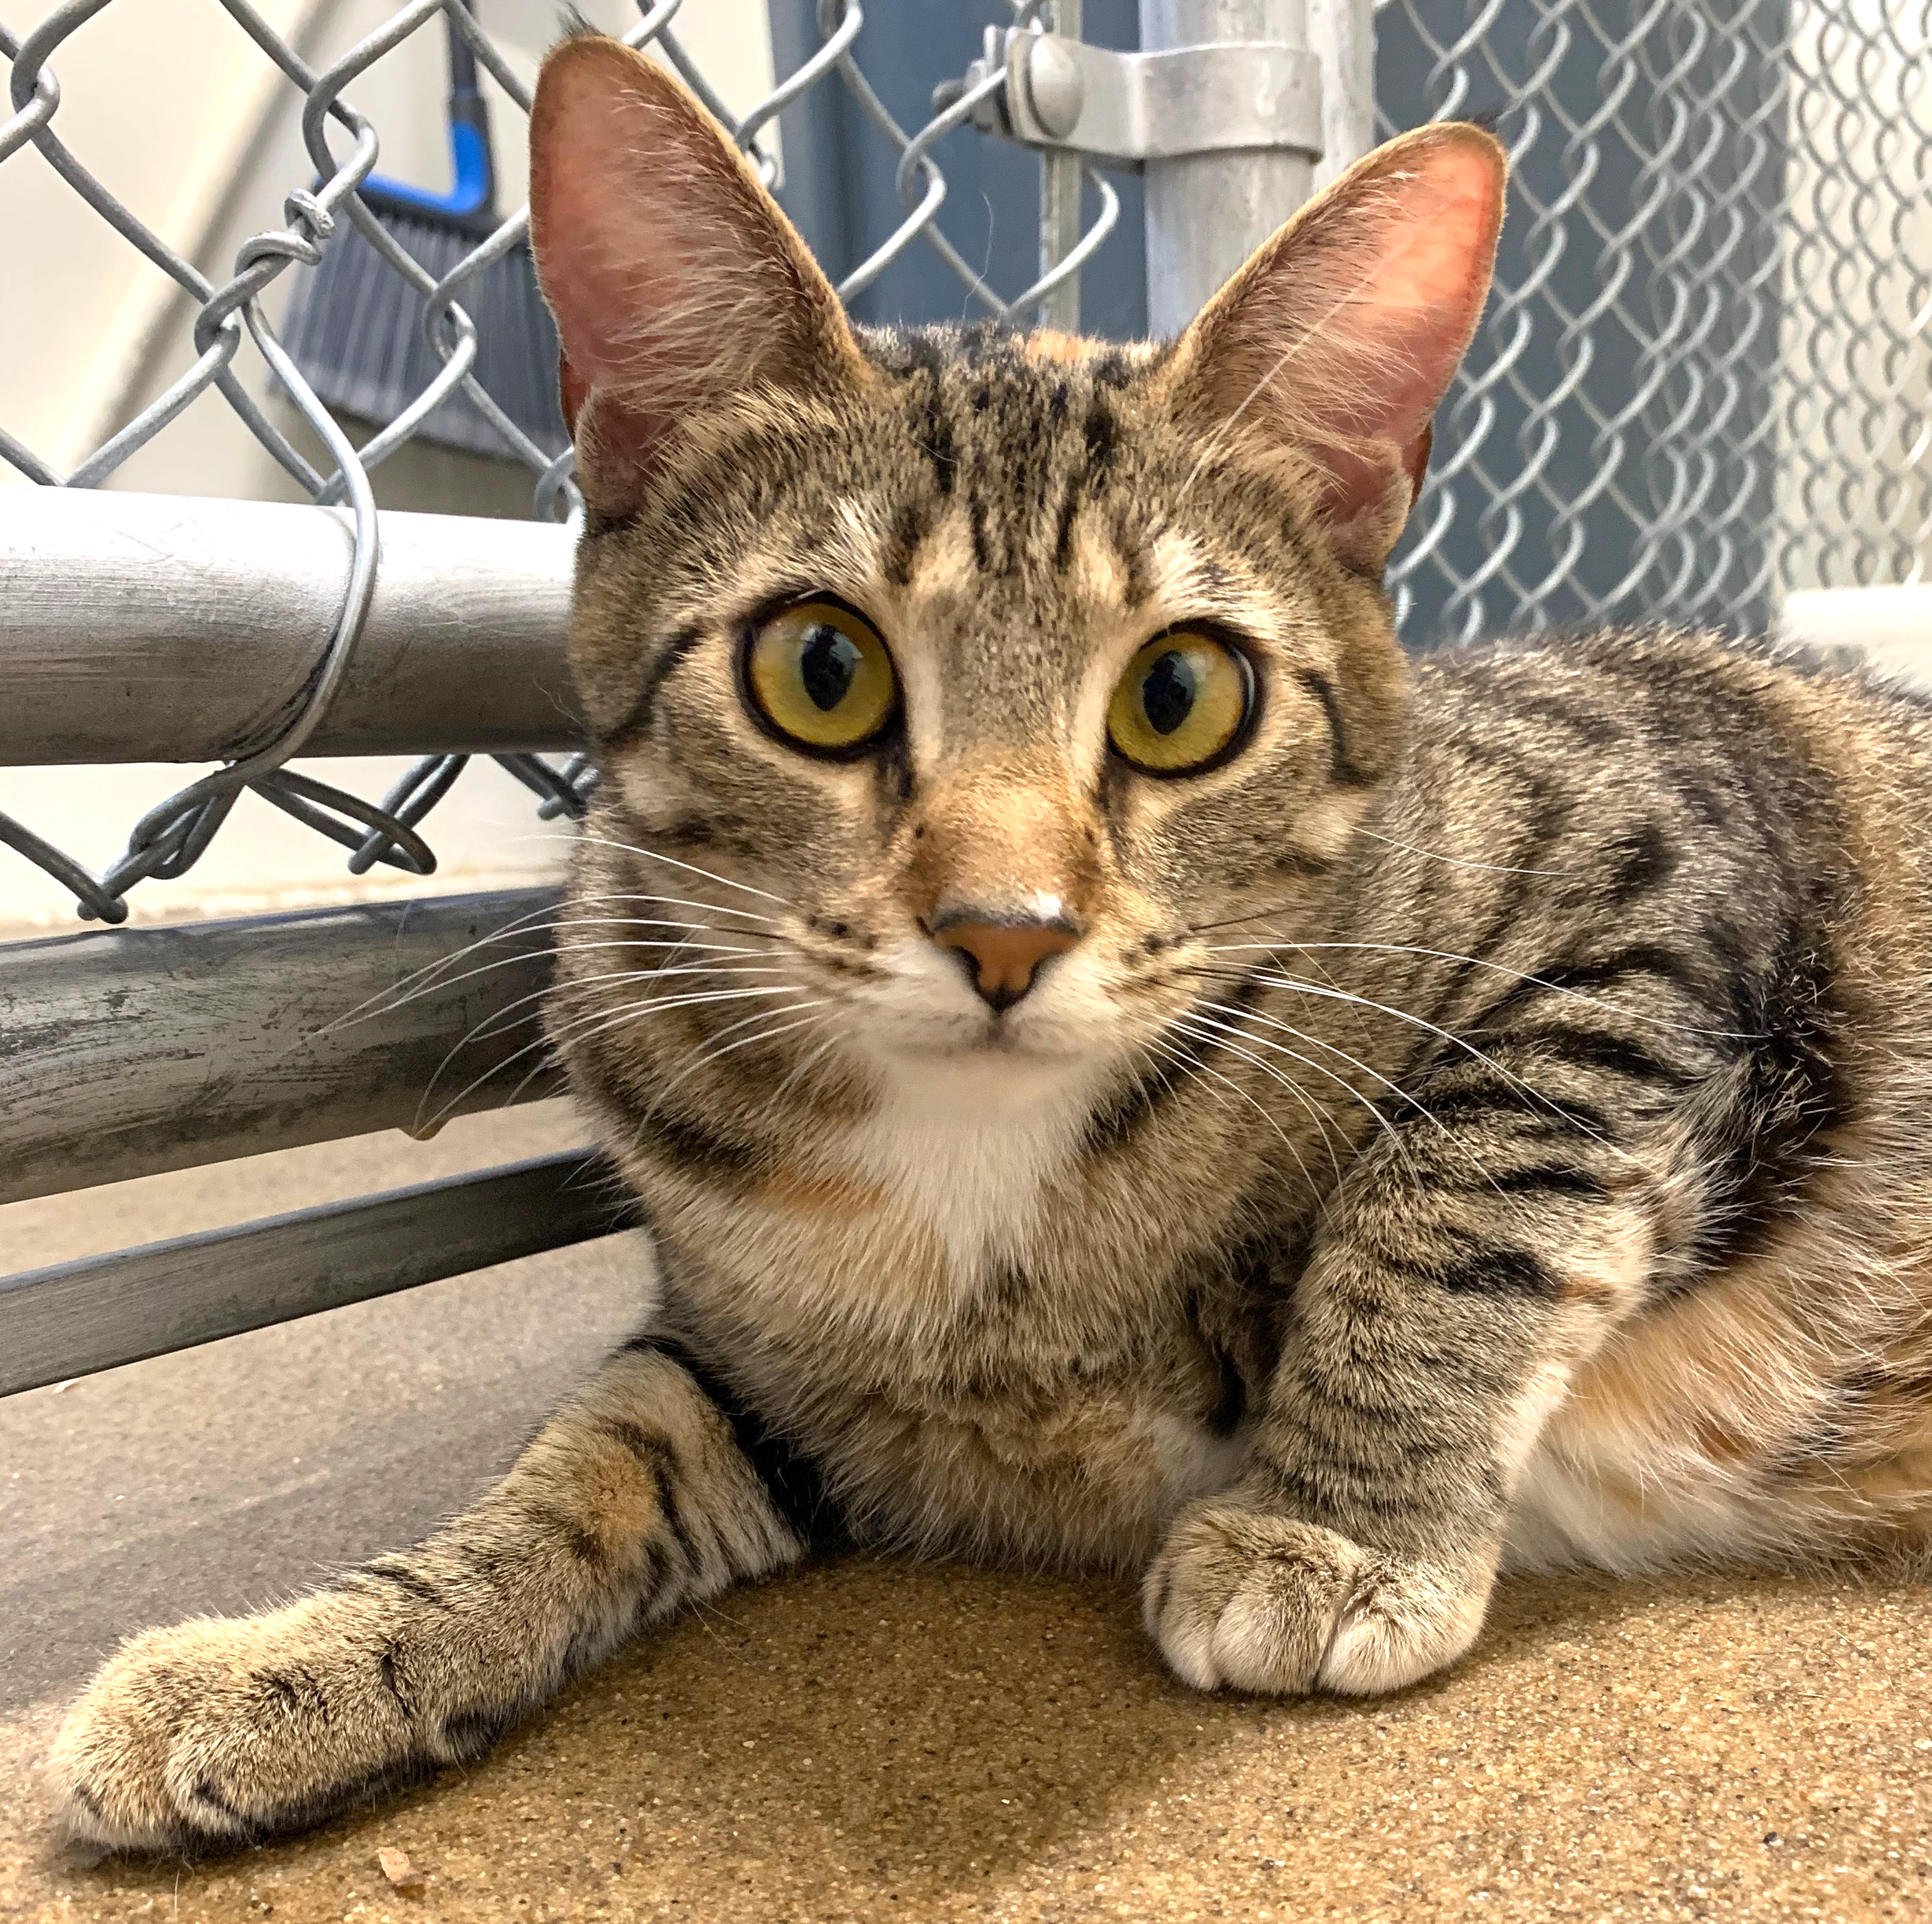
Study Subjects
Introduction Methods Results Discussion Conclusion
9 healthy cats from the UC Davis Feline HCM Research Laboratory
Notes:
9 healthy 1 year old cats were selected from a colony of Maine Coon-cross cats bred and raised at the UC Davis Feline HCM Research Laboratory
Normal on physical and echocardiographic examinations
Heterozygous/wild type for A31P myosin binding protein C mutation

Slide 8
Treatment Timeline
Introduction Methods Results Discussion Conclusion
7 day Rivaroxaban only trial
7 day Clopidogrel only trial
7 day
Dual Therapy trial
3 day washout
15 day washout
2.5 mg PO q24h
18.75 mg PO q24h
Rivaroxaban 2.5 mg + Clopidogrel 18.75 mg PO q24h
Blood Sample Collection
Post Rivaroxaban
Post Clopidogrel
Post Dual Therapy
Pre Rivaroxaban
Pre Clopidogrel
Pre-Dual Therapy
Notes:
3 day washout (riva has short half life, anti-Xa activity subsides after 24h)
15 day washout (allow platelet regeneration)
Baseline values returned to normal

Slide 9
Measuring Platelet Parameters
Introduction Methods Results Discussion Conclusion
Platelet Dependent Thrombin Generation
Platelet Activation
Platelet Aggregation
Platelet rich plasma
Platelet rich plasma
Whole blood
Fluorogenic thrombin generation assay
Flow cytometry +/- ADP
ADP-induced multiple electrode aggregometry
Measure peak thrombin gen. & endogenous thrombin potential
Measure P-selectin expression
Measure aggregation
Notes:
These 3 platelet parameters are good markers to estimate likelihood of clot formation
P-selectin = protein released from alpha-granules and expressed on platelet surface upon activation

Slide 10
Decreased Thrombin Generation Post Rivaroxaban
Introduction Methods Results Discussion Conclusion
Rivaroxaban diminished peak thrombin generation
Rivaroxaban diminished endogenous thrombin potential
Relative Fluorescence Units:
5.13x10⁷ ±4.20 vs 1.64 x10⁷ ±1.09
p=0.004
Area Under the Curve:
1.6x10¹¹ (1.1 x10¹¹, 1.8 x10¹¹) vs 2.1x10¹⁰ (1.9x10¹⁰, 3.6x10¹⁰)
p=0.004
Notes:
Each line represents 1 cat
Since riva inhibits factor Xa which is necessary to form thrombin, these results align w/expectations
Peak thrombin generation = highest point on curve
Endogenous thrombin potential

Slide 11
Decreased Platelet Activation Post Rivaroxaban
Introduction Methods Results Discussion Conclusion
Rivaroxaban lowered P-selectin expression in resting platelets
Rivaroxaban increased P-selectin density in ADP-activated platelets
Rivaroxaban augmented platelet responsiveness to ADP
Mean Fluorescence Intensity:
1465 ±205.4 vs 1076 ±190.7
p=0.008
Mean Fluorescence Intensity:
1911 ±498.2 vs 2435 ±929.2
p=0.05
Fold Change:
0.17 ± 0.095 vs. 0.40 ±0.21
p=0.002
Notes:
Each line is 1 cat
Left shows favorable response: Platelets were more well rested in absence of agonist
Middle and right show riva would NOT help reduce clot formation in the presence of agonist
Middle: ADP-activated platelets had greater density of P-selectin after rivaroxaban treatment
Right: Platelet responsiveness to ADP increased after riva. Riva appears to prime platelets to be hyperreactive to ADP.
Not only was there a greater density of activated platelets after the same stimulation after riva, but degree of responsiveness of each cat increased
Underscores need for an antiplatelet

Slide 12
Decreased Platelet Activation Post Clopidogrel
Introduction Methods Results Discussion Conclusion
Clopidogrel lowered P-selectin expression in resting platelets
Clopidogrel decreased P-selectin density in ADP-activated platelets
Clopidogrel decreased platelet responsiveness to ADP
Mean Fluorescence Intensity:
1676 ±664.8 vs 1034 ±157.5
p=0.017
Mean Fluorescence Intensity:
2331 (2051, 3103) vs 1003 (944.5, 1296)
p=0.004
Fold Change:
0.24 (0.04, 0.35) vs 0.02 (0.005, 0.025)
p=0.02
Notes:
As expected
ADP can’t bind as well to these platelets, which is needed for activation

Slide 13
Thrombin Generation Dynamics Affected by Clopidogrel
Introduction Methods Results Discussion Conclusion
Clopidogrel did not affect peak thrombin generation
Clopidogrel diminished endogenous thrombin potential
Relative Fluorescence Units:
5.6x10⁷ (5.1x10⁷, 5.7x10⁷) vs 5.6x10⁷ (5.5x10⁷, 5.7x10⁷)
p=0.37
Area Under the Curve:
1.5x10¹¹ ±3.9x10¹⁰ vs 7.4x10¹⁰ ±7.2x10¹⁰
p=0.03
Notes:
Clopidogrel doesn't affect peak thrombin
BUT clopidogrel affects thrombin generation dynamics, suggesting interaction between primary and secondary hemostasis

Slide 14
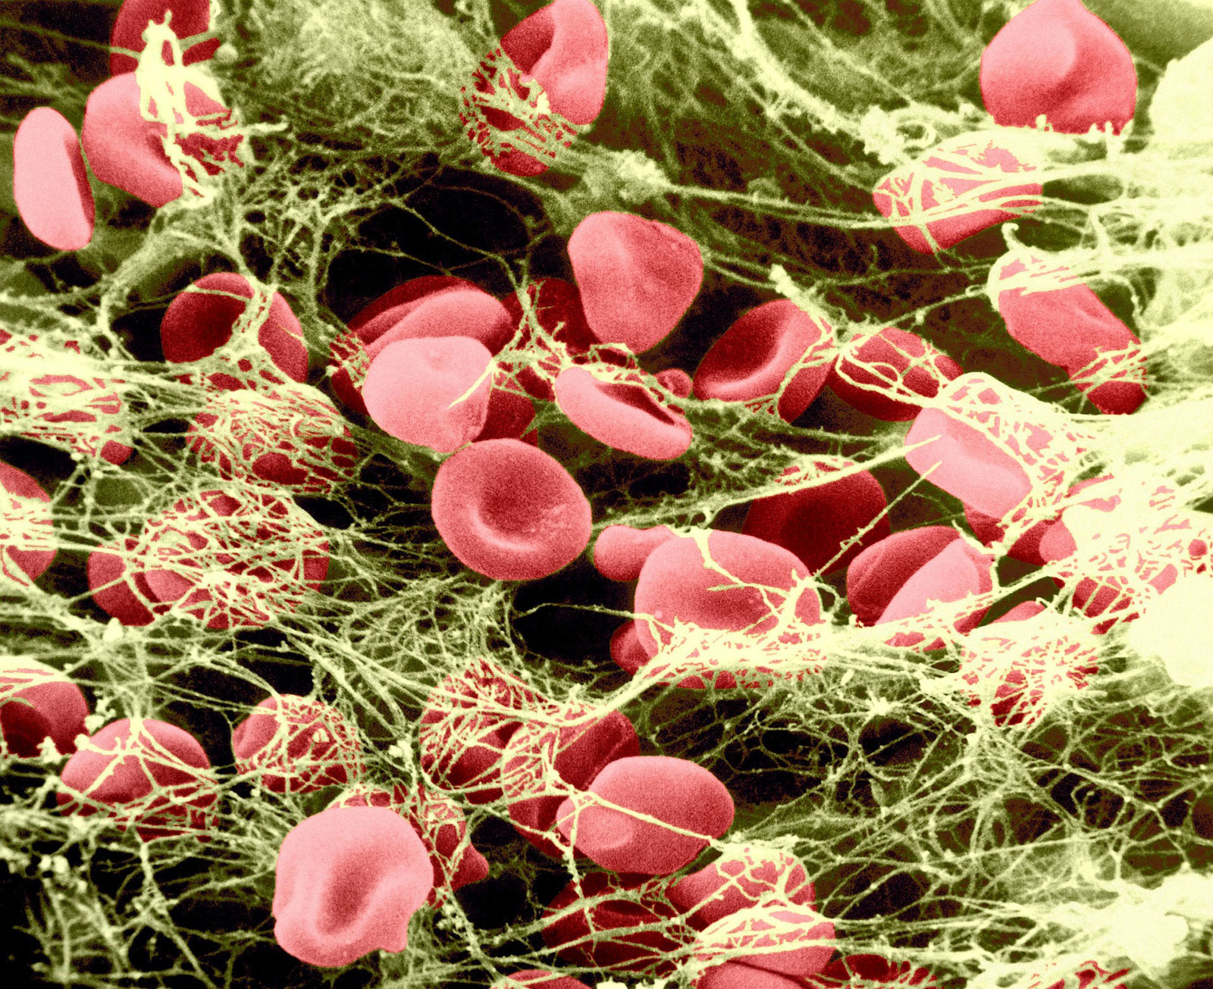


Possible Synergistic Inhibition
Introduction Methods Results Discussion Conclusion
Rivaroxaban may indirectly inhibit platelet activation by modulating thrombin generation
Rivaroxaban alone may prime platelets to be hyperreactive to circulating agonists
Novel drug effects identified
https://www.britannica.com/science/thrombin
Notes:
Preliminary data showed no adverse events in cats receiving single agent rivaroxaban or clopidogrel therapy
In absence of circulating agonists, riva may inhibit platelet activation
BUT it primes platelets
Novel drug effect = riva priming platelets and clopidogrel modulating dynamics of thrombin generation

Slide 15
Future Directions
Introduction Methods Results Discussion Conclusion
Dual therapy trial data generation is ongoing
Retrospective study of client-owned cats receiving dual therapy
Possible dual therapy clinical trial in HCM cats

Slide 16

Acknowledgements
Introduction Methods Results Discussion Conclusion
Special Thanks To:
Joshua Stern
Ronald Li
Nghi Nguyen
Cheyenne Chen
Claire Stuhlmann
Victor Rivas
Maureen Oldach
Sam Fousse
Eric Ontiveros
Maria Montano
Samantha Harris
Research Funding:
Student Funding:
Students Training in Advanced Research (STAR) Program
T35 OD010956
Notes:
Thanks to members of Stern and Li labs who helped at various points with data generation
Donations to the Translational Cardiac Genetics and Pharmacogenomics Laboratory

