Slide 1
Dynamic changes in chromatin accessibility and Runx transcription factor interactions in T cell development
Victoria Tobin

Slide 2
Schematic of T cell development
Phase1
Phase2

Slide 3
How do transcription factors (TFs) function?

Slide 4
ChIP-seq and ATAC-seq
https://www.activemotif.com/blog-atac-seq

Slide 5
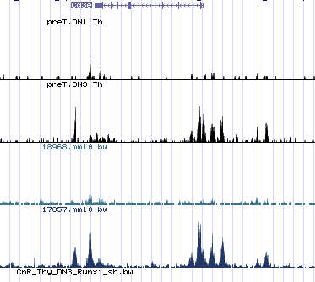
Visualizing ATAC-seq and ChIP-seq data
Phase1 ATAC
Phase2 ATAC
Phase1 Runx1 ChIP
Phase2 Runx1 ChIP

Slide 6
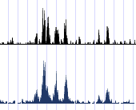
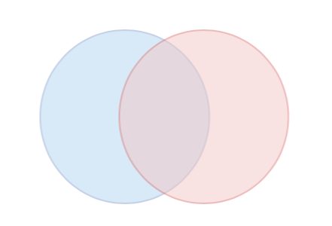
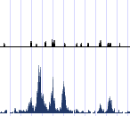
Comparing ChIP-seq and ATAC-seq data
ATAC
ChIP
ChIP-seq
peaks
ATAC-seq
peaks
ATAC
ChIP
HOMER (Hypergeometric Optimization of Motif EnRichment) Heinz S, Benner C, Spann N, Bertolino E et al. Simple Combinations of Lineage-Determining Transcription Factors Prime cis-Regulatory Elements Required for Macrophage and B Cell Identities. Mol Cell 2010 May 28;38(4):576-589. PMID: 20513432

Slide 7
Runx binds open chromatin in phase1, and both open and closed chromatin in phase2
Phase1
Phase2

Slide 8
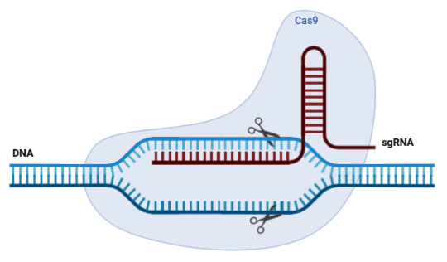
How are these sites associated with genes regulated by Runx?
Runx differentially expressed genes (DEGs) determined by deleting Runx in pro-T cells and doing RNA-seq to look for changes in expression
Expression of Runx repression targets increases
Expression of Runx dependent targets increases
RNA-seq
Runx
Compare DEGs to genes associated with ChIP and ATAC sites determined by GREAT

Slide 9
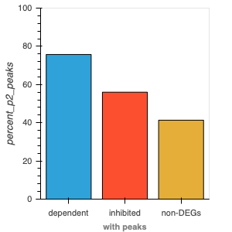
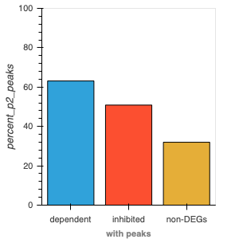
Are Runx binding sites associated with Runx differentially expressed genes (DEGs)?
DEG association with Phase2 open Runx binding sites
DEG association with Phase2 closed Runx binding sites
Percentage of total DEGs
Percentage of total DEGs
Genes associated with open Runx binding sites
Genes associated with closed Runx binding sites

Slide 10
Can transcription factors directly repress genes?
We know a lot about how TF’s activate genes but we know less about how they can repress
If we focus in on only sites that were open in phase1 but closed in phase2, perhaps we can catch Runx in action to uncover a mechanism of repression

Slide 11
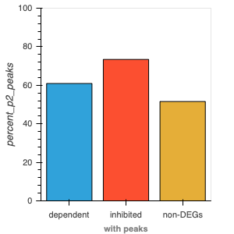
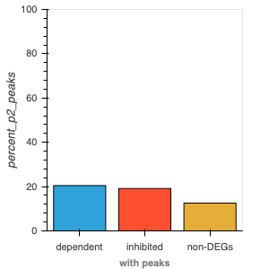
Are the Runx binding sites that go from open in phase1 to closed in phase2 associated with Runx DEGs?
DEGS associated with sites open in Phase1, closed in Phase2, and bound by Runx
DEGS associated with sites closed in Phase1 and Phase2, and bound by Runx
Percentage of total DEGs
Percentage of total DEGs
Genes associated with Runx binding open to closed
Genes associated with Runx binding always closed
Phase1
Phase2
Phase1
Phase2

Slide 12
How is Runx repressing genes?

Slide 13
Summary
Runx dependent genes (eg. Bcl11b, Cd3, and Tcf7) were highly correlated with regions of Runx binding in both open and closed chromatin states
Runx repressed genes were correlated with Runx binding regions that were open in Phase 1 but closed in Phase 2
Runx may be repressing genes through a mechanism that closes the associated chromatin
Despite constant expression throughout T cell development, Runx mediates phase specific roles by interacting with genomic loci undergoing dynamic changes in accessibility

Slide 14
Acknowledgments
Rothenberg lab at Caltech
Ellen Rothenberg
Boyoung Shin
Wen Zhou
Xun Wang
Mary Yui
Tom Sidwell
Rochelle Diamond
Maria Quiloan
UC Davis
Luke Wittenburg
Isaac Pessah
Eileen English

