Slide 1
The effects of deferoxamine(DFO) on murine traumatic brain injury
STAR student: Jingjing Wang
Mentor: Dr. Lillian Cruz-Orengo

Slide 2
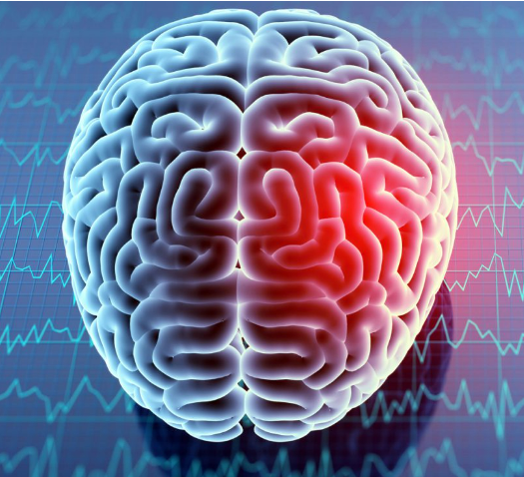
Traumatic Brain Injury(TBI)
Damage to the brain caused by a sudden trauma to the head.
TBI is a major cause of death and disability in the US, contributing to about 30% of all injury deaths, including over 69,000 in 2021
Causes for moderate and severe TBI: falls, firearm-related suicide, car crashes, military, etc.
Although statistics are limited TBI is also common among dogs and cats
https://www.cdc.gov/traumaticbraininjury/moderate-severe/index.html

Slide 3
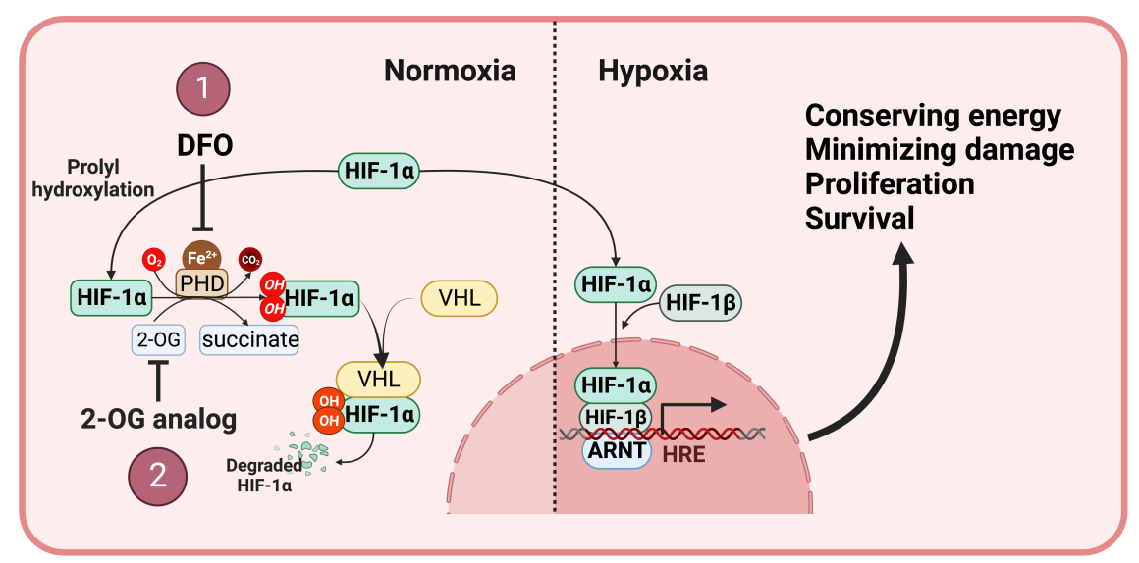
Deferoxamine(DFO) and HIF-1α
Hypoxia-inducible factor-1α (HIF-1α) is a transcription factor regulator of oxygen homeostasis, and its expression is rapidly induced with hypoxia
HIF-1α promotes cell proliferation and survival, and inhibits inflammation and apoptosis
HIF-1α is vital for the neurovascular repair after stroke, retinopathy, and other neurodegenerative conditions
Deferoxamine (DFO) is an FDA-approved iron chelator, and can stabilizes HIF-1α by inhibiting the activity of HIF-prolyl hydroxylase
DFO has been considered as a therapeutic agent for many neurodegenerative conditions

Slide 4
We hypothesize that daily administration of DFO facilitates faster recoveries and better outcomes after TBI by prolonging the presence of HIF-1α.

Slide 5
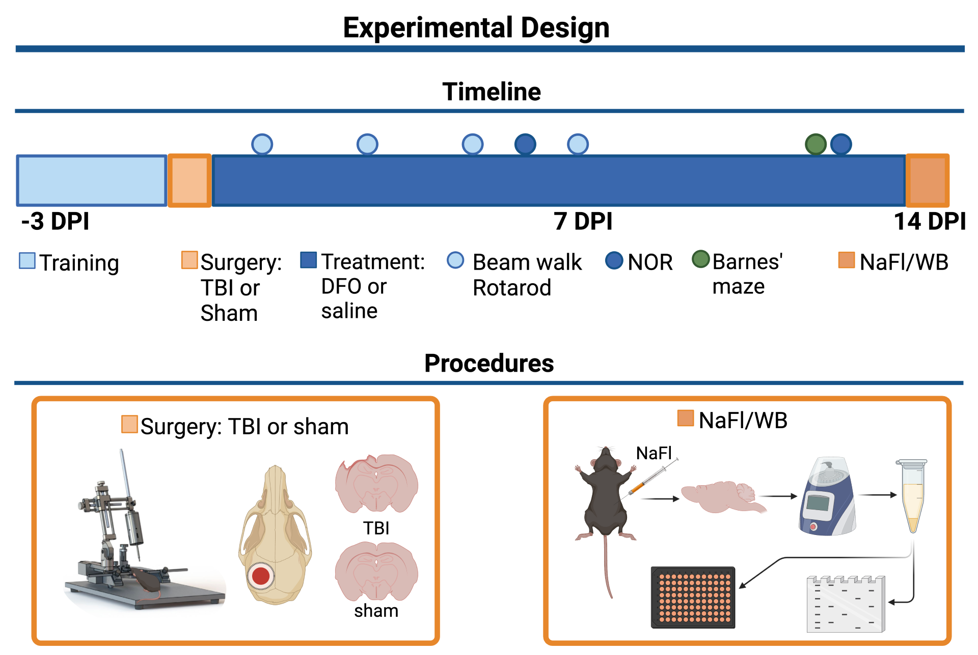
Experimental Design

Slide 6
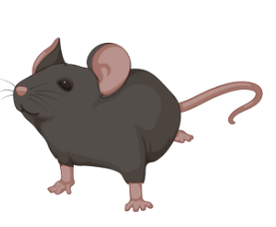
Overall sample size(n=46)
 | TBI Surgery | Sham Surgery
DFO | 11 | 12
Vehicle/saline | 12 | 11
3 groups with different euthanasia time-points: 3 DPI (15), 7 DPI (15), and long-term (16)
23 males, 23 females

Slide 7
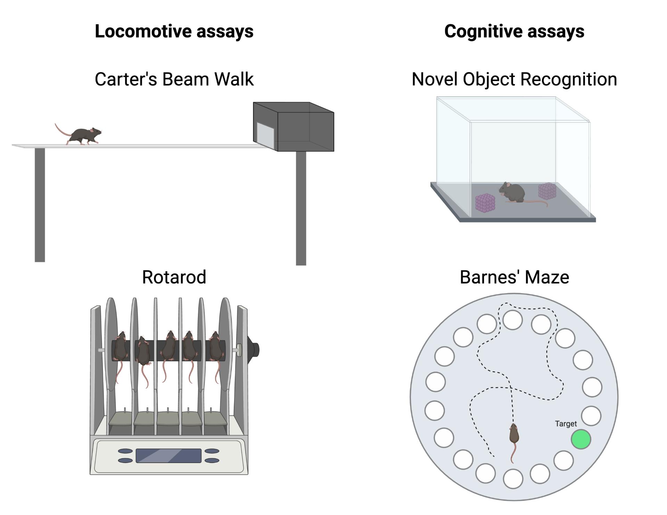
Behavioral Assays

Slide 8
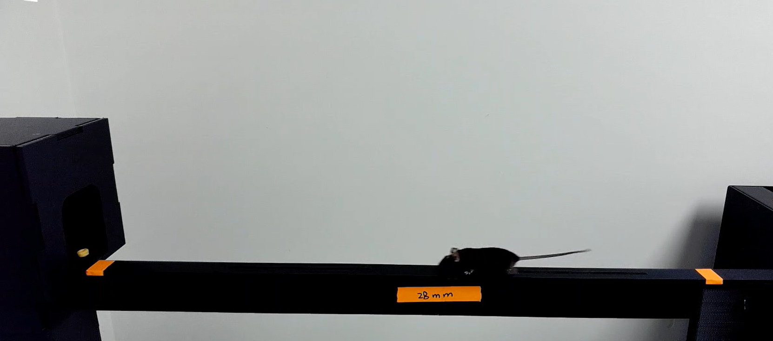
Carter’s Beam Walk
Assess motor balance and coordination
Different beam width: 28mm, 12mm, 6mm, and 3mm (rod)
Performance is quantified by measuring the time it takes for the mouse to traverse the beam and the number of paw slips that occur in the process

Slide 9
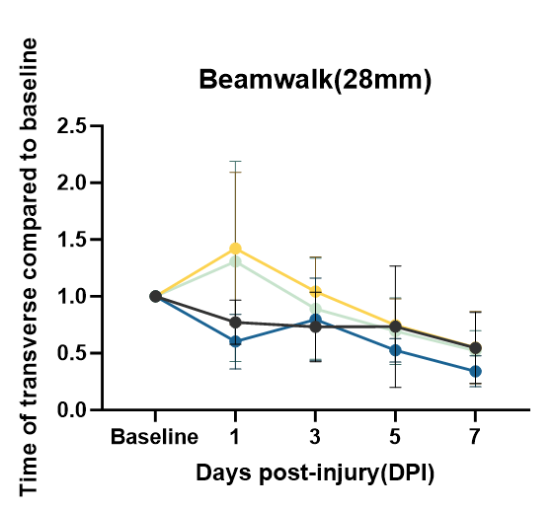
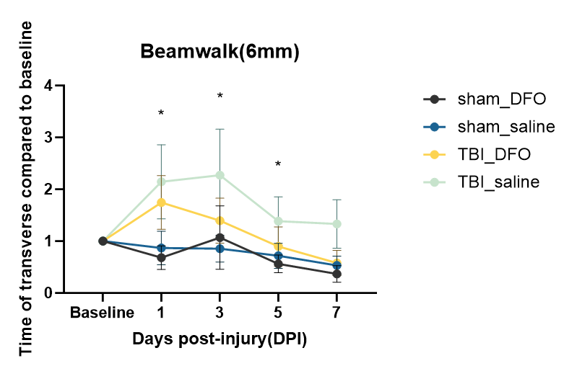
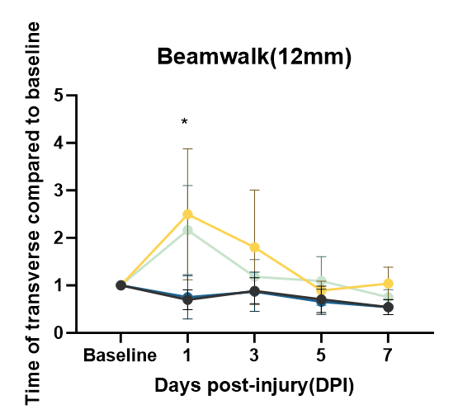

Slide 10
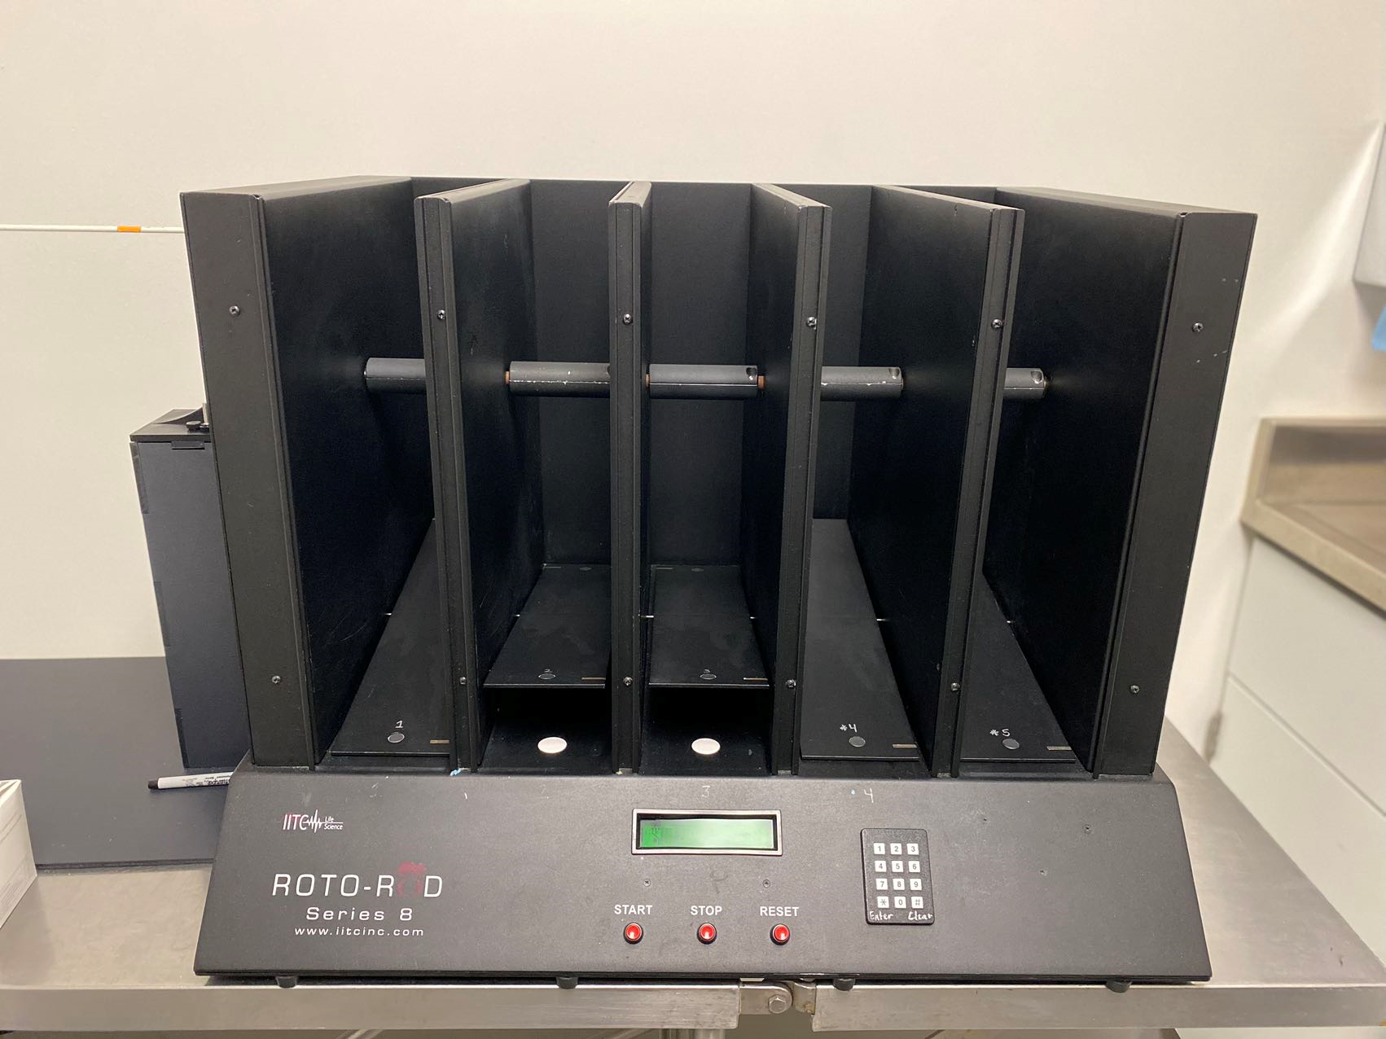
Rotarod Test
Sensitive to motor impairment
Measure motor coordination and motor skill learning
Performance is quantified by the latency to fall from accelerating rotarod

Slide 11
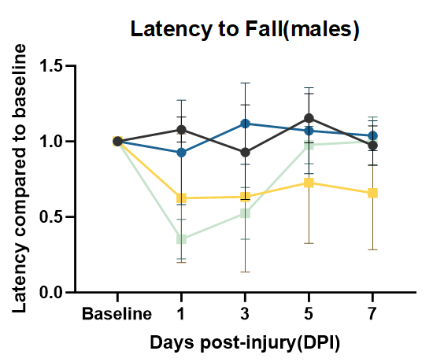
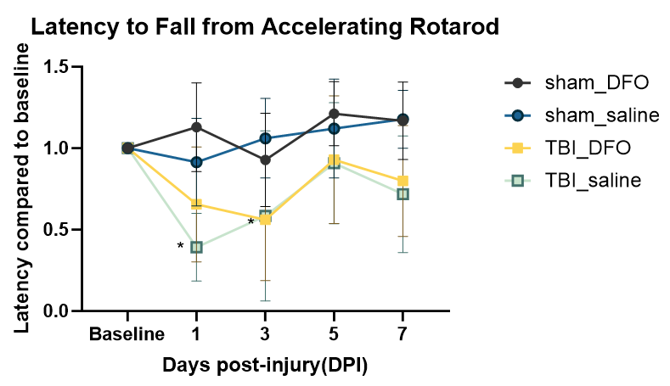
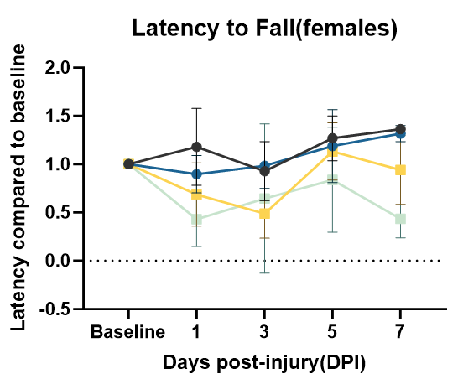

Slide 12
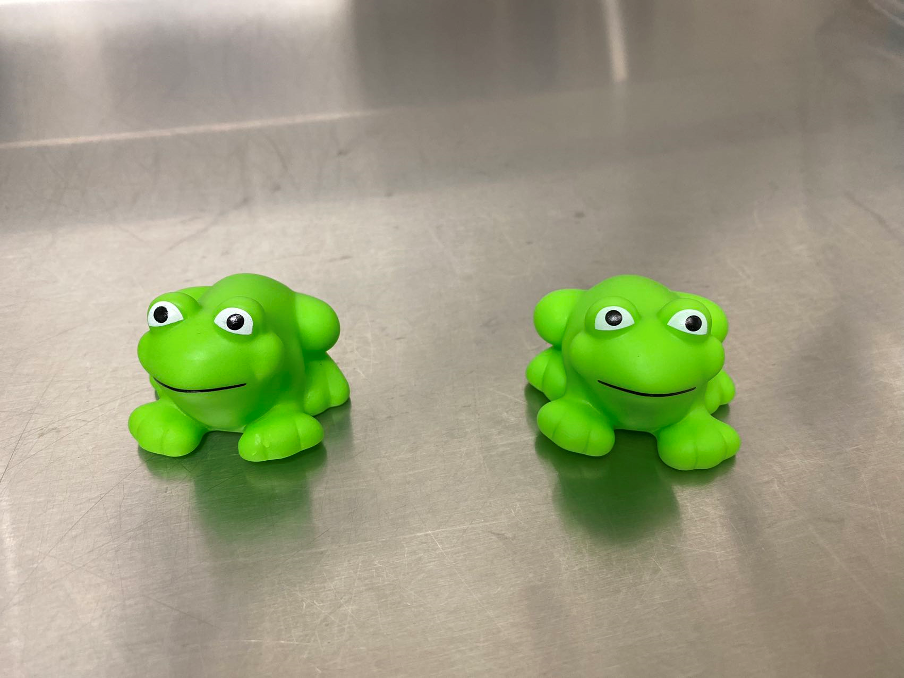
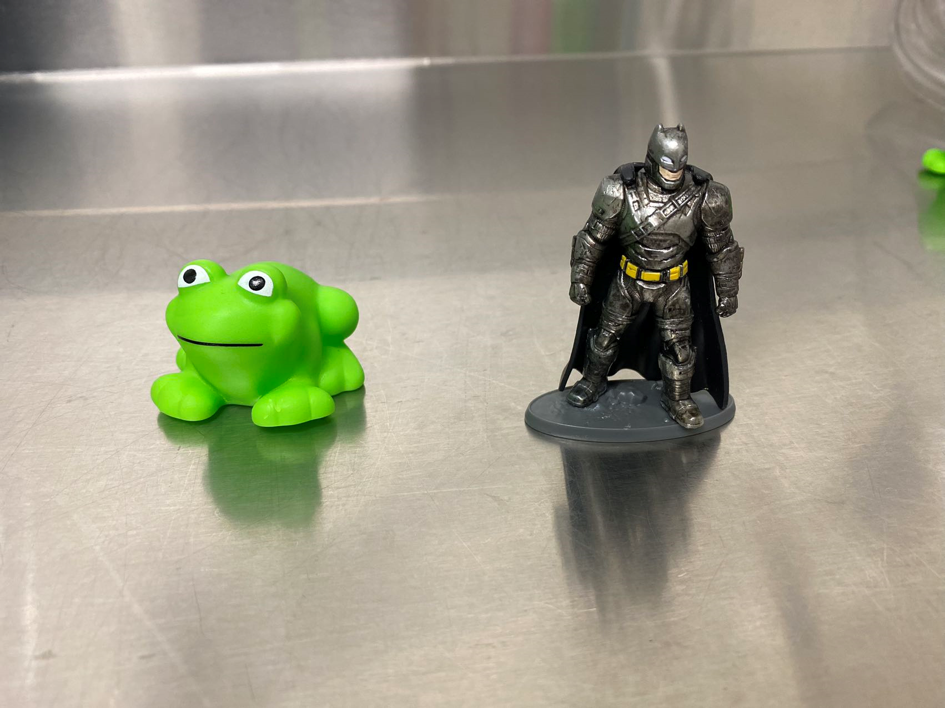
Novel object recognition test
Test short-term memory
Training phase (2 identical objects) + 90 mins interval + Testing phase (1 familiar object and 1 novel object)
Discrimination index (DI) = (time spend with novel object-with familiar object)/total time of interaction

Slide 13
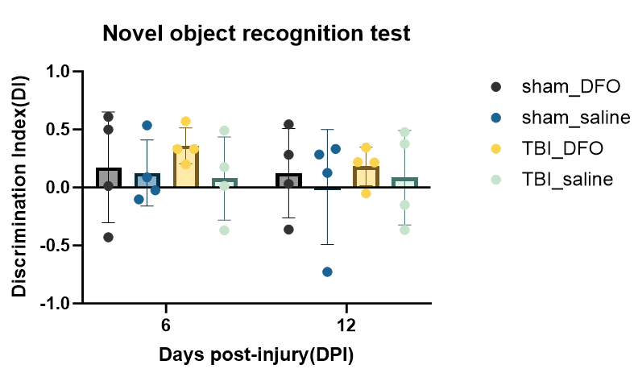
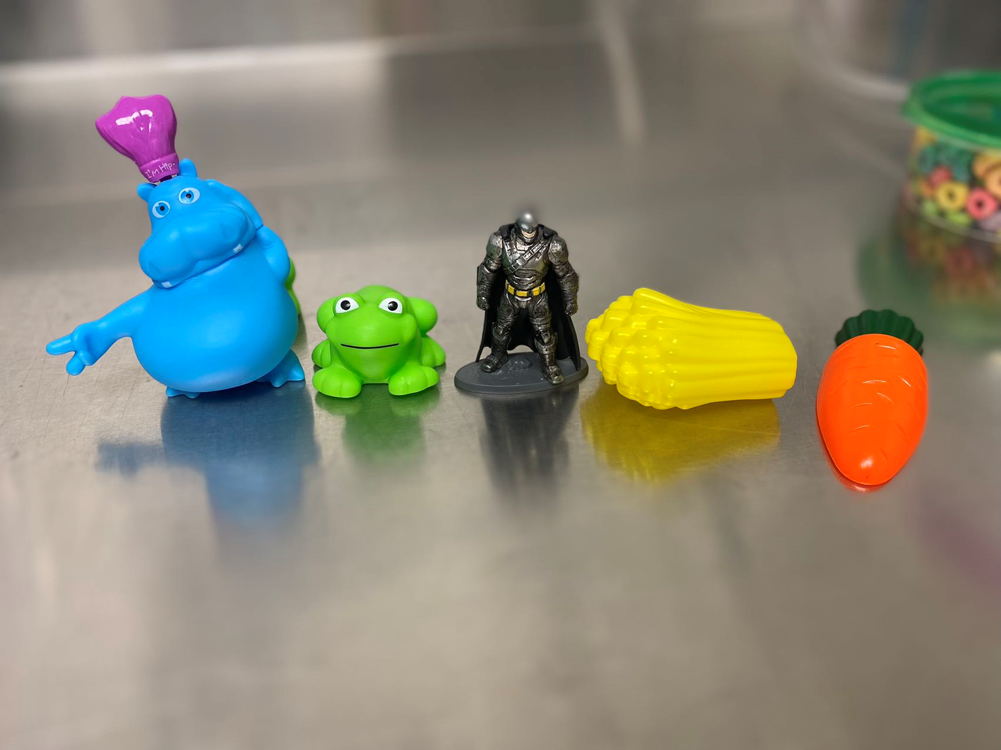

Slide 14
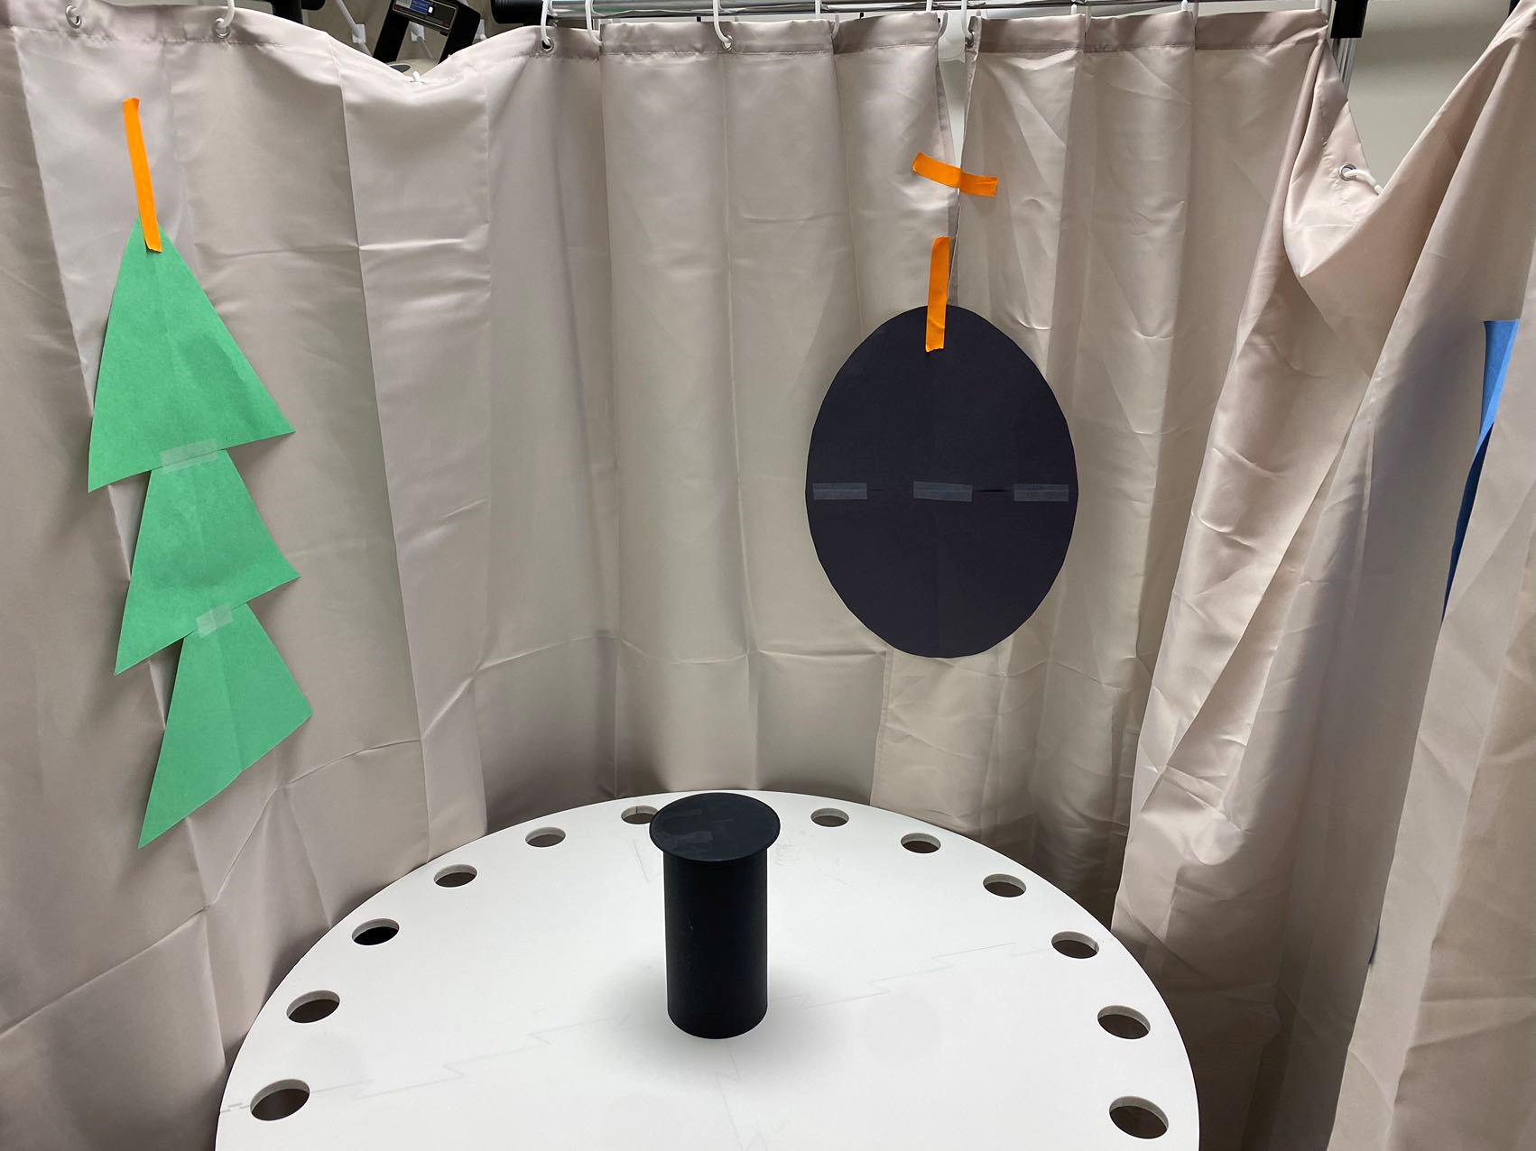
Barnes Maze
Access spatial memory
Circular surface with 20 equally spaced holes and an escape tunnel underneath one hole
Mice are trained for 4 days to associate the visual cues with the location of the escape tunnel
On the fifth day, mice are given 5 mins to escape from the maze

Slide 15
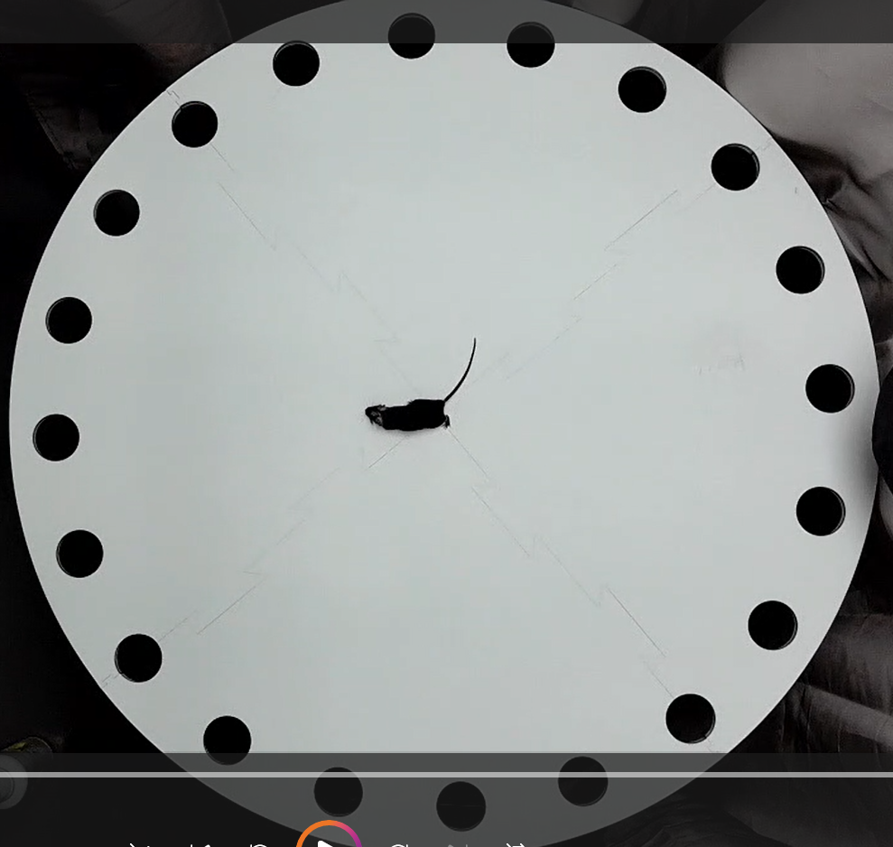
Barnes Maze
The time of recognizing the escape hole
The time of the actual escape
Success rate:
  1=successfully escape the maze in 5 mins
  0=not successful

Slide 16
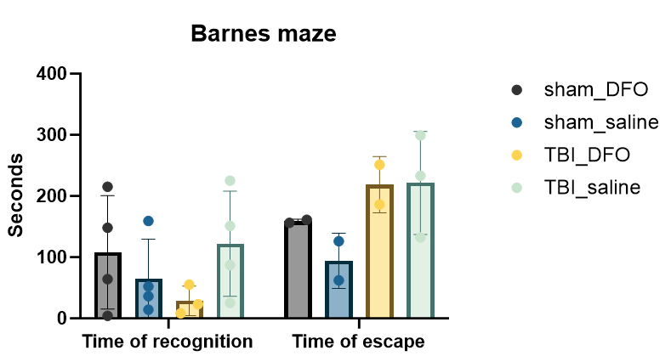
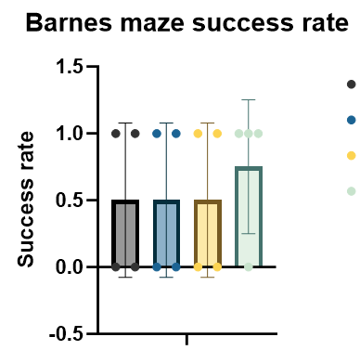

Slide 17
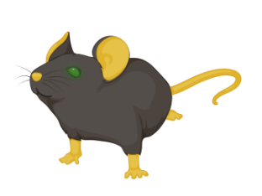
Blood-brain barrier NaFl Permeability Assay
Quantify blood-brain barrier (BBB) permeability at the cortex
Sodium fluorescein (NaFl) cannot cross an intact BBB
Mice are injected with NaFl dye 45 mins before perfusion
The cortex is separated from other CNS tissues (brainstem, cerebellum, etc)
Tissues are harvested and processed
Permeability index (PI) is determined based on fluorescein intensity per gram of weight tissue relative to serum fluorescein level

Slide 18
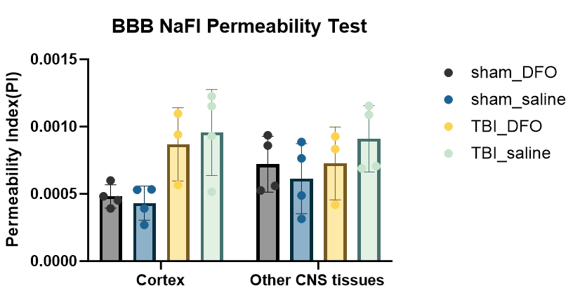
We have tissues from 30 mice, but are only able to perform this test on 15 mice from DPI3 cohort

Slide 19
Further studies
To analyze Carter’s BW number of paw slips
To perform NaFl BBB permeability assay with tissue obtained form the 7 DPI cohort
To perform Western blot against HIF-1α and BBB-related proteins with the tissue lysate from the 3 and 7 DPI cohorts
To follow-up with the long-term cohort

Slide 20
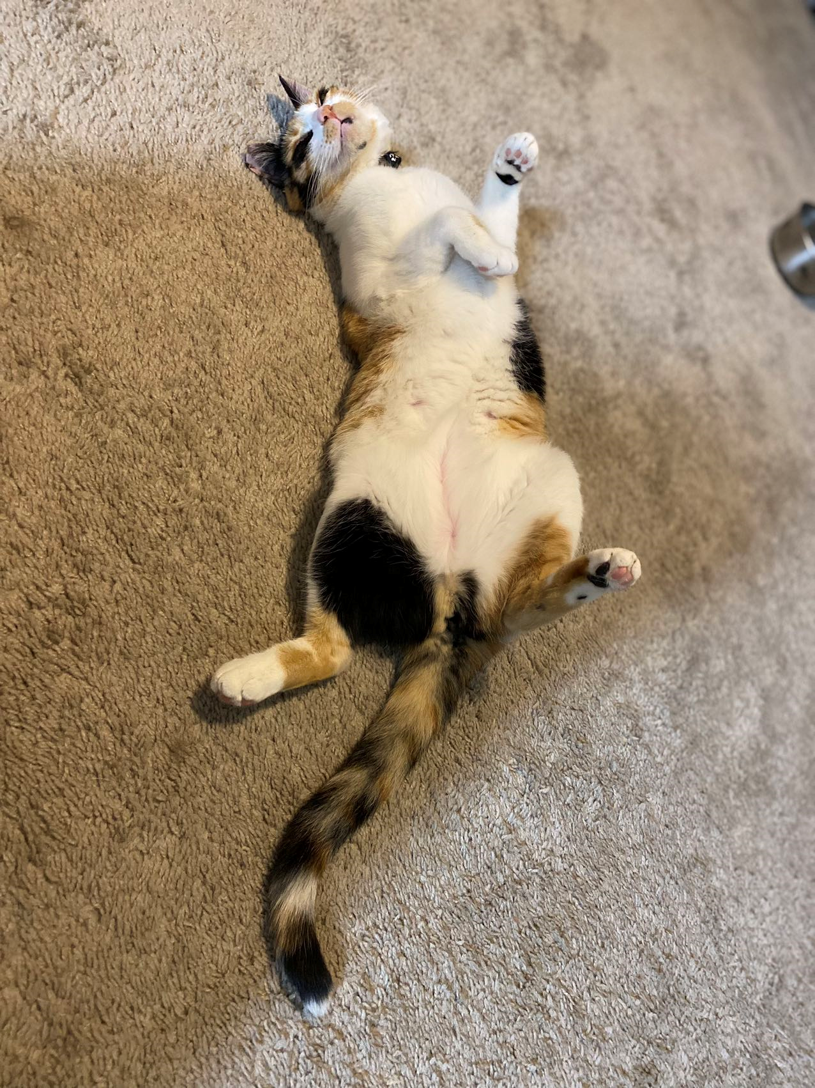
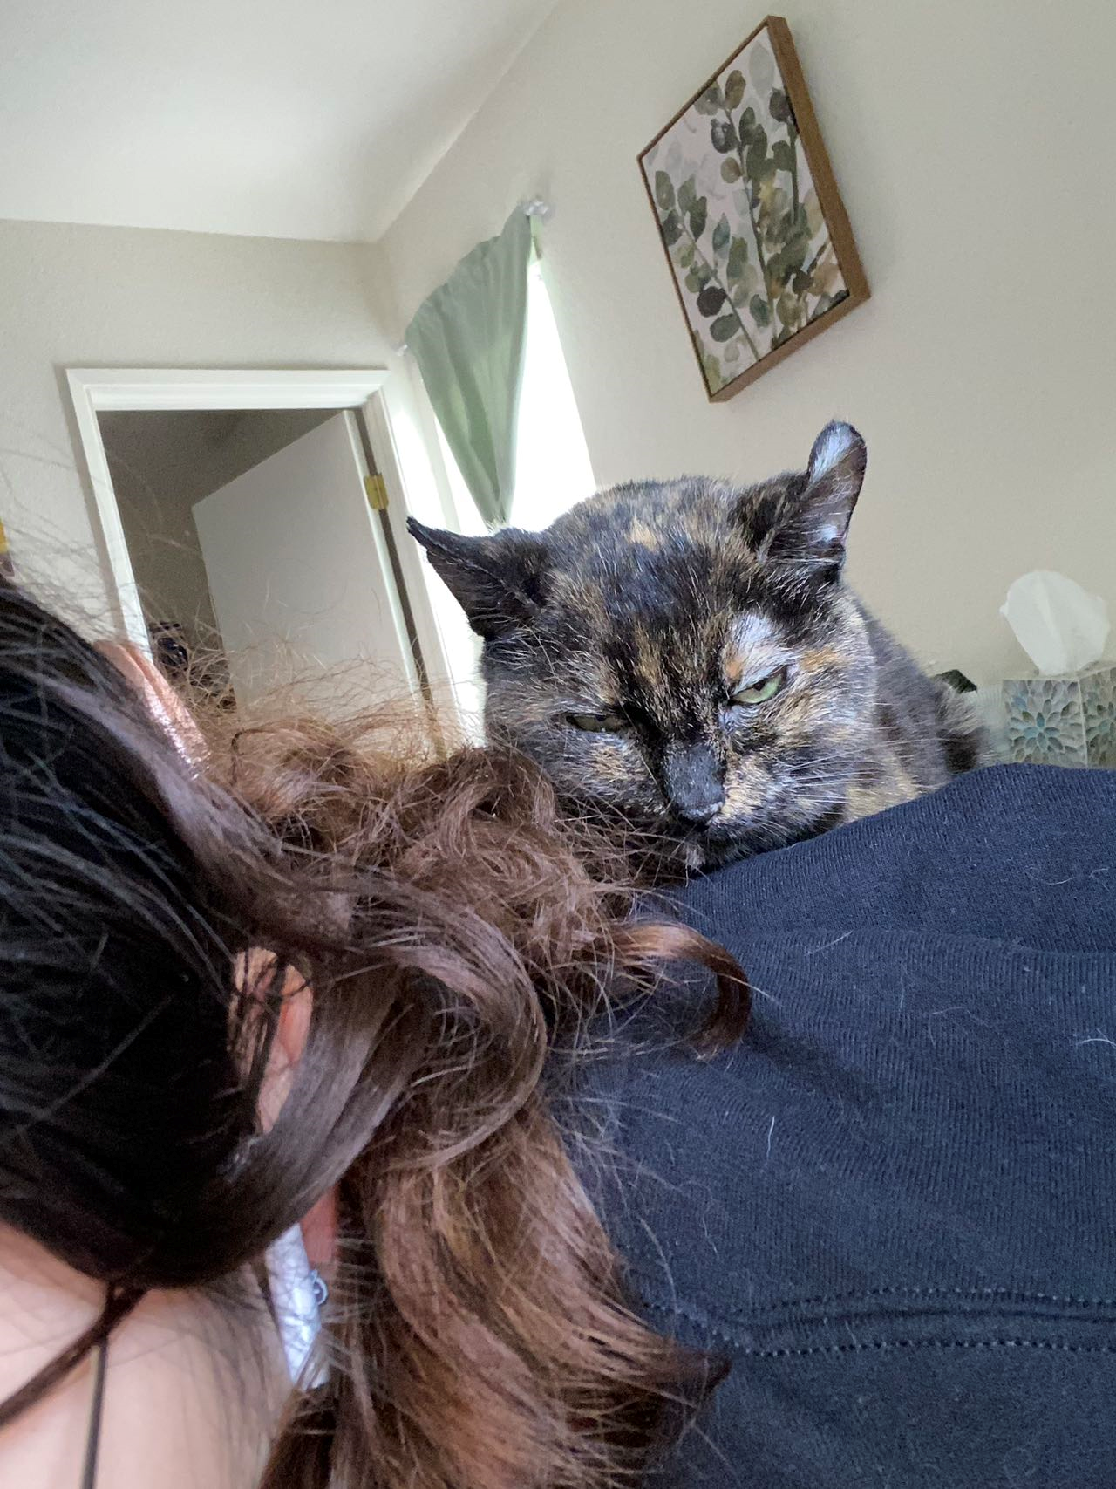
Acknowledgments
Research Grant: This research was supported by Dr. Lillian Cruz-Orengo SVM PI Bridge Funds and Dr. Jorge Contreras SOM Start-up funds.
Student Support: Boehringer Ingelheim Veterinary Scholars Program
This project would not have been possible without Jacquelyn Dayton, Katherine Kim, Peng Fei Dong, and Valerie Navidad’s assistance with the surgical procedure, tissue processing, and molecular assay

Slide 21
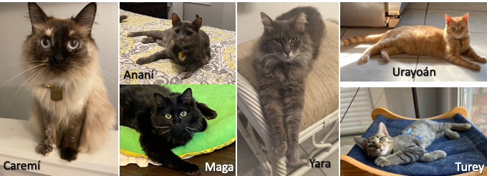
Lillian’s fur babies

Slide 22
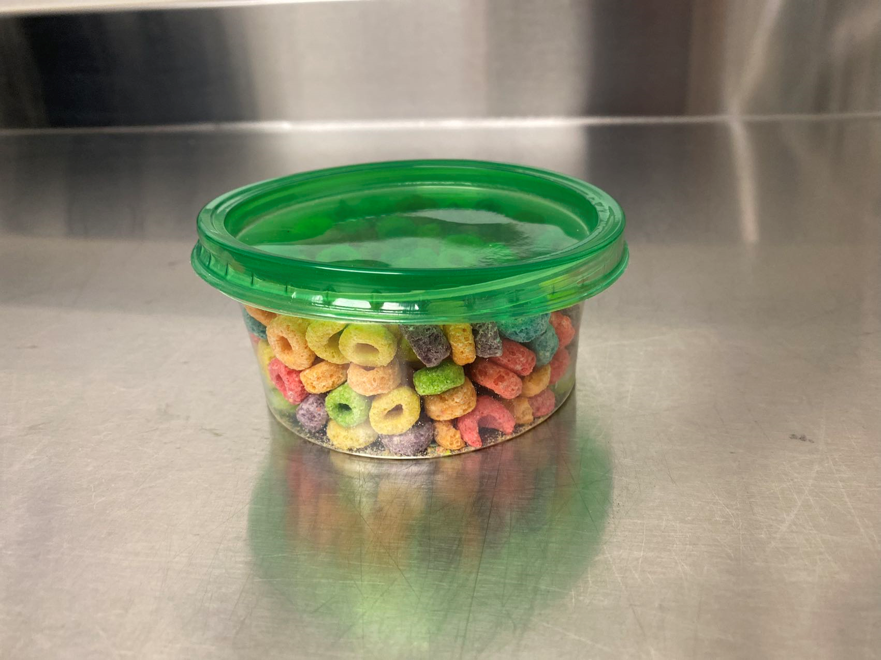
Thank you !

Slide 23
Reference
He, Q., Ma, Y., Liu, J., Zhang, D., Ren, J., Zhao, R., Chang, J., Guo, Z.-N., & Yang, Y. (2021). Biological functions and regulatory mechanisms of hypoxia-inducible factor-1α in ischemic stroke. Frontiers in Immunology, 12. https://doi.org/10.3389/fimmu.2021.801985
Kosyakovsky, J., Fine, J., Frey, W., & Hanson, L. (2021). Mechanisms of intranasal deferoxamine in neurodegenerative and neurovascular disease. Pharmaceuticals, 14(2), 95. https://doi.org/10.3390/ph14020095
Luong, T. N., Carlisle, H. J., Southwell, A., & Patterson, P. H. (2011). Assessment of Motor Balance and coordination in mice using the balance beam. Journal of Visualized Experiments, (49). https://doi.org/10.3791/2376-v

