Slide 1

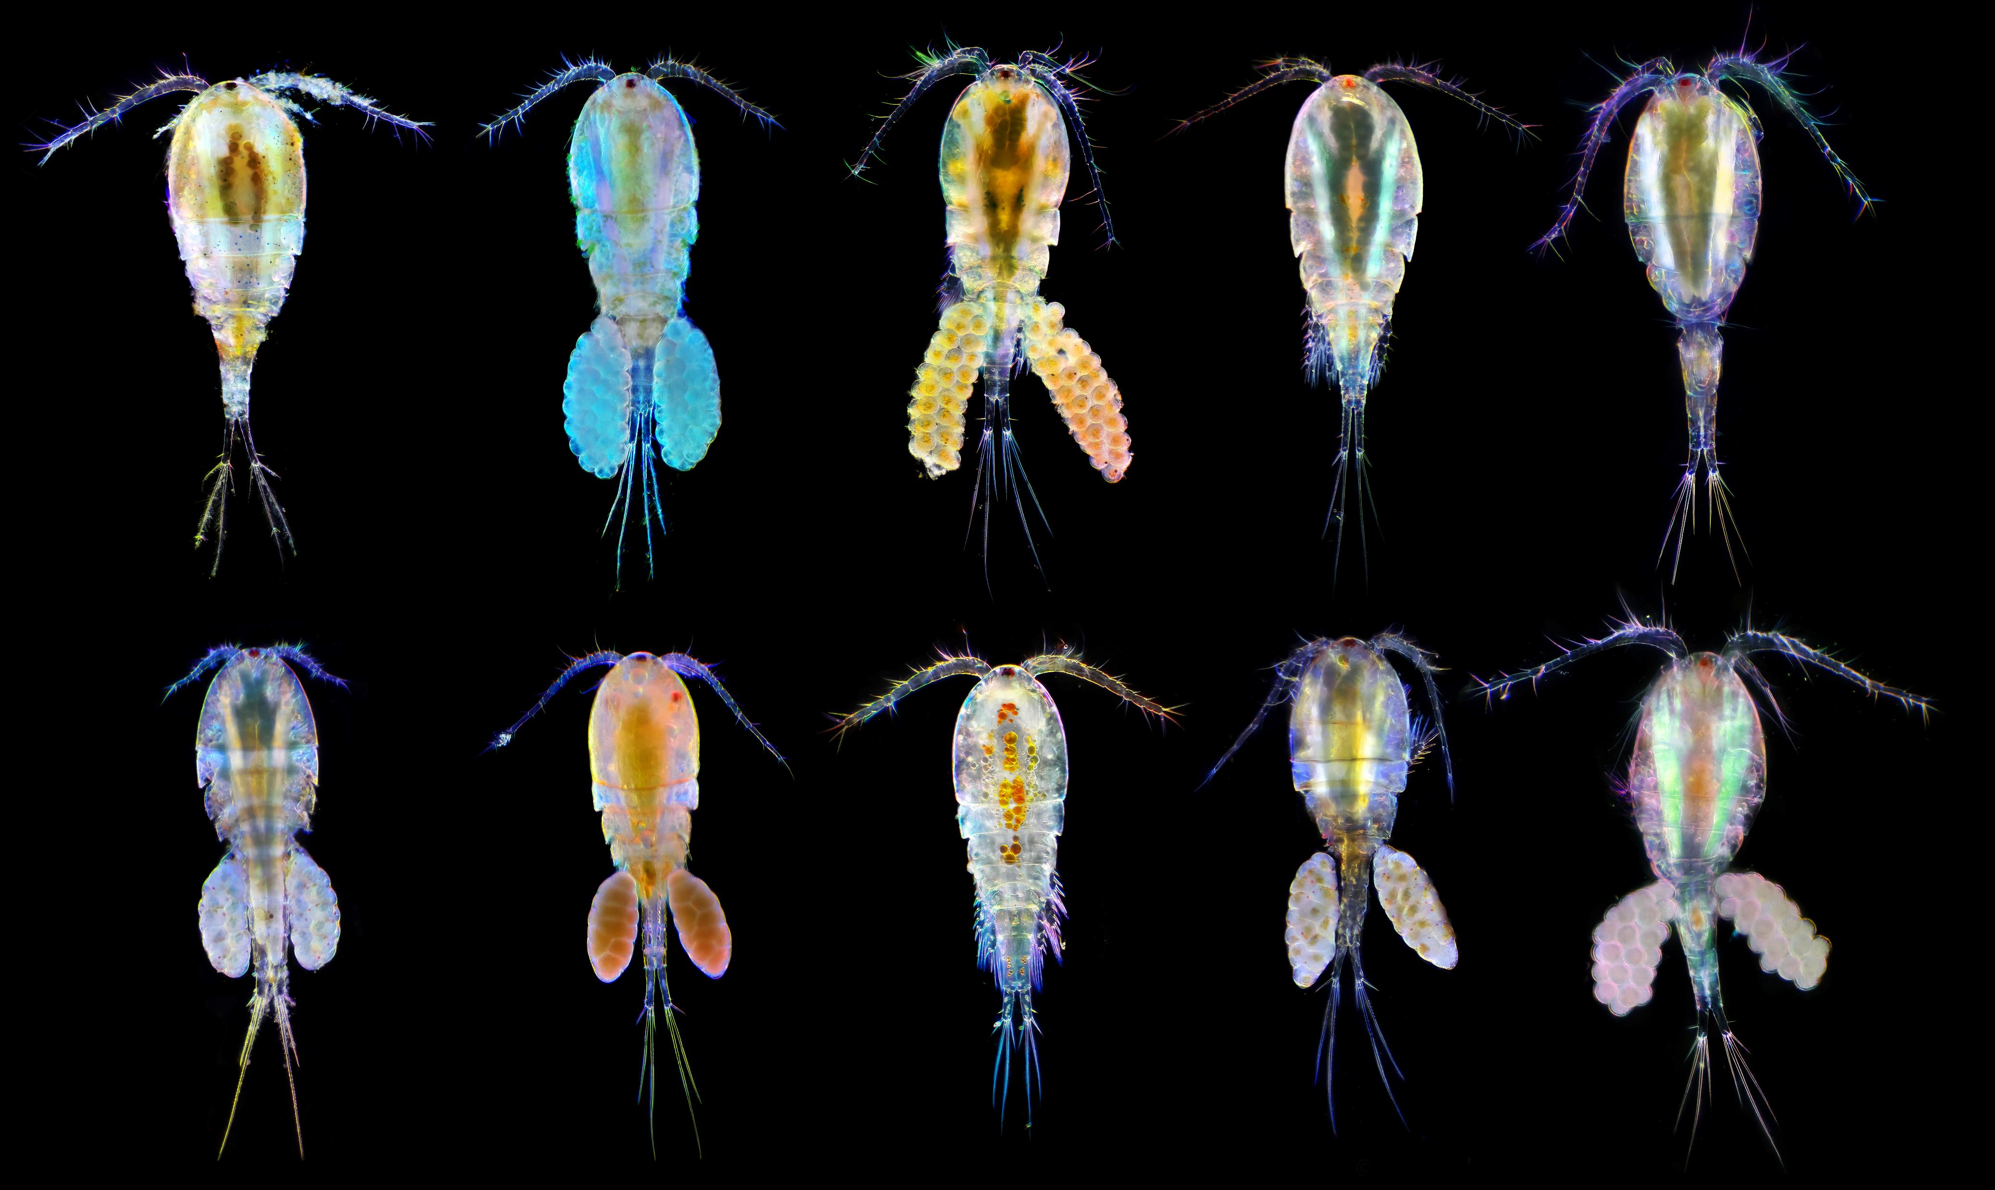
Sensitivity of Eurytemora affinis and Pseudodiaptomus forbesi to bifenthrin, chlorpyrifos, and copper
Yafen Zhen, Tomofumi Kurobe, Ching Teh, and Swee Teh
By Andrei Savitsky - Own work, CC BY-SA 4.0,
https://commons.wikimedia.org/w/index.php?curid=78800127

Slide 2
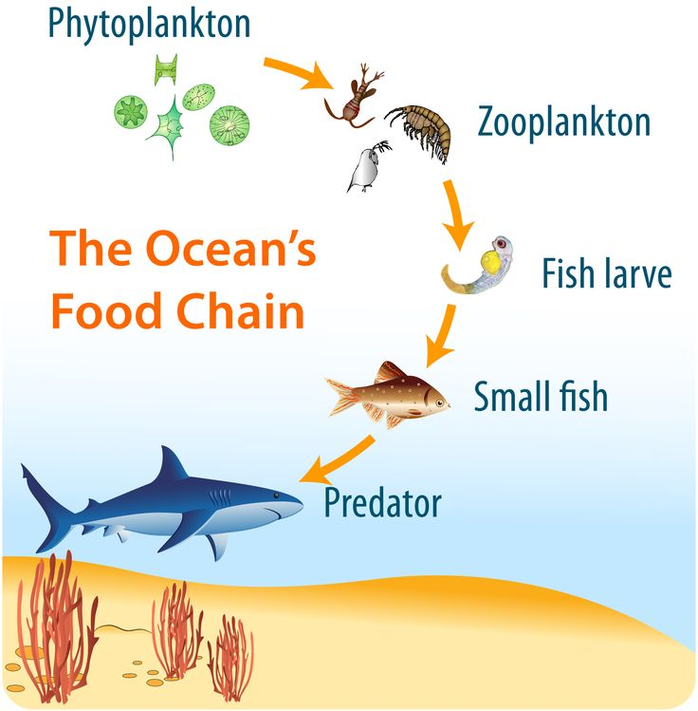
Eurytemora affinis and Pseudodiaptomus forbesi
  Dominant copepods in the Sacramento-San Joaquin Delta
  Crucial link between phytoplanktons (algae) and fish
  Primary food source for pelagic fish
  Unprecedented population decline
https://www.pinterest.com/erinsgarden2/edu-science-wonder/

Slide 3


Urban development
Waste Water treatment plant
Personal care & pharmaceutical products, plastic debris, ammonia, etc..
Pesticide, fertilizer
Landfill
Agriculture
Plastic debris, metals, chemicals
Hormones, antibiotics, nutrients
Animal Feedlot
Cyanobacteria & harmful Algal blooms

Slide 4
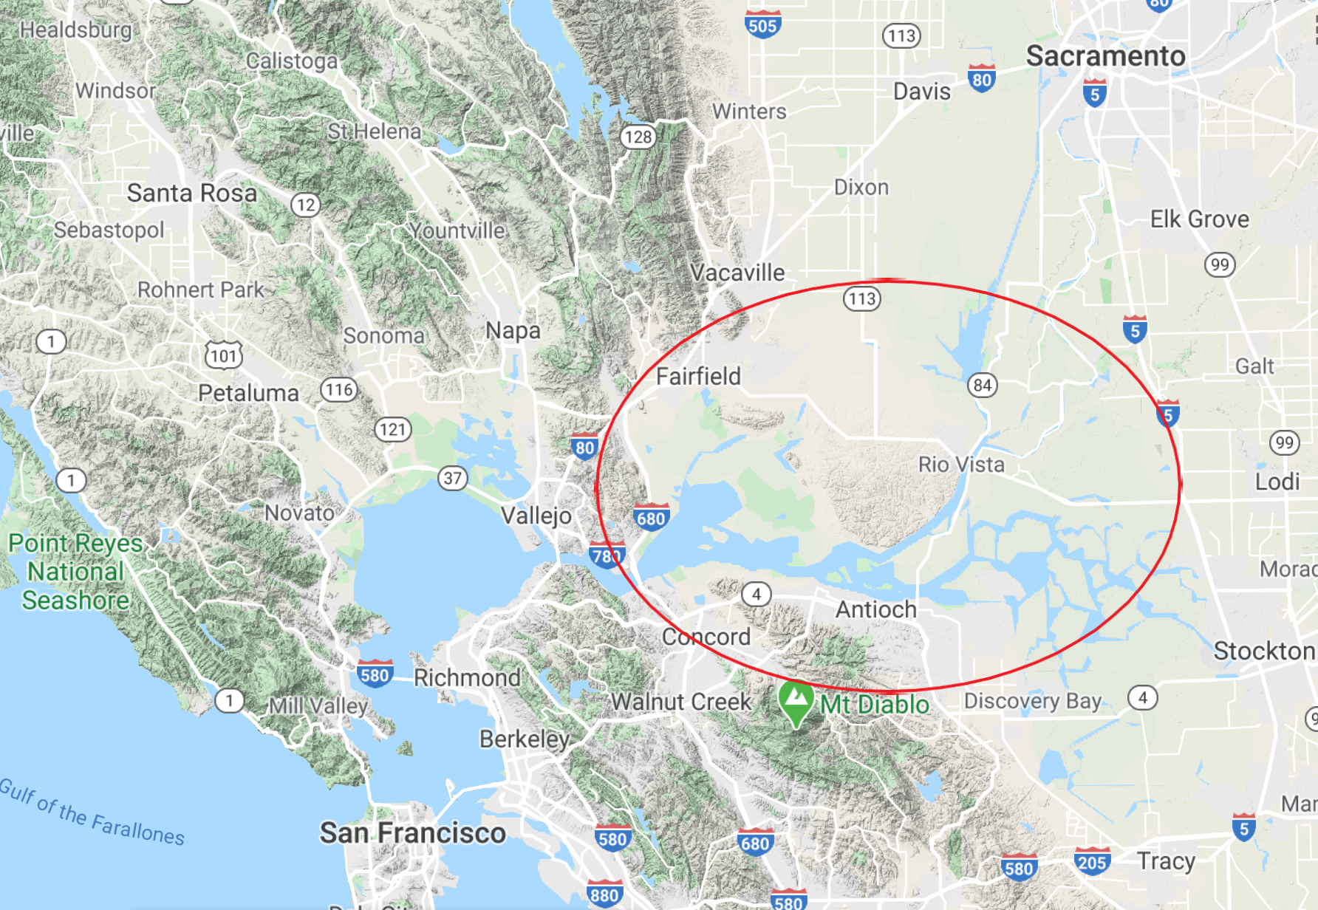
Pesticide | Class | Sac-San Joaquin Delta
Bifenthrin | Pyrethroid | 1ng/L
Chlorpyrifos | Organophosphate | 14.7ng/L
Copper | Fungicide | 2160-4410ng/L
Maps.google.com

Slide 5
Objectives
Determine LC50 of bifenthrin, chlorpyrifos, and copper using Eurytemora affinis and Pseudodiaptomus forbesi
Compare sensitivity of Eurytemora affinis and Pseudodiaptomus forbesi to bifenthrin, chlorpyrifos, and copper

Slide 6

LC50
The chemical concentration that causes death in 50% of the individuals in a particular test sample
Evaluated using chemical exposure test

Slide 7
Approach to acute toxicity testing
Range finding test
Definitive 96hr exposure test
Generate dose-response curve
Calculate LC50 using LC_logit function in R software

Slide 8
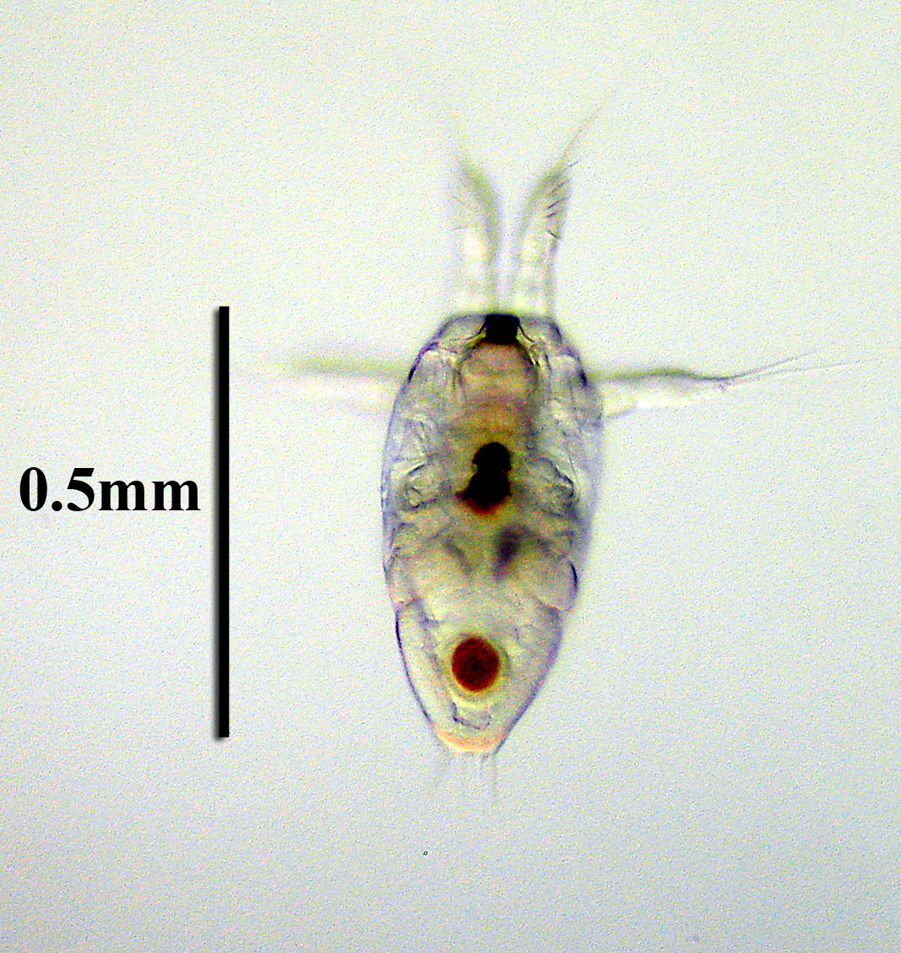
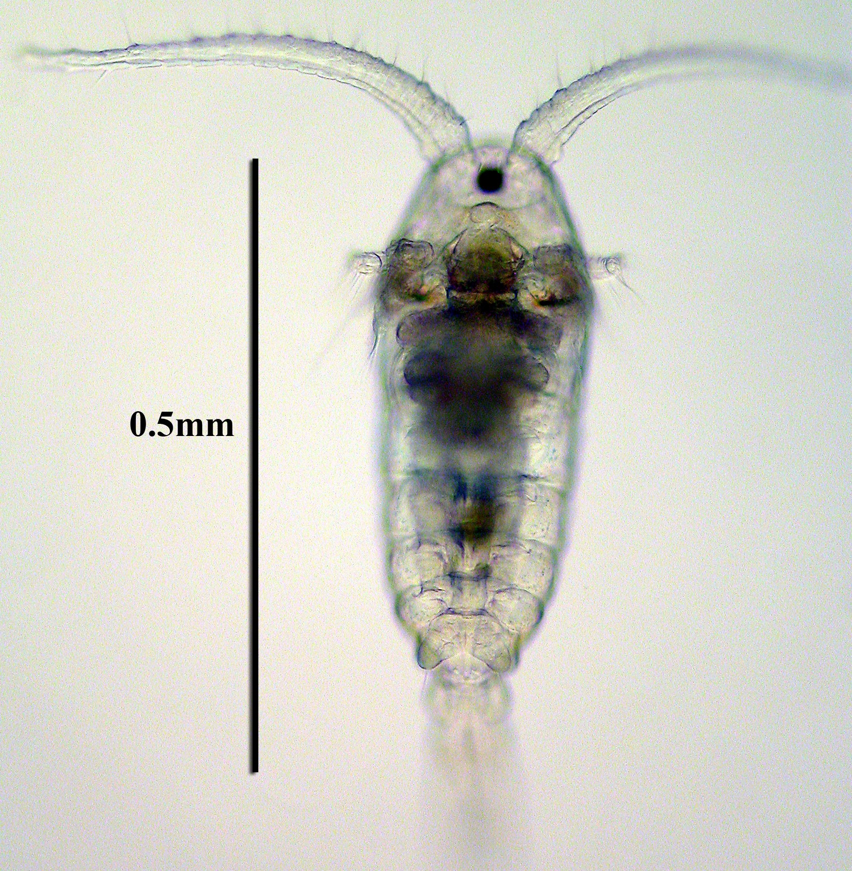
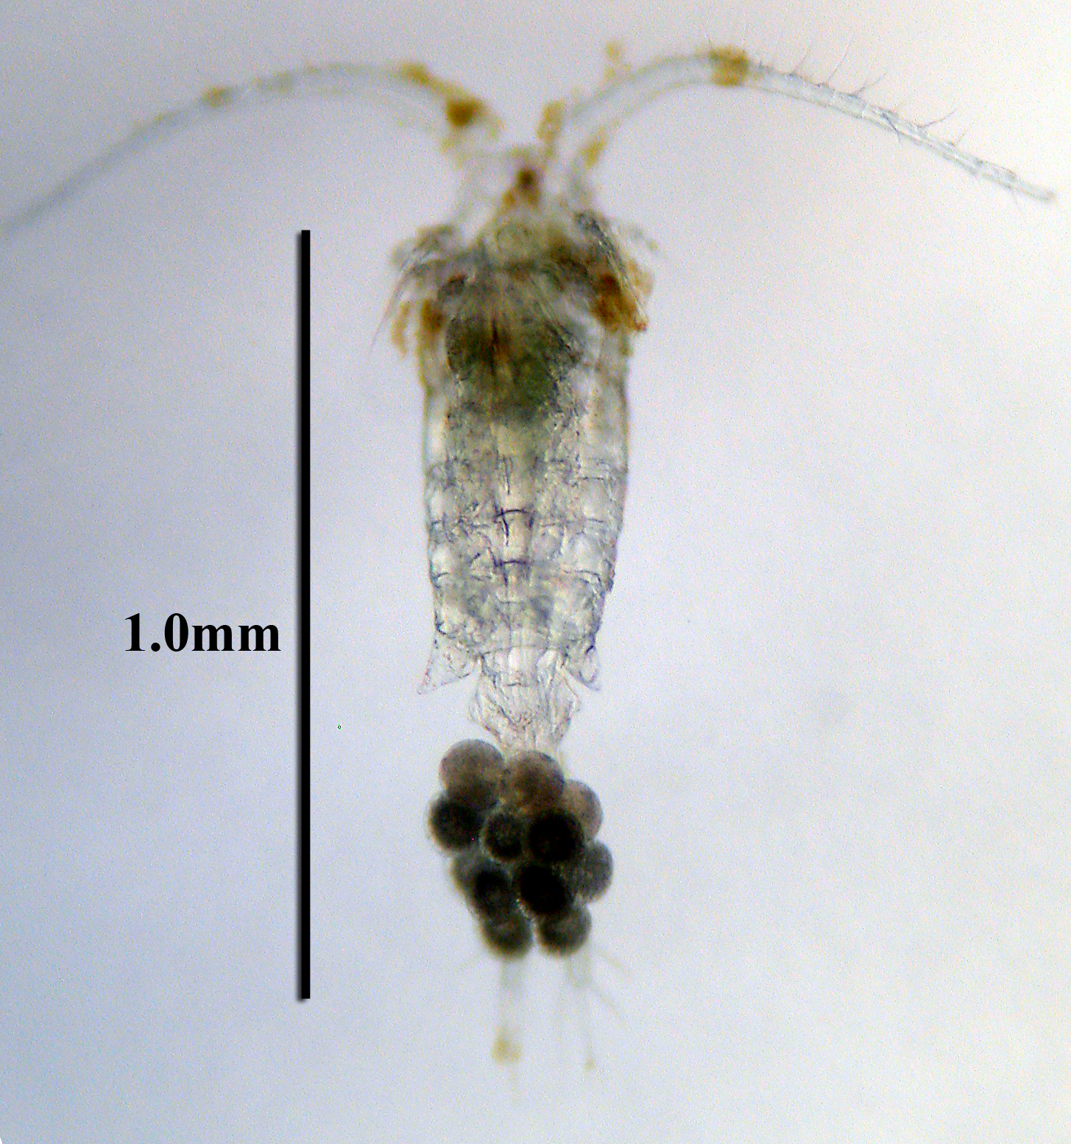
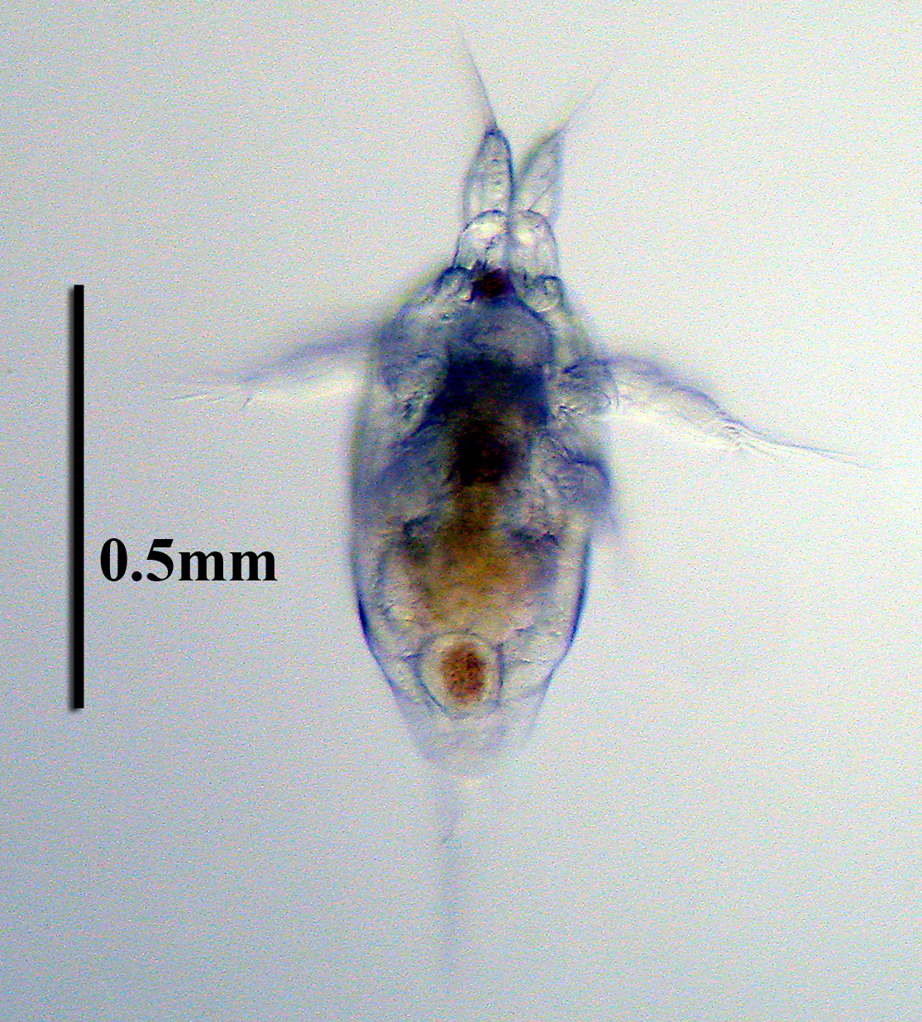
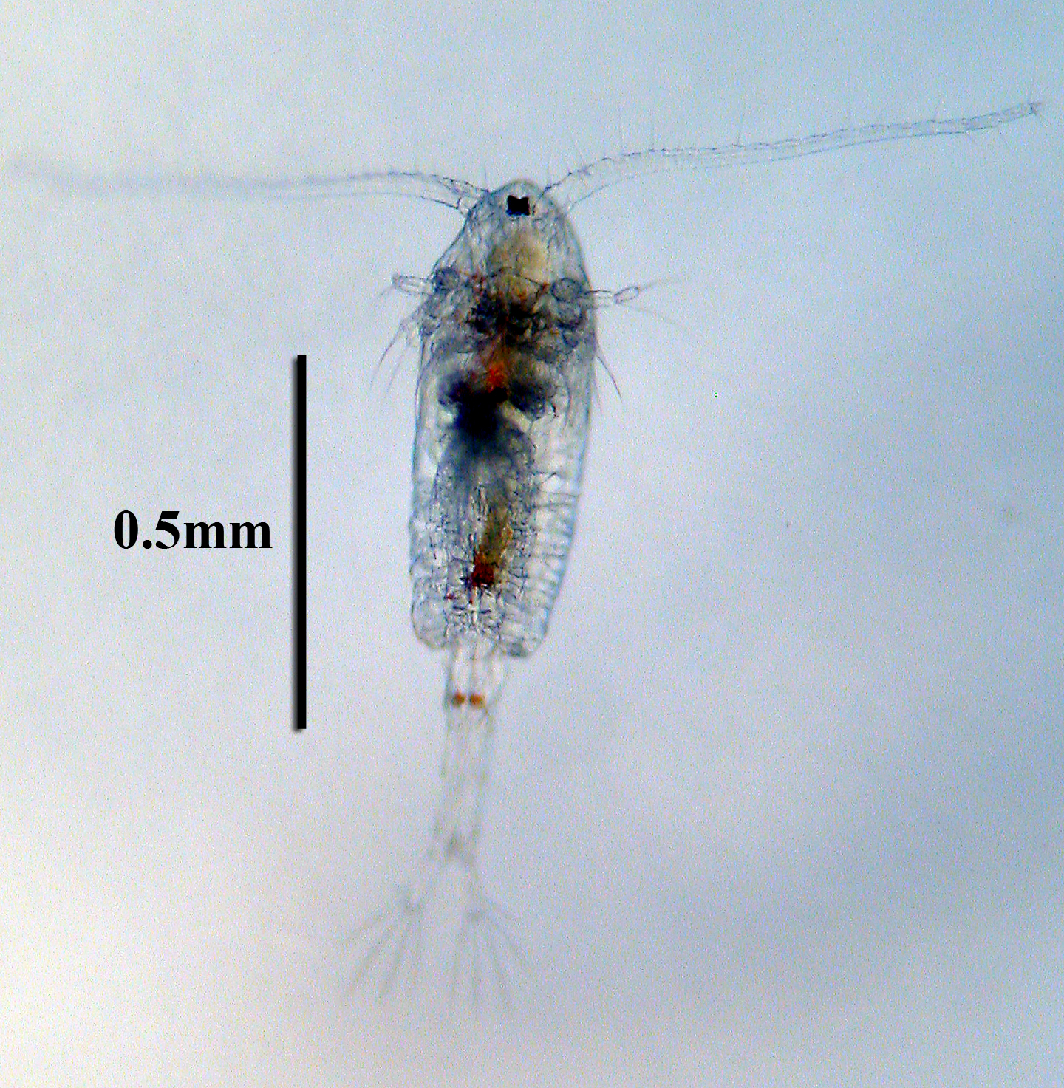
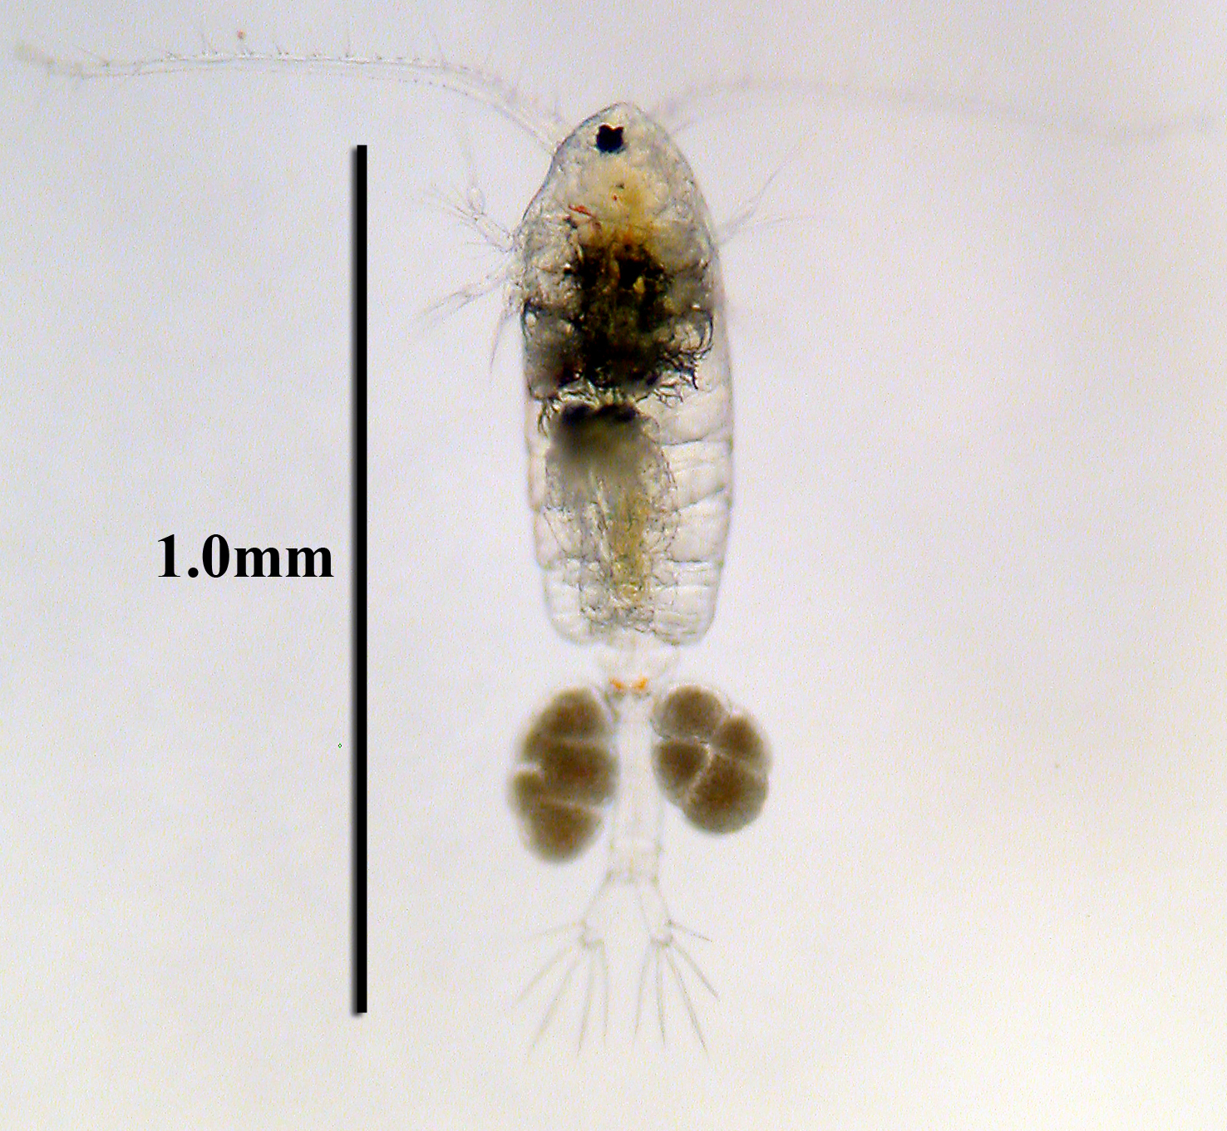
Eurytemora
affinis
nauplius juvenile adult
Pseudodiaptomus forbesi

Slide 9
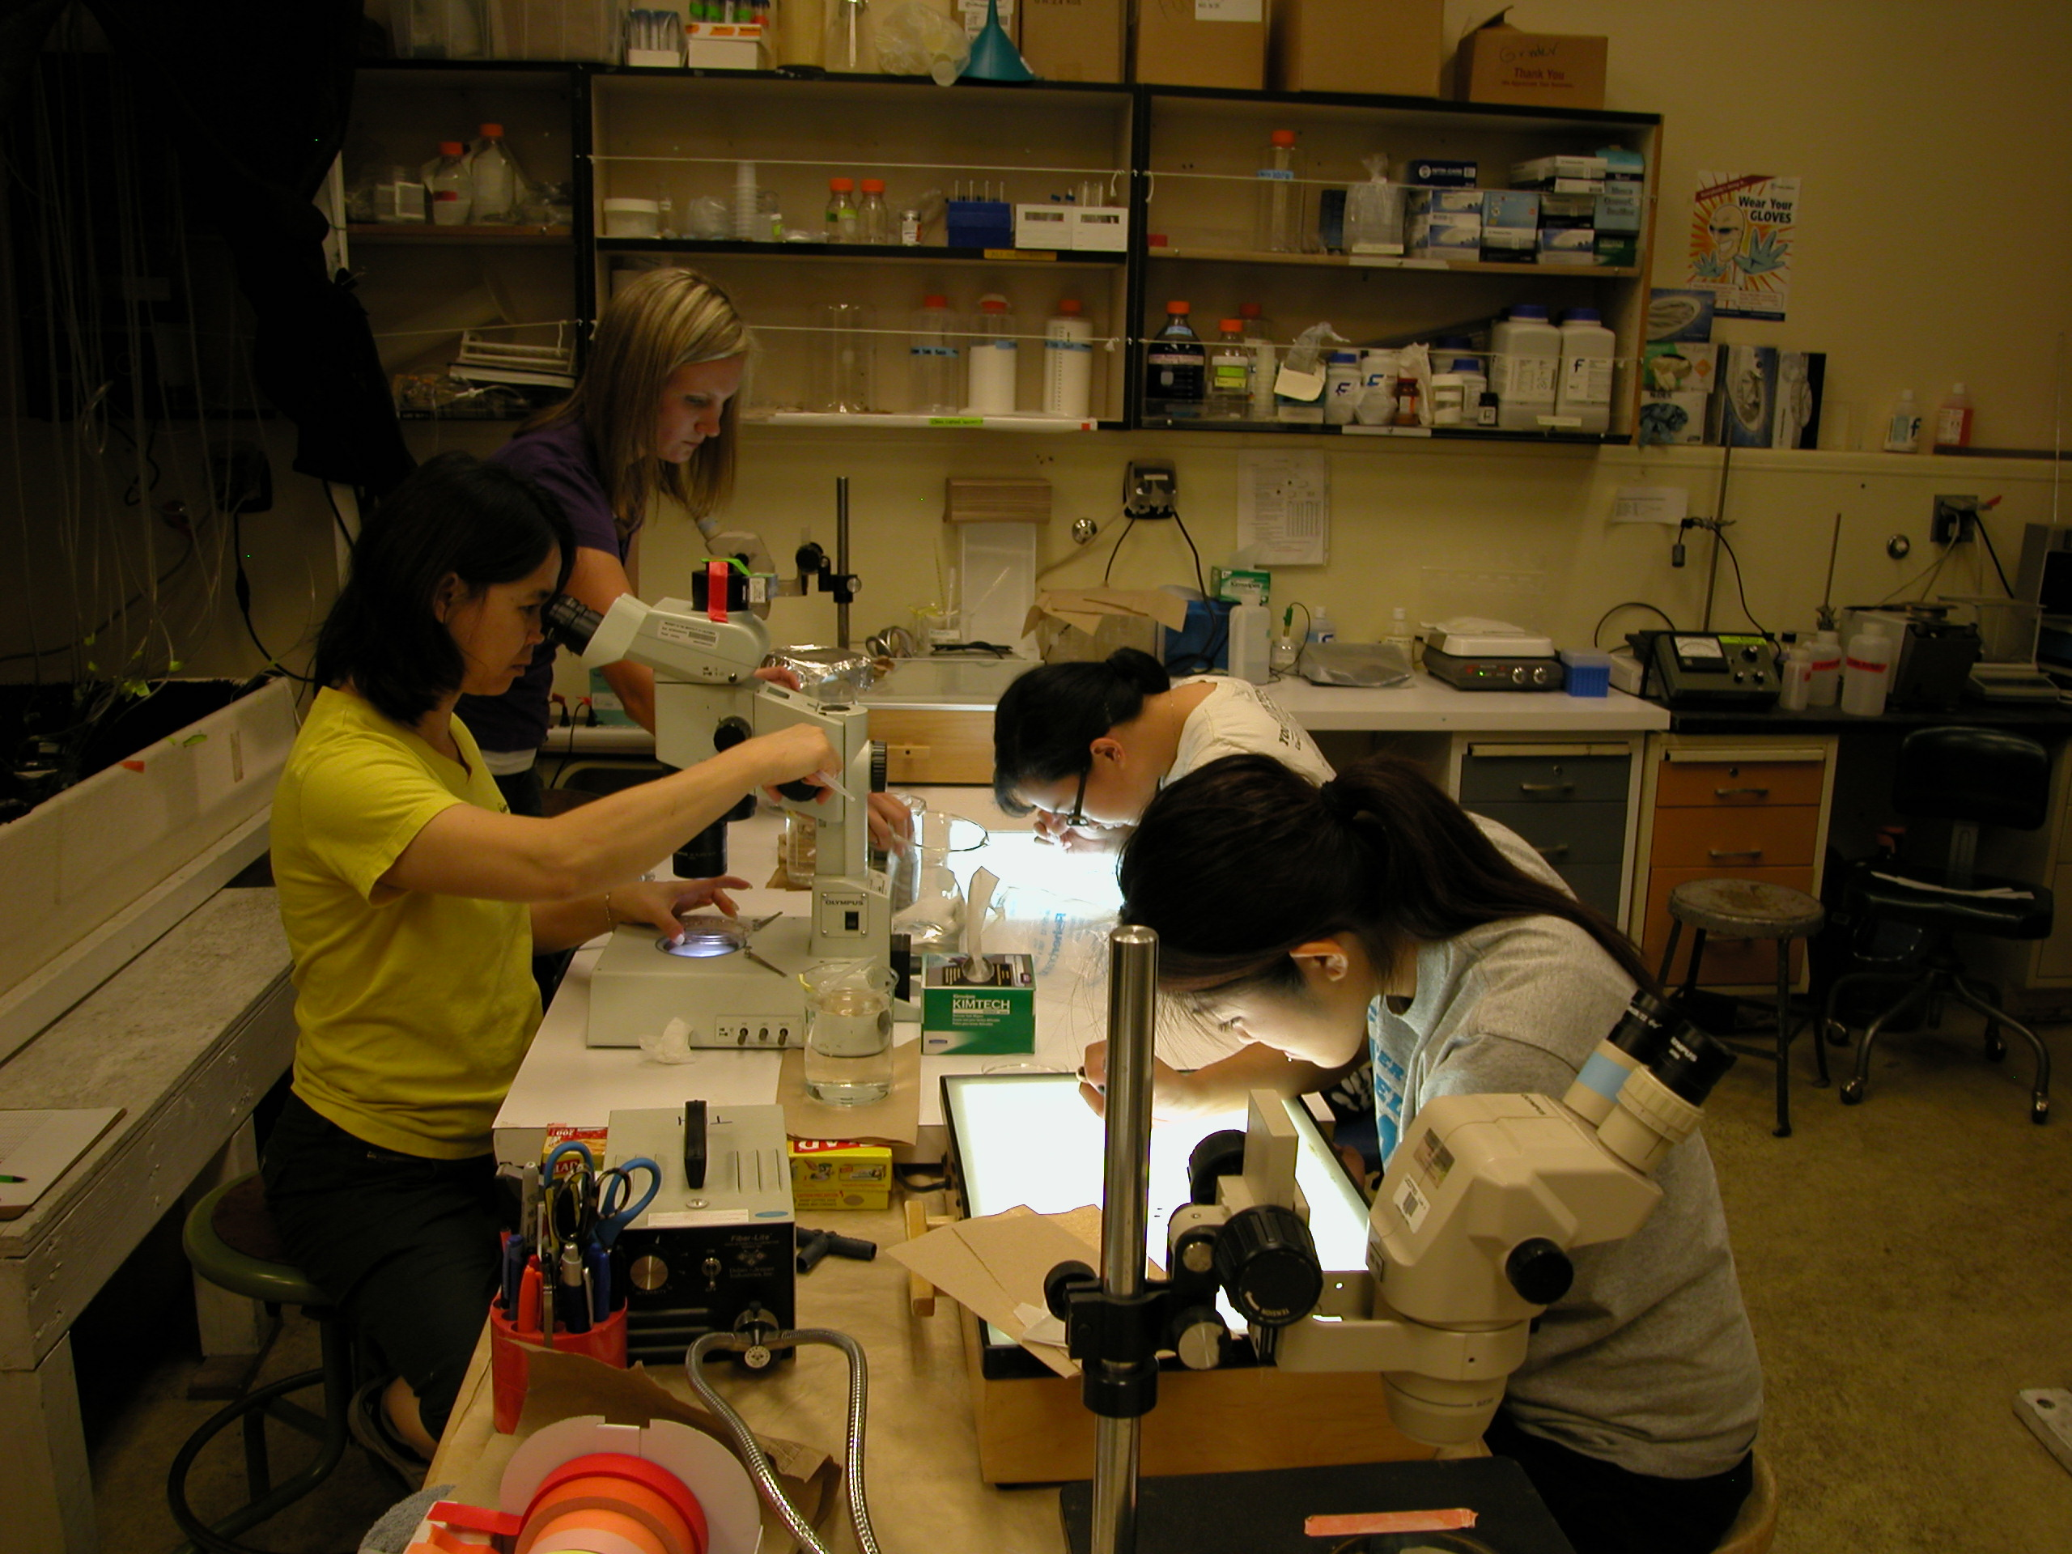
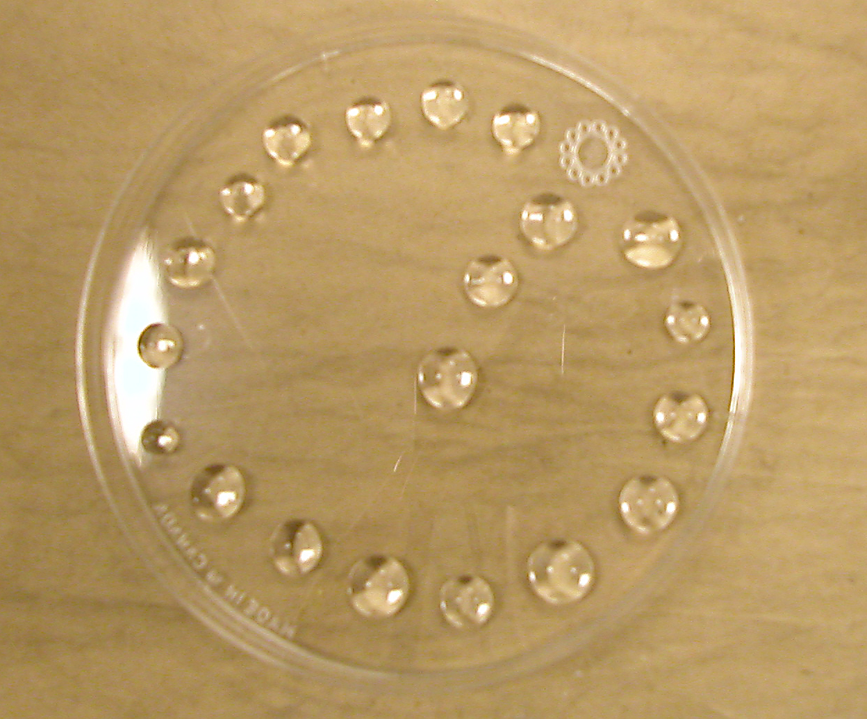
Test Conditions Used for E. affinis and P. forbesi
Temperature (ºC ) | 20±0.1
Salinity (ppt) | 1-2
pH | 8.0±0.1
Acceptability in control survival | >70%
Size of test beaker (mL) | 600
Volume of test solution (mL) | 500
Life stage of copepods | Juvenile
# of copepods | 20
# of replicates per concentration | 3
# of concentrations | 6
Feeding regime | Daily
Static-renewal test Duration | 24-96 h

Slide 10
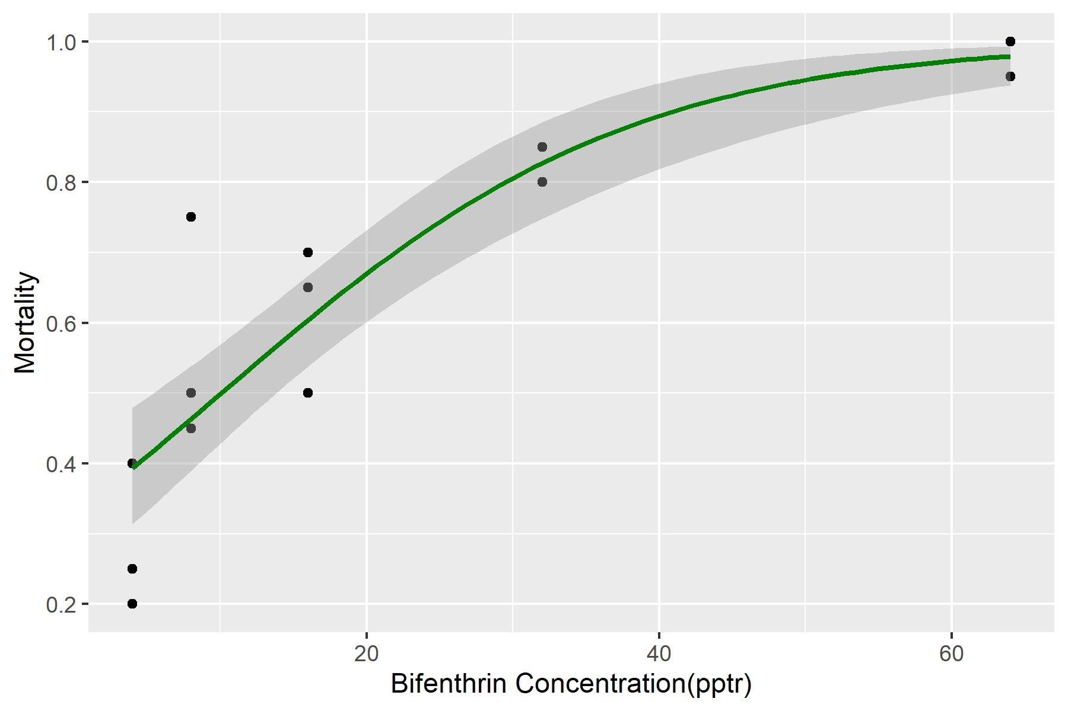
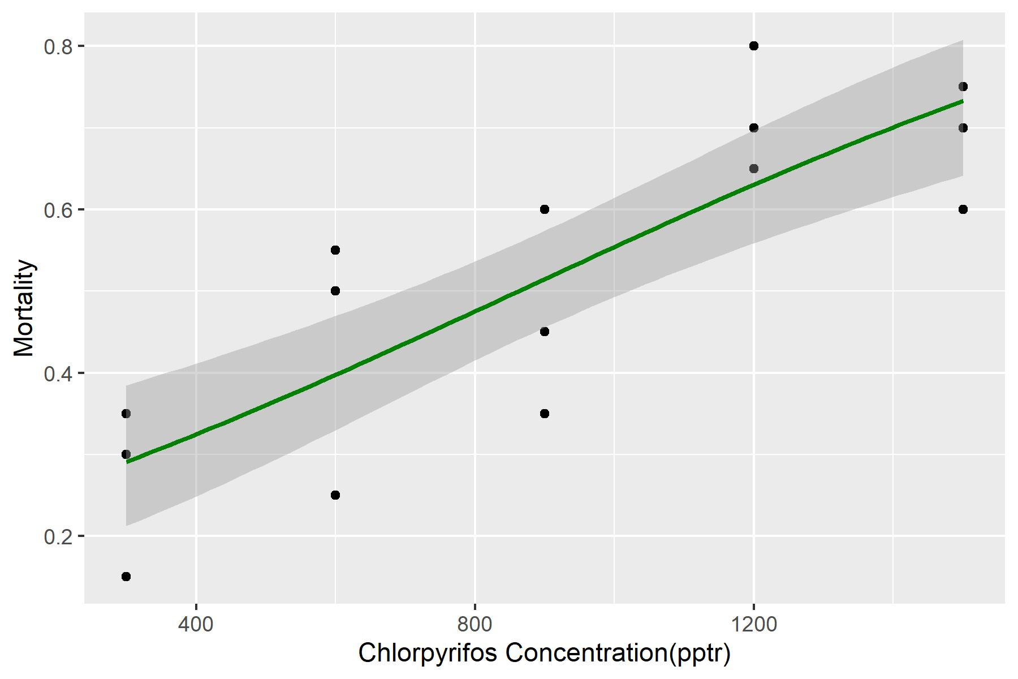
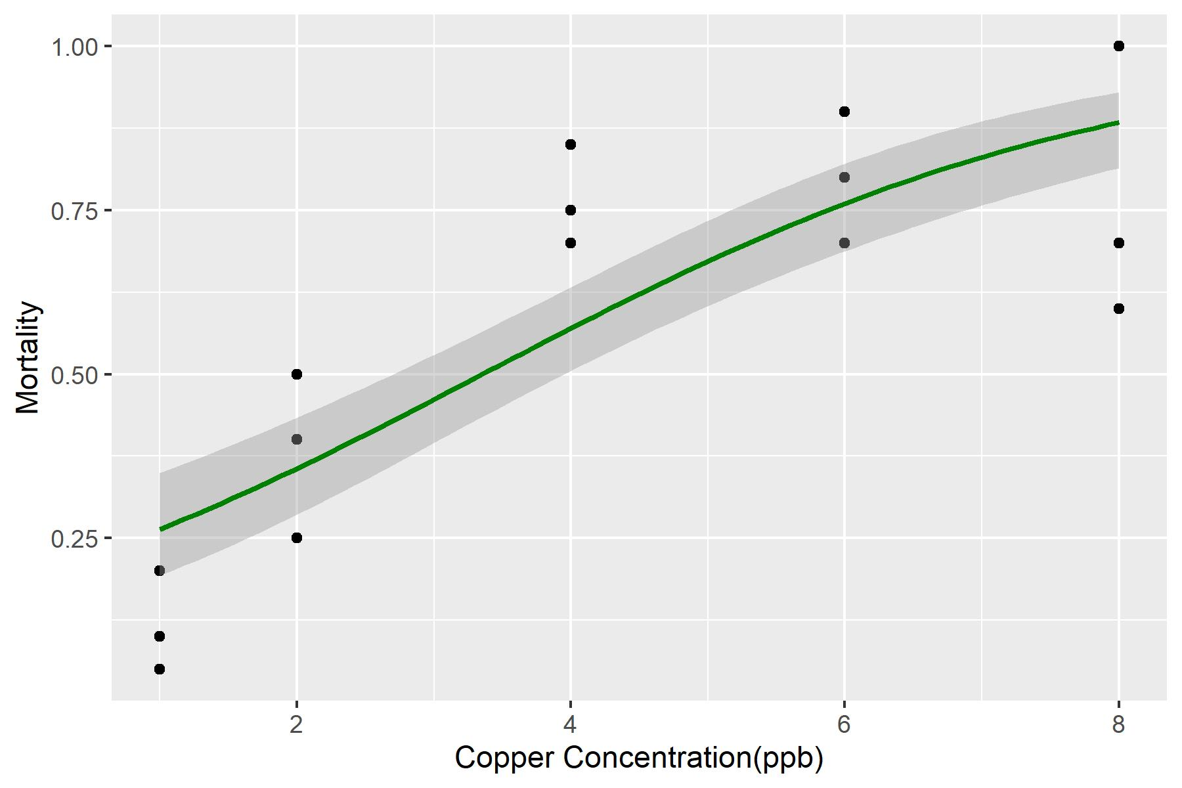
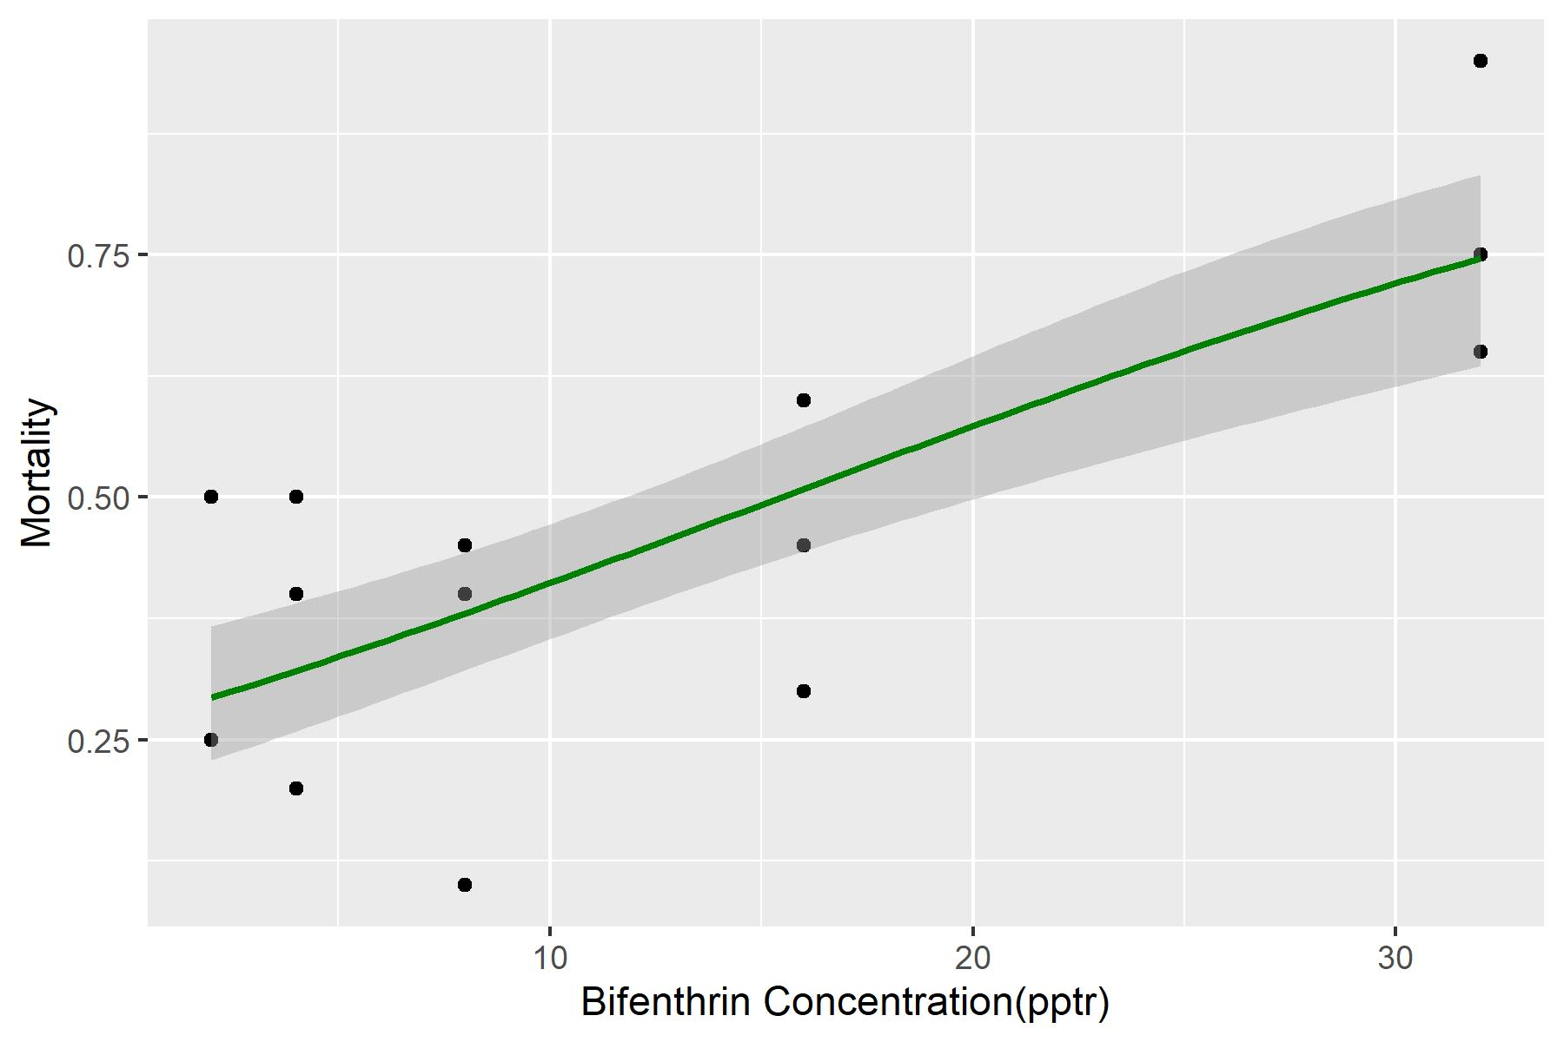
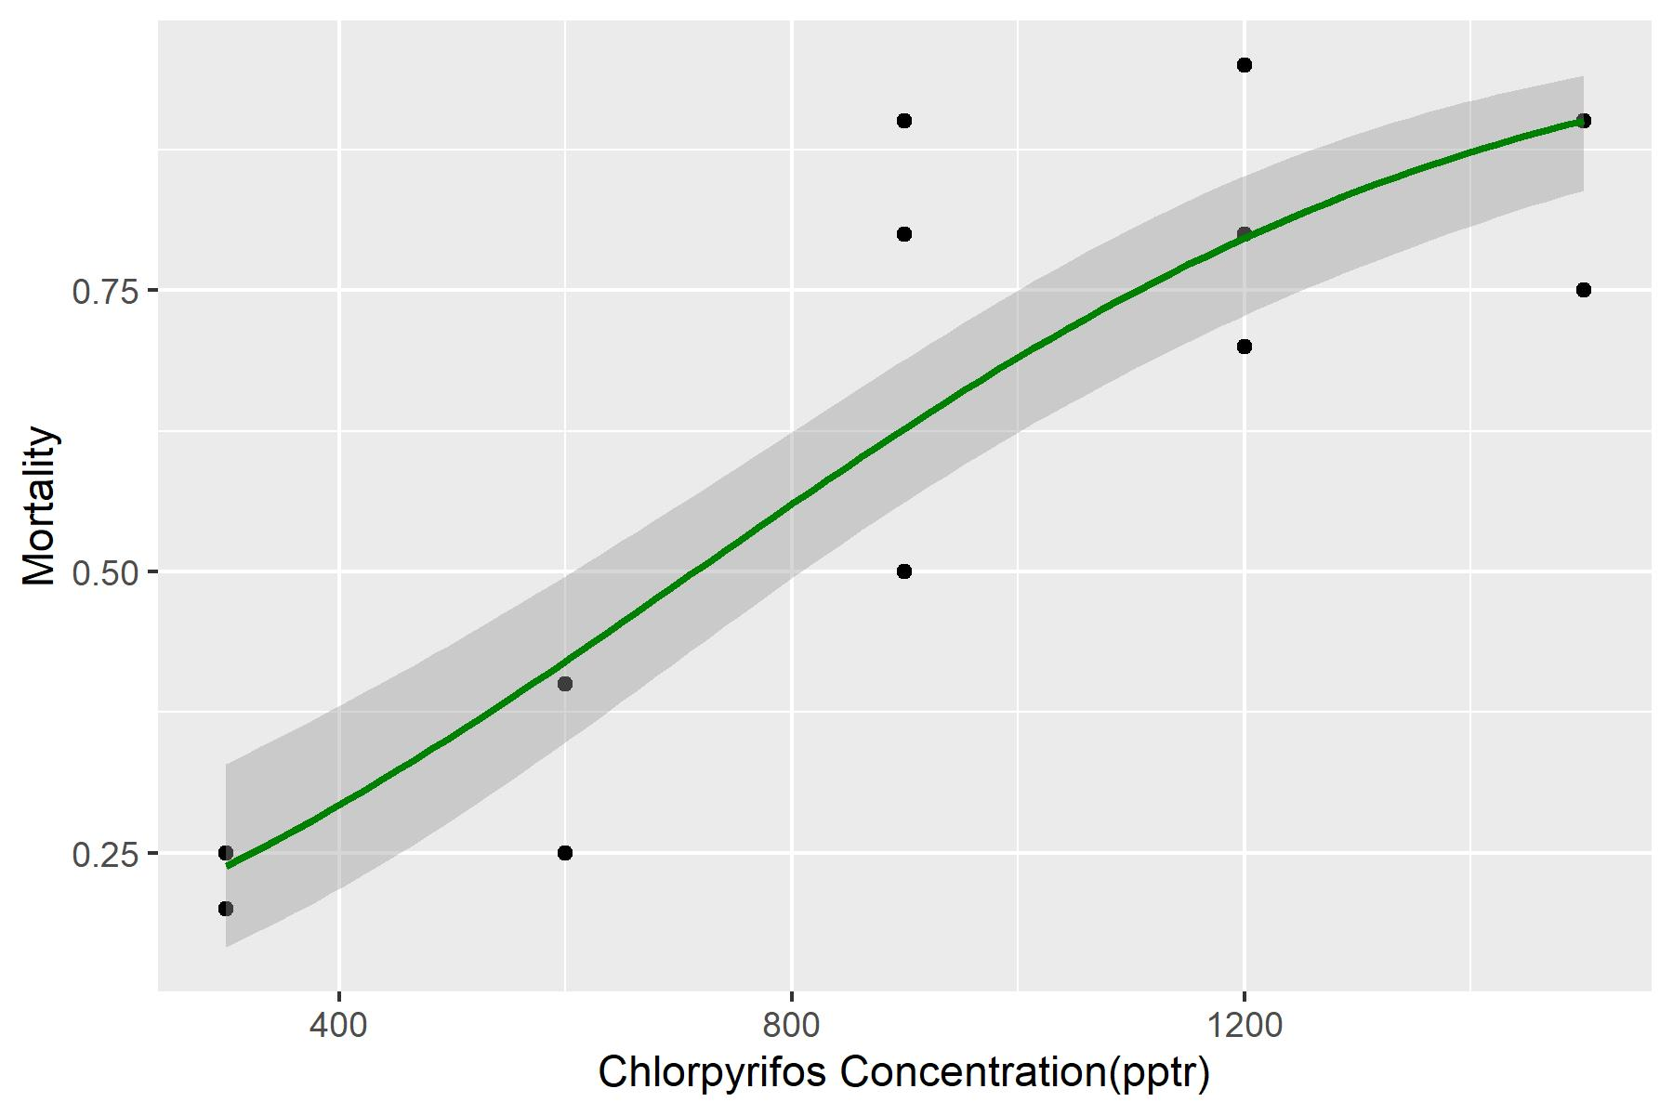
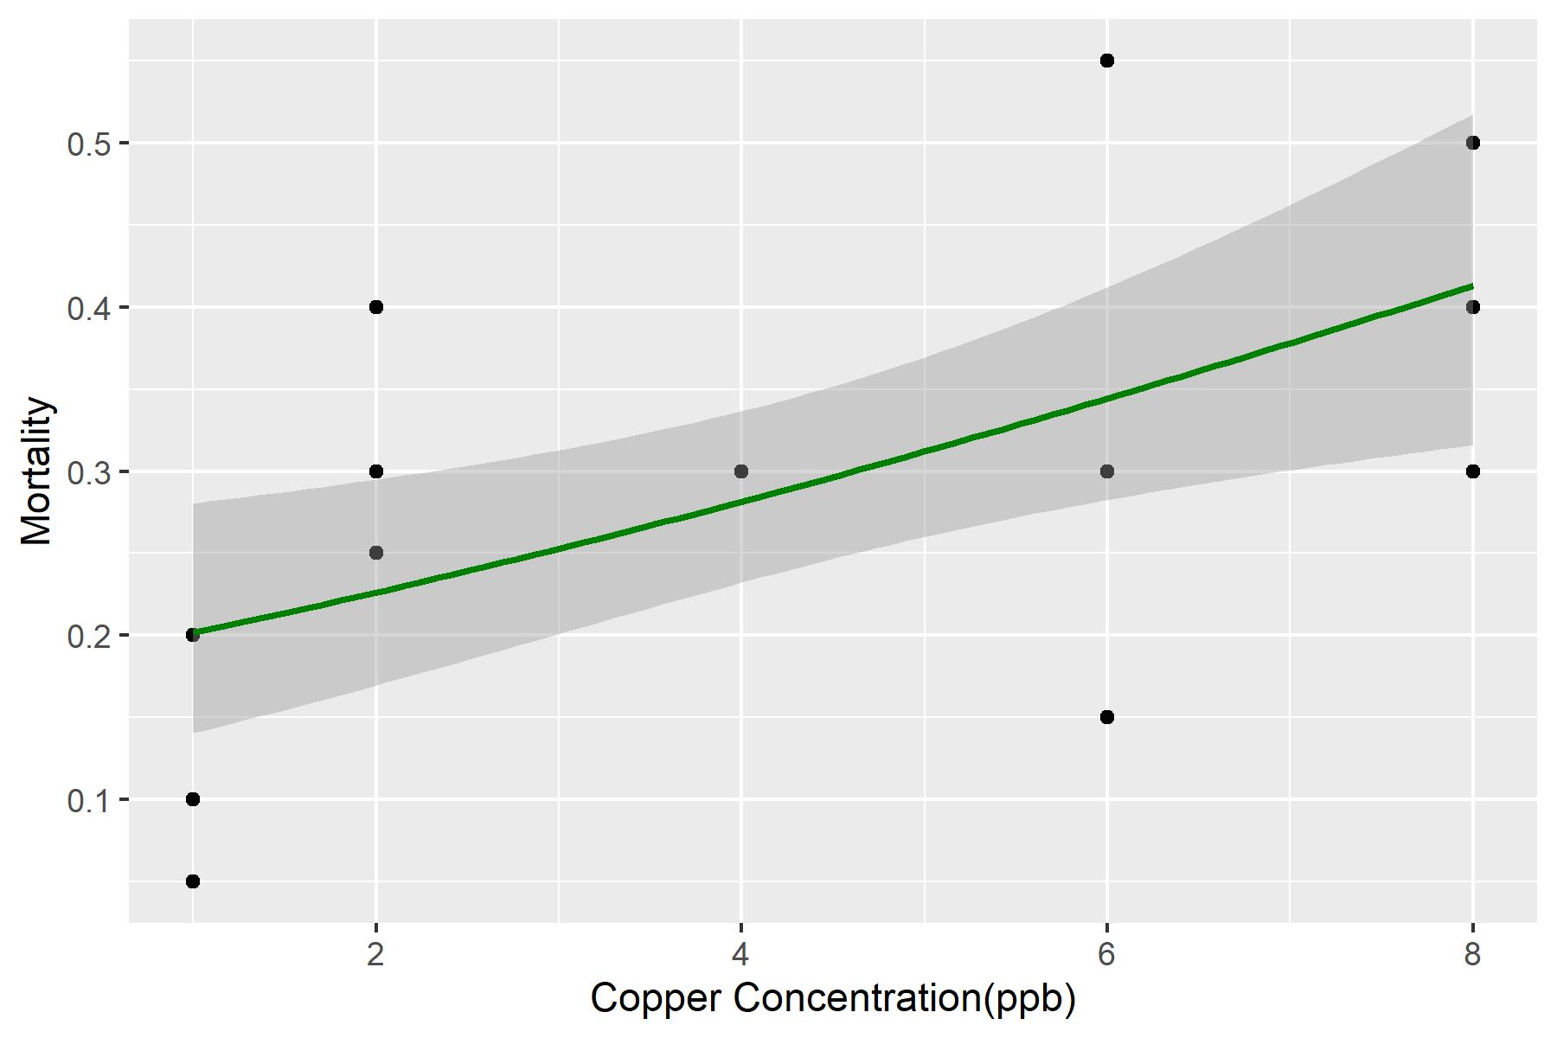
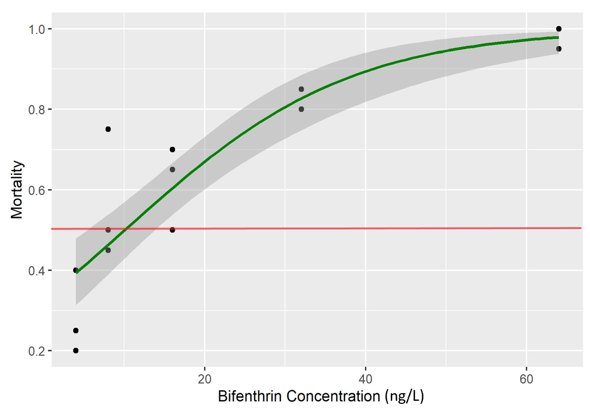
Eurytemora affinis
Dose Response Curves
(ng/L)
(ng/L)
(µg/L)
Pseudodiaptomus forbesi
(ng/L)
(ng/L)
(µg/L)

Slide 11
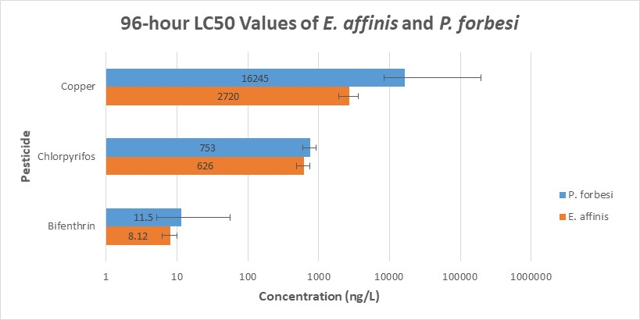
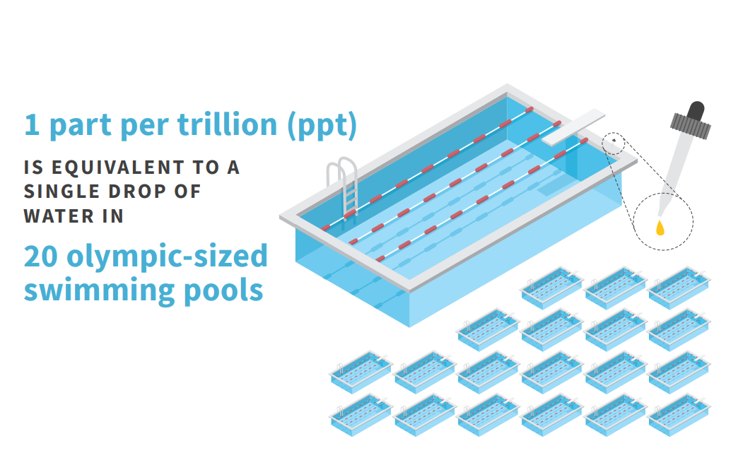
https://www.michigan.gov/documents/pfasresponse/1ppt_is_Equal_to_1_Drop_of_Water_in_20_Olympic_Swimming_Pools_664966_7.pdf

Slide 14
Pesticide | Class | Sac-San Joaquin Delta
Bifenthrin | Pyrethroid | 1ng/L
Chlorpyrifos | Organophosphate | 14.7ng/L
Copper | Fungicide | 2000-4500ng/L

Slide 15
Going forward
To further characterize toxicity effects, evaluate sublethal effects such as growth and reproduction at environmentally relevant concentrations
Compare sensitivities in other pesticides, particularly neonicotinoids

Slide 16
Acknowledgements
Financial support provided by the Students Training in Advanced Research (STAR) Program through the NIH T35 Training Grant (OD010956)
Thank you to Dr. Pessah and Eileen for helping us navigate through special times
Thank you to Dr. Teh, Tomo, and Ching for YOUR MENTORSHIP

